Slide 1
Differential Analysis: The Key to Decision Making
Chapter 12
Notes:
Chapter 12: Differential Analysis: The Key to Decision Making
Making decisions is one of the basic functions of a manager. To be successful in decision making, managers must be able to tell the difference between relevant and irrelevant data and must be able to correctly use the relevant data in analyzing alternatives. The purpose of this chapter is to develop these skills by illustrating their use in a wide range of decision-making situations.

Slide 2
Learning Objective 1
Identify relevant and irrelevant costs and benefits in a decision.
Notes:
Learning objective number 1 is to identify relevant and irrelevant costs and benefits in a decision.

Slide 3
Relevant Costs and Benefits
A relevant cost is a cost that differs between alternatives.
A relevant benefit is a benefit that differs between alternatives.
1
2
Notes:
Costs that differ between alternatives are called relevant costs. Benefits that differ between alternatives are relevant benefits.

Slide 4
Identifying Relevant Costs
An avoidable cost is a cost that can be eliminated, in whole or in part, by choosing one alternative over another. Avoidable costs are relevant costs. Unavoidable costs are irrelevant costs.
Two broad categories of costs are never relevant in any decision. They include:
  Sunk costs.
  A future cost that does not differ between the alternatives.
Notes:
An avoidable cost is a cost that can be eliminated, in whole or in part, by choosing one alternative over another. Avoidable costs are relevant costs. Unavoidable costs are irrelevant costs.
Two broad categories of costs are never relevant in any decision:
A sunk cost is a cost that has already been incurred and cannot be avoided regardless of what a manager decides to do.
A future cost that does not differ between alternatives is never relevant in a decision.

Slide 5
Decision Making: A Two-Step Process
Step 1
Eliminate costs and benefits that do not differ between alternatives.
Use the remaining costs and benefits that differ between alternatives in making the decision. The costs that remain are the differential, or avoidable, costs.
Step 2
Notes:
Decision making is a two-step process.
The first step is to eliminate costs and benefits that do not differ between alternatives. These irrelevant costs consist of sunk costs and future costs that do not differ between alternatives.
The second step is to use the remaining costs and benefits that do differ between alternatives in making the decision. The costs that remain are the differential, or avoidable, costs.

Slide 6

Different Costs for Different Purposes
Costs that are relevant in one decision situation may not be relevant in another context. Thus, in each decision situation, the manager must examine the data at hand and isolate the relevant costs.
Notes:
Costs that are relevant in one decision situation may not be relevant in another context. Thus, in each decision situation, the manager must examine the data at hand and isolate the relevant costs.

Slide 7
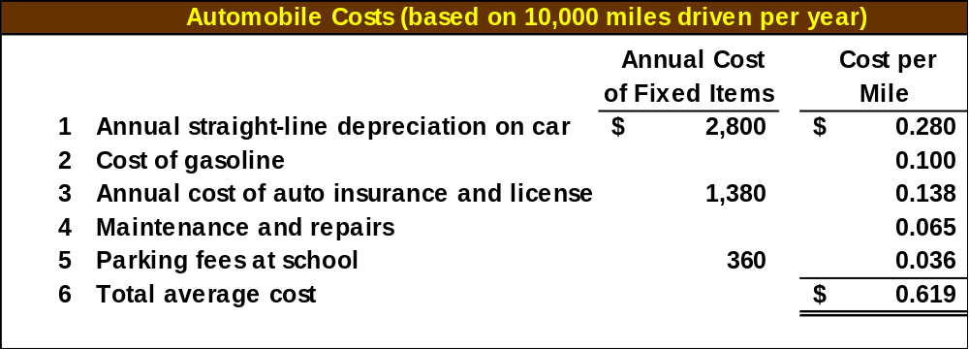
Identifying Relevant Costs
Cynthia, a Boston student, is considering visiting her friend in New York. She can drive or take the train. By car, it is 230 miles to her friend’s apartment. She is trying to decide which alternative is less expensive and has gathered the following information:
$45 per month × 8 months
$2.70 per gallon ÷ 27 MPG
$24,000 cost – $10,000 salvage value ÷ 5 years
Notes:
Part I
Assume the following information with respect to Cynthia, a Boston student who is considering visiting her friend in New York. Cynthia is trying to decide whether it would be less expensive to drive or take the train to New York. She has compiled the following information with respect to her automobile.
Part II
The straight-line depreciation is calculated as cost minus salvage value divided by useful life.
Part III
Gasoline per mile is calculated by taking the price per gallon of gasoline and dividing it by the number of miles per gallon of the car. The annual cost of insurance and license and maintenance and repairs are also included to arrive at the average cost per mile.
Part IV
The parking fee at school is $45 a month. Cynthia attends school only eight months out of the year.

Slide 8
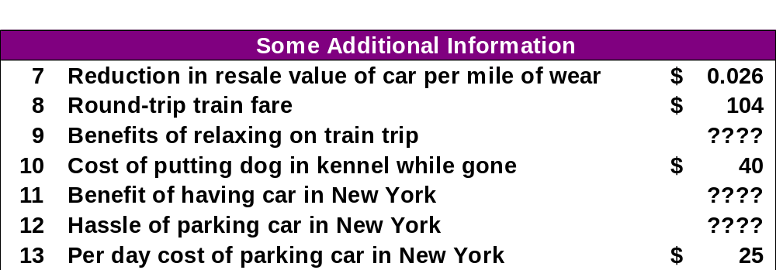
Identifying Relevant Costs
Notes:
She has also gathered additional information to aid in her decision, such as the reduction in resale value per mile driven, round-trip train fare, benefits of relaxing on the train, cost of putting her dog in the kennel, benefits of having a car in New York, hassle of parking in New York, and the per day cost of parking in New York. Some of these items can be measured in dollars and some can’t.

Slide 9
Identifying Relevant Costs
Which costs and benefits are relevant in Cynthia’s decision?
Notes:
Part I
Which costs are relevant to her decision?
The cost of the car is irrelevant to the decision because it is a sunk cost.
The annual cost of auto insurance is irrelevant because it does not differ between alternatives.
Part II
The cost of the gasoline is relevant because it is avoidable if she takes the train.

Slide 10
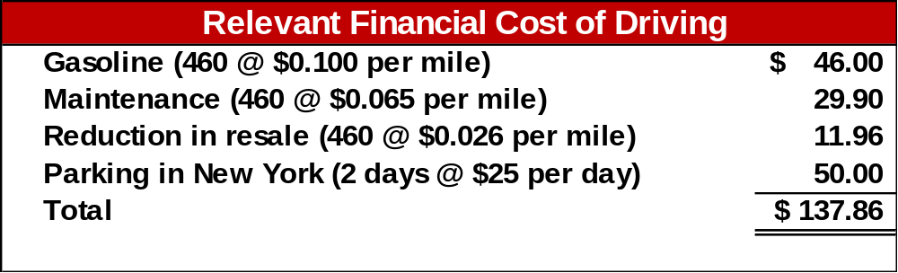
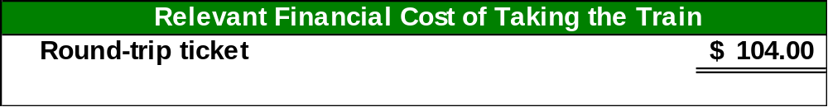
Identifying Relevant Costs
From a financial standpoint, Cynthia would be better off taking the train to visit her friend. Some of the non-financial factors may influence her final decision.
Notes:
From a financial standpoint, Cynthia would be better off taking the train. But, as with any decision we may face, it may be the non-financial or non-quantitative factors that have the most impact on our decision.

Slide 11
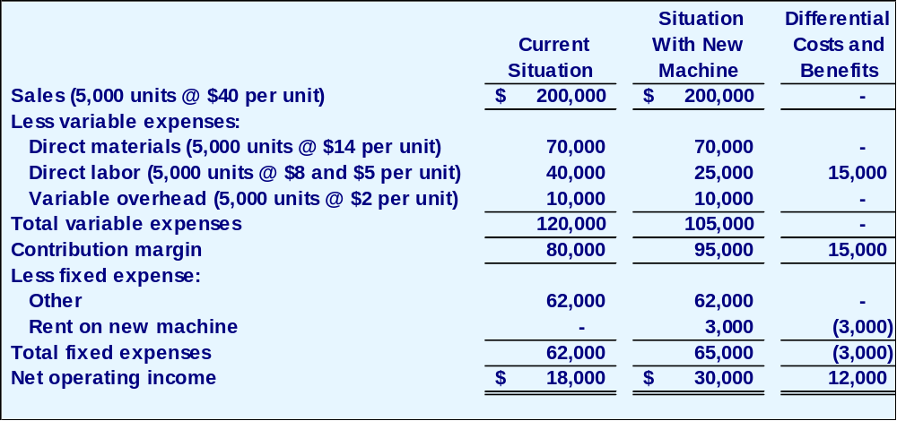
Total and Differential Cost Approaches
The management of a company is considering a new labor saving machine that rents for $3,000 per year. Data about the company’s annual sales and costs with and without the new machine are:
Notes:
Assume the following information for a company considering a new labor-saving machine that rents for $3,000 per year.
The total approach requires constructing two contribution format income statements – one for each alternative.
The difference between the two income statements of $12,000 equals the differential benefits shown at the bottom of the right-hand column.

Slide 12
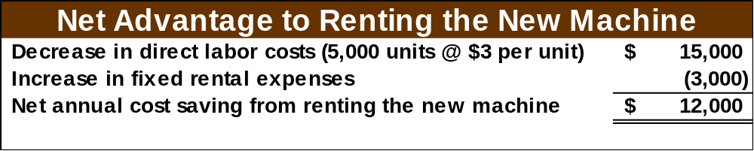
Total and Differential Cost Approaches
As you can see, the only costs that differ between the alternatives are the direct labor costs savings and the increase in fixed rental costs.
We can efficiently analyze the decision by
looking at the different costs and revenues
and arrive at the same solution.
Notes:
The most efficient means of analyzing this decision is to use the differential approach to isolate the relevant costs and benefits as shown.

Slide 13
Total and Differential Cost Approaches
Using the differential approach is desirable for two reasons:
Only rarely will enough information be available to prepare detailed income statements for both alternatives.
Mingling irrelevant costs with relevant costs may cause confusion and distract attention away from the information that is really critical.
Notes:
Using the differential approach is desirable for two reasons:
First, only rarely will enough information be available to prepare detailed income statements for both alternatives.
Second, mingling irrelevant costs with relevant costs may cause confusion and distract attention away from the information that is really critical.

Slide 14
Learning Objective 2
Prepare an analysis showing whether a product line or other business segment should be added or dropped.
Notes:
Learning objective number 2 is to prepare an analysis showing whether a product line or other business segment should be added or dropped.

Slide 15
Adding/Dropping Segments
One of the most important decisions managers make is whether to add or drop a business segment. Ultimately, a decision to drop an old segment or add a new one is going to hinge primarily on the impact the decision will have on net operating income.
To assess this impact, it is necessary to carefully analyze the costs.
Notes:
One of the most important decisions managers make is whether to add or drop a business segment. Ultimately, a decision to drop an old segment or add a new one is going to hinge primarily on the impact the decision will have on net operating income. To assess this impact it is necessary to carefully analyze the costs.

Slide 16

Adding/Dropping Segments
Due to the declining popularity of digital watches, Lovell Company’s digital watch line has not reported a profit for several years. Lovell is considering discontinuing this product line.
Notes:
Assume that Lovell Company’s digital watch line has not reported a profit for several years; accordingly, Lovell is considering discontinuing this product line.

Slide 17

A Contribution Margin Approach
DECISION RULE
Lovell should drop the digital watch segment only if its profit would increase.
Lovell will compare the contribution margin that would be lost to the costs that would be avoided if the line was to be dropped.
Notes:
To determine how dropping this line will affect the overall profits of the company, Lovell will compare the contribution margin that would be lost to the costs that would be avoided if the line was to be dropped.
Lovell should drop the digital watch segment only if its profit would increase. This would only happen if the fixed cost savings exceed the lost contribution margin.

Slide 18

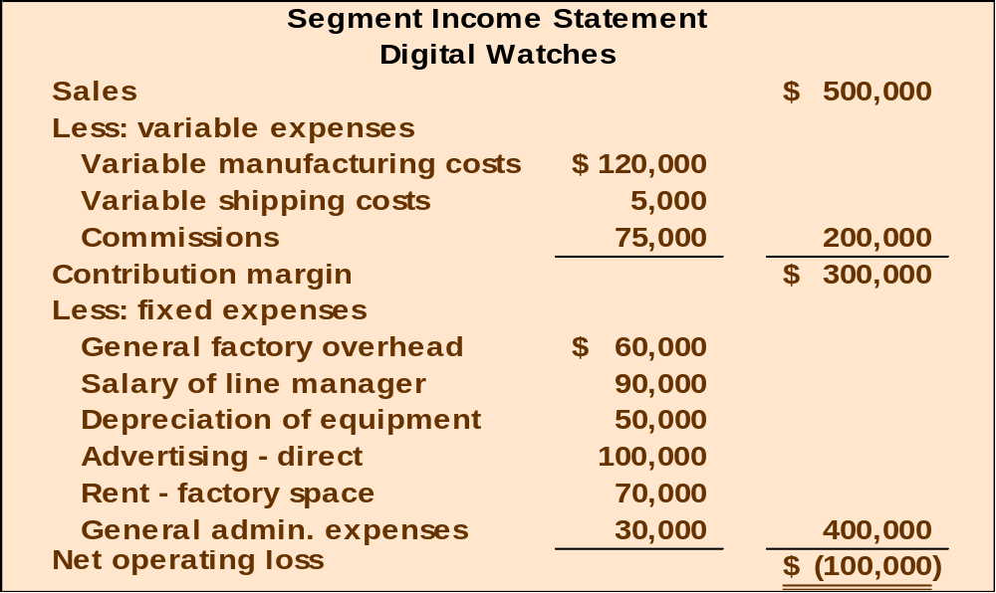
Adding/Dropping Segments
Notes:
Assume a segmented income statement for the digital watches line is as shown.

Slide 19
Adding/Dropping Segments
An investigation has revealed that the fixed general factory overhead and fixed general
administrative expenses will not be affected by dropping the digital watch line. The fixed general factory overhead and general administrative expenses assigned to this product would be reallocated to other product lines.
Notes:
An investigation has revealed that the fixed general factory overhead and fixed general administrative expenses will not be affected by dropping the digital watch line. The fixed general factory overhead and general administrative expenses assigned to this product would be reallocated to other product lines.

Slide 20
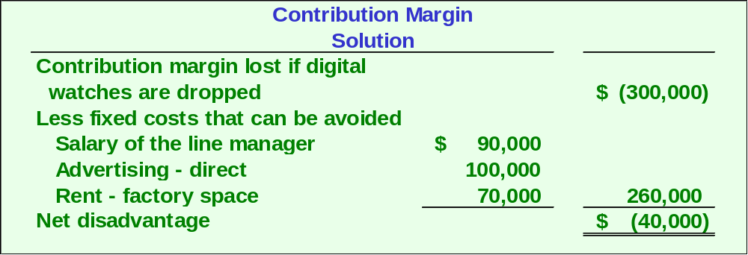

A Contribution Margin Approach
Retain
Notes:
A contribution margin approach reveals that the contribution margin lost ($300,000) exceeds the fixed costs avoided ($260,000) by $40,000. Therefore, Lovell should retain the digital watch segment.

Slide 21
Comparative Income Approach
The Lovell solution can also be obtained by preparing comparative income statements showing results with and without the digital watch segment.
Let’s look at this second approach.
Notes:
Comparative income statements can also be prepared to help make the decision.
Let’s look at this second approach.

Slide 22
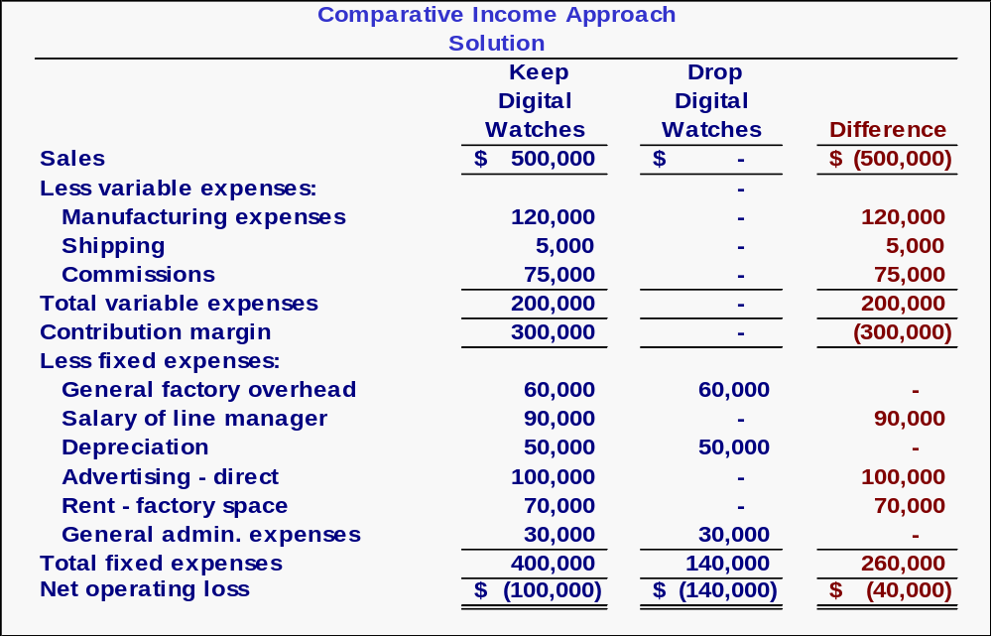
Notes:
The complete comparative income statements reveal that Lovell would earn $40,000 of additional profit by retaining the digital watch line.

Slide 23

Beware of Allocated Fixed Costs
Why should we keep the digital watch segment when it’s showing a $100,000 loss?
Notes:
Lovell’s allocated fixed costs can distort the keep/drop decision.
Lovell’s managers may ask “why keep the digital watch segment when its segmented income statement shows a $100,000 loss?”

Slide 24
Beware of Allocated Fixed Costs
The answer lies in the way we allocate common fixed costs to our products.
Notes:
The answer lies in the way common fixed costs are allocated to products.

Slide 25

Beware of Allocated Fixed Costs
Including unavoidable common fixed costs makes the product line appear to be unprofitable.
Our allocations can make a segment look less profitable than it really is.
Notes:
Including unavoidable common fixed costs in the segmented income statement makes the digital watch product line appear to be unprofitable, when in fact, dropping the product line would decrease the company’s overall net operating income.

Slide 26
Learning Objective 3
Prepare a make or buy analysis.
Notes:
Learning objective number 3 is to prepare a make or buy analysis.

Slide 27
The Make or Buy Decision
When a company is involved in more than one activity in the entire value chain, it is vertically integrated. A decision to carry out one of the activities in the value chain internally, rather than to buy externally from a supplier is called a “make or buy” decision.
Notes:
When a company is involved in more than one activity in the entire value chain, it is vertically integrated.
A decision to carry out one of the activities in the value chain internally, rather than to buy externally from a supplier, is called a make or buy decision.

Slide 28
Vertical Integration- Advantages
Smoother flow of parts and materials
Better quality control
Realize profits
Notes:
Vertical integration provides certain advantages.
An integrated company may be able to ensure a smoother flow of parts and materials for production than a nonintegrated company.
Some companies feel that they can control quality better by producing their own parts and materials.
Integrated companies realize profits from the parts and materials that they choose to make instead of buy.

Slide 29
Vertical Integration- Disadvantage
Companies may fail to take advantage of suppliers who can create economies of scale advantage by pooling demand from numerous companies.
While the economics of scale factor can be appealing, a company must be careful to retain control over activities that are essential to maintaining its competitive position.
Notes:
The primary disadvantage of vertical integration is that a company may fail to take advantage of suppliers who can create an economies of scale advantage by pooling demand from numerous companies.
While the economies of scale factor can be appealing, a company must be careful to retain control over activities that are essential to maintaining its competitive position.

Slide 30
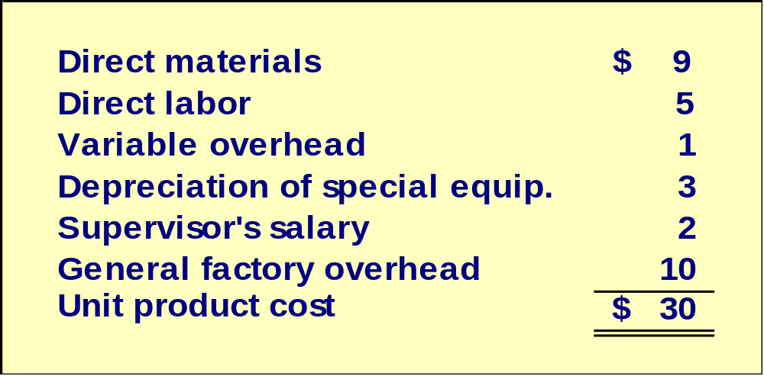
The Make or Buy Decision: An Example
Essex Company manufactures part 4A that is used in one of its products. The unit product cost of this part is:
Notes:
Assume that Essex Company manufactures part 4A with a unit product cost as shown.

Slide 31
The Make or Buy Decision
The special equipment used to manufacture part 4A has no resale value.
The total amount of general factory overhead, which is allocated on the basis of direct labor hours, would be unaffected by this decision.
The $30 unit product cost is based on 20,000 parts produced each year.
An outside supplier has offered to provide the 20,000 parts at a cost of $25 per part.
Should we accept the supplier’s offer?
Notes:
Also, assume the following information as shown with respect to part 4A.
Given these additional assumptions, should Essex make or buy part 4A?

Slide 32
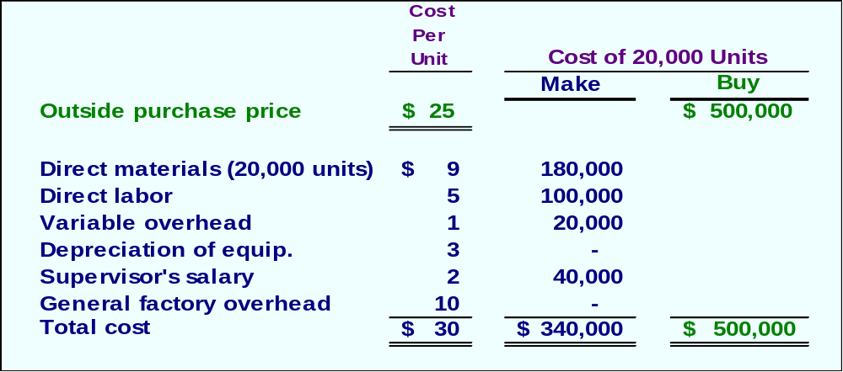
The Make or Buy Decision
The avoidable costs associated with making part 4A include direct materials, direct labor, variable overhead, and the supervisor’s salary.
Notes:
The avoidable costs associated with making part 4A include direct materials, direct labor, variable overhead, and the supervisor’s salary.

Slide 33
Opportunity Cost
An opportunity cost is the benefit that is foregone as a result of pursuing some course of action.
Opportunity costs are not actual cash outlays and are not recorded in the formal accounts of an organization.
How would this concept potentially relate to the Essex Company?
Notes:
An opportunity cost is the benefit that is foregone as a result of pursuing a course of action. These costs do not represent actual cash outlays and they are not recorded in the formal accounts of an organization.
In the Essex Company example that we just completed, if Essex had an alternative use for the capacity that it used to make part 4A, there would have been an opportunity cost to factor into the analysis.
The opportunity cost would have been equal to the segment margin that could have been derived from the best alternative use of the space.

Slide 34
Learning Objective 4
Prepare an analysis showing whether a special order should be accepted.
Notes:
Learning objective number 4 is to prepare an analysis showing whether a special order should be accepted.

Slide 35
Key Terms and Concepts
A special order is a one-time order that is not considered part of the company’s normal ongoing business.
When analyzing a special order, only the incremental costs and benefits are relevant.
Since the existing fixed manufacturing overhead costs would not be affected by the order, they are not relevant.
Notes:
A special order is a one-time order that is not considered part of the company’s normal ongoing business.
When analyzing a special order, only the incremental costs and benefits are relevant. Since the existing fixed manufacturing overhead costs would not be affected by the order, they are not relevant.

Slide 36
Special Orders
Jet, Inc. makes a single product whose normal selling price is $20 per unit.
A foreign distributor offers to purchase 3,000 units for $10 per unit.
This is a one-time order that would not affect the company’s regular business.
Annual capacity is 10,000 units, but Jet, Inc. is currently producing and selling only 5,000 units.
Should Jet accept the offer?
Notes:
Assume the following information with respect to a special order opportunity for Jet, Inc.
Should Jet accept the offer?

Slide 37
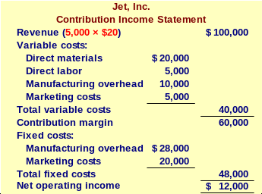
Special Orders
$8 variable cost
Notes:
Part I
A contribution format income statement for Jet’s normal sales of 5,000 units is as shown.
Part II
Assume variable cost is $8 a unit. Total variable cost would be 5,000 units times $8 a unit.

Slide 38
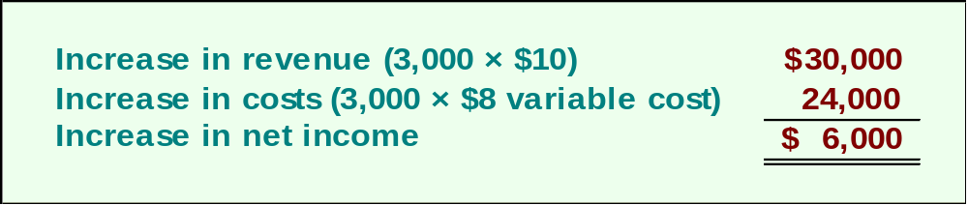
Special Orders
If Jet accepts the special order, the incremental revenue will exceed the incremental costs. In other words, net operating income will increase by $6,000. This suggests that Jet should accept the order.
Note: This answer assumes that the fixed costs are unavoidable and that variable marketing costs must be incurred on the special order.
Notes:
If Jet accepts the special order, the incremental revenue of $30,000 will exceed the incremental costs of $24,000 by $6,000. This suggests that Jet should accept the order. Notice that this answer assumes that the fixed costs are unavoidable and that variable marketing costs must be incurred on the special order.

Slide 39

Quick Check ✓
Northern Optical ordinarily sells the X-lens for $50. The variable production cost is $10, the fixed production cost is $18 per unit, and the variable selling cost is $1. A customer has requested a special order for 10,000 units of the X-lens to be imprinted with the customer’s logo. This special order would not involve any selling costs, but Northern Optical would have to purchase an imprinting machine for $50,000.
(see the next page)
Notes:
Northern Optical ordinarily sells the X-lens for $50. The variable production cost is $10, the fixed production cost is $18 per unit, and the variable selling cost is $1. A customer has requested a special order for 10,000 units of the X-lens to be imprinted with the customer’s logo. This special order would not involve any selling costs, but Northern Optical would have to purchase an imprinting machine for $50,000.

Slide 40
Quick Check ✓
What is the rock bottom minimum price below which Northern Optical should not go in its negotiations with the customer? In other words, below what price would Northern Optical actually be losing money on the sale? There is ample idle capacity to fulfill the order and the imprinting machine has no further use after this order.
  a. $50
  b. $10
  c. $15
  d. $29
Notes:
What is the rock bottom minimum price below which Northern Optical should not go in its negotiations with the customer? In other words, below what price would Northern Optical actually be losing money on the sale? There is ample idle capacity to fulfill the order and the imprinting machine has no further use after this order.

Slide 41
Learning Objective 5
Determine the most profitable use of a constrained resource.
Notes:
Learning objective number 5 is to determine the most profitable use of a constrained resource.

Slide 42

Key Terms and Concepts
When a limited resource of some type restricts the company’s ability to satisfy demand, the company is said to have a constraint.
The machine or process that is limiting overall output is called the bottleneck – it is the constraint.
Notes:
When a limited resource of some type restricts the company’s ability to satisfy demand, the company is said to have a constraint. The machine or process that is limiting overall output is called the bottleneck – it is the constraint.

Slide 43
Utilization of a Constrained Resource
Fixed costs are usually unaffected in these situations, so the product mix that maximizes the company’s total contribution margin should ordinarily be selected.
A company should not necessarily promote those products that have the highest unit contribution margins.
Rather, total contribution margin will be maximized by promoting those products or accepting those orders that provide the highest contribution margin in relation to the constraining resource.
Notes:
Fixed costs are usually unaffected in these situations, so the product mix that maximizes the company’s total contribution margin should ordinarily be selected.
A company should not necessarily promote those products that have the highest unit contribution margin.
Rather, total contribution margin will be maximized by promoting those products or accepting those orders that provide the highest contribution margin in relation to the constraining resource.

Slide 44
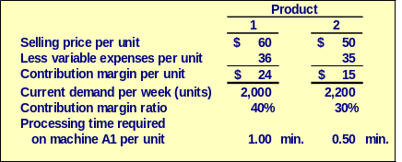
Utilization of a Constrained Resource: An Example
Ensign Company produces two products and selected data are shown below:
Notes:
Assume that Ensign Company produces two products and selected data are as shown.

Slide 45
Utilization of a Constrained Resource: An Example
Machine A1 is the constrained resource and is being used at 100% of its capacity.
There is excess capacity on all other machines.
Machine A1 has a capacity of 2,400 minutes per week.
Should Ensign focus its efforts on Product 1 or Product 2?
Notes:
In addition, assume that Machine A1 is the constraint, and there is excess capacity on all other machines. Machine A1 has a capacity of 2,400 minutes per week.
Should Ensign focus its efforts on Product 1 or Product 2?

Slide 46
Quick Check ✓
How many units of each product can be processed through Machine A1 in one minute?
Product 1 Product 2
  a. 1 unit 0.5 unit
  b. 1 unit 2.0 units
  c. 2 units 1.0 unit
  d. 2 units 0.5 unit
Notes:
How many units of each product can be processed through Machine A1 in one minute?

Slide 47
Quick Check ✓
What generates more profit for the company, using one minute of machine A1 to process Product 1 or using one minute of machine A1 to process Product 2?
  a. Product 1
  b. Product 2
  c. They both would generate the same profit.
  d. Cannot be determined.
Notes:
What generates more profit for the company, using one minute of machine A1 to process Product 1 or using one minute of machine A1 to process Product 2?

Slide 48
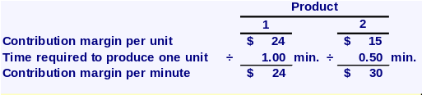
Utilization of a Constrained Resource
The key is the contribution margin per unit of the constrained resource.
Ensign should emphasize Product 2 because it generates a contribution margin of $30 per minute of the constrained resource relative to $24 per minute for Product 1.
Notes:
As suggested by the answer to the Quick Check question, Ensign should emphasize Product 2 because it generates a contribution margin of $30 per minute of the constrained resource relative to $24 per minute for Product 1.

Slide 49
Utilization of a Constrained Resource
The key is the contribution margin per unit of the constrained resource.
Ensign can maximize its contribution margin by first producing Product 2 to meet customer demand and then using any remaining capacity to produce Product 1. The calculations would be performed as follows.
Notes:
Ensign can maximize its contribution margin by first producing Product 2 to meet customer demand and then using any remaining capacity to produce Product 1.

Slide 50
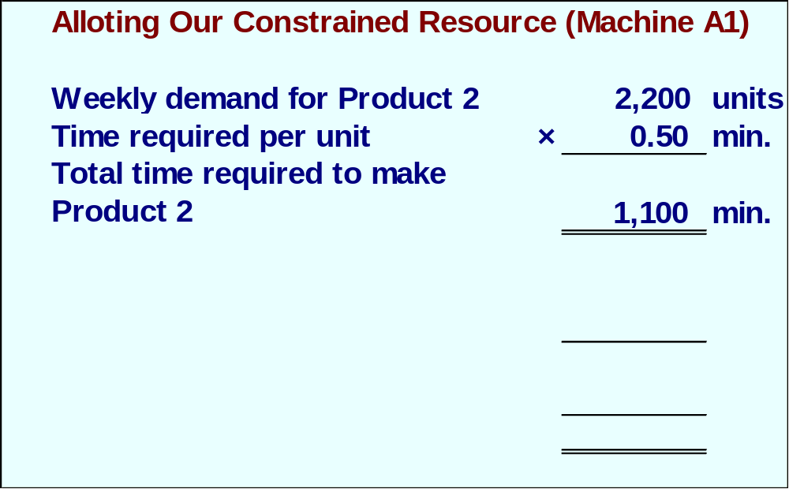
Utilization of a Constrained Resource
Let’s see how this plan would work.
Notes:
Satisfying the weekly demand of 2,200 units for Product 2 would consume 1,100 minutes of available capacity on machine A1.

Slide 51
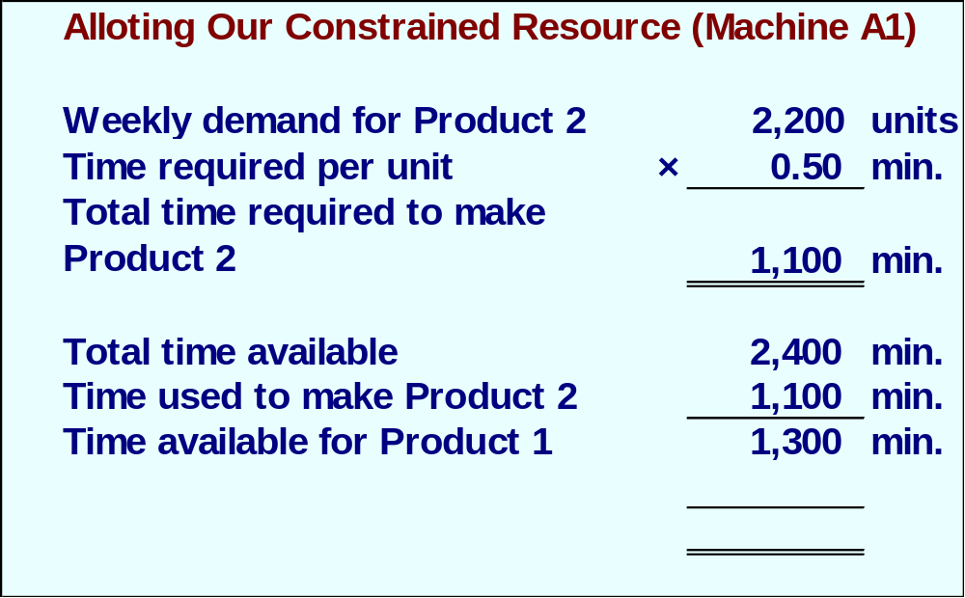
Utilization of a Constrained Resource
Let’s see how this plan would work.
Notes:
This implies that 1,300 constraint minutes would still be available to satisfy demand for Product 1.

Slide 52
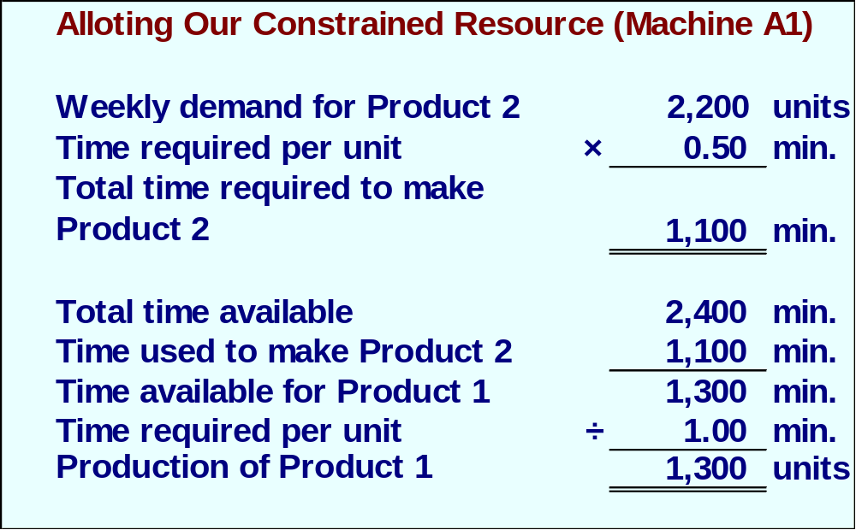
Utilization of a Constrained Resource
Let’s see how this plan would work.
Notes:
Since each unit of Product 1 requires one minute of A1 machine time, Ensign could produce 1,300 units of Product 1 with its remaining capacity.

Slide 53
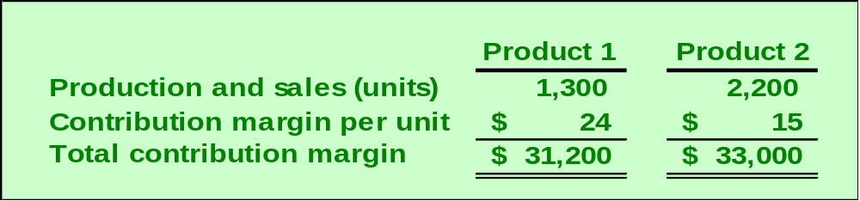
Utilization of a Constrained Resource
According to the plan, we will produce 2,200 units of Product 2 and 1,300 of Product 1. Our contribution margin looks like this.
The total contribution margin for Ensign is $64,200.
Notes:
This mix of production would yield a total contribution margin of $64,200.

Slide 54
Learning Objective 6
Determine the value of obtaining more of the constrained resource.
Notes:
Learning objective number 6 is to determine the value of obtaining more of the constrained resource.

Slide 55

Value of a Constrained Resource
Increasing the capacity of a constrained resource should lead to increased production and sales.
How much should Ensign be willing to pay for an additional minute of A1 machine time?
Notes:
How much should Ensign be willing to pay for an additional minute of A1 machine time?

Slide 56
Value of a Constrained Resource
The additional machine time would be used to make more units of Product 1, which had a contribution margin per minute of $24.
Ensign should be willing to pay up to $24 per minute. This amount equals the contribution margin per minute of machine time that would be eared producing more units of Product 1.
Notes:
Because the additional machine time would be used to make more units of Product 1, Ensign should be willing to pay up to $24 per minute. This amount equals the contribution margin per minute of machine time that would be earned producing more units of Product 1.

Slide 57
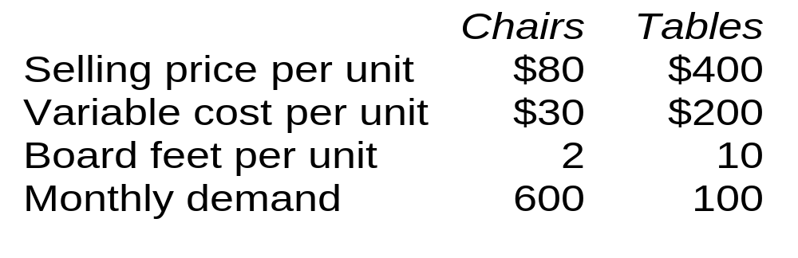
Quick Check ✓
Colonial Heritage makes reproduction colonial furniture from select hardwoods.
The company’s supplier of hardwood will only be able to supply 2,000 board feet this month. Is this enough hardwood to satisfy demand?
  a. Yes
  b. No
Notes:
Review the information provided about Colonial Heritage. Is this enough hardwood to satisfy demand?

Slide 58
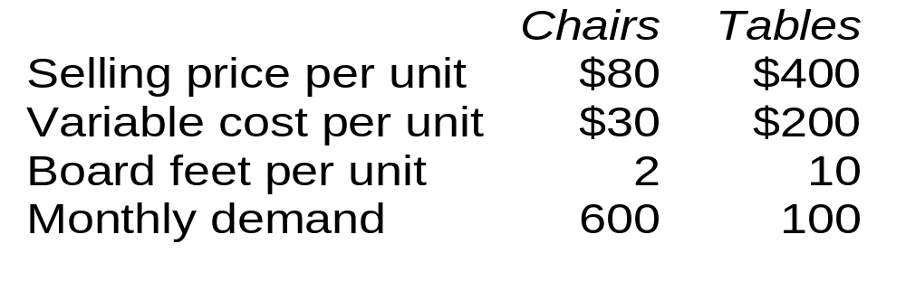
Quick Check ✓
The company’s supplier of hardwood will only be able to supply 2,000 board feet this month. What plan would maximize profits?
  a. 500 chairs and 100 tables
  b. 600 chairs and 80 tables
  c. 500 chairs and 80 tables
  d. 600 chairs and 100 tables
Notes:
The company’s supplier of hardwood will only be able to supply 2,000 board feet this month. What plan would maximize profits?

Slide 59
Quick Check ✓
As before, Colonial Heritage’s supplier of hardwood will only be able to supply 2,000 board feet this month. Assume the company follows the plan we have proposed. Up to how much should Colonial Heritage be willing to pay above the usual price to obtain more hardwood?
  a. $40 per board foot
  b. $25 per board foot
  c. $20 per board foot
  d. Zero
Notes:
Read this information about Colonial Heritage. Up to how much should Colonial Heritage be willing to pay above the usual price to obtain more hardwood?

Slide 60
Managing Constraints
It is often possible for a manager to increase the capacity of a bottleneck, which is called relaxing (or elevating) the constraint, in numerous ways such as:
  Working overtime on the bottleneck.
  Subcontracting some of the processing that would be done at the bottleneck.
  Investing in additional machines at the bottleneck.
  Shifting workers from non-bottleneck processes to the bottleneck.
  Focusing business process improvement efforts on the bottleneck.
  Reducing defective units processed through the bottleneck.
These methods and ideas are all consistent with the Theory of Constraints, which was introduced in Chapter 1.
Notes:
It is often possible for a manager to increase the capacity of a bottleneck, which is called relaxing (or elevating) the constraint, in numerous ways such as:
Working overtime on the bottleneck.
Subcontracting some of the processing that would be done at the bottleneck.
Investing in additional machines at the bottleneck.
Shifting workers from non-bottleneck processes to the bottleneck.
Focusing business process improvement efforts on the bottleneck.
Reducing defective units processed through the bottleneck.
These methods and ideas are all consistent with the Theory of Constraints, which was introduced in Chapter 1.
If a company has more than one potential constraint, the proper “mix” of products can be found using a quantitative method known as linear programming, which is covered in quantitative methods and operations management courses.

Slide 61
Learning Objective 7
Prepare an analysis showing whether joint products should be sold at the split-off point or processed further.
Notes:
Learning objective number 7 is to prepare an analysis showing whether joint products should be sold at the split-off point or processed further.

Slide 62
Joint Costs
In some industries, a number of end products are produced from a single raw material input.
Two or more products produced from a common input are called joint products.
The point in the manufacturing process where each joint product can be recognized as a separate product is called the split-off point.
Notes:
In some industries, a number of end products are produced from a single raw material input. When two or more products are produced from a common input these products are known as joint products. The split-off point is the point in the manufacturing process at which the joint products can be recognized as separate products.

Slide 63

Joint Products
For example, in the petroleum refining industry, a large number of products are extracted from crude oil, including gasoline, jet fuel, home heating oil, lubricants, asphalt, and various organic chemicals.
Oil
Joint
Input
Common
Production
Process
Gasoline
Chemicals
Split-Off
Point
Notes:
For example, in the petroleum refining industry a large number of products are extracted from crude oil, including gasoline, jet fuel, home heating oil, lubricants, asphalt, and various organic chemicals.

Slide 64
Joint Products
Joint costs
are incurred
up to the
split-off point
Separate
Processing
Final
Sale
Oil
Joint
Input
Common
Production
Process
Gasoline
Final
Sale
Separate
Processing
Final
Sale
Chemicals
Split-Off
Point
Separate
Product
Costs
Notes:
The term joint cost is used to describe costs incurred up to the split-off point. Joint costs are common costs incurred to simultaneously produce a variety of end products.

Slide 65
The Pitfalls of Allocation
Joint costs are traditionally allocated among different products at the split-off point. A typical approach is to allocate joint costs according to the relative sales value of the end products.
Although allocation is needed for some purposes such as balance sheet inventory valuation, allocations of this kind are very dangerous for decision making.
Notes:
Joint costs are traditionally allocated among different products at the split-off point. A typical approach is to allocate joint costs according to the relative sales value of the end products.
Although allocation is needed for some purposes such as balance sheet inventory valuation, allocations of this kind are very dangerous for decision making.

Slide 66
Sell or Process Further
Joint costs are irrelevant in decisions regarding what to do with a product from the split-off point forward. Therefore, these costs should not be allocated to end products for decision-making purposes.
  With respect to sell or process further decisions, it is profitable to continue processing a joint product after the split-off point so long as the incremental revenue from such processing exceeds the incremental processing costs incurred after the split-off point.
Notes:
Joint costs are irrelevant in decisions regarding what to do with a product from the split-off point forward. Therefore, these costs should not be allocated to end products for decision making purposes.
With respect to sell or process further decisions, it is profitable to continue processing a joint product after the split-off point so long as the incremental revenue from such processing exceeds the incremental processing costs incurred after the split-off point.

Slide 67


Sell or Process Further: An Example
Sawmill, Inc. cuts logs from which unfinished lumber and sawdust are the immediate joint products.
Unfinished lumber is sold “as is” or processed further into finished lumber.
Sawdust can also be sold “as is” to gardening wholesalers or processed further into “presto-logs.”
Notes:
Assume the facts as shown with respect to Sawmill, Inc.

Slide 68
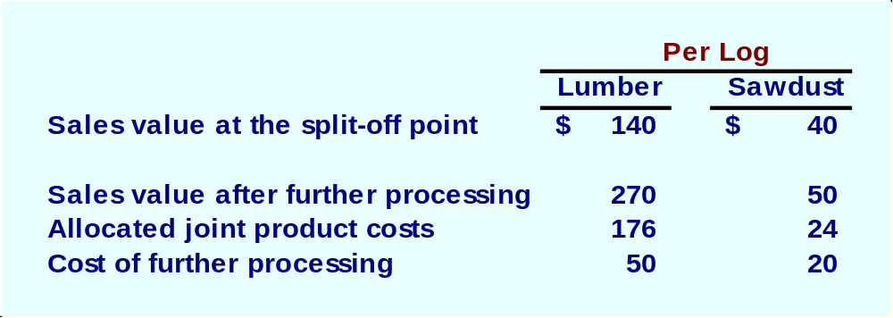
Sell or Process Further
Data about Sawmill’s joint products includes:
Notes:
Sawmill has two joint products – lumber and sawdust. Selected financial information is shown for each joint product.

Slide 69
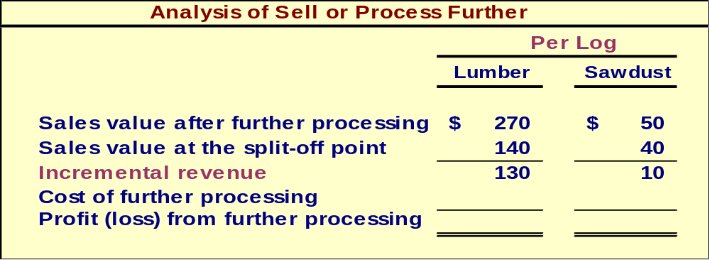
Sell or Process Further
Notes:
The incremental revenue from further processing of the lumber and sawdust is $130 and $10, respectively.

Slide 70
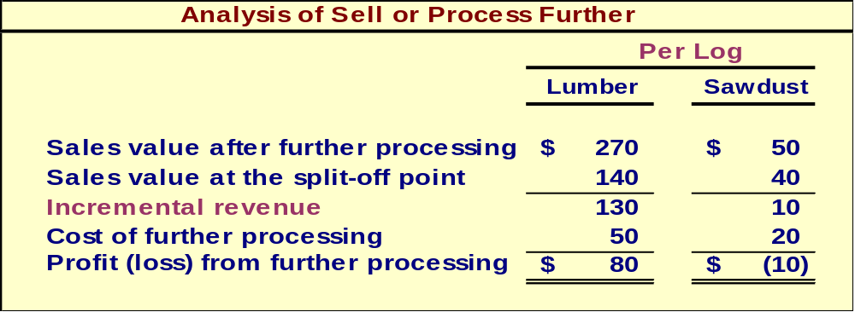
Sell or Process Further
Notes:
The profit (loss) from further processing is $80 for the lumber and ($10) for the sawdust.

