Slide 1
Chapter 1
_{What is interaction design?}
Slides adapted for COMP 135 by Dan Cliburn
www.id-book.com

Slide 2
What is interaction design?
Designing interactive products to support the way people communicate and interact in their everyday and working lives
      Sharp, Rogers and Preece (2011)
The design of spaces for human communication and interaction
      Winograd (1997)
www.id-book.com

Slide 3
Design principles
Generalizable abstractions for thinking about different aspects of design
The do’s and don’ts of interaction design
What to provide and what not to provide at the interface
Derived from a mix of theory-based knowledge, experience and common-sense
www.id-book.com

Slide 4

Visibility
• This is a control panel for an elevator
• How does it work?
• Push a button for the floor you want?
• Nothing happens. Push any other button? Still nothing. What do you need to do?
It is not visible as to what to do!
From: www.baddesigns.com
www.id-book.com

Slide 5
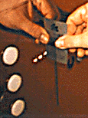
Visibility
      …you need to insert your room card in the slot by the buttons to get the elevator to work!
      How would you make this action more visible?
      • make the card reader more obvious
      • provide an auditory message, that says what to do (which language?)
      • provide a big label next to the card reader that flashes when someone enters
  • make relevant parts visible
  • make what has to be done obvious
www.id-book.com

Slide 6
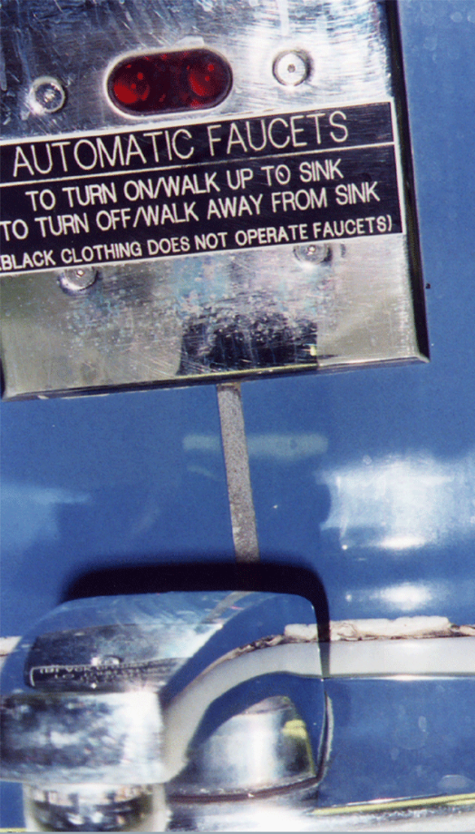
What do I do if I am wearing black?
Invisible automatic
controls can make it
more difficult
to use
www.id-book.com

Slide 7
Feedback
Sending information back to the user about what has been done
Includes sound, highlighting, animation and combinations of these
  e.g. when screen button clicked on provides sound or red highlight feedback:
“ccclichhk”
www.id-book.com

Slide 8
Constraints
Restricting the possible actions that can be performed
Helps prevent user from selecting incorrect options
Physical objects can be designed to constrain things
  e.g. only one way you can insert a key into a lock
www.id-book.com

Slide 9
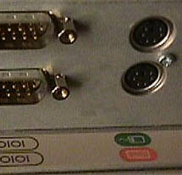
Logical or ambiguous design?
Where do you plug the mouse?
Where do you plug the keyboard?
top or bottom connector?
Do the color coded icons help?
From: www.baddesigns.com
www.id-book.com

Slide 10


How to design them more logically
(i) A provides direct adjacent mapping between icon and connector
(ii) B provides color coding to associate the connectors with the labels
From: www.baddesigns.com
www.id-book.com

Slide 11
Consistency
Design interfaces to have similar operations and use similar elements for similar tasks
For example:
  always use ctrl key plus first initial of the command for an operation – ctrl+C, ctrl+S, ctrl+O
Main benefit is consistent interfaces are easier to learn and use
www.id-book.com

Slide 12
Internal and external consistency
Internal consistency refers to designing operations to behave the same within an application
  Difficult to achieve with complex interfaces
External consistency refers to designing operations, interfaces, etc., to be the same across applications and devices
  Very rarely the case, based on different designer’s preference
www.id-book.com

Slide 13
Keypad numbers layout
A case of external inconsistency
(a) phones, remote controls
(b) calculators, computer keypads
1
2
3
7
8
9
4
5
6
4
5
6
7
8
9
1
2
3
0
0
www.id-book.com

Slide 14
Affordances: to give a clue
Refers to an attribute of an object that allows people to know how to use it
  e.g. a mouse button invites pushing, a door handle affords pulling
Norman (1988) used the term to discuss the design of everyday objects
Since has been much popularised in interaction design to discuss how to design interface objects
  e.g. scrollbars to afford moving up and down, icons to afford clicking on
www.id-book.com

Slide 15


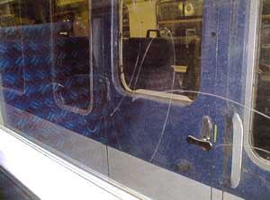
Activity
  Physical affordances:
    How do the following physical objects afford? Are they obvious?
www.id-book.com

Slide 16
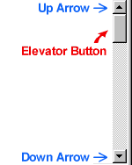


Activity
  Virtual affordances
    How do the following screen objects afford?
    What if you were a novice user?
    Would you know what to do with them?
www.id-book.com

