Slide 1
Chapter 11
_{Design, prototyping}
_{and construction}
Slides adapted for COMP 135 by Dan Cliburn
www.id-book.com

Slide 2
Prototypes
What is a prototype?
  “a prototype is a limited representation of a design that allows users to interact with it an explore its suitability”
  H. Sharp, Y. Rogers and J. Preece. Interaction Design: beyond human-computer interaction (2nd edition). West Sussex, England: Wiley, 2007, p. 530.
Why prototype?
  Helps to communicate ideas and formalize requirements before we waste lots of time and money building something that does not do the job.

Slide 3
Designs versus Prototypes
What is the difference between a design and a prototype?
  A prototype is an interactive version of a design

Slide 4
Types of Prototypes
Low-fidelity
  Do not look much like the final product
  Simple, cheap, and quick to produce
  Exploration only, not part of the final version
High-fidelity
  Much closer to the intended final product
  Use for exploration and testing
  (Closer to) complete functionality

Slide 5
Low-fidelity prototype examples
Video 1
Video 2
Video 3

Slide 6
Low-fidelity Prototypes
Possible approaches:
  Storyboards
  Sketches
  Index Cards
  Wizard-of-Oz
  Just about anything else …
    even PowerPoint

Slide 7
Storyboards
Often used with scenarios, bringing more detail, and a chance to role play
It is a series of sketches showing how a user might progress through a task using the device
Used early in design
Storyboards are often used in the movie industry (see video)
www.id-book.com

Slide 8
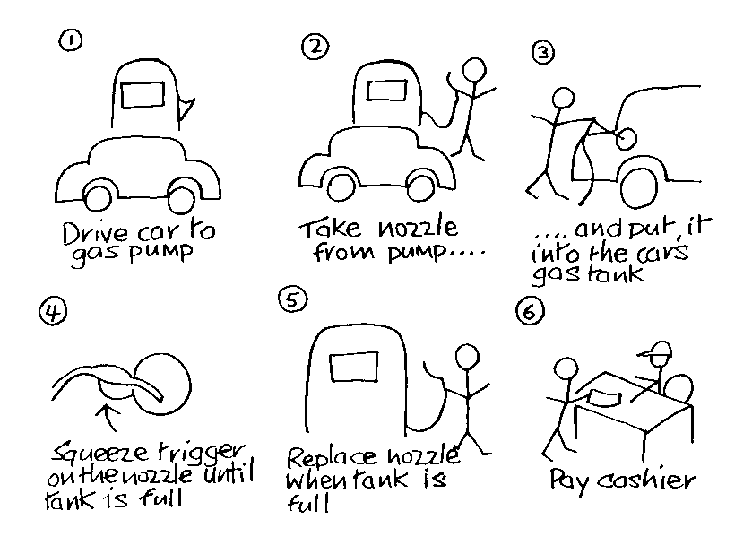
Sketching
Sketching is important to low-fidelity prototyping
Don’t be inhibited about drawing ability. Practice simple symbols
www.id-book.com

Slide 9
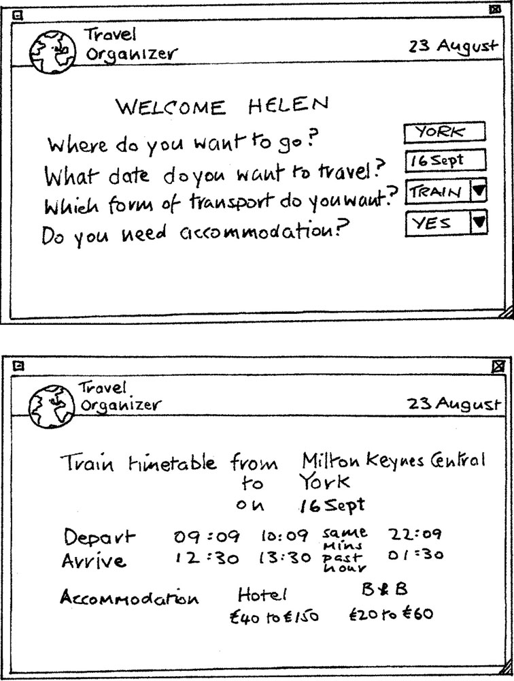
Card-based prototypes
  Index cards (3 X 5 inches)
  Each card represents
  one screen or part of screen
  Often used in website
  development
www.id-book.com

Slide 10
‘Wizard-of-Oz’ prototyping
The user thinks they are interacting with a computer, but a developer is responding to output rather than the system.
Usually done early in design to understand users’ expectations
User
>Blurb blurb
>Do this
>Why?
www.id-book.com

Slide 11
High-fidelity prototyping
  Uses materials that you would expect to be in the final product.
  Prototype looks more like the final system than a low-fidelity version.
  Danger that users think they have a full system…….see compromises (next slide)
www.id-book.com

Slide 12
Compromises in prototyping
All prototypes involve compromises
For software-based prototyping maybe there is a slow response? sketchy icons? limited functionality?
Two common types of compromise
    horizontal: provide a wide range of functions, but with little detail
    vertical: provide a lot of detail for only a few functions
You will be conducting usability testing on your high-fidelity prototype at the end of the term.
www.id-book.com

