Slide 1
Chapter 15
_{Analytical evaluation}
Slides adapted for COMP 135 by Dan Cliburn
www.id-book.com

Slide 2
Analytical Evaluation
Type of evaluation that does not (usually) involve users.
Today we will discuss:
  Inspections
  Analytics
  Predictive Models

Slide 3
1. Inspections
Several kinds
  We will discuss heuristic evaluations and walkthroughs
Experts use their knowledge of users & technology to review software usability.
www.id-book.com

Slide 4
Heuristic evaluation
Developed by Jacob Nielsen in the early 1990s.
Based on heuristics distilled from an empirical analysis of 249 usability problems.
These heuristics have been revised for current technology.
  Web design, mobile devices, wearables, virtual worlds, etc.
www.id-book.com

Slide 5
Nielsen’s original heuristics
Visibility of system status.
Match between system and real world.
User control and freedom.
Consistency and standards.
Error prevention.
Recognition rather than recall.
Flexibility and efficiency of use.
Aesthetic and minimalist design.
Help users recognize, diagnose, recover from errors.
Help and documentation.
www.id-book.com

Slide 6
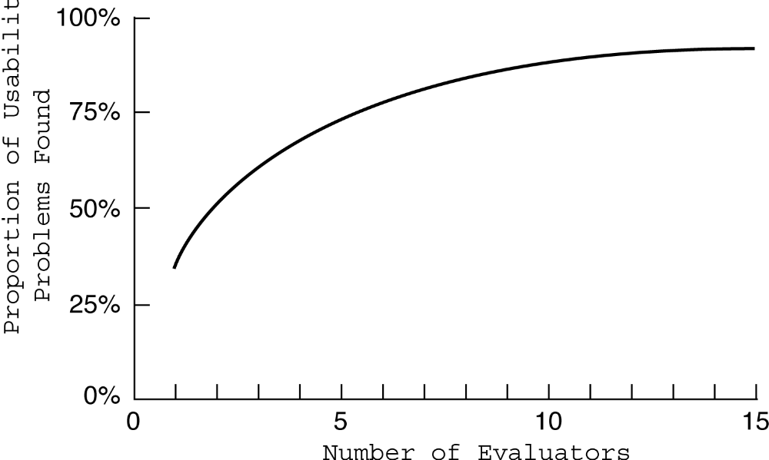
Heuristic evaluation
Empirical evidence suggests that on average 5 evaluators identify 75-80% of usability problems.

Slide 7
3 stages for doing heuristic evaluation
Briefing session to tell experts what to do.
Evaluation period of 1-2 hours in which:
  Each expert works separately;
  Take one pass to get a feel for the product;
  Take a second pass to focus on specific features.
Debriefing session in which experts work together to prioritize problems.
www.id-book.com

Slide 8
Advantages and problems
Fewer ethical & practical issues to consider because users not involved.
Can be difficult & expensive to find experts.
Biggest problems:
  Important problems may get missed;
  Many trivial problems are often identified;
  Experts have biases.
www.id-book.com

Slide 9
Cognitive walkthroughs
Designer presents an aspect of the design & usage scenarios.
Expert is told the assumptions about user population, context of use, task details.
One or more experts walk through the design prototype with the scenario.
Experts are guided by 3 questions.
www.id-book.com

Slide 10
The 3 questions
Will the correct action be sufficiently evident to the user?
Will the user notice that the correct action is available?
Will the user associate and interpret the response from the action correctly?
As the experts work through the scenario they note problems.
www.id-book.com

Slide 11
Pluralistic walkthrough
Variation on the cognitive walkthrough theme.
Performed by a carefully managed team.
  Involves users, developers, and experts
Then there is managed discussion that leads to agreed decisions.
www.id-book.com

Slide 12

An Example
_{Domain Experts}
_{Usability Experts}
_{Decision-Makers}

Slide 13
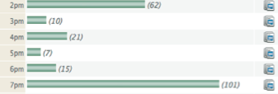
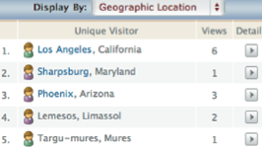
2. Analytics
A method for evaluating user traffic through a system or part of a system
Times of day & visitor IP addresses
www.id-book.com

Slide 14
3. Predictive models
Provide a way of evaluating products or designs without directly involving users (or experts).
Less expensive than user testing.
Usefulness limited to systems with predictable tasks - e.g., telephone answering systems, mobiles, cell phones, etc.
Based on expert error-free behavior.
www.id-book.com

Slide 15
Keystroke Level Model (KLM)
The keystroke model allows predictions to be made about how long it takes an expert user to perform a task.
www.id-book.com

Slide 16
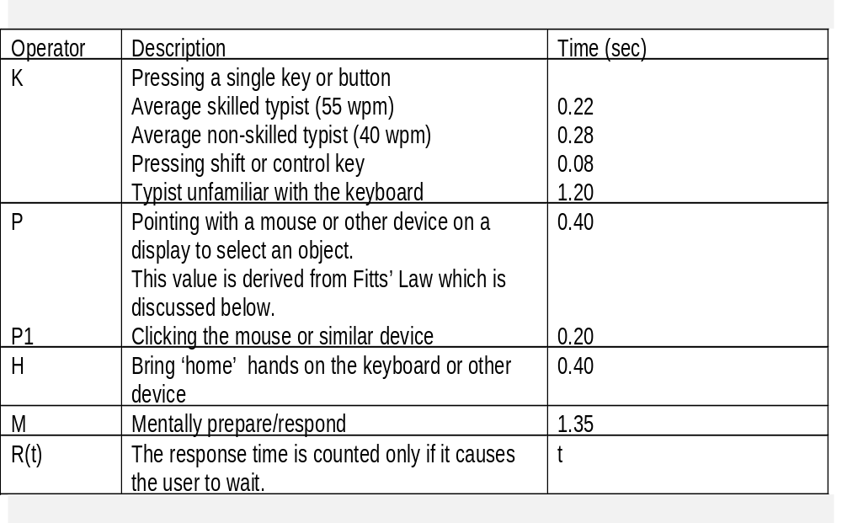
Response times for keystroke level operators (Card et al., 1983)
www.id-book.com

Slide 17
Summing together
www.id-book.com

Slide 18
Fitts’ Law (Fitts, 1954)
Fitts’ Law predicts that the time to point at an object using a device is a function of the distance from the target object & the object’s size: Time = K•log₂(D/S + 1.0)
    D is distance between pointer and object
    S is the size of the target
    K is approximately 200 msec/bit
  Further away & the smaller the object, the longer the time to locate it and point to it.
Fitts’ Law is useful for evaluating systems for which the time to locate an object is important, e.g., a cell phone,
a handheld devices.

Slide 19
Key points
User testing & heuristic evaluation may reveal different usability problems.
Inspections involve having experts evaluate the usability of software.
• Analytics involves collecting data about user activity on a website or product.
• Predictive models can be used to predict expert, error-free performance for certain kinds of tasks.
www.id-book.com

