Slide 1
Chapter 4
_{Social Interaction}
Slides adapted for COMP 135 by Dan Cliburn
www.id-book.com
_{<number>}

Slide 2
Being social
Are F2F conversations being superseded by our social media interactions?
  Which is easier, F2F or electronic communication?
How many friends do you have on Facebook and/or LinkedIn, vs real life?
  How much overlap?
  Are the friendships of similar nature?
Are the established rules and etiquette still applicable to online and offline?
_{www.id-book.com}
_{<number>}

Slide 3
Conversational rules
Sacks et al. (1978) work on conversation analysis describe three basic rules:
  Rule 1: the current speaker chooses the next speaker by asking an opinion, question, or request
  Rule 2: another person decides to start speaking
  Rule 3: the current speaker continues talking
How does someone new enter into the conversation?
Are there other conversation rules?
_{www.id-book.com}
_{<number>}

Slide 4
What happens in electronic conversations/interactions?
Do same rules apply?
Is the chance of being misunderstood greater?
What is so compelling about online communication/ interaction?
_{www.id-book.com}
_{<number>}

Slide 5
3D virtual worlds
Second Life (2007)
  Over 8 million users
What kinds of conversation take place in these environments?
VoIP versus chatroom talk?
  Which is preferred and why?
_{www.id-book.com}
_{<number>}

Slide 6
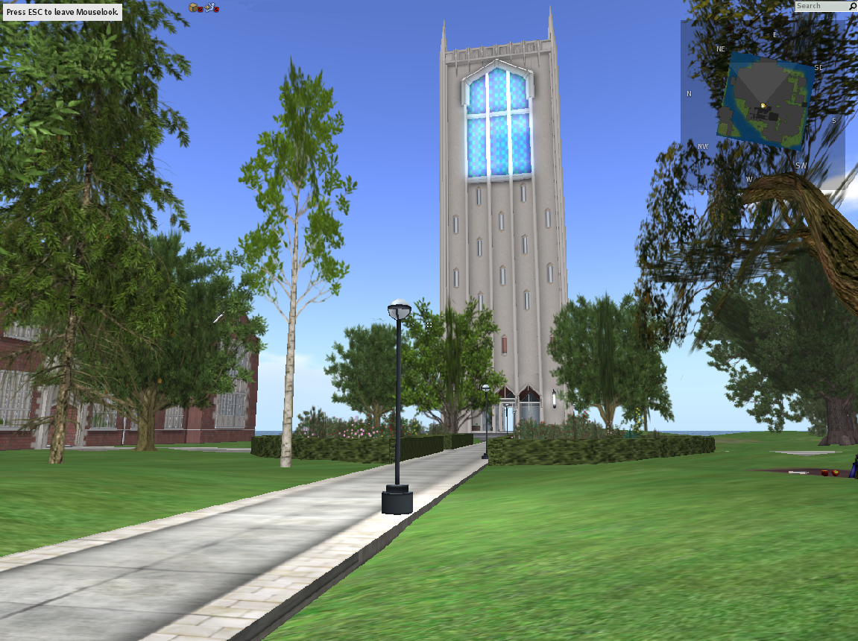
Second Life – UOP
_{<number>}

Slide 7
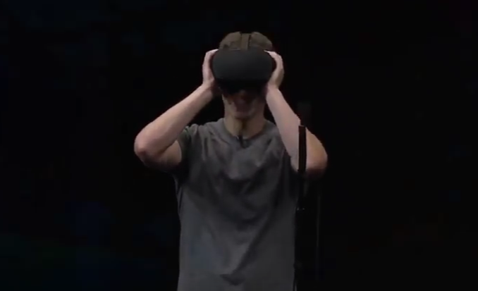
The Future: Facebook and VR
Opening Keynote at Oculus Connect 3, San Jose, CA, October 6th_{, 2016}
_{<number>}

