Slide 1
Chapter 5
_{Emotional Interaction}
Slides adapted for COMP 135 by Dan Cliburn
www.id-book.com

Slide 2
Activity
Describe a time that a computing application evoked in you an emotional response. Was it positive or negative?
How did this impact your willingness to use the application?

Slide 3
Emotions and the user experience
HCI has traditionally been about designing efficient and effective systems
Now more about how to design interactive systems that make people respond in certain ways
  e.g. to be happy, to be trusting, to learn, to be motivated
Emotional interaction is concerned with how we feel and react when interacting with technologies
www.id-book.com

Slide 4
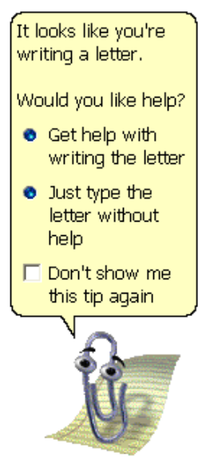
Clippy
Attempt to make an interface appear more “friendly”
Why was Clippy disliked
by so many?
www.id-book.com

Slide 5
Frustrating interfaces
Many causes:
  When an application doesn’t work properly or crashes
  When a system doesn’t do what the user wants it to do
  When a user’s expectations are not met
  When a system does not provide sufficient information to enable the user to know what to do
  When error messages pop up that are vague, obtuse or condemning
  When the appearance of an interface is garish, noisy, gimmicky or patronizing
  When a system requires users to carry out too many steps to perform a task, only to discover a mistake was made earlier and they need to start all over again
www.id-book.com

Slide 6
Error messages
“The application Word Wonder has unexpectedly quit due to a type 2 error.”
Why not instead:
“the application has expectedly quit due to poor coding in the operating system”
Shneiderman’s guidelines for error messages include:
    avoid using terms like FATAL, INVALID, BAD
    Audio warnings
    Avoid UPPERCASE and long code numbers
    Messages should be precise rather than vague
    Provide context-sensitive help
www.id-book.com

Slide 7
Persuasive technologies and behavioral change
Interactive computing systems deliberately designed to change people’s attitudes and behaviors (Fogg, 2003)
A diversity of techniques now used to change what they do or think
  Pop-up ads, warning messages, reminders, prompts, personalized messages, recommendations, Amazon 1-click
  Commonly referred to as “nudging”
How effective are pedometers at getting people to walk more?
www.id-book.com

Slide 8
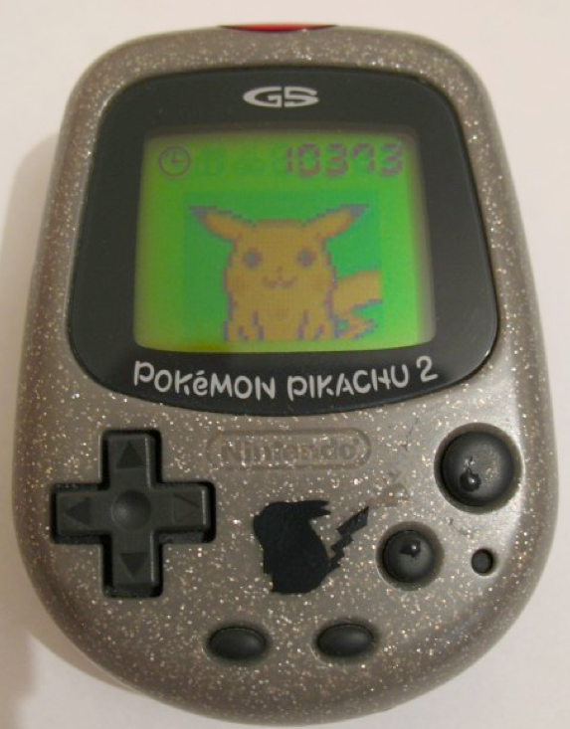
Nintendo’s Pocket Pikachu
Changing bad habits and improving well being
  Designed to motivate children
  to be more physically active on
  a regular basis
  owner of the digital pet that
  ‘lives’ in the device is required
  to walk, run, or jump
  If owner does not exercise the virtual pet becomes angry and refuses to play anymore
www.id-book.com
Notes:
This use of positive rewarding and sulking can be a powerful means of persuasion, given that children often become emotionally attached to their virtual pets, especially when they start to care for them.

Slide 9
Anthropomorphism
Attributing human-like qualities to inanimate objects (e.g. cars, computers)
  Zoomorphism is making objects appear in animal form
Well known phenomenon in advertising
  Dancing butter, drinks, breakfast cereals
Much exploited in human-computer interaction
  Make user experience more enjoyable, more motivating, make people feel at ease, reduce anxiety
www.id-book.com

Slide 10
Which do you prefer?
1. As a welcome message
“Hello Chris! Nice to see you again. Welcome back. Now what were we doing last time? Oh yes, exercise 5. Let’s start again.”
“User 24, commence exercise 5.”
www.id-book.com

Slide 11
Which do you prefer?
2. Feedback when get something wrong
“Now Chris, that’s not right. You can do better than that.Try again.”
“Incorrect. Try again.”
Is there a difference as to what you prefer depending on type of message? Why?
www.id-book.com

Slide 12
Evidence to support anthropomorphism
Reeves and Naas (1996) found that computers that flatter and praise users in education software programs -> positive impact on them
“Your question makes an important and useful distinction. Great job!”
Students were more willing to continue with exercises with this kind of feedback
www.id-book.com

Slide 13
Criticism of anthropomorphism
Deceptive, make people feel anxious, inferior or stupid
People tend not to like screen characters that wave their fingers at the user and say:
  Now Chris, that’s not right. You can do better than that.Try again.”
Many prefer the more impersonal:
  “Incorrect. Try again.”
Studies have shown that personalized feedback is considered to be less honest and makes users feel less responsible for their actions (e.g. Quintanar, 1982)
www.id-book.com

Slide 14

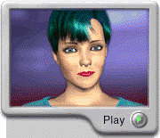
Virtual characters
Appearing on our screens in the form of:
  Sales agents, characters in videogames, learning companions, wizards, pets, newsreaders
Provides a persona that is welcoming, has personality and makes user feel involved with them
www.id-book.com

Slide 15
Can you think of other places virtual characters might be useful?
CITATION: Daugherty, B., Badu, S., Cutler, B. & Hodges, L. (2007). “Officer Garcia: A Virtual Human for Mediating Eyewitness Identification.” Proceedings of ACM VRST, Newport Beach, California, November 5-7, 2007.

Slide 16
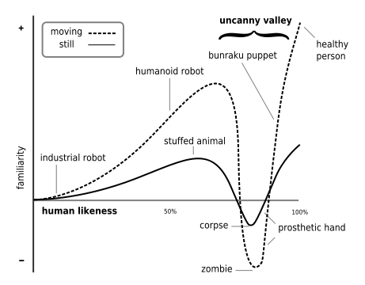
Uncanny Valley
Image Source: http://en.wikipedia.org/wiki/Uncanny_valley

Slide 17
What do you think?
“emotional attachment and involvement with products is as important as how easy we find them to use”
(Sharp, Rogers & Preece, 2011, p. 149)
Will users forgive a product that has problems/errors if it is easy to use and/or makes them feel good?

