Slide 1
Chapter 6
_{Interfaces}
Slides adapted for COMP 135 by Dan Cliburn
www.id-book.com

Slide 2
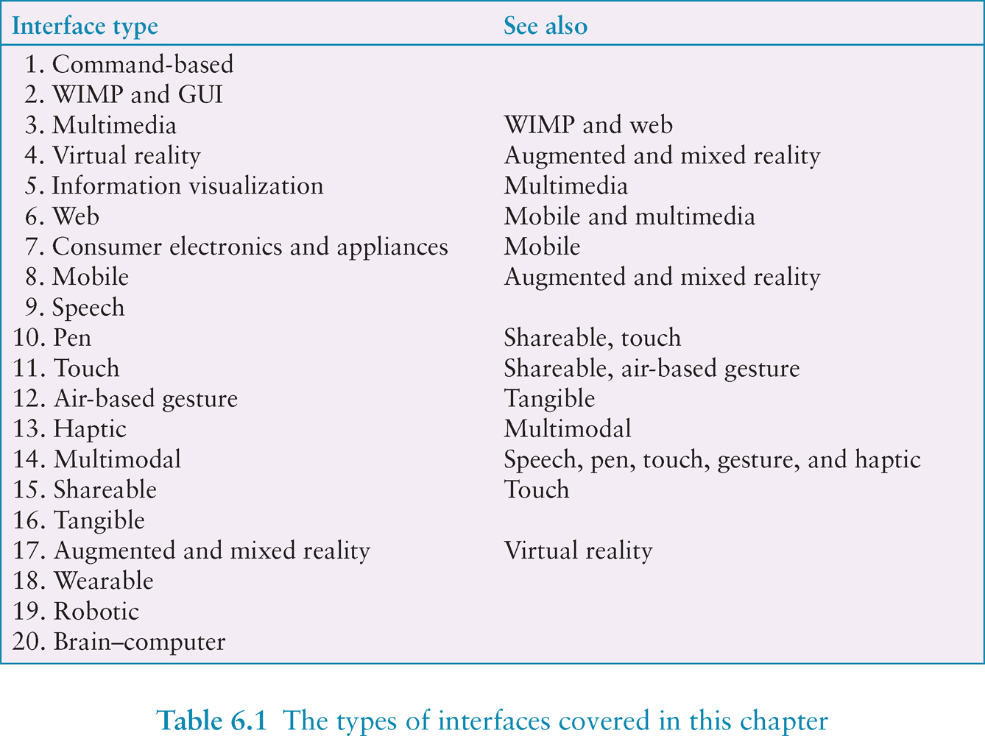
www.id-book.com
Notes:
There is now a diversity of interfaces. The goal of this chapter is to consider how to design interfaces for different environments, people, places, and activities. We present a catalog of 20 interface types, starting with command-based and ending with brain-computer. For each one, we present an overview and outline the key research and design concerns. Some are only briefly touched upon while others – that are more established in interaction design – are described in more depth.
Numerous adjectives have been used to describe the different kinds of interfaces that have been developed, including graphical, command, speech, multimodal, invisible, ambient, mobile, intelligent, adaptive, tangible, touchless and natural. Some of the interface types are primarily concerned with a function (e.g. to be intelligent, to be adaptive, to be ambient), while others focus on the interaction style used (e.g. command, graphical, multimedia), the input/output device used (e.g. pen-based, speech-based), or the platform being designed for (e.g. PC, mobile, tabletop). The interface types are loosely ordered in terms of when they were developed. They are numbered to make it easier to find a particular one (see Table 6.1 for complete set). It should be noted, however, that this classification is for convenience. The interface entries are not mutually exclusive since some products can appear in two categories. For example, a smartphone can be considered to be either mobile or touch. Table 6.1 suggests which interfaces are related or have design issues in common.

Slide 3
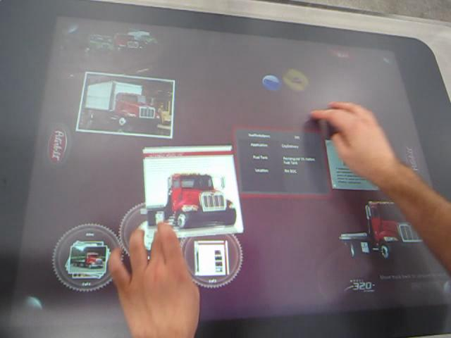
Microsoft Surface
(see page 202 in the textbook)
15. Shareable
SOURCE:https://en.wikipedia.org/wiki/File:Peterbilt_application_on_Microsoft_Surface.ogv

Slide 4
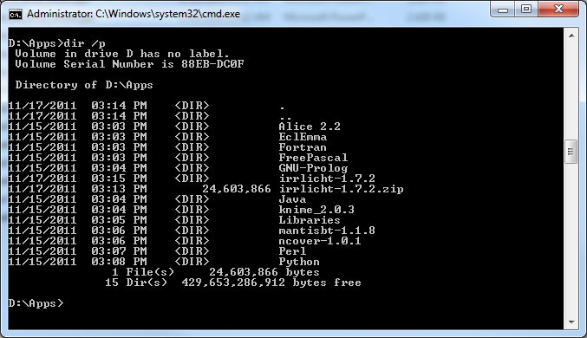
1. Command-based
Commands such as abbreviations (e.g. ls) typed in at the prompt to which the system responds (e.g. listing current files)
Some are hard wired at keyboard, others can be assigned to keys
Efficient, precise, and fast
Large overhead to learn sets of commands
www.id-book.com

Slide 5
2. WIMP and GUI
Xerox Star first WIMP -> rise to GUIs
Windows
  could be scrolled, stretched, overlapped, opened, closed, and moved around the screen using the mouse
Icons
  represented applications, objects, commands, and tools that were opened when clicked on
Menus
  offering lists of options that could be scrolled through and selected
Pointing device
  a mouse controlling the cursor as a point of entry to the windows, menus, and icons on the screen
www.id-book.com

Slide 6
GUIs
Same basic building blocks as WIMPs but more varied
  Color, 3D, sound, animation
  Many types of menus, icons, windows
New graphical elements, e.g.
  toolbars, rollovers, …
www.id-book.com

Slide 7
4. Virtual Reality
Computer-generated graphical simulations providing:
  “the illusion of participation in a synthetic environment rather than external observation of such an environment” (Gigante, 1993)
provide new kinds of experience, enabling users to interact with objects and navigate in 3D space
Create highly engaging user experiences
www.id-book.com

Slide 8
Pros and cons
Induces a sense of presence where someone is totally engrossed by the experience
  “a state of consciousness, the (psychological) sense of being in the virtual environment” (Slater and Wilbur, 1999)
Head-mounted displays are uncomfortable to wear, and can cause motion sickness and disorientation
  A lot of contemporary work in this area
  EXAMPLES: Oculus Rift and HTC Vive
www.id-book.com

Slide 9
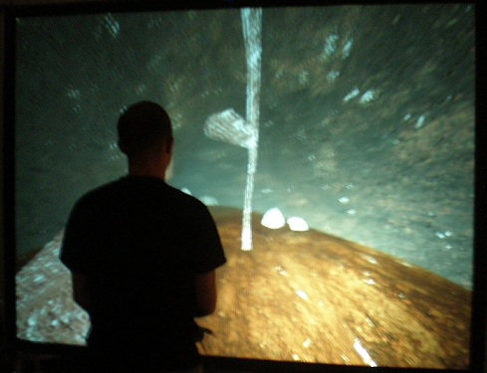
Virtual Reality Images and Videos
STRIVR
Sense of Presence: What is Virtual Reality
Sense of Presence: Building Virtual Reality

Slide 10
Research and design issues
Much research on how to design safe and realistic VRs to facilitate training
  e.g. flying simulators
  help people overcome phobias (e.g. spiders, talking in public)
Design issues
  level of realism to aim for to engender a sense of presence
  how best to navigate through them (e.g. first versus third person) without causing motion sickness
  how to control interactions and movements (e.g. use of head and body movements)
www.id-book.com

Slide 11
8. Mobile
Handheld devices intended to be used while on the move
Have become pervasive, increasingly used in all aspects of everyday and working life
Applications running on handhelds have greatly expanded, e.g.
  used in restaurants to take orders
  car rentals to check in car returns
  supermarkets for checking stock
  in the streets for multi-user gaming
  in education to support life-long learning
www.id-book.com

Slide 12
Mobile challenges
What are the usability challenges for mobile past what is typical for the GUI?
  Small screens, small number of keys and restricted number of controls
  Dexterity?
www.id-book.com

Slide 13
20. Brain-computer
Brain–computer interfaces (BCI) provide a communication pathway between a person’s brain waves and an external device, such as a cursor on a screen
Person is trained to concentrate on the task, e.g. moving the cursor
BCIs work through detecting changes in the neural functioning in the brain
www.id-book.com

Slide 14
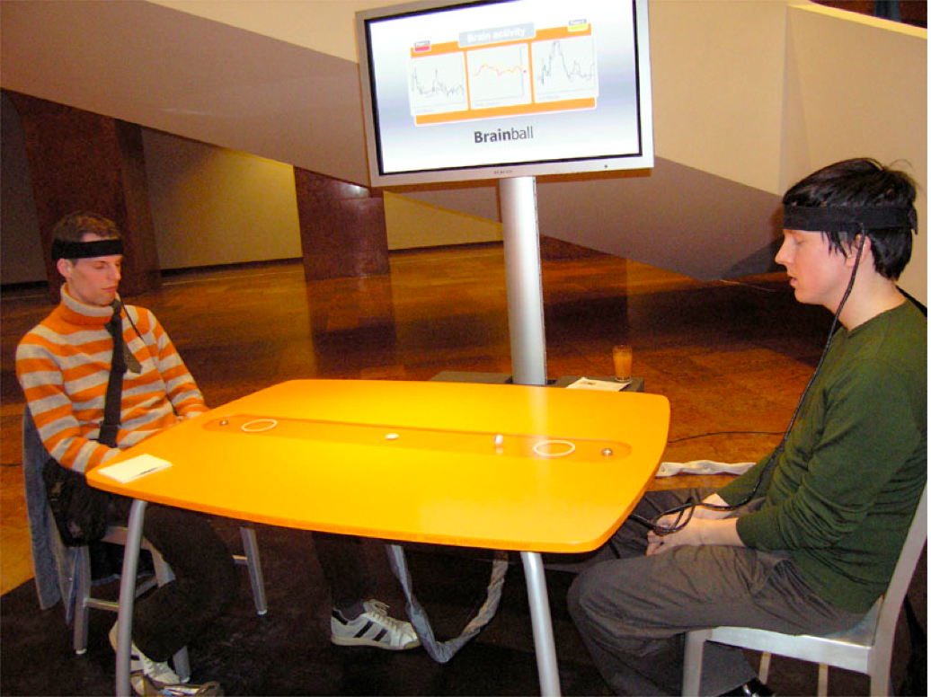
Brainball game
www.id-book.com
Notes:
Brain-computer interfaces have also been developed to control various games. For example, a game called Brainball is controlled by players’ brain waves in which players compete to control a ball’s movement across a table by becoming more relaxed and focussed.

Slide 15
Summary
Many innovative interfaces have emerged post the WIMP/GUI era, including speech, wearable, mobile, brain and VR
Many design and research questions need to be considered to decide which to use
An important concern that underlies the design of any kind of interface is how information is represented to the user so they can carry out ongoing activity or task
www.id-book.com

