Slide 1
Chapter 7
_{Data Gathering}
Slides adapted for COMP 135 by Dan Cliburn
www.id-book.com

Slide 2
REVIEW: The process of Interaction Design
Establishing requirements
Developing alternatives
Prototyping
Evaluating
What points in this process would involve gathering data from users?

Slide 3
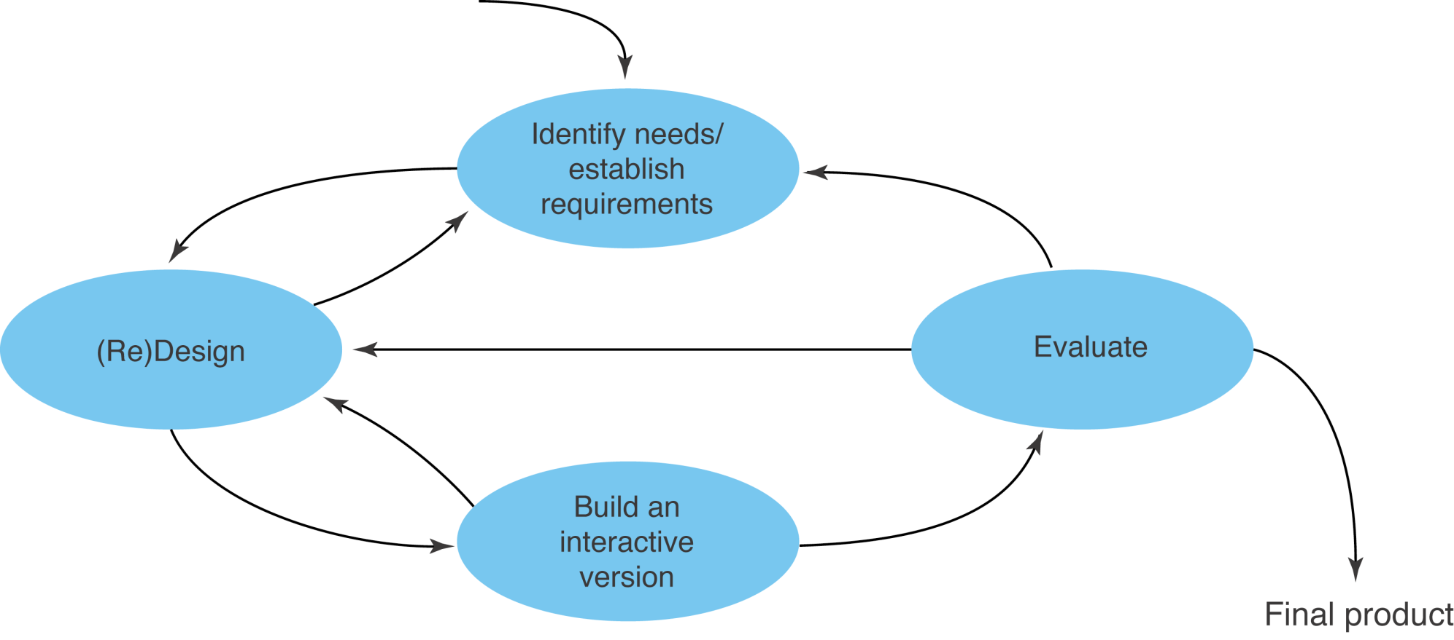
A simple interaction design model
Exemplifies a user-centered design approach (from Chapter 9)

Slide 4
Five key issues
Setting goals
    Decide how to analyze data once collected
Identifying participants
    Decide who to gather data from (stakeholders)
Relationship with participants
    Clear and professional
    Informed consent when appropriate
    What is an Institutional Review Board (IRB)?
Triangulation
    Look at data from more than one perspective
    (Use more than one data gathering technique)
Pilot studies
    Small trial of main study
www.id-book.com

Slide 5
Three main approaches to data collection
Interviews
Questionnaires
Observation

Slide 6
1. Interviews
Unstructured - are not directed by a script. Rich but not replicable.
Structured - are tightly scripted, often like a questionnaire. Replicable but may lack richness.
Semi-structured - guided by a script but interesting issues can be explored in more depth. Can provide a good balance between richness and replicability.
www.id-book.com

Slide 7
Interview questions
Two types:
  ‘closed questions’ have a predetermined answer format, e.g., ‘yes’ or ‘no’
  ‘open questions’ do not have a predetermined format
Closed questions are easier to analyze
Avoid:
  Long questions
  Compound sentences - split them into two
  Jargon and language that the interviewee may not understand
  Leading questions that make assumptions e.g., “Why do you like …?”
  Unconscious biases e.g., gender stereotypes
www.id-book.com

Slide 8
Running the interview
Introduction – introduce yourself, explain the goals of the interview, reassure about the ethical issues, ask to record, present any informed consent form.
Warm-up – make first questions easy and non-threatening.
Main body – present questions in a logical order
A cool-off period – include a few easy questions to defuse tension at the end
Closure – thank interviewee, signal the end,
e.g, switch recorder off.
www.id-book.com

Slide 9

Enriching the interview process
Props - devices for prompting interviewee, e.g., a sketch, prototype, scenario, …
www.id-book.com

Slide 10
2. Questionnaires
Questions can be closed or open
Closed questions are easier to analyze, and may be done by computer
Can be administered to large populations
Paper, email and the web used for dissemination
Sampling can be a problem when the size of a population is unknown as is common online
Who responds to online questionnaires?
Ann Landers story …
Convenience sampling
www.id-book.com

Slide 11
Question and response format
‘Yes’ and ‘No’ checkboxes
Checkboxes that offer many options
Rating scales
  Likert scales: Strongly Agree Agree Disagree Strongly Disagree
  semantic differential scales:
  rural urban
    3, 5, 7 or more points?
Open-ended responses
www.id-book.com

Slide 12
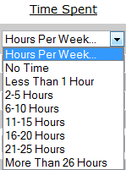
Questionnaires: What problems can you identify?
1. What is your age? 0-13 13-18 18-30 30-60 60-110
2. The place I grew up is:
Bucolic Oppidan
3. My hometown can best be described as:
Rural Urban
4. Presence in video games is important?
Strongly Agree Agree Disagree Strongly Disagree
5. Where do you use the Internet to play online games?
__ Home __Work __Coffee Shop __Library
6. Describe some strategies you use to cram for exams:

Slide 13
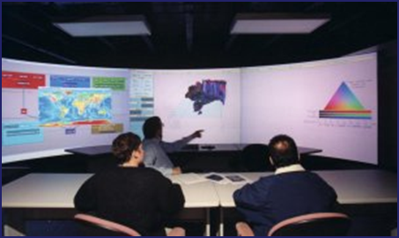
3. Observation
Direct observation in the field
  Degree of participation (insider or outsider)
Direct observation in controlled environments
  Think-aloud technique
Indirect observation: tracking users’ activities
  Diaries
  Interaction logging
www.id-book.com

Slide 14
Summary
Three main data gathering methods: interviews, questionnaires, observation
Five key issues of data gathering: goals, choosing participants, triangulation, participant relationship, pilot studies
Interviews may be structured, semi-structured or unstructured
Questionnaires may be on paper, online or telephone
Observation may be direct or indirect, in the field or in controlled setting
Techniques can be combined depending on study focus, participants, nature of technique and available resources
www.id-book.com

