Slide 1
Chapter 8
_{Data analysis, interpretation}
_{and presentation}
Slides adapted for COMP 135 by Dan Cliburn
www.id-book.com

Slide 2
Quantitative and qualitative
Quantitative data:
  expressed as numbers (time, number of errors, …)
Qualitative data:
  difficult to measure sensibly as numbers, e.g. count number of words to measure dissatisfaction
Be careful how you manipulate data and numbers!
www.id-book.com

Slide 3
Activity
What do these statements tell you?
  2 of 4 users took less than half an hour to place an order through an e-commerce website
  “50% of users take longer than 30 minutes to place an order through an e-commerce website” [2:271]
  “It is better not to use percentages unless the number of data points is at least over 10” [2:271]

Slide 4
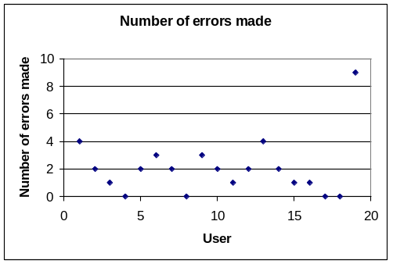
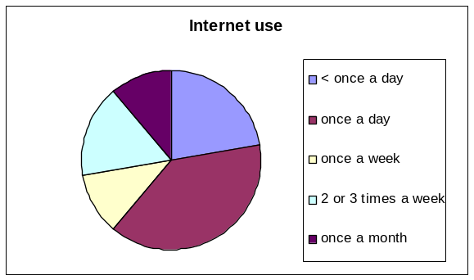
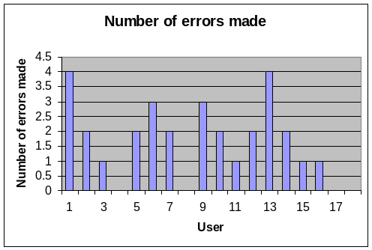
Simple quantitative analysis
Averages: (1 2 5 5 5 7 8 8 9 9 10)
  Mean: add up values and divide by number of data points
  Median: middle value of data when ranked
  Mode: figure that appears most often in the data
Percentages
Graphical representations give overview of data
  (6.27)
(7)
(5)
www.id-book.com

Slide 5
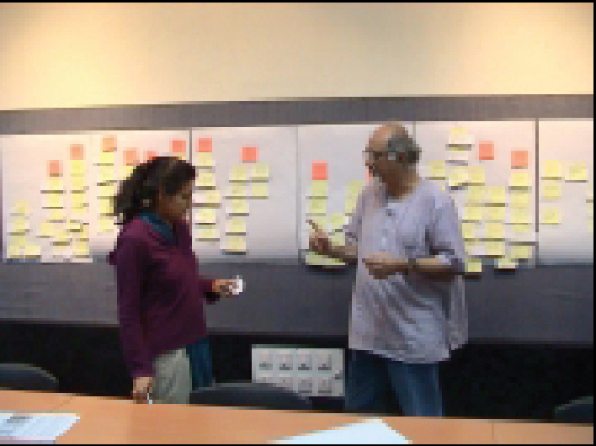
Simple qualitative analysis
Recurring patterns or themes
  Emergent from data, dependent on observation framework if used
Categorizing data
  Categorization scheme may be emergent or pre-specified
Looking for critical incidents
  Helps to focus in on key events
What is inter-rater reliability?
www.id-book.com

Slide 6
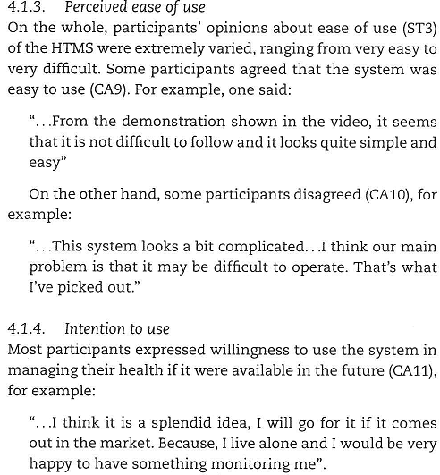
Interpreting Qualitative Data, an example [1]

Slide 7
Presenting your findings
Make sure your analysis and presentation of the results connect to your data collection goals.
  Use the results you present to support your claims
    Only make claims that your data can support
  Qualitative data can often help to explain quantitative data
Look at your data objectively – don’t let biases influence your interpretation
Words like “many”, “often”, or even “all” should be used carefully [2:270]

Slide 8
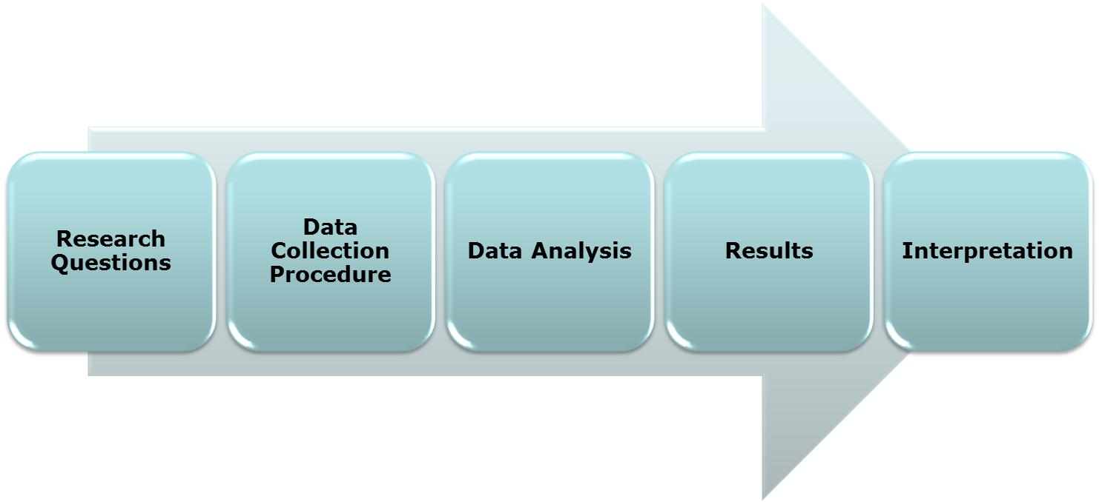

Typical flow of an evaluation study
The Interpretation should provide answers to the Research Questions using the Results to support all claims.

Slide 9
Summary
The data analysis that can be done depends on the data gathering that was done
Qualitative and quantitative data may be gathered from any of the three main data gathering approaches (interviews, questionnaires, observation)
Percentages and averages are commonly used in Interaction Design
Mean, median and mode are different kinds of ‘average’ and can have very different answers for the same set of data
Presentation of the findings should not overstate the evidence
  Do not make claims past what your data can support
www.id-book.com

Slide 10
References
[1] M. Rahimpour, N. H. Lovell, B. G. Celler, and J. McCormick. Patient’s perceptions of a home telecare system. International Journal of Medical Informatics, vol. 77, pp. 486-498, 2008.
[2] H. Sharp, Y. Rogers and J. Preece. Interaction Design: beyond human-computer interaction (3rd edition). West Sussex, United Kingdom: Wiley, 2011.

