Slide 1
COMP 135: Human-Computer Interface Design
Exam 2 Review

Slide 2
Important Dates
4/26 - Conduct Final Project Evaluations during class time
4/28 - Conduct Final Project Evaluations during class time
5/1 - Final Project Presentations
Evaluation Credit Signature Sheet due at 2pm
5/2 - OPTIONAL: draft of Final Project Written Report due at 8am
5/3 - Final Project Presentations
Final Project Assessments due by 6:00am
Final Project Written Report due by 6:00am
(everyone in the group needs to upload the paper)
5/8 - Final Exam, 12pm, Anderson 216

Slide 3
Exam Preparation
Know terms in the book/slides from Chapters 10-15 (see terms2.pdf)
Be able to describe the difference between low-fidelity prototyping and high-fidelity prototyping (Ch. 11)
Also horizontal versus vertical prototyping
Be able to describe the quantitative and qualitative research methods that we discussed during the course
Be able to explain the kinds of research questions that these methods may be most appropriate for answering
Be able to write an evaluation plan for a product (similar to what you did for Assignment 8)
Be able to interpret the results of an inferential statistics data analysis (similar to what you did for Assignment 9)

Slide 4
Types of Questions
Matching (terms to definitions)
Multiple Choice
Short Answer

Slide 5
What WAs this class about?
There are just way too many bad interfaces out there.
In this class, we talked about how to make interactive products that are both useful and usable.
How do you do this?
Involve potential users early and often
“talk to users”
Have users evaluate your product

Slide 6
REVIEW: The process of Interaction Design
Establishing requirements
Developing alternatives
Prototyping
Evaluating
Notes:
6

Slide 7
Typical flow of an evaluation study
Research Questions
Data Collection Procedure
Data Analysis
Results
Interpretation
The Interpretation should provide answers to the Research Questions using the Results to support all claims.

Slide 8
A Selection of Research Methods
Quantitative
Qualitative
Experiment
True experiment
Quasi-experiment
Ex Post Facto
Prediction
Descriptive / Observational
Ethnography
Phenomenological
Content Analysis
Case Study
Multi Methods Research

Slide 9
What is the most appropriate method?
1. Do the SOECS computer laboratories meet the needs of students?
2. Can excessive cell phone usage cause brain tumors?
3. What are the demographics of Firefox users?
4. What is it like to own a Kindle?
5. Is my new algorithm faster than three other common algorithms for accomplishing the same task?
6. Can someone’s high school GPA and SAT scores be used to predict someone’s college GPA?
7. Can the integration of an iPad app into 5th grade classes help increase student understanding of a course concept?
8. What themes are common on Facebook user pages?
9. For what purposes do citizens of developing countries use mobile devices?

Slide 10
Usability Testing
Involves testing whether a product is usable in a controlled environment [2:646]
Has elements common to both quantitative and qualitative research
What are the key components?
user test and satisfaction questionnaire [2]
My opinion is that you could call usability testing a type of multi methods research used in HCI.

Slide 11
Sources of Data in Usability Testing
Qualitative
Open-ended survey questions
Observations
Interviews
Quantitative
Subject data: gender, age, group, …
Performance Metrics: task success, time-on-task, errors, efficiency, learnability [3:64]

Slide 12
Inferential Statistics Example
Assume that as part of your senior project you create a virtual reality (VR) video game that helps students learn about concepts from HCI. To evaluate the game, IRB approval is obtained to recruit students from sections of an HCI course at a large public state university. Students who fail the course's first test are invited to play the game during the week leading up to test 2 and also the week leading up to test 3. During each week of game play the students complete a level that that exposes them to topics that have recently been covered in the course and that will be tested on an upcoming exam. You are also curious about the potential impacts of immersive technologies on the results of the study; therefore, half of the game students are provided with an Oculus Rift so that they can play the game in VR. Thus, there are three groups in your study: the immersion group (who play the game with the Rift), the game group (who play the game using a standard computer monitor), and the control group (who do not take you up on your offer to play the game, but who remain in the course).
What are the independent and dependent variables?

Slide 13
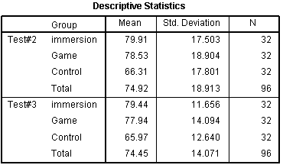
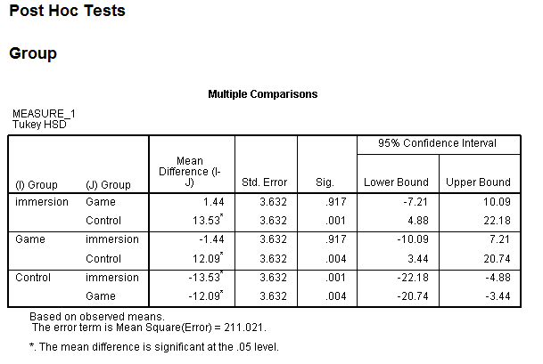
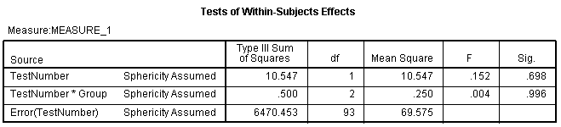
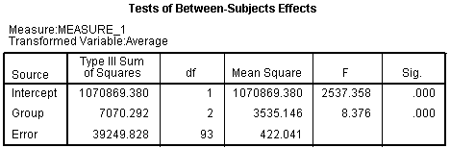
Inferential Statistics Example
Questions to answer:
What is the within-subject variable?
What is the between-subject variable?
What statistical test was performed?
Was there a main effect of the within-subject variable?
Was there a main effect of the between-subject variable?
Was there an interaction?

Slide 14
Validity and Reliability
Validity - refers to how well a method allows the researcher to measure what is intended to be measured [2:640]
Internal Validity
“focuses on the viability of causal links between the independent and dependent variables” [1:134]
Some threats to internal validity:
Selection
Experimenter effects
Testing /order effect
Attrition (mortality)
External Validity
“refers to the generalizability of the results and conclusions to other people and locations” [1:134]
Reliability - refers to how well a research method can produce “the same results on separate occasions under the same circumstances” [2:640]

Slide 15
References
[1] J. H. McMillan and S. Schumacher, Research in education: Evidence-based inquiry, 6th edition. Boston, MA: Pearson, 2006.
[2] H. Sharp, Y. Rogers and J. Preece. Interaction design: beyond human-computer interaction. West Sussex, UK: Wiley, 2007.
[3] T. Tullis and B. Albert, Measuring the user experience. Burlington, MA: Morgan Kaufmann, 2008.

