Slide 1
Validity and Inferential Statistics
COMP 135: Human-Computer Interface Design

Slide 2
What is wrong with this fictitious study?
Researchers have developed a new type of game controller they believe will help improve the performance of game players. The researchers conduct a study to investigate their hypothesis. Five different types of game controllers are used in the study and assigned the numbers 1-5 (5 is assigned to the researcher’s controller). The researchers have subjects play a video game five times (first with controller 1, then controller 2, …, and always concluding with controller 5). The researchers analyze the data they collect using T-tests and find that subjects did indeed have higher scores when playing the game with their controller. The researchers proclaim their design to be a success!

Slide 3
Validity
Internal Validity – “focuses on the viability of causal links between the independent and dependent variables” [2:134]
Some threats to internal validity:
Selection
Experimenter effects
Instrumentation
Testing /order effect
Attrition (mortality)
Statistical conclusion validity – “refers to the appropriate use of statistical tests to determine whether purported relationships are a reflection of actual relationships” [2:134]
External Validity – “refers to the generalizability of the results and conclusions to other people and locations” [2:134]
What could have improved the study described on the previous slide?

Slide 4
Strategies to improve internal validity [1]
A controlled laboratory study
A double-blind experiment
Unobtrusive measures
Triangulation
Does increasing internal validity also increase external validity?
What is reliability?
“how well it produces the same results on separate occasions under the same circumstances” [3:640]

Slide 5
Activity
Pretend that you have developed a typing game and you want to conduct a summative evaluation to determine if it really helps people learn to type to a “significant” degree.
Describe an experimental procedure to evaluate the effectiveness of this application? Clearly state your independent and dependent variables.
Independent Variables
Condition and TestNumber
Dependent Variable
Typing Test Score

Slide 6
Some possible evaluation designs
Lets assume that a typing test can be given to measure someone’s typing ability.
game test
test game test
test game test
test test
Of course, we don’t know how well subjects could type before playing the game
Here, some improvement could be due to taking the test twice
It might also be helpful to have students in the “game” group complete a satisfaction questionnaire

Slide 7
Analyzing your quantitative data
Lets assume we have collected the following data:
Was the application effective?
How do we know?
Within-Subject variable (TestNumber)
 | Test#1 mean | Test#2 mean
Game Group | 57.10 | 60.60
Control Group | 57.00 | 57.90
Between-Subject variable (Condition)

Slide 8
Analyzing Quantitative Data
Descriptive statistics “those methods used to organize and describe information that has been collected” [4: 10].
Inferential statistics “allow us to make inferences about a large population from relatively small samples” [1: 275].
T-test – used to compare two group means for statistical significance
Analysis of variance (ANOVA) - used to compare two or more group means for statistical significance
Post hoc comparisons can be used to determine which means are significantly different
Regression – can be used to construct an equation to predict a dependent variable from one or more independent variables.
What does it mean for the difference between two groups means to be statistically significant?

Slide 9
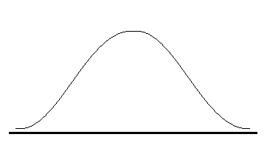
Statistical Significance
The Central Limit Theorem: “The sampling distribution of the mean is approximately normal for nonnormal sampled populations. The larger the sample size, the closer the sampling distribution is to being normal” [4:351].
approximation considered good provided n ≥ 30
What if we have a sample that falls over here?
p
|
α

Slide 10
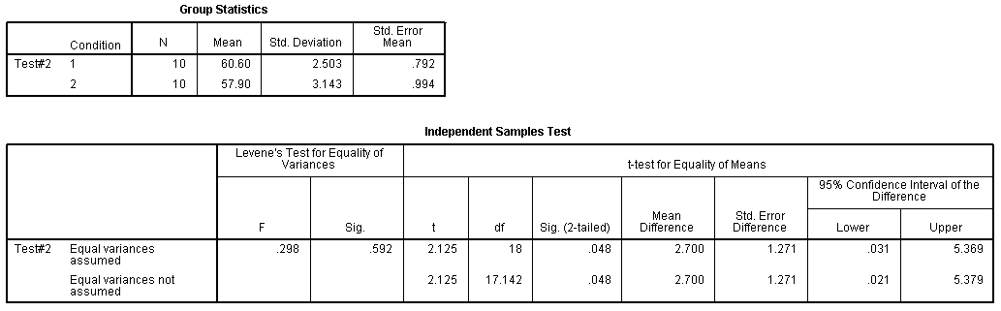
T-Test

Slide 11
Analyzing your quantitative data
Lets assume we have collected the following data:
Was the application effective?
We might want to answer these questions:
Is there a significant difference between the groups?
Is there a significant difference between Test#1 means and Test#2 means?
Is there an interaction?
Within-Subject variable (TestNumber)
 | Test#1 mean | Test#2 mean
Game Group | 57.10 | 60.60
Control Group | 57.00 | 57.90
Between-Subject variable (Condition)

Slide 12
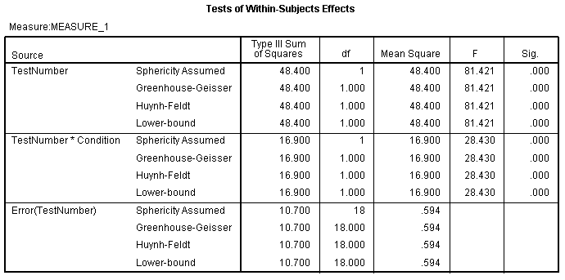
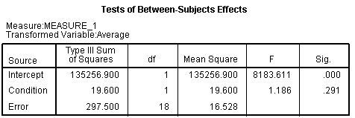
ANOVA
Results of a Repeated Measures ANOVA
Interaction
statistical significance versus practical significance

Slide 13
Analyzing your qualitative data
What themes do you identify in these comments? Do these comments help to explain the quantitative findings?
The game was kinda fun and kept my interest.
The game really helped me with my hand and finger placement. I felt like I wasn’t hunting and pecking anymore.
The game was pointless.
The practice makes a difference. I don’t normally try to type fast but the game made me try to get faster.
I never really tried to learn the layout of the keys before. The game helped me learn where to put my hands on the keyboard.
As far as learning games go this was fun. Not sure I’ll play it again though.
Maybe if you made more of a penalty for losing people would try harder to get better – as it is, there is not much motivation to improve.
Repetition really helps to learn something like this. The game gives you this opportunity.

Slide 14
Remember
Make sure your analysis and interpretation connect to your original research question/problem.
Use the results you present to support your claims
Look at your data objectively – don’t let biases influence your interpretation
Only make claims that your data can support
Direct quotes from the qualitative data are often used to support your claims.
Words like “many”, “often”, or even “all” should be used carefully [3:354]

Slide 15
Typical flow of an evaluation study
Research Questions
Data Collection Procedure
Data Analysis
Results
Interpretation
The Interpretation should provide answers to the Research Questions using the Results to support all claims.

Slide 16
References
[1] P. D. Leedy and J. E. Ormrod, Practical research: Planning and Design, 9th edition. Boston: Pearson, 2010.
[2] J. H. McMillan and S. Schumacher, Research in education: Evidence-based inquiry, 6th edition. Boston, MA: Pearson, 2006.
[3] H. Sharp, Y. Rogers and J. Preece. Interaction design: beyond human-computer interaction. West Sussex, UK: Wiley, 2007.
[4] R. C. Weimer, Statistics, 2nd edition. Dubuque, IA: WCB, 1987.

