Slide 1
COMP 135: Human-Computer Interface Design

Slide 2
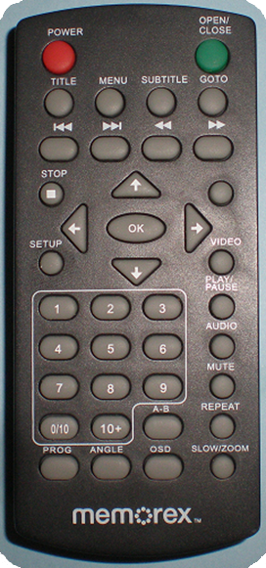
What is this class about?
What is an interface?
What is the best interface you have ever seen/used?
What is the worst interface you have ever seen/used?
How does something like this remote control get released into the market?
Who proofreads your papers?
Who proofreads your programs?

Slide 3
What is this class about?
There are just way too many bad interfaces out there.
In this class, we talk about how to make interactive products that are both useful and usable.
How would you define the terms useful and usable in the context of product design?
How do you make products useful and usable?
Involve potential users early and often: “talk to users”
Which do you think users prefer?
A product with twice the number of needed features and nearly impossible to figure out how to use
A product with only the needed features and extremely easy to figure out how to use

Slide 4
What is this?
Analysis
Design
Implementation
Testing
This is the “waterfall” model for software development
Evaluation
This class is mostly concerned with what goes on at these stages

Slide 5

What is interaction design?
Designing interactive products to support the way people communicate and interact in their everyday and working lives
Sharp, Rogers and Preece (2011)*
*
Notes:
5

Slide 6
What is involved in the process of interaction design
Establishing requirements
Developing alternatives
Prototyping
Evaluating
Notes:
6

Slide 7
Class Project
Working with a group of 4-5 students, you will design, prototype, and evaluate some interactive computing product
Web applications, video games, mobile apps, …
You may not use a product that you are working on for some other course
You may not use a product that you have already started making
You may create a product that you have always wanted to make, but have never had the time and/or motivation to do it
You probably will not have time during this term to implement every feature you ever wanted
You may evaluate an interface research question

Slide 8
Roles on the Course Project
Programming Lead
Creates the code design, manages programmers, and writes code for the final product
Evaluation Lead
Designs and conducts the final product evaluation
Project Manager
Manages the team, maintains required documents, writes the final report and assists the other team members as needed
Programmers
Write code for the final product

Slide 9
Cone of Learning
Percentage of knowledge recall after six weeks with each instruction method.
Lecture
4%-8%
Reading
6%-10%
Lecture with visuals
12%-18%
Demonstration
20%-45%
Hands-on independent student
45%-65%
Cooperative learning group
60%-80%
Teaching another
80%-98%
SOURCE: Lord, T. (2007). Revisiting the Cone of Learning: Is it a Reliable Way to Link Instruction Method with Knowledge Recall?. Journal of College Science Teaching, November/December, 14-17.

Slide 10
Student Evaluation
The grading will come from these areas:
Quizzes and Exams will be individual
Classroom Activities will be done in small groups
Some assignments will be done individually and others will be done in groups
The final project will be done with a group
Quizzes 10%
Classroom Activities 10%
Assignments 20%
Final Project 20%
Exams 40%

Slide 11
Course Logistics
Class schedule:
MWF 2:00-2:55
Course Canvas Site
Syllabus
Assignments
Course materials
Textbook:

Slide 12
FIRST TWO WEEKS Schedule
TODAY: Course Introduction
FRIDAY: Plan your Final Project Proposal Presentation (Assignment 1)
--------------------------------------------------------------------------------------------------
MONDAY: Quiz 1 due (does not require the textbook)
WEDNESDAY: Quiz 2 due (requires the textbook)
FRIDAY: Final Project Proposal Presentations (Assignment 1)

