Slide 1
Game Development COMP3064
Week 9

Slide 2
This week
Mecanim animations
Quaterions

Slide 3
Animations - Mecanim

Slide 4
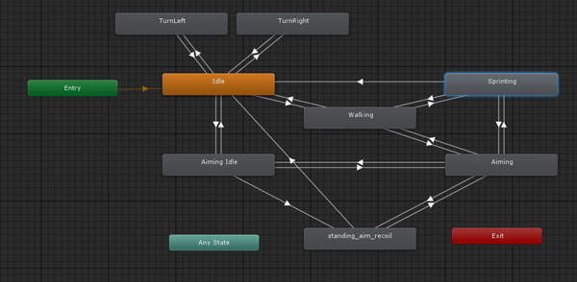

Slide 5
What is Mecanim?
Mecanim is Unity's animation state machine system.
It essentially allows you to create 'states' that play animations and define transition logic that will tell your game how to move between the different states.

Slide 6
When to use Mecanim?
You can use Mecanim if you have an imported .fbx character with a rig.
Your mesh and rig can be any type (human, dog, tree, waving flag).
Your rig will need to be defined as humanoid or generic as Mecanim does not work with legacy imported characters and animations.

Slide 7
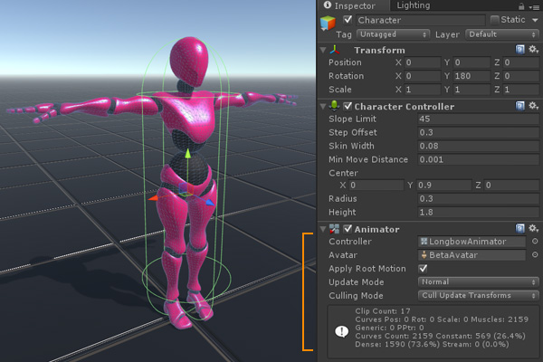

Slide 8
Mecanim parts: Animator
The Animator is a special type of component that is attached to animated characters.
Animator Controller The animator controller is a node-based system that defines state machines and handles the transitions of your animations.
Avatar The avatar is essentially a definition for your rig. You can use it to retarget animations that have the same rig (Super useful for Mixamo animations!). When you import an .fbx an avatar will automatically be generated for it.
Apply Root Motion With this option you can tell Mecanim to use the root motion of your character to move your character through the scene. If you want to control your character motion through code, you can uncheck this, but it may create less realistic animation and 'footslide' if the animation and speed don't match.

Slide 9
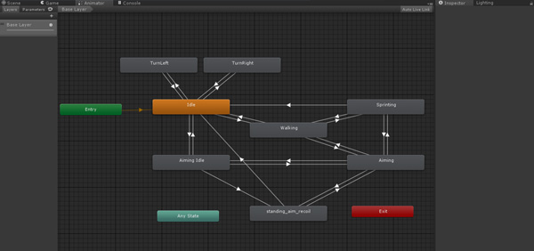
Mecanim parts: Animator Controller

Slide 10
Mecanim parts: Animator Controller
The animator controller is a requirement of the Animator component.
It refers to the actual system of creating mecanim animation states and transitions.
You can view the animator controller by selecting the asset in the project view or selecting a character that the controller is assigned to and opening the Window > Animator panel.
Here is where you will create your states and logic!

Slide 11
Mecanim parts: States
A state within Mecanim is a single node and can come in several forms.
Clicking on a state will provide useful information like the motion or blendtree used by the state, the speed of the state, whether it is Mirrored or not, and a list of all the transitions from that state to any other state.

Slide 12
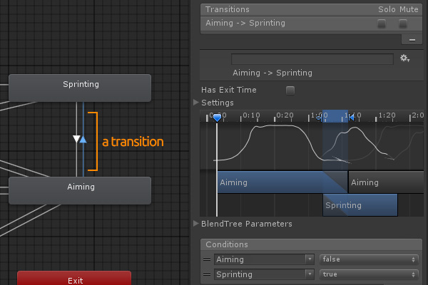
Transition
In order to move from one state to another you need to create a transition.
Transitions can be created by right clicking on a state and choosing "Create Transition".
A connector arrow will appear.
Drag the connector to the state you want to transition into.
Transitions between states are based on conditions and a transition can have one or multiple conditions, shown as a list in the Inspector.

Slide 13
Parameters
To create parameters, open the animator controller. On the right hand panel you'll find the Parameters tab.
You can click the + button to add a new parameter and choose the type you want to create. In the example below we see each type: HSpeed and VSpeed are floats (0.0), Sprinting, Aiming and Moving are booleans (squares), Fire is a trigger (circle), and Turning is an int (0).
You can also see how these can be used as the blendspace is being created from combinations of HSpeed and VSpeed with different animations at each 'point' in the space.

Slide 14
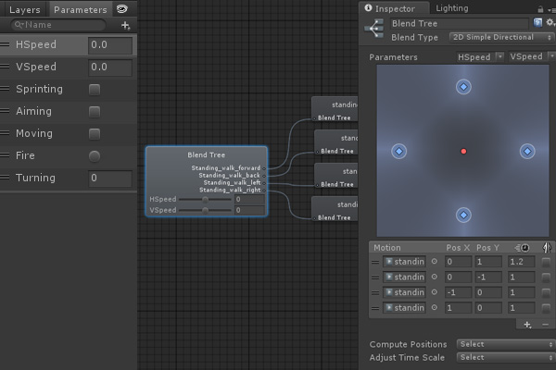

Slide 15
Layers
The Mecanim system also features animation layering.
You can use this to overlay and overwrite animation across the whole character or to control animation on specific parts of the body.
A great example is having the base layer control body animation while a separate layer controls facial animation.
All Animator Controllers start with a Base Layer. You can add more layers with the + button in the layer menu along the left side of the animator window.

Slide 16
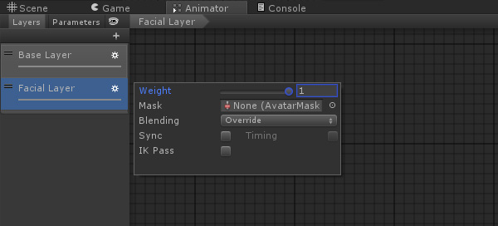

Slide 17
Animation Avatar
Humanoid Rigs and Avatars
Generic Rigs and Avatars
As briefly explained earlier, the avatar is essentially a definition of your rig.
Unity has created a basic 'humanoid' definition inside of the engine so when you import your rig you can define it as also being humanoid.
This means you're drawing a map between Unity's 'idea' of a humanoid rig and your rig so that Unity knows what bone you're talking about when you say 'left arm'.
A generic rig could be anything from a tree to a dragon.
Generic just means 'does not meet the definition for humanoid'.
For generic rigs the avatar you're creating is making a new definition based off of your bones.

Slide 18
Avatar
By default Unity will define a new avatar for every .fbx import. If you're importing animations as their own .fbx files you don't need a new definition for each animation.
The ideal setup is to import your bind-pose character .fbx with the mesh and create a new Avatar.
Then, import the animations on that character as skeleton only and have them copy the avatar from the t-pose.
This means you only have to keep one 'definition' of the rig, one copy of the mesh, and one import of the textures and materials.

Slide 19
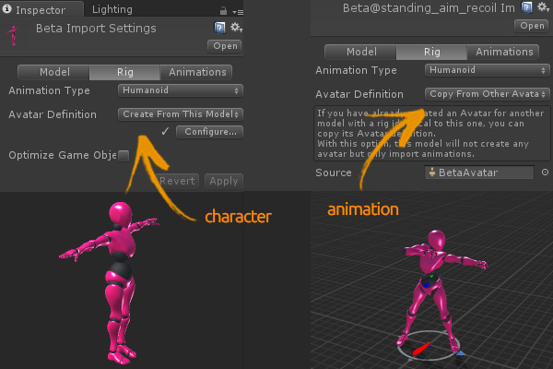

Slide 20
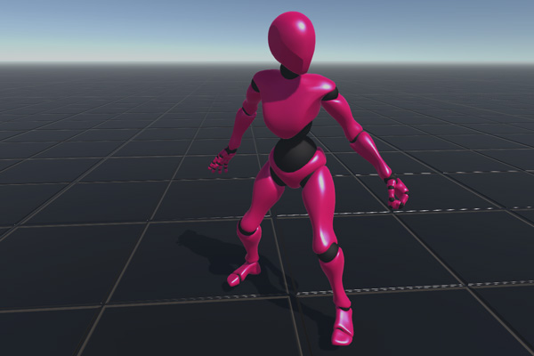

Slide 21
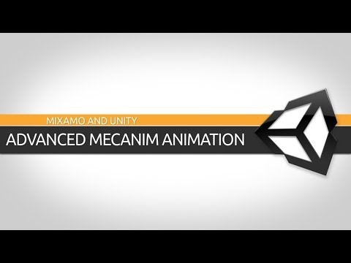

Slide 22
Questions?

Slide 23
Quaternion
Quaternion represents a rotation.
The underlying math is quite complicated but you don't need to understand it to use quaternions in Unity.
You almost never access or modify individual Quaternion components (x,y,z,w);
The Quaternion functions that you use 99% of the time are:
Quaternion.LookRotation,
Quaternion.Angle,
Quaternion.Euler,
Quaternion.Slerp,
Quaternion.FromToRotation,
Quaternion.identity.

Slide 24
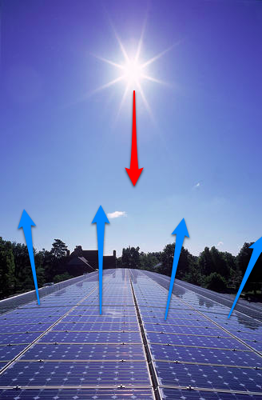
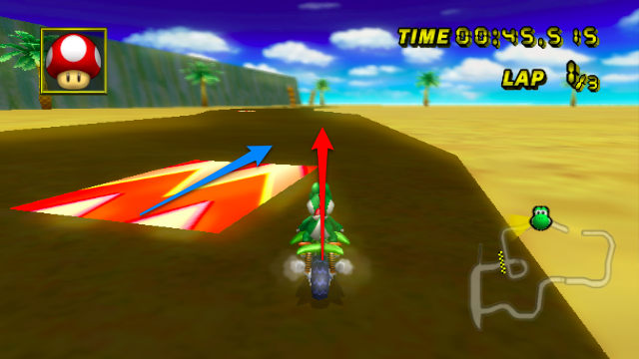
Dot product of two vectors
How much energy is going in our original direction
Boost the speed
Energy absorption

Slide 25
Why Quaterions?
We can represent 3D rotations as 3 numbers (see euler angles) but such a representation is non-linear and difficult to work with.
An analogy is a two dimensional map of the earth, there is no way that we can map the surface of the earth without distorting either angles or areas.
However once the 2D map is wrapped round a 3D sphere it becomes linear, in a similar way the 3D space of rotations becomes linear when it is mapped to a 4D hypersphere.

Slide 26
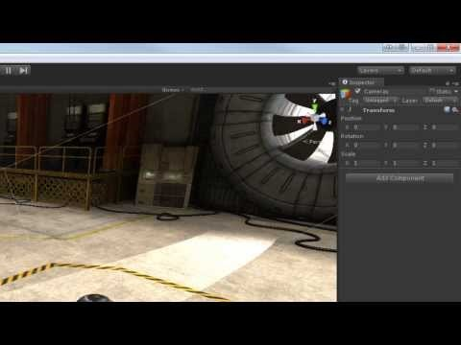

Slide 27
Questions?

