Slide 1
Date : 2/8/2025
Assignment:
Brand me
Student ID: 24020989
Name: Arshadha

Slide 2
Introduction
My portfolio theme, "Neon Glow", is inspired by neon signage and cyberpunk visuals. It represents bold creativity, individuality, and the future of digital design. I want to present myself as a vibrant designer and coder who embraces both modern trends and classic inspirations. The neon aesthetic also reflects a strong personal identity and a love for vibrant, glowing interfaces.

Slide 3
Human-Centred Design
Target Audience of your portfolio
Age: 17–30
Gender: All
Income Bracket: Students to early-career professionals
Education Level: Polytechnic/University
Computer Literacy: Medium to High
Motivation to Use the App: To view my portfolio, contact me for internships or freelance work
Preferences: Unique visuals, clean layout, fun interactive experience
Portfolio Theme
  A digital portfolio themed like neon signs at night – bright, energetic, and modern. I use electric colors like cyan, magenta, and lime green with black backgrounds to make the glowing elements pop. This reflects creativity and individuality while maintaining a clean structure.

Slide 4
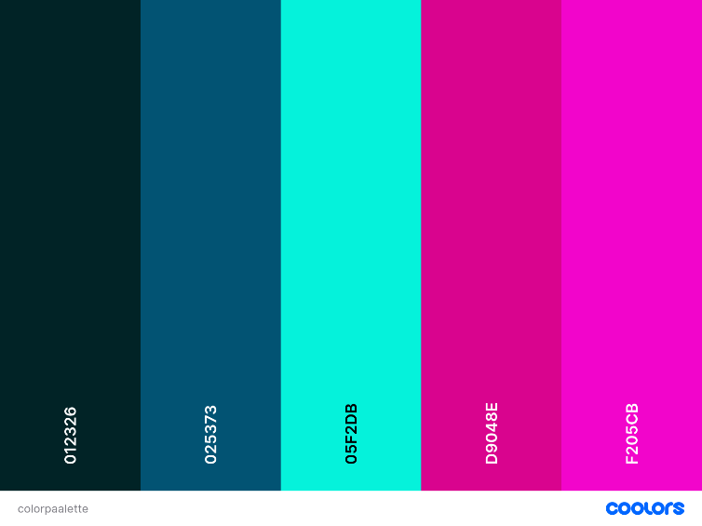
Branding & Visual Consistency
Create a colour scheme, colour palette and typography guide tailored for student users.
Ensure consistency across all designed elements.
Example:
Colour scheme: Analogous
Colour palette:
Typography used:
Orbitron
Bahnschrift

Slide 5
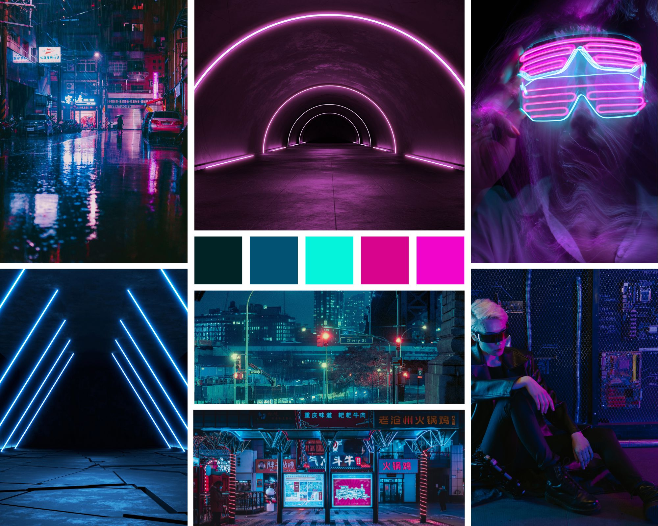
Branding & Visual Consistency
Mood board

Slide 6
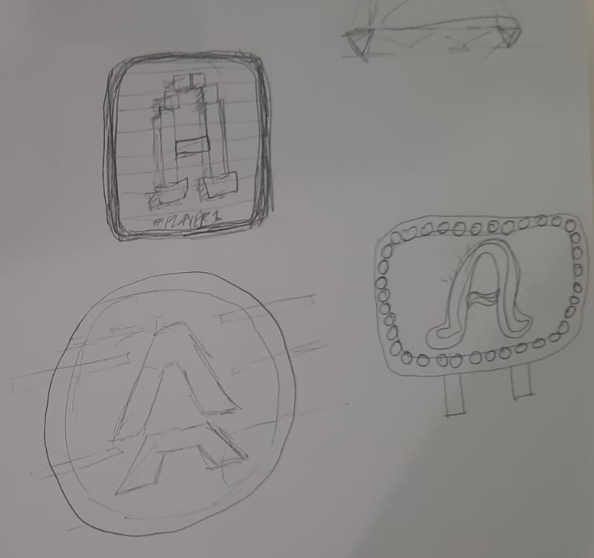

Creating Original Assets
Logo design and 3 concept sketches
Ensure all assets are original and well-structured for a portfolio.

Slide 7
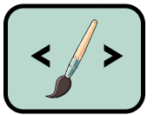


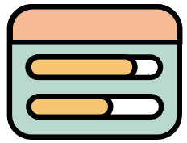
Creating Original Assets
Design at least 5 custom assets (e.g., icons for achievement, skillsets competency bar, contact, tab, etc).
Ensure all assets are original and well-structured for a portfolio.
Example:
Create a icon that visually represents students’ competency.
Skillset Community Work Achievements Progression

Slide 8
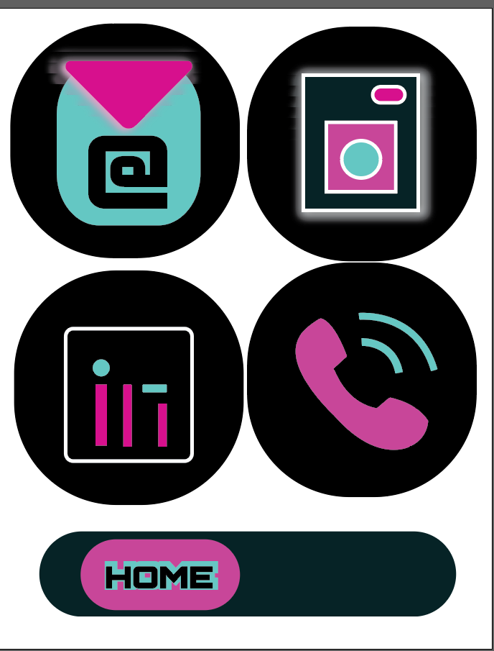
Custom Assets
5 UI elements
1. email icon
2. IG icon
3. LinkedIn icon
4. Call icon
5. navbar icon

Slide 9
AI-Assisted Design Tools
Use Photoshop’s AI features (e.g., Generative Fill, AI-powered selection) or Illustrator’s AI tools (e.g., Vector recolouring, Auto-trace).
Submit before-and-after screenshots showing how AI tools improved your design.
Example:
Use Adobe Firefly to generate a background texture that enhances your interface’s modern look.
Before AI Enhancement
Hand-drawn background with plain colours.
After AI Enhancement
AI-generated background texture applied with better gradients and details.

Slide 10
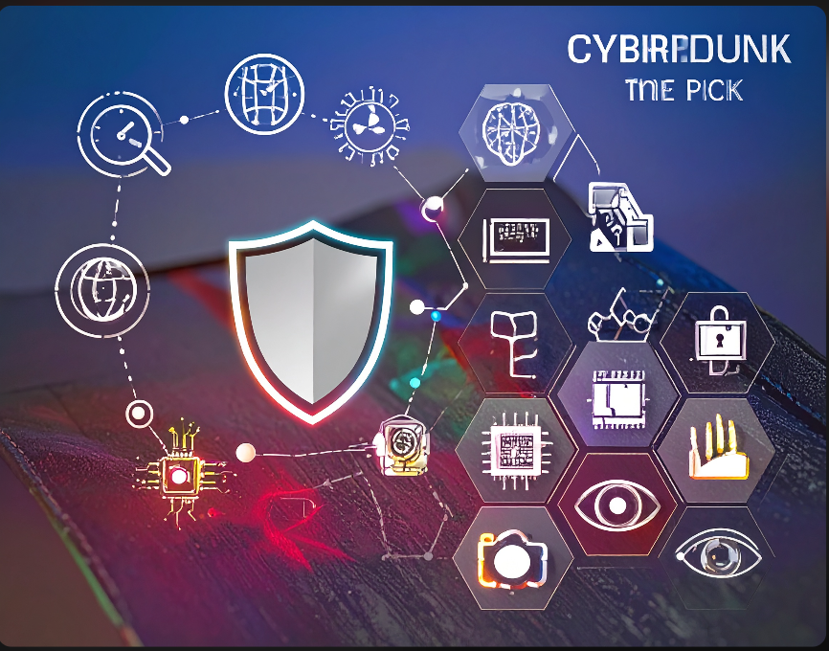
Adobe firefly
Generate a cyberpunk theme icon pack

Slide 11
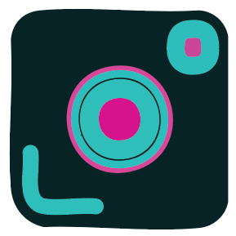
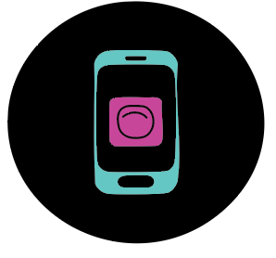
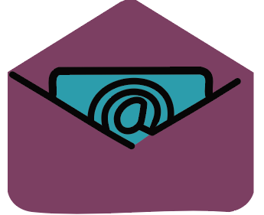


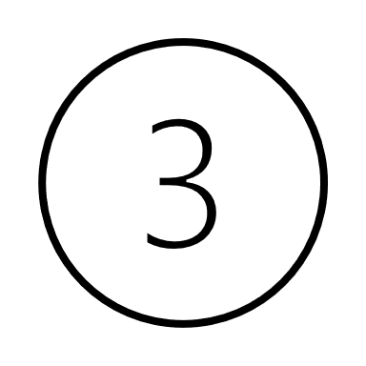
Prompt Design & AI Collaboration
Write three AI prompts for generating icons, textures, or design variations. Show AI-generated variations and justify your final selection.
AI prompt 1: Generate a glowing neon email icon in the shape of an envelope, centered on a dark background. Use cyan or light blue for the glow. Flat style, minimal, futuristic
AI prompt 2: create a app icon with camera shape; neon gradient outline
AI prompt 3: create a app icon with cell phone shape; neon gradient outline
I chose the middle one because it looks the most like a real app icon , the rest look to simple like an illustration

Slide 12
Final Artwork (Social Media)
Type : Instagram Grid, or banner or sticker
3 sketches
Design conceptualisation and rationale:
I chose to do Instagram Grid. The design is built around a central "neon" theme, aiming for a modern and energetic look. Color Choice: The bright pink and blue colors stand out strongly against the dark background. This high contrast is designed to be eye-catching and immediately draw attention.
Text Style: It uses two different fonts. The main font is styled to look like glowing neon tubes, which clearly communicates the theme. A secondary script font is used to add visual interest and a more personal touch.
Imagery: The graphics, like the logo and the headphones, are kept simple. The product photo is integrated into the theme with a neon outline, which helps maintain a consistent look across all the posts.

Slide 13
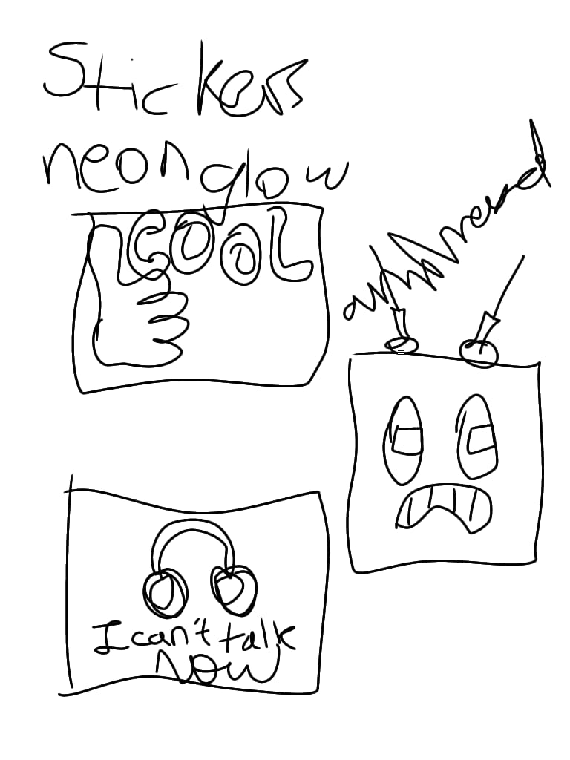
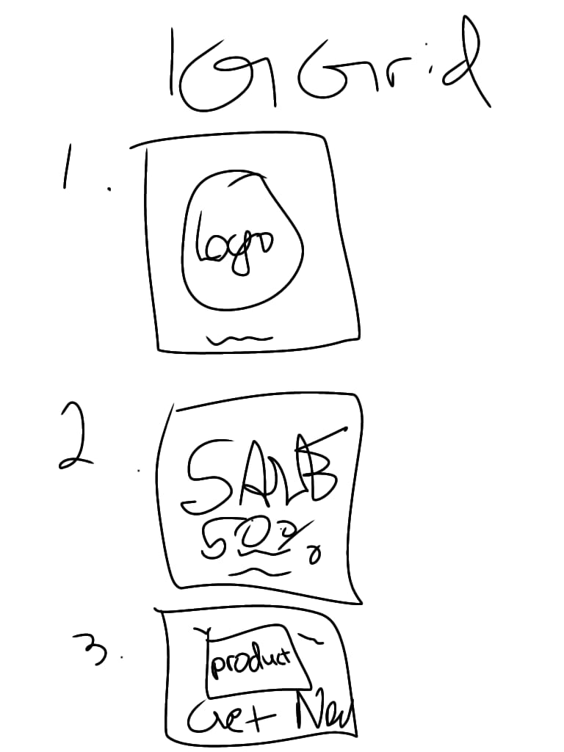
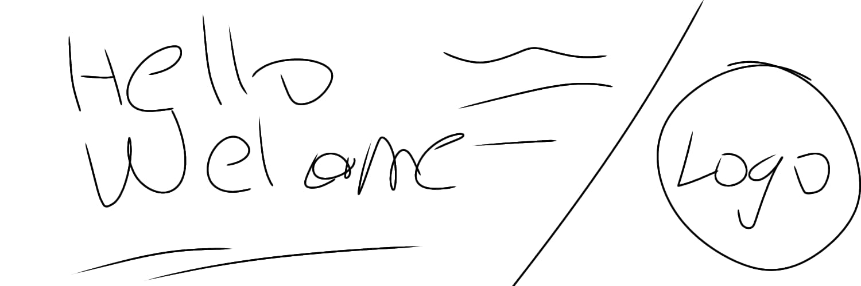

Slide 14
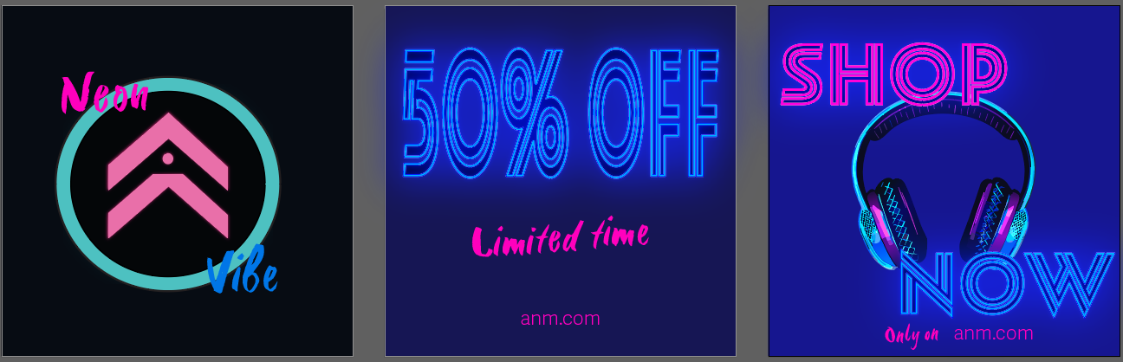
Final Artwork (Social Media)
Images of your social media branding FA

Slide 15
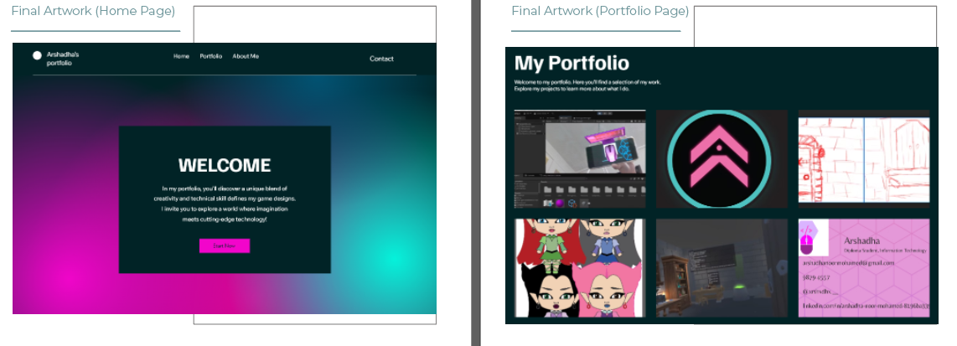
Final Artwork (Portfolio Web pages)
Images of your Portfolio web pages FA (Home page, Portfolio)

Slide 16
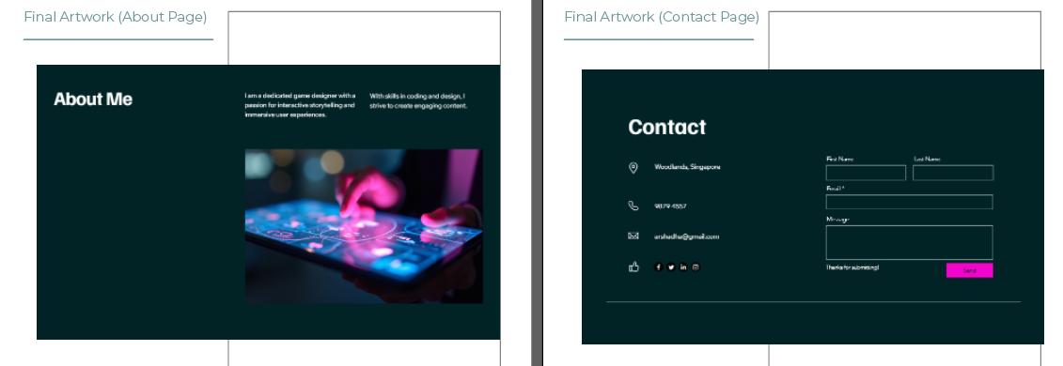
Final Artwork (Portfolio Web pages)
Images of your Portfolio web pages FA (About, Contact)

Slide 17
Conclusion (Reflections, Challenges)
This assignment helped me explore how branding, color theory, and AI tools come together to build a unique digital identity. I struggled with designing original assets and using Illustrator efficiently, but AI tools helped speed up the process. I’m proud of how the neon theme came together, and I plan to continue refining my design and coding skills for future projects.

