Slide 1
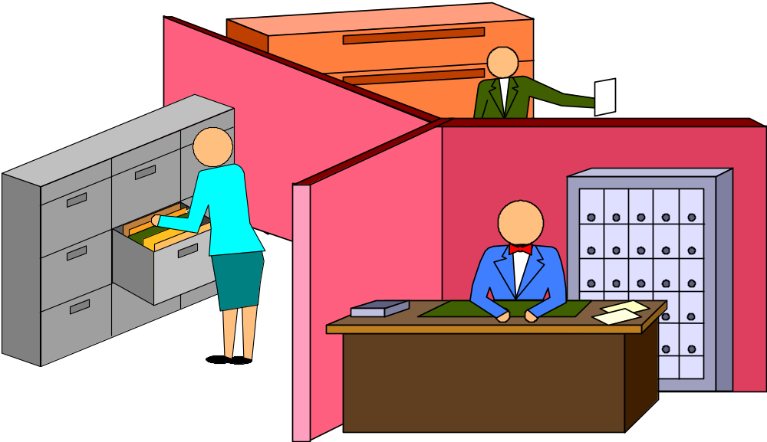
COMMUNICATION BARRIERS IN ORGANIZATIONS
Lecture 10a

Slide 2
GENERAL BARRIERS TO COMMUNICATION
    1. LOSS OR DISTORTION OF
    INFORMATION (SERIAL)
2. FAILURE TO CONSULT
    3. TASK SPECIALIZATION
    4. STATUS, POWER AND
    AUTHORITY DIFFERENCES
5. GEOGRAPHIC FACTORS
Fisher Ch. 3

Slide 3
GENERAL BARRIERS TO COMMUNICATION: STRUCTURAL
    1. LOSS OR DISTORTION OF INFORMATION (SERIAL COMMUNICATION)
      MANY STEPS - UP AND DOWN THE HIERARCHY IN MACHINE AND DIVISONALIZED BUREAUCRACIES

Slide 4
LOSS OF INFORMATION DOWN THE HIERARCHY
ORIGINAL MESSAGE 100%
BOARD OF GOVERNORS
63%
Vice President
56%
General Manager
40%
Plant Manager
30%
Supervisor
20%
Worker

Slide 5
GENERAL BARRIERS TO COMMUNICATION: STRUCTURAL
    2. TASK SPECIALIZATION (PSYCHOLOGICAL SEPARATION)
    D.O.L. FOR EFFICIENCY - BY FUNCTION, BY TASK- IN MACHINE AND DIVISIONALIZED BUT CERTAINLY IN PROFESSIONAL BUREAUCRACIES
    3. STATUS, POWER AND AUTHORITY DIFFERENCES (SOCIAL SEPARATION)
    ALL FORMS OF BUREAUCRACY (EXCEPT ADHOCRACY) - HIERARCHY, DELEGATION OF AUTHORITY
    4. GEOGRAPHIC FACTORS (PHYSICAL
    SEPARATION) IN LARGE MACHINE AND
    DIVISONALIZED BUREAUCRACIES

Slide 6
ORGANIZATIONAL BARRIERS TO COMMUNICATION FLOW
BY DIRECTION OF FLOW
1. VERTICAL
2. HORIZONTAL

Slide 7
BARRIERS TO DOWNWARD COMMUNICATION
1.ONE-WAY COMMUNICATION
  NO FEEDBACK
2.DIFFERENCES IN VALUES AND PERCEPTIONS
3.MISTRUST
4.PSYCHIC CONFLICTS OF LEADERSHIP

Slide 8
DISAGREEMENTS ABOUT UPWARD COMMUNCATION
WORKERS SAY ABOUT FOREMEN SAY THE FORMEN ABOUT THEMSELVES

Slide 9
DISAGREEMENTS ABOUT UPWARD COMMUNCATION
WORKERS SAY ABOUT FOREMEN SAY THE FORMEN ABOUT THEMSELVES
ALWAYS GETS 16% 73%
SUB’S. IDEAS
UNDERSTANDS WELL
SUB’S. PROBLEMS 34% 95%

