Slide 1
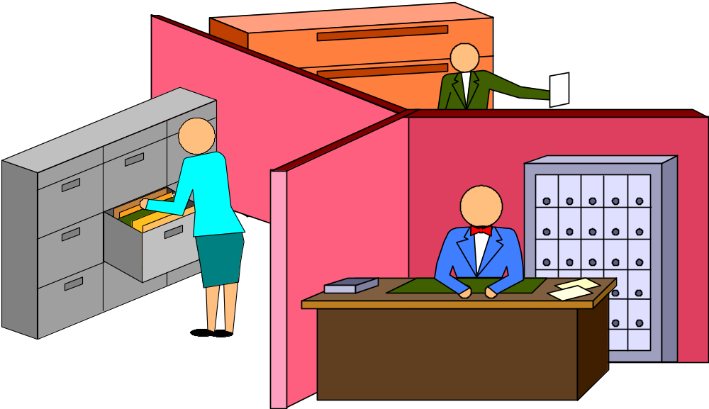
COMMUNICATION BARRIERS IN ORGANIZATIONS
Lecture 10b

Slide 2
BARRRIERS TO UPWARD COMMUNICATION
1. ATTITUDES OF SUBORDINATES
WITHOLD INFO - POWER
PROMOTION MEANS HIDE PROBLEMS
MISTRUST OF BOSS
2. ATTITUDES AND ACTIONS OF THE SUPERIOR
OPEN VS. DEFENSIVE
ASSUMED KNOWLEDGE OF SUB.’S
3. CHARACTERISTICS OF THE ORGANIZATION
LEVELS OF HIERARCHY
PHYSICAL DISTANCE
M.U.M. NORMS

Slide 3
BARRIERS TO LATERAL COMMUNICATION
INCREASED SPECIALIZATION
LACK OF MANAGEMENT RECOGNITION AND REWARD
SUPPRESSION OF DIFFERENCES-FEAR OF OPEN CONFLICT

Slide 4
GENERAL BARRIERS TO COMMUNICATION: PERSONAL
AS IF STRUCTURALLY BASED BARRIERS WEREN’T ENOUGH:
PERCEPTUAL SELECTIVITY
GOOD-BAD EVALUATION (ALLNESS THINKING, INFERENCE LADDER)
IMPLICIT ASSUMPTIONS (UNAWARE BELIEFS)
POOR LISTENING
LACK OF FEEDBACK

Slide 5
CULTURAL BARRIERS TO COMMMUNICATION IN ORGANIZATIONS
COMMUNICATION IN
ORGANIZATIONS

Slide 6
CULTURE: SCHEIN’S DEFINITION
BASIC ASSUMPTIONS AND BELIEFS, THAT
OPERATE UNCONSIOUSLY, AND ARE
AN ORGANIZATION’S ‘TAKEN-FOR-GRANTED’ VIEW OF ITSELF AND ITS ENVIRONMENT

Slide 7
ORGANIZATIONAL CULTURE
IT IS THE SUM TOTAL OF THE GROUP’S WAYS OF THINKING, FEELING AND ACTING
INCLUDES PHYSICAL MANIFESTATIONS,
CLOTHING, POLICIES, TECHNIQUES,
OFFICE SET-UP

Slide 8
ORGANIZATIONAL CULTURE:
A REMINDER
YOU ACQUIRE ORGANIZATIONAL CULTURE THROUGH LEARNING:
1. VALUES
2. NORMS
3. ROLES

