Slide 1
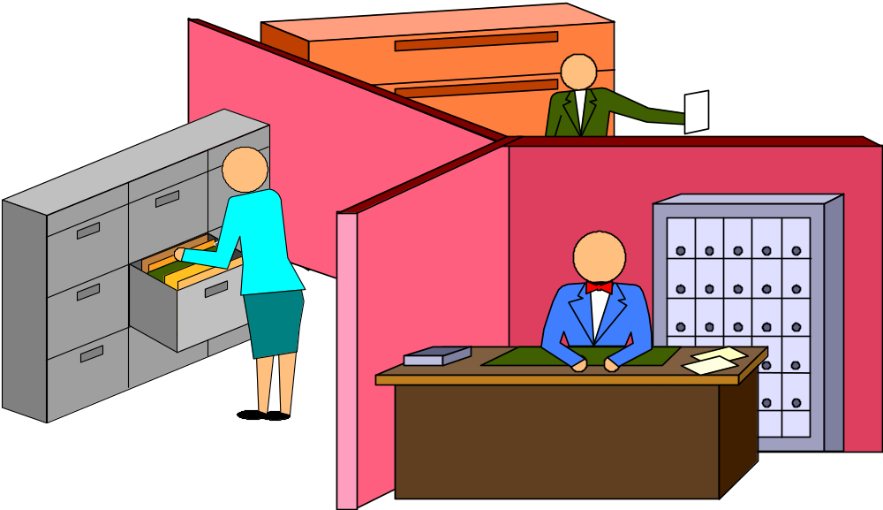
COMMUNICATION BARRIERS IN ORGANIZATIONS
Lecture 10c

Slide 2
ORGANIZATIONAL SUBCULTURES
WHILE PERVASIVE CULTURES MAY EXIST ORGANIZATION-WIDE, HIGHLY DIVERSE SUB-CULTURES MAY EXIST AS WELL
A GROUP OF ANY SIZE MAY DEVELOP ITS OWN UNIQUE CULTURE

Slide 3
ORGANIZATIONAL SUBCULTURES: BARRIERS TO COMMUNICATION
DIVERSE SUB-CULTURES MEAN DIFFERENCES IN MEANING OF COMMON GOALS, VALUES, NORMS
DIFFERENCES CAN BE BARRIERS

Slide 4
GENDER-BASED ORGANIZATIONAL SUB-CULTURES
THE ASSUMPTION: WOMEN AND MEN IN CONVERSATION SPEAK THE SAME “LANGUAGE” WITH THE SAME INTENTIONS AND SAME MEANINGS
THIS UNCONSCIOUS ASSUMPTION CREATES A MISTAKEN “TAKEN-FOR GRANTED” VIEW OF THE WORLD
RESEARCH BY SOCIO-LINGUISTS SAYS THE ASSUMPTION OF SAMENESS IS WRONG. GENERALLY, MEN AND WOMEN OPERATE IN TWO DIFFERENT SUB-CULTURES

Slide 5
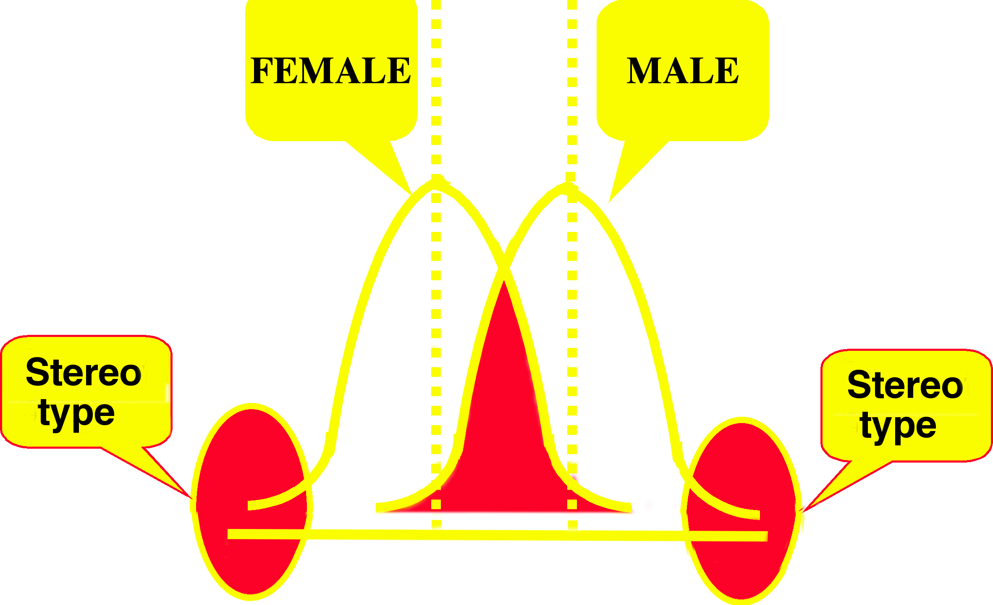
GENDERED TALK
IN THE SOCIAL SCIENCES WE DISCUSS CENTRAL TENDENCIES IN DATA

Slide 6

TWO VIEWS OF THE WORLD
MEN SPEAK TO DISCOVER WHO IS IN CHARGE - HIGH VS. LOWS - COMPETITION
WOMEN SPEAK TO DISCOVER WHO IS CONNECTED - CLOSE VS. FAR - CONNECTION
MEN
WOMEN

Slide 7
GENDER-RELATED BARRIERS TO EFFECTIVE COMMUNICATION
WOMEN SPEAK:
TO ESTABLISH THEIR CONNECTION TO EACH OTHER (COOPERATE TO MAINTAIN IT)
TO NEGOTIATE INTIMACY
USING ‘RAPPORT TALK’
THEIR “TAKEN-FOR-GRANTED” WORLD IS BASED ON CLOSENESS AND DISTANCE

Slide 8
GENDER-RELATED BARRIERS TO EFFECTIVE COMMUNICATION
MEN SPEAK:
TO ESTABLISH AUTONOMY RELATIVE TO EACH OTHER (COMPETE TO MAINTAIN IT)
TO NEGOTIATE STATUS
USING ‘REPORT TALK’
THEIR “TAKEN FOR GRANTED” WORLD IS ONE OF HIERARCHY AND CONTROL

Slide 9
CHARACTERISTICS
MEN RESIST BEING “ONE DOWN”:
LESS LIKELY TO ASK QUESTIONS WHEN THEY DON’T KNOW SOMETHING
COMPETE IN CONVERSATIONS
GIVE ANSWERS RATHER THAN LISTEN
DEBATE RATHER THAN DISCUSS
EXPECT TO BE ATTACKED AND ATTACK OTHERS
“FIGHT IT OUT” THEN “DROP IT” AND MOVE ON
RITUAL COMBAT IS SEEN AS NATURAL

Slide 10
AND WHAT IF YOU CAN PLAY THE GAME?
www.cbsnews.com
Put these names into the search box on the site.
Carly Fiorina
Patricia Hurd

Slide 11
Bell Canada Example
The first female senior executives at the satellite TV delivery service surpassed the performance of their male predecessors, posting better results and earning shares and praise, respectively, from Bell Canada's top boss, Michael Sabia, the two say in sworn court documents.
In documents filed in a civil lawsuit alleging gender discrimination in the workplace by their former employers, the women say they had to put up with a macho corporate culture that included sexist, vulgar language and being frozen out of drinking sessions with the "boys' club.”
Not long after refusing to fully participate in a “war themed” retreat, the two women, separately, earned the dubious distinction of being the company's first two female VPs to be fired.
In their court submissions, the women say Smith met with male colleagues at local pubs and bars, or in his office, but excluded the women. Bell, in response, says Smith met with individuals on a one-on-one basis to foster an "open dialogue."

Slide 12
Bell Canada Example
Under Smith, executive meetings were run "in a sexist fashion" where men monopolized the conversation, the women say in their court submissions. Male executives were permitted to make "vulgar, sexist and demeaning comments" without consequences.
Bell denies there was any gender discrimination in the workplace.
But,
In 2006, Bell settled a long-running pay equity dispute with a $104 million payment to thousands of telephone operators who had been earning up to $4 an hour less than workers in comparable male-dominated jobs.

