Slide 1
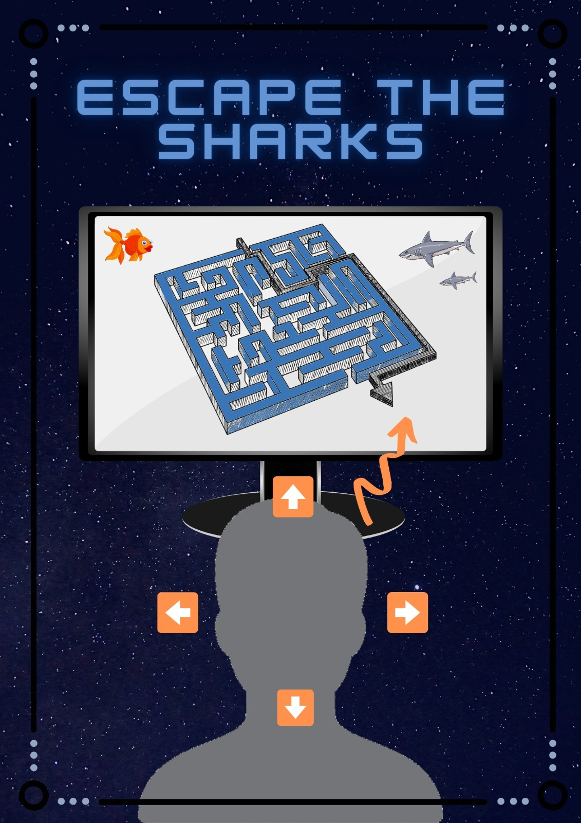
How it works
Our game is about trying to collect all the 'food' inside the game without being caught by the two sharks who swim around in the maze with the search strategy of Greedy search. We made use of the library 'OpenCV', which we call in the logic_class. By moving your nose outside of the center in the direction that you want to go in, the player will move that direction.
The logic class contains three kinds of functions; intro-, player- and game over functions. The definition run keeps track of these states. For example, once the player enters the game, the intro will be shown up until the space bar is pressed, then the game state will change. However, once the player loses the game, the game over screen will be shown with the option to quit or play the game again.

Slide 2
LOGIC_CLASS
Def. run
Keeps track of states
Def. get_nose
Initializes OpenCV
Player.move
Def. load
Loads background
Loads maze
Intro function –
Def. events
Space -> state = playing
Def. update
Def. draw
Player function –
Def. events
Callcv
Navigation player
Def. update
Player.update
Enemies.update
Lives.update -> if lives = 0 then state = game over
Def. draw
Foods.draw
Text.draw
Enemies.draw
Def. draw_foods
Game over function –
Def. events
reset
Def. update
Def. draw
Text.draw
MAIN
Logic.run
Walls.txt
GRID_ELEMENT
DETECTION_CLASS
Def. detect_nose
Def. keyboard_events
PLAYER_CLASS
Def. update
Def. draw
ENEMY_CLASS
Def. update
Use Greedy search to find target
Def. draw
Crab.png
Shark.png

