Slide 1
ENCS5325
Smart-Home IoT Network Design and Performance Evaluation Using OMNeT++
12-node smart-home baseline • 5 experiments • multi-seed quantitative evaluation
Experimental study • IEEE 802.15.4 • OMNeT++ 6.3.0 • INET 4.6.0
Wireless Sensor Networks and Internet of Things
Birzeit University • Summer 2026
By Nooreen AbuHmoud 1222470

Slide 2
Project Goal & Required Scenario
What we built and what the project evaluates
Build a smart-home IoT network and quantify how load, reporting interval, packet size, traffic type, and application strategy affect performance.
Use a constrained IEEE 802.15.4 access network with a gateway/border-router role and an IP/core monitoring application.
Support both periodic monitoring traffic and event-driven / critical traffic.
Evaluate latency, reliability (PDR/loss), throughput, energy, and cross-layer fragmentation effects.
12+
2
baseline smart-home devices
mandatory traffic classes
5
5
independent seeds per key point
evaluation studies
Engineering question
How far can the network scale while preserving timely and reliable delivery — and what does that cost in traffic and energy?

Slide 3
System Architecture & Simulation Boundary
Same topology is reused across the controlled experiments
IEEE 802.15.4
IP forwarding
Smart-Home Devices
Sensors + Actuators
IoT Gateway
IEEE 802.15.4 ↔ IP
PPP / IP Core
Monitoring Server
Application
Implemented end-to-end stack
6LoWPAN scope
Application
UdpBasicApp / UdpEchoApp / UdpSink
The simulator does NOT claim a full IPv6/6LoWPAN adaptation layer. Packet-size results come from the current IPv4/UDP INET model; RFC 4944/6282 are used separately for analytical fragmentation and airtime estimates.
Transport
UDP
Network
IPv4
Access
IEEE 802.15.4 narrowband
SIMULATED: IPv4 / UDP
ANALYTICAL: 6LoWPAN

Slide 4
Experimental Design
Controlled sweeps, common baseline, and multi-seed statistics
Study | Sweep / comparison | Duration | Key outputs
Exp. 1 | N = 5, 10, 20, 30, 40 | 100 s | PDR, delay, throughput, energy
Exp. 2 | T = 1, 5, 10, 30, 60 s | 600 s | PDR, delay, total energy
Exp. 3 | 5 background-load levels | 100 s | critical delay, loss, max delay
Exp. 4 | RR vs PUB at T = 1…60 s | 600 s | delivery, latency, packet cost
Packet size | 20…500 B simulated; 20…400 B required analytically | 600 s | PDR, delay, energy, fragments
Study
Sweep / comparison
Duration
Key outputs
5
50 B
10 s
100 ms
250 kbps
independent repetitions
baseline application payload
baseline reporting interval
critical-event target
802.15.4 airtime basis

Slide 5
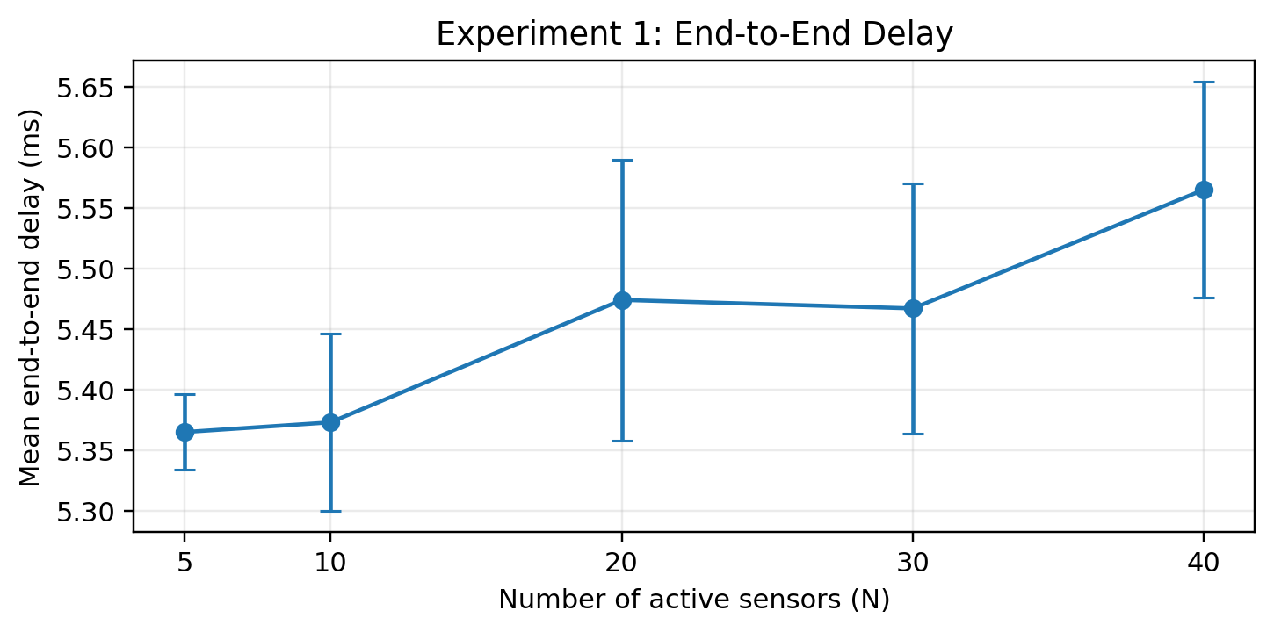
Experiment 1 — Network Scalability
Increasing the number of active periodic sensors from 5 to 40
100%
0%
PDR at every N
packet loss
5.37→5.57
200→1600
ms mean delay
bps throughput
Result
No significant congestion/contention was observed up to N = 40 under the baseline workload. Reliability stayed perfect while delay rose only slightly.
Scalable under the tested baseline load

Slide 6
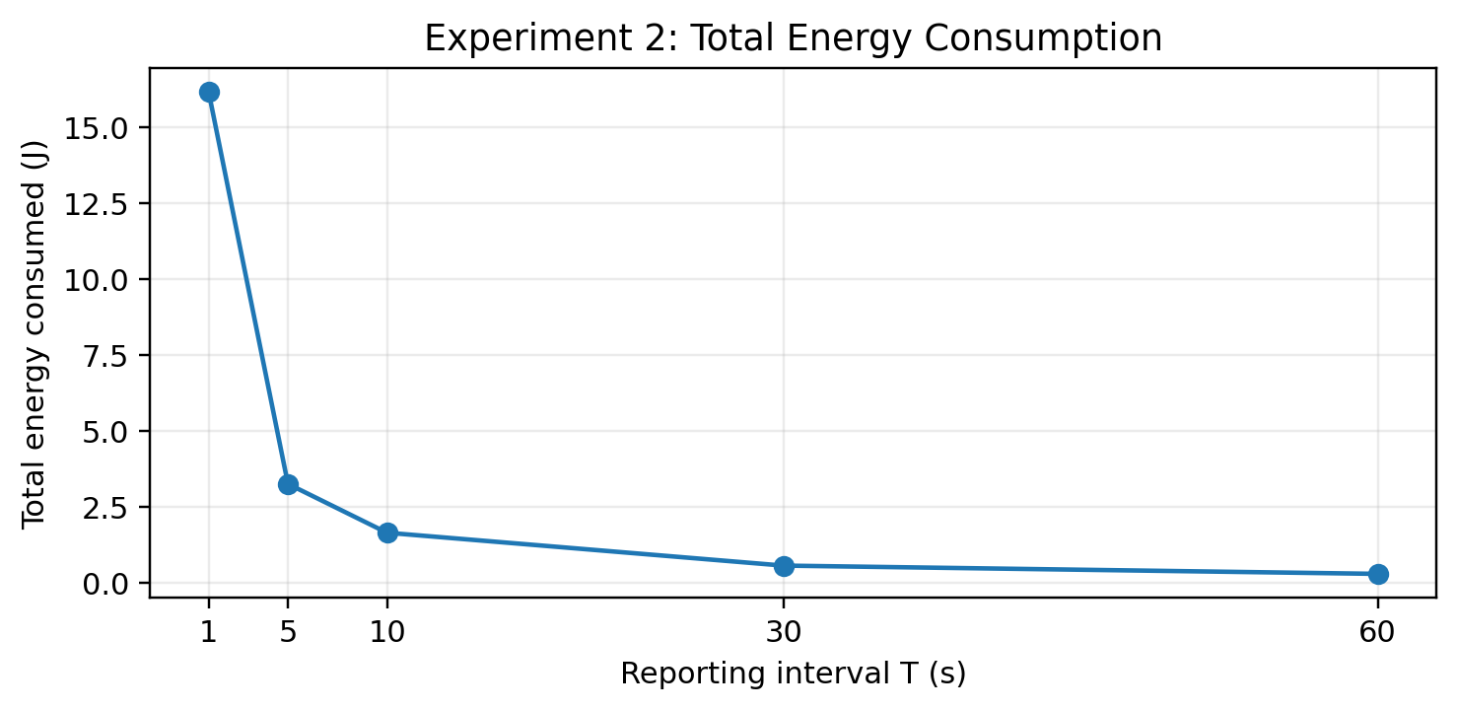
Experiment 2 — Reporting Interval vs Energy
Shorter reporting improves freshness, but dramatically raises network/battery cost
16.15 J
0.31 J
T = 1 s
T = 60 s
98.1%
≈5.4 ms
energy reduction
delay for T ≥ 5 s
Trade-off
T = 10–30 s gives a practical balance: much lower total energy with essentially perfect delivery and low delay, at the cost of less frequent updates.

Slide 7
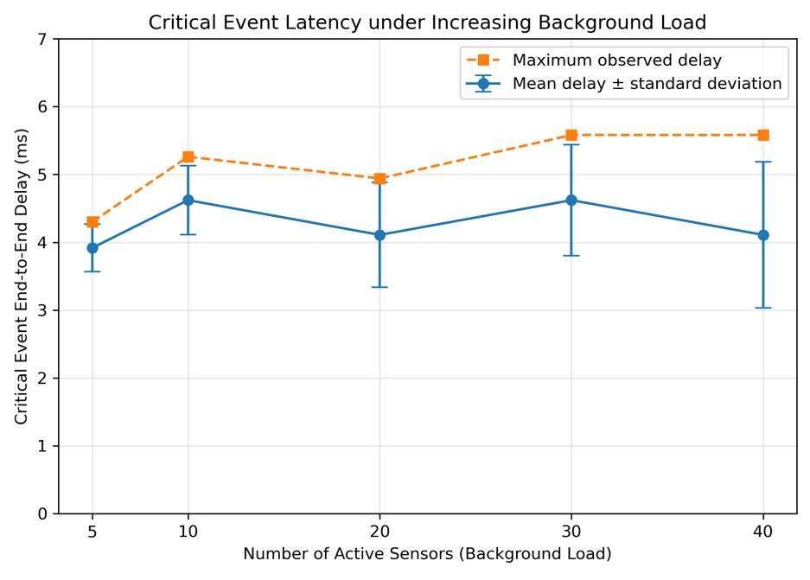
Experiment 3 — Critical Event Under Background Traffic
A 20 B smoke alarm is injected while ordinary sensors continue periodic reporting
100%
0%
critical delivery
critical loss
5.58 ms
100 ms
worst observed delay
engineering target
Result
All 25 critical-event runs satisfied the latency target by a large margin. Higher load mainly increased run-to-run variation rather than mean delay.

Slide 8
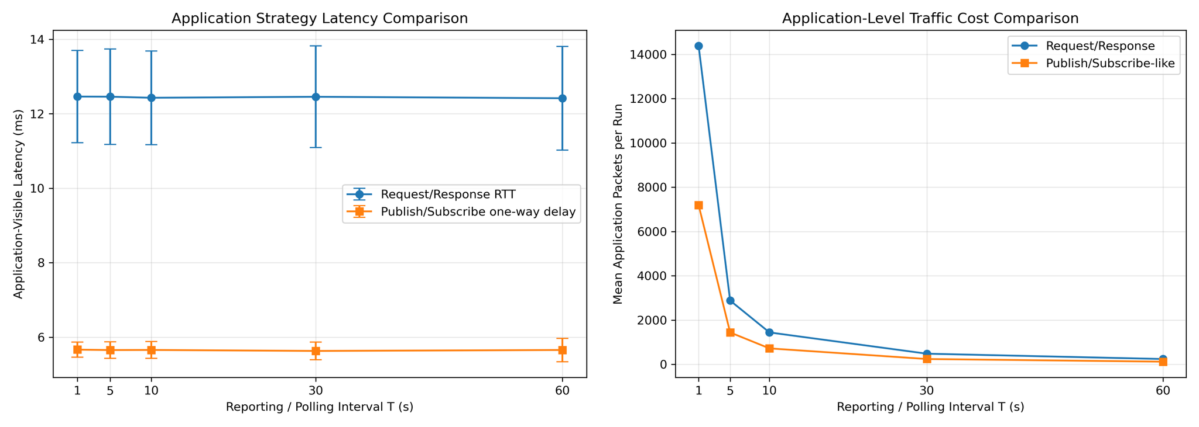
Experiment 4 — Request/Response vs Publish/Subscribe
Same topology and intervals; different application communication strategies
≈12.4 ms
≈5.65 ms
RR round-trip latency
PUB one-way delay
2×
100%
RR app packets
PUB delivery
Interpretation
The latency numbers are not a direct 2:1 speed comparison: RR measures round trip, while PUB measures one-way delay. The clear efficiency gain is traffic cost: publication uses 50% fewer application packets.
Lower forwarding load with publication

Slide 9
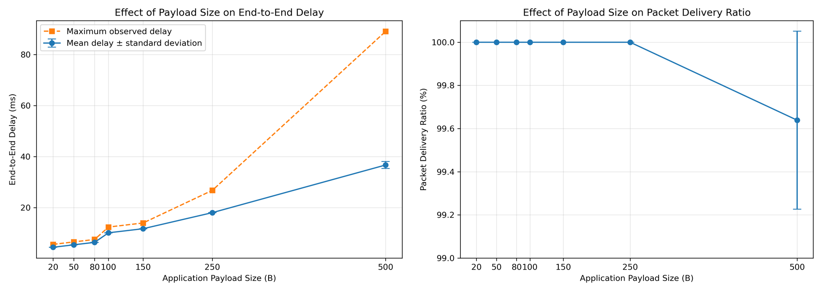
Cross-Layer Packet Size / 6LoWPAN Study
Simulator-derived packet-size trends + separate RFC-based fragmentation analysis
Analytical fragment estimate (required payloads)
Payload | Fragments | Min airtime
20 B | 1 | 2.59 ms
50 B | 1 | 3.55 ms
100 B | 2 | 6.94 ms
200 B | 3 | 11.81 ms
400 B | 6 | 23.20 ms
Simulated trend
Cross-layer meaning
Mean delay rises from 4.44 ms (20 B) to 36.69 ms (500 B); PDR stays 100% through 250 B and falls to 99.639% at 500 B.
More fragments mean more airtime, more energy, and more exposure to retransmissions. FRAG1/FRAGN counts are analytical approximations — not simulator traces.

Slide 10
Key Findings
What the experiments say about this smart-home network
Scalability
Energy / freshness
Baseline periodic traffic scaled to 40 active sensors with 100% PDR and only a small delay increase.
Increasing reporting interval from 1 s to 60 s reduced total energy by ~98.1%.
Critical traffic
Application strategy
Every smoke alarm met the <100 ms target; worst observed delay was ~5.58 ms.
Publish/subscribe-like traffic used half the application packets of request/response polling.
Packet size
Engineering takeaway
Large payloads increase latency and energy; fragmentation explains why constrained links become increasingly expensive.
Traffic policy and payload design matter before raw link capacity becomes the dominant limitation.

Slide 11
Limitations & Reproducibility
What the results do — and do not — prove
Limitations
Reproducibility
The simulated end-to-end stack is IPv4/UDP; full IPv6/6LoWPAN adaptation behavior was not simulated.
Topology uses one constrained wireless access hop before the wired PPP core.
Energy values depend on the chosen INET energy model and configured radio behavior.
Five repetitions quantify variability but do not exhaust all placement / interference conditions.
OMNeT++ 6.3.0 + INET 4.6.0.
Five independent repetitions using seed-set = ${repetition}.
Processed CSVs generated from OMNeT++ scalar/statistical outputs with opp_scavetool.
Saved configuration sets and Python aggregation/plotting scripts reproduce the tables and figures.
Evidence boundary
Simulator-derived evidence and analytical 6LoWPAN estimates are explicitly labeled separately throughout the project.

Slide 12
Conclusion
The tested smart-home network remained highly reliable and low-latency under the required sweeps, while energy cost, application strategy, and payload fragmentation emerged as the main design trade-offs.
Best design lessons
Use longer reporting intervals when freshness requirements allow it.
Prefer publish/subscribe-like updates for regular sensor reporting to reduce traffic overhead.
Keep constrained-link payloads small enough to avoid fragmentation where practical.
Questions?
Thank you
Sources: ENCS5325 project specification; INET / OMNeT++ documentation; RFC 4944; RFC 6282.

