Slide 1

Tourism Data Analysis
By:
Nour Emil

Slide 2
Objective
The main goal of this project is to analyze a large, dirty tourism dataset to uncover insights about tourist behavior, demographics, and preferences. The project also aims to help the country in encouraging tourism by identifying key patterns and trends that can inform strategic decisions in tourism promotion, targeted marketing, and service improvements. This will involve data cleaning, visualization, and interactive dashboard creation using various tools.

Slide 3
Data Cleaning and Exploration in Python
Import data into Python using pandas
Clean the data (dealing with nulls, transforming data types, standardizing dates, country names, feedback and purpose of visit, and trimming white spaces)
Add columns for clarity and ease of access for Tourist ID and Age group
Creating charts to explore the data using matplotlib and seaborn (Bar charts, Pie charts, Heatmaps, and Line charts)
Export the cleaned data to a .csv file

Slide 4
Excel
Import the data into Excel
Clean and adjust the data in Power Query
Add Pivot Tables to provide insights on the data
Add charts to represent the Pivot Tables to be more visually appealing

Slide 5
Data Visualization in Power BI (Dashboard)
Create an interactive dashboard in Power BI using clear charts to simplify the concepts and drive data-backed decision-making.
Use different charts like bar charts, line charts, and pie charts.
Use slicers for easy access to data.
Add cards to get important insights at a glance.

Slide 6
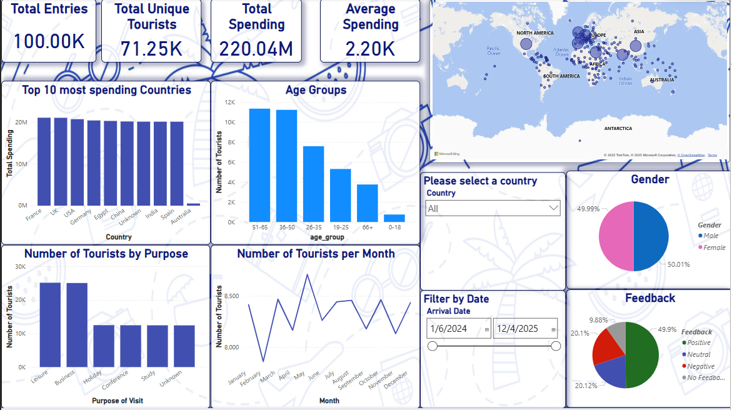
My Dashboard

Slide 7
Recommendations Based on the Data
Focus on marketing to middle-aged men and women because they are the largest majority of visitors.
Focus on marketing for Visitors with purposes of business and leisure as that’s the absolute majority of visitor purposes.
Focus on May visitors as most people travel during May.
Focus on neutral marketing to both genders as the male and female visitors are split 50/50.
Its important to note that conference and study visitors spend more on average than other purposes.
The countries with most visitors are France, UK, USA, Germany, Egypt, China, India, and Spain (they represent more than 80% of all visitors)

Slide 8
Notes
It’s important to note that conference and study visitors spend more on average than on other purposes.
The countries with the most visitors are France, the UK, the USA, Germany, Egypt, China, India, and Spain (they represent more than 80% of all visitors).
In the future, we should focus on the surveying quality of the visitors to get more accurate data, as the data seems to have a lot of empty values and bad entries.

Slide 9
Thank You
for your time

