Slide 1
COMPUTER CONCEPT- CILMIGA COMPUTERKA
CONTENTS:
1.Computers And Digital Basics.
2.Computer Hardware.
3.Computer Software.
4.Operating System And File Management
5.Lans And Wlans.
6.The Internet.
7.The web and E-mail.
8.Digital Media.
9.The Computer Industry.
10.Information System analysis and design.
11.Database.
12.Computer Programming.

Slide 2
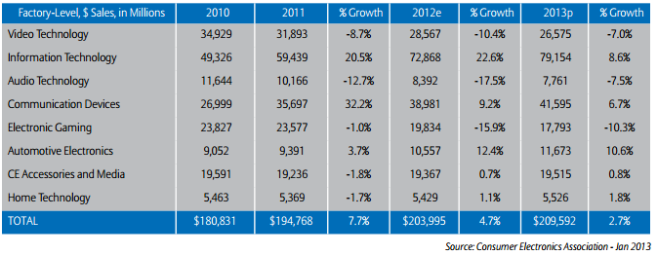
1.Computers and Digital Basics
Chapter one.
1.1. What is digital revolution?
Continuous or on going process of the daily life of the humans comprising social, political and economic changes brought about by digital technology:-
1.Computers
2.Internet

Slide 3
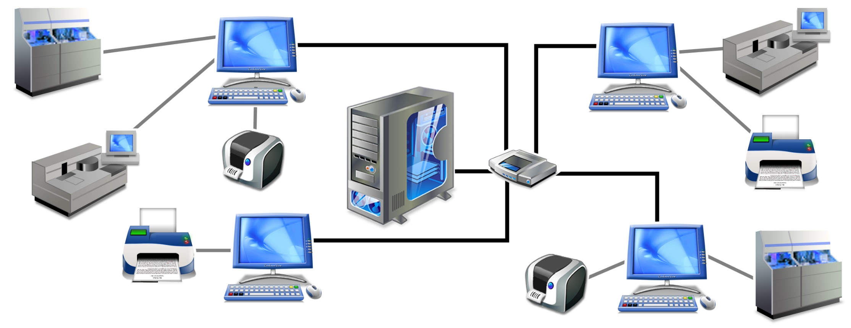
1.2 What is a computer network?
A computer network is a set of computers connected together for the purpose of sharing resources. The most common resource shared today is connection to the Internet. Other shared resources can include a printer or a file server
Computer 2
Computer 3
Server
Router
Printer
Printer
Computer 1
Computer 4

Slide 4
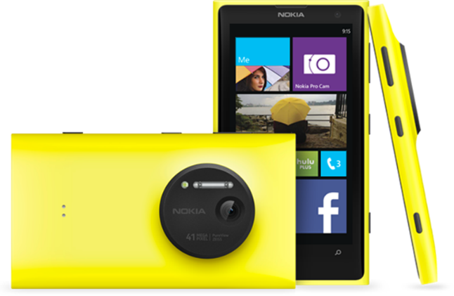
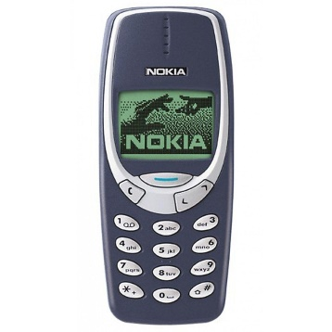
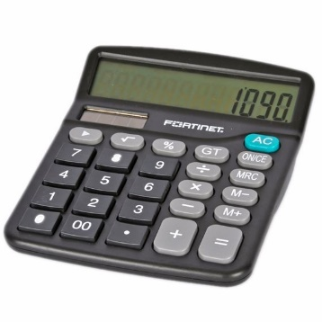
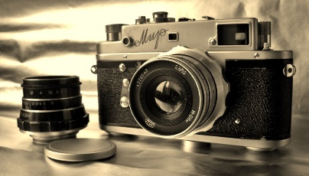
1.3.What about the web?
Short for World Wide Web is a collection of linked documents, graphics and sounds that can be accessed over the internet.
1.4. What is a convergence?
A process by which several technologies with distinct functionalities evolve to form a single product.
+
+
=

Slide 5
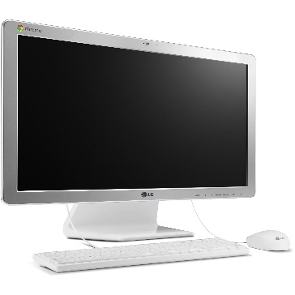
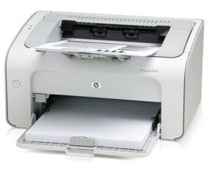
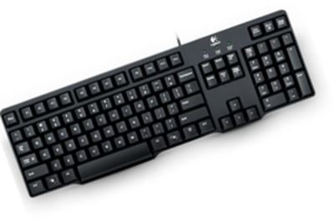
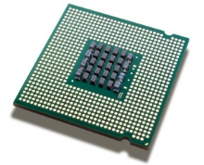
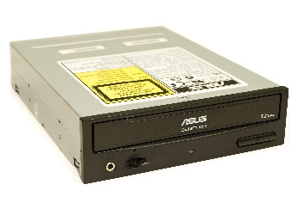
1.5.What is Computer?
Is a multipurpose device that accepts input, process data, stores data and produces output, all according to a series of stored instructions.
Computers produce output on devices such as screens and printers
Input is whatever typed, submitted or transmitted to a computer system.
Output is the result produced by a computer.
Data refers to the symbols that represent facts, objects, and ideas.
A computer accepts input from an input device such as keyboard, mouse, scanner or digital camera
The manipulation of the data by the computers is called Processing.
A computer uses disks CDs, DVDs and flash drives to permanently store data.
Data is processed in the CPU according to the instructions that have been loaded into the computer’s memory.

Slide 6
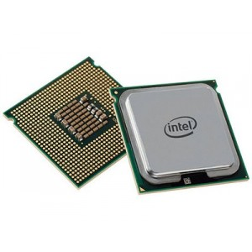
1.6. Central Processing Unit (CPU)
The most processing in a computer takes place in a component called the Central Processing Unit (CPU).
The CPU of the most modern computers is a microprocessor, which is an electronic component that can be programmed to perform tasks based on data it receives.
1.7 How do computers store data?
A file is a named collection of data that exists on a storage medium such as hard disk, floppy disk, CD, DVD or flash drive.
A computer stores data so that it will be available for processing.
Memory is an area of a computer that temporarily holds data waiting to be processed, stored, or output.
Storage is the area where data can be left on a permanent basis when it is not immediately needed for processing.

Slide 7
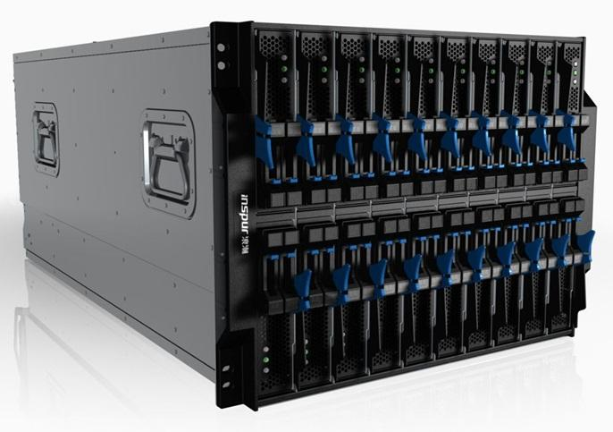
1.8 What is a computer Program?
A series of instructions that tells a computer how to carry out processing tasks.
These programs form the software that sets up a computer to do a specific task.
1.9 What type of software do computers run?
Application Software- Is a set of computer programs that helps a person carry out a task.
System Software- Is to help the computer system monitor itself in order to function efficiently.
2.0 What makes a computer a server?
Server can refer to computer hardware to a specific type of software, or a combination of hardware and software. It’s purpose is to serve computers on network by supplying them with data.

Slide 8
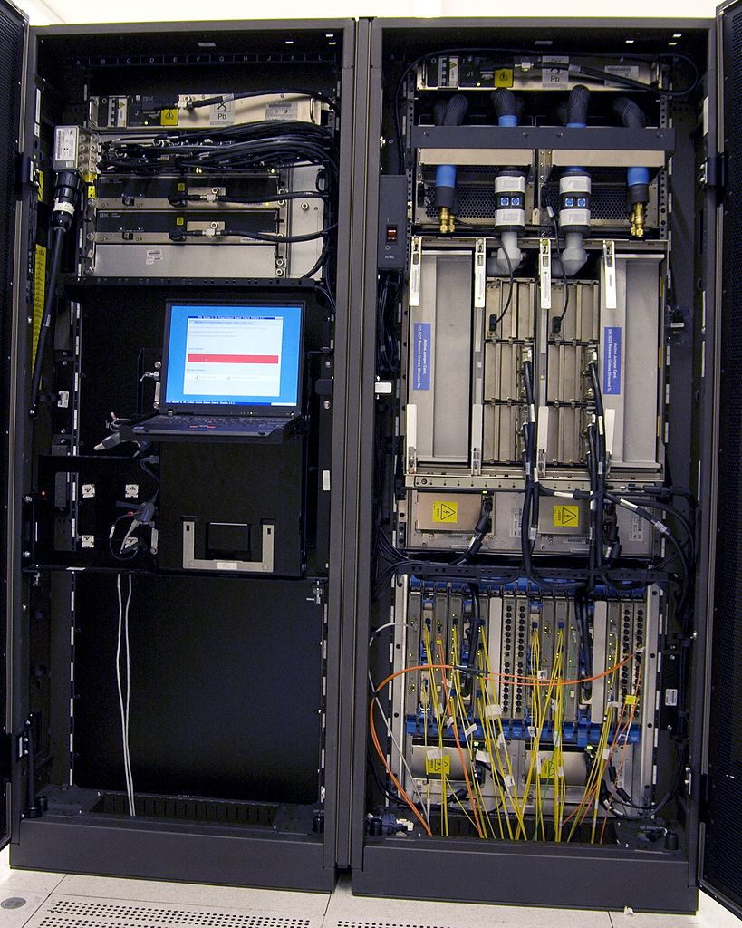
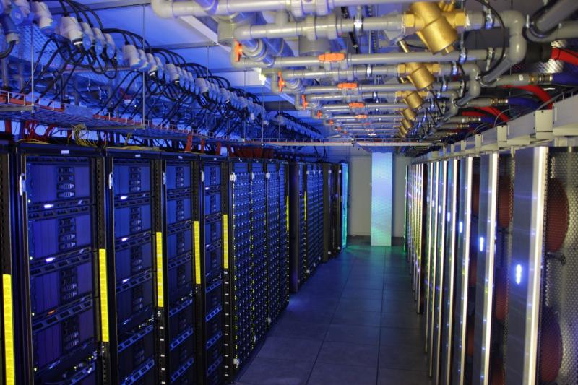
2.1 What is a mainframe and Super Computer?
A mainframe computer is a large and expensive computer capable of simultaneously processing data for hundreds or thousands of users.
Mainframe
A computer is considered supercomputer if it is, at the time of construction, one of the fastest computers in the world. They are used for a compute-intensive problems.
Supercomputer

Slide 9
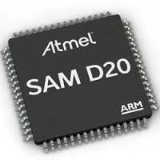
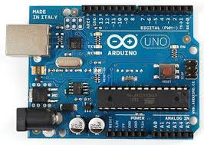
.20.2 MICROCONTROLLERS
Is a special-purpose microprocessor that is built into the machine it controls
It is sometimes called a computer-on-a-chip.

