Slide 1

What is Project Management?
A project is an interrelated set of activities that has a definite starting and ending point and that results in a unique product. (service)
Management is generally perceived as concerned with planning, organizing, and control of an ongoing process or activity.
Project management is concerned with control of an important activity for a relatively short period of time after which management effort ends.
Dr.Bokkasam Sasidhar

Slide 2
Process vs. Project Work
Process
Ongoing, day-to-day activities to produce goods and services
Use existing systems, properties, and capabilities
Typically repetitive
Project
Take place outside the normal, process-oriented world
Unique and separate from routine, process-driven work
Continually evolving
A project is a temporary endeavor undertaken to create a unique product or service.

Slide 3
Additional Definitions
A project is a unique venture with a beginning and an end, conducted by people to meet established goals within parameters of cost, schedule, and quality. Buchanan & Boddy 92
Projects are goal-oriented, involve the coordinated undertaking of interrelated activities, are of finite duration, and are all, to a degree unique. Frame 95

Slide 4
Project Definitions Summarized
A project can be considered any series of activities and tasks that have:
Specific objectives to be completed within certain specifications,
Defined start and end dates,
Funding limits,
Human and nonhuman resources, and
Multifunctional focus.

Slide 5
Characteristics of Project
A one-time focus
A specific purpose and a desired result
A start and a finish
A time frame for completion
A limited set of resources
A logical sequence of interdependent activities
A clear user(customer, client) of the result
Dr.Bokkasam Sasidhar

Slide 6
Elements of Project Planning
Define project objective(s)
Identify activities
Establish precedence relationships
Make time estimates
Determine project completion time
Compare project schedule objectives
Determine resource requirements to meet objective
Dr.Bokkasam Sasidhar

Slide 7
Project Success Rates
Software & hardware projects fail at a 65% rate,
Over half of all IT projects become runaways,
Only 30% of technology-based projects and programs are a success.
Only 2.5% of global businesses achieve 100% project success and over 50% of global business projects fail,
Average success of business-critical application development projects is 32%, and
Approximately 42% of the 1,200 Iraq reconstruction projects were eventually terminated due to mismanagement or shoddy construction

Slide 8
The Project Team
Project team typically consists of a group of individuals from various areas in an organization and often includes outside consultants.
Members of engineering staff often assigned to project work.
Project team may include workers.
Most important member of project team is the project manager.
Project manager is often under great pressure because of uncertainty inherent in project activities and possibility of failure. Potential rewards, however, can be substantial.
Project manager must be able to coordinate various skills of team members into a single focused effort.
Dr.Bokkasam Sasidhar

Slide 9
Project Manager Responsibilities
Selecting a team
Developing project objectives and a plan for execution
Performing risk management activities
Cost estimating and budgeting
Scheduling
Managing resources

Slide 10
Steps in Managing a Project
Steps in Managing a Project
Define the problem
Develop solution options
Plan the Project : what must be done ?, who will do it?, How will it be done ?
How much will it cost? ,what do we need to do?
Execute the plan
Monitor & Control Progress
Close Project
What was done well?
What should be improved?
Dr.Bokkasam Sasidhar

Slide 11
Project Life Cycles
Man Hours
Conceptualization
Planning
Execution
Termination
Project Life Cycle Stages

Slide 12
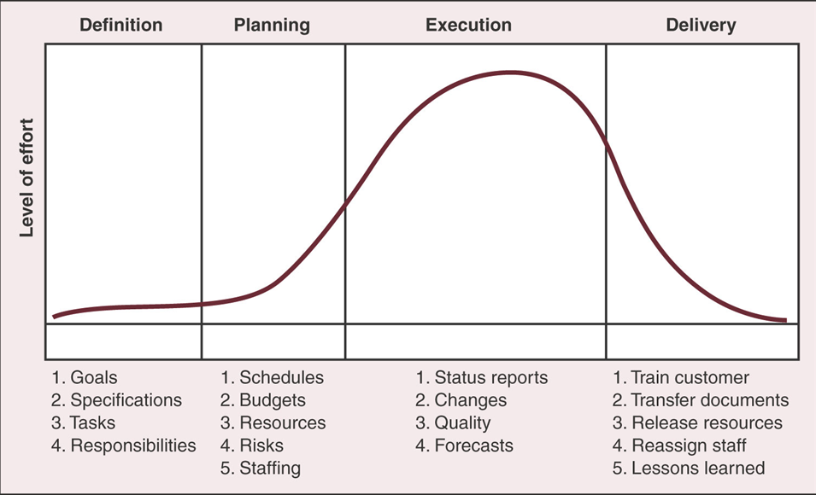
Project Life Cycle
Dr.Bokkasam Sasidhar

Slide 13
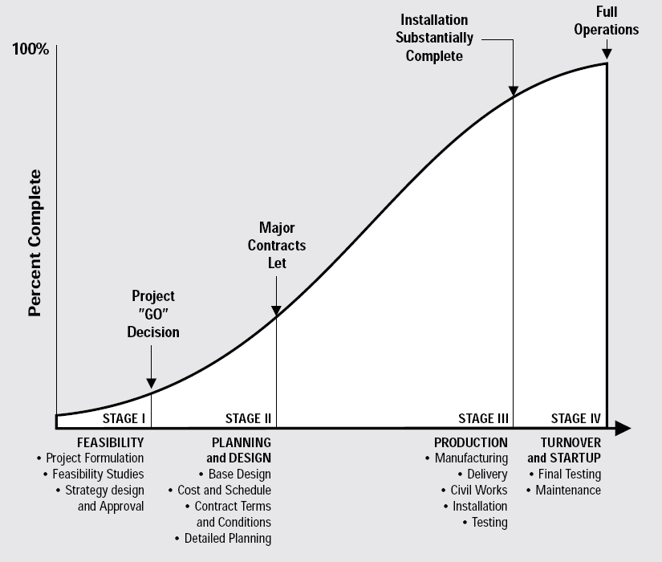
Project Life Cycle
Dr.Bokkasam Sasidhar

Slide 14
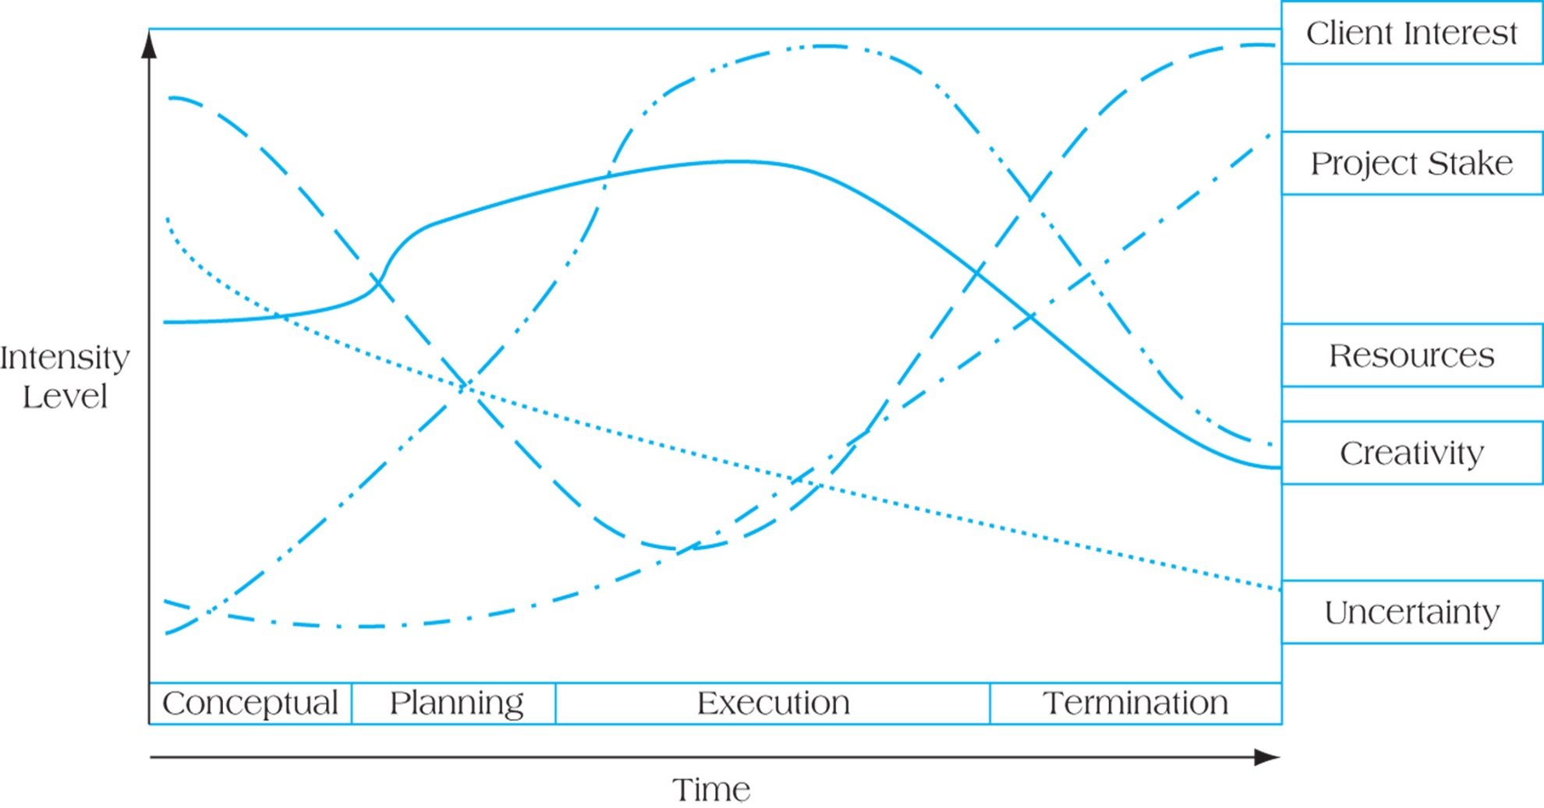
Project Life Cycles and Their Effects
Project Life Cycles and Their Effects

Slide 15
Elements of Project Management
Work Breakdown Structure (WBS)
WBS breaks down project into major components (modules).
Modules are further broken down into subcomponents, components, activities, and finally, into individual tasks.
Identifies activities, tasks, resource requirements and relationships between modules and activities.
Helps avoid duplication of effort.
Basis for project development, management , schedule resources and modifications.
Approaches for WBS development:
1. Top down process 2. Brainstorm entire project
Dr.Bokkasam Sasidhar

Slide 16
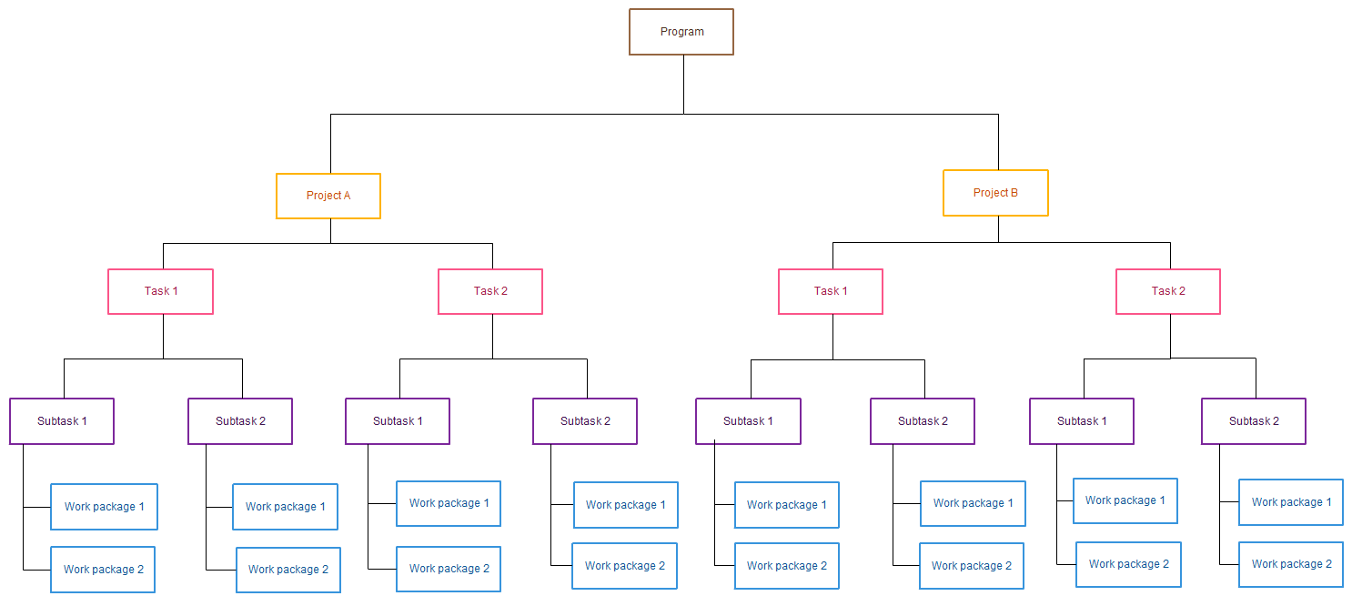
Work Breakdown Structure
Dr.Bokkasam Sasidhar

Slide 17
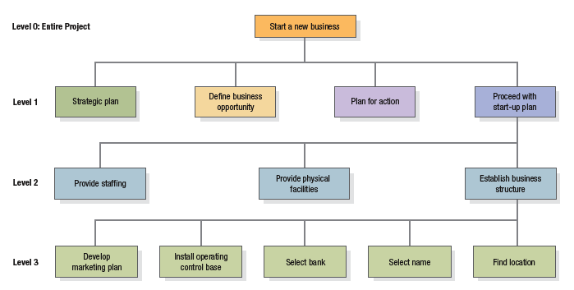
A Work Breakdown Structure (three levels)
for a new business

Slide 18
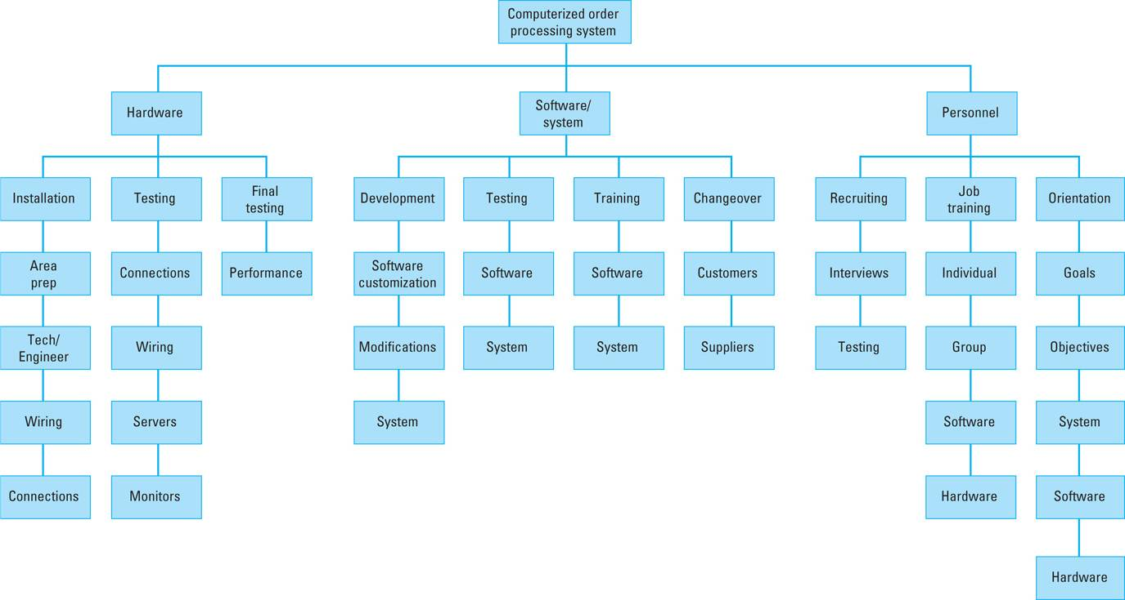
Elements of Project Management
Work Breakdown Structure
WBS for computerized order-processing system project

Slide 19
Elements of Project Management
Project Scheduling
Project schedule evolves from planning documents, with focus on timely completion.
Critical element in project management – source of most conflicts and problems.
Schedule development steps:
1. Define activities, 2. Sequence activities,
3. Estimate activity times, 4. Develop schedule.
Gantt chart and CPM/PERT techniques can be useful.
Computer software packages available, e.g. QM for Windows, Microsoft Project.
Dr.Bokkasam Sasidhar

Slide 20
Elements of Project Management
Gantt Chart
Popular, traditional technique, also known as a bar chart -developed by Henry Gantt (1914).
Direct precursor of CPM/PERT for monitoring work progress.
A visual display of project schedule showing activity start and finish times and where extra time is available.
Suitable for projects with few activities and precedence relationships.
Drawback: precedence relationships are not always discernible which limits chart’s use for smaller projects
Dr.Bokkasam Sasidhar

Slide 21
Gantt Chart
Visual scheduling tool
Graphical representation of information
Show dependencies between tasks, personnel, and other resources allocations
Track progress towards completion
Dr.Bokkasam Sasidhar

Slide 22
Building a Gantt Chart
List all tasks and milestones from the project along the vertical axis
List time frame along the horizontal axis
Activity 1
Activity 2
Milestone
Time Frame: day 1 day 2 day3
Dr.Bokkasam Sasidhar

Slide 23
Building a Gantt Chart
Activities: Create box the length of each activity time duration
  E.g., activity one is scheduled from day1-day3
Activity 1
Activity 2
Time Frame: day 1 day 2 day3
Dr.Bokkasam Sasidhar

Slide 24
Building a Gantt Chart
Dependencies: Show dependencies between activities with arrows
  E.g., activity 2 cannot start until activity 1 is complete
Activity 1
Activity 2
Time Frame: day 1 day 2 day3…
Dr.Bokkasam Sasidhar

Slide 25
Sequence of Activities of The Project -
House Building
Number | Activity | Predecessor | Duration
1 | Design house and obtain financing | -- | 3 months
2 | Lay foundation | 1 | 2 months
3 | Order and receive materials | 1 | 1 month
4 | Build house | 2,3 | 3 months
5 | Select paint | 2, 3 | 1 month
6 | Select carper | 5 | 1 month
7 | Finish work | 4, 6 | 1 month
Dr.Bokkasam Sasidhar

Slide 26
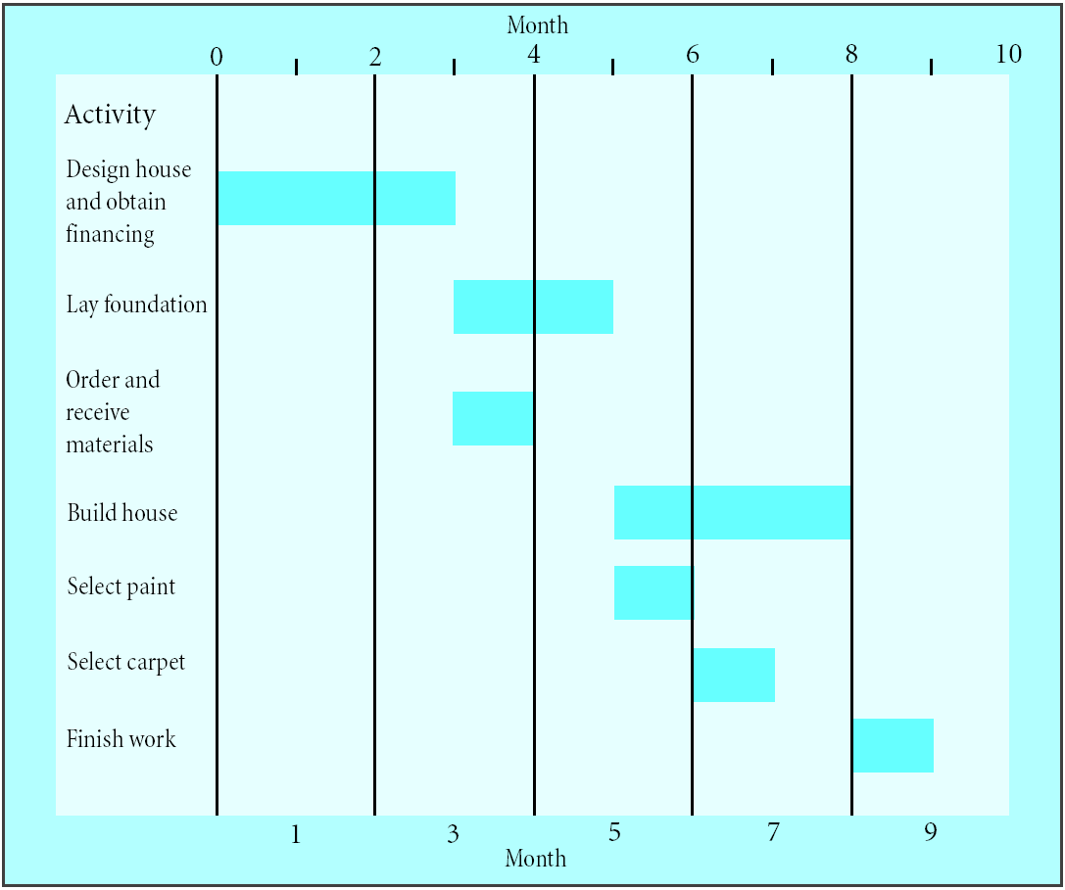
Gantt Chart for House Building Project
Dr.Bokkasam Sasidhar
A Gantt chart

Slide 27
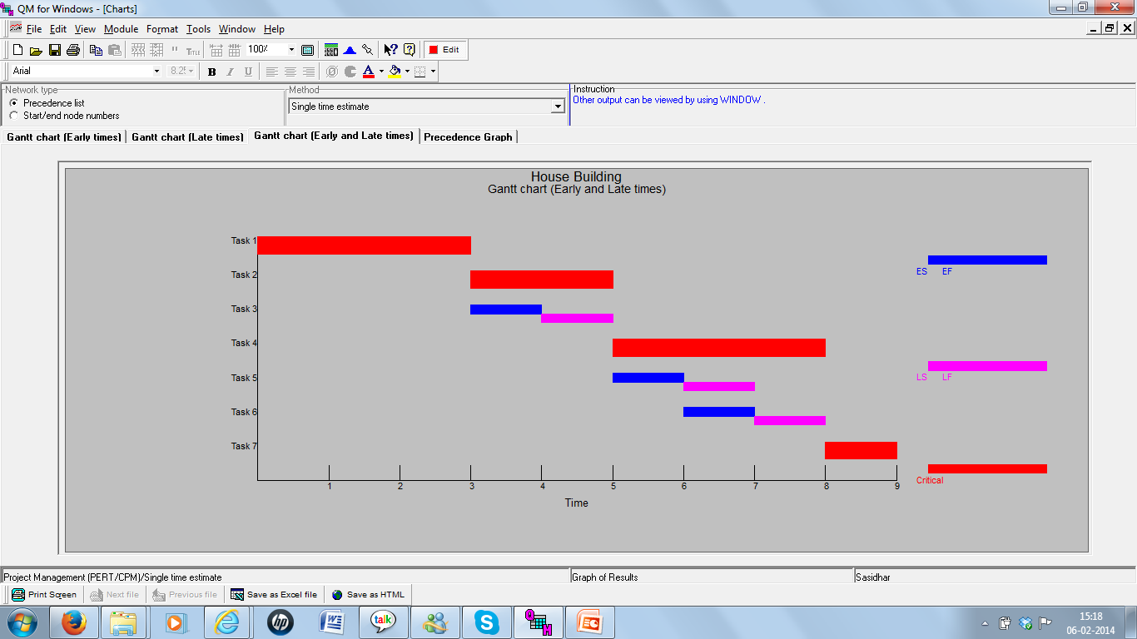
Gantt Chart for House Building Project using QM for Windows
Dr.Bokkasam Sasidhar

Slide 28
Gantt Charts
Establish a time-phased network
Can be used as a tracking tool
Benefits of Gantt charts
Easy to create and comprehend
Identify the schedule baseline network
Allow for updating and control
Identify resource needs

Slide 29
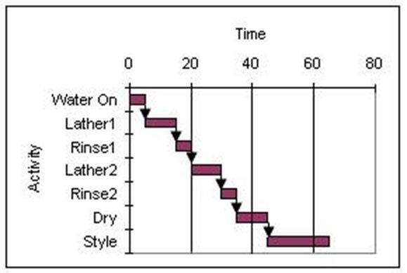
Gantt Charts – Example
Consider the Gantt chart shown below where the time scale is in minutes and all activities are performed on an early start basis. How much slack is available in the project?
Answer: Nil
Dr.Bokkasam Sasidhar

Slide 30
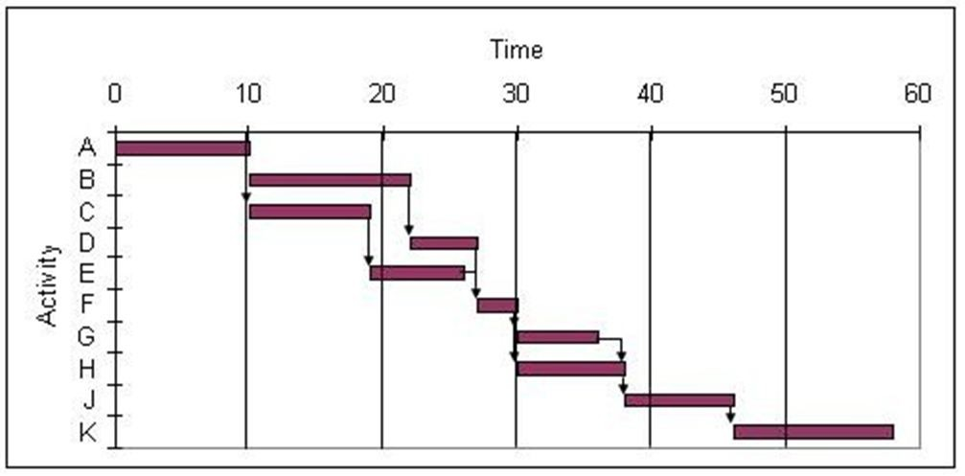
Gantt Charts – Resource Allocation Example
Use the Gantt chart and the activity list to determine when resource 5 is free.
Activity | Resources | Activity | Resources
A | 1 | F | 1
B | 5 | G | 2
C | 4 | H | 5
D | 3 | J | 3
E | 2 | K | 4
A) between 0 and 15
B) between 15 and 30
C) between 30 and 45
D) between 45 and 60
Answer: D
Dr.Bokkasam Sasidhar

Slide 31
Gantt Charts – Resource Allocation Example
Use the Gantt chart and the activity list to determine when resource 2 is free.
Activity | Resources | Activity | Resources
A | 1 | F | 1
B | 5 | G | 2
C | 4 | H | 5
D | 3 | J | 3
E | 2 | K | 2
A) between 0 and 15
B) between 15 and 30
C) between 30 and 45
D) between 45 and 60
Answer: A
Dr.Bokkasam Sasidhar

