Slide 1
Experimental evaluation of a DASH implementation
Arka Deb​ (A20386958),
Noor Afshan Fathima​ (A20385838)​

Slide 2
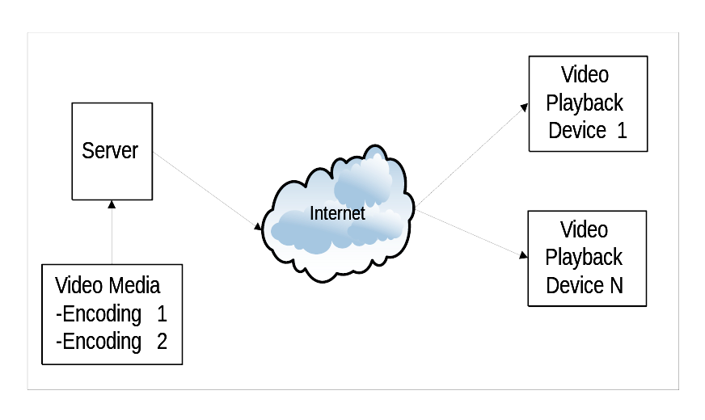
Basic Network Diagram and Data Flow

Slide 3
Fundamental Problem
Solution
How can you maintain seamless video and audio playback over a network that can not guarantee quality of service ?
A streaming algorithm that adjusts to the bandwidth available on the network.

Slide 4
Video Streaming Technologies
Adobe Flash progressive download
Apple HTTP Live Streaming
Microsoft Smooth Streaming (Netflix)
Adobe HTTP Dynamic Streaming
DASH – Dynamic Adaptive Streaming over HTTP (MPEG-DASH)

Slide 5
Adaptive Bitrate Algorithm
A video streaming system should dynamically adapt to the network conditions and playback device CPU load then automatically select the highest possible resolution the network can support. The general concept is called “adaptive bitrate streaming” (ABR).
ABR follows this simple algorithm:
Encode the media at various resolutions, color depth, frame rate. The result is multiple data sets with different sizes which in turn will require different network bandwidths for streaming for playback.
As the media is played, the client monitors the playback. If the playback stalls, use a lower bitrate encoding.
If the playback is not stalling and there is bandwidth available such that the player can use a higher bitrate encoding, switch to the higher bitrate encoding

Slide 6
DASH in a Nutshell
What: Video streaming solution where small pieces of video streams/files are requested with HTTP and spliced together by the client. Client entirely controls the delivery.
Why: Reuse widely deployed standard HTTP servers/caches for scalable delivery, e.g. existing Internet CDNs; traverse NAT/Firewalls; simple rate adaptation; fixed-mobile convergence; convergence of services, etc.
Use case: Accessing OTT video streaming services over any access network to any device

Slide 7
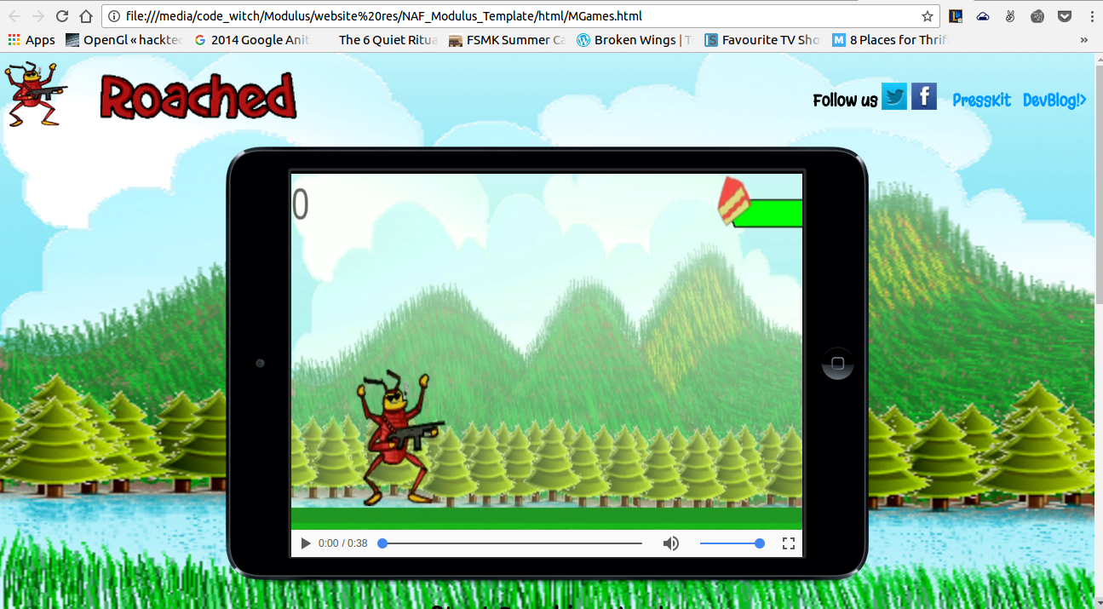
Website on which we are planning to implement DASH

