Slide 1







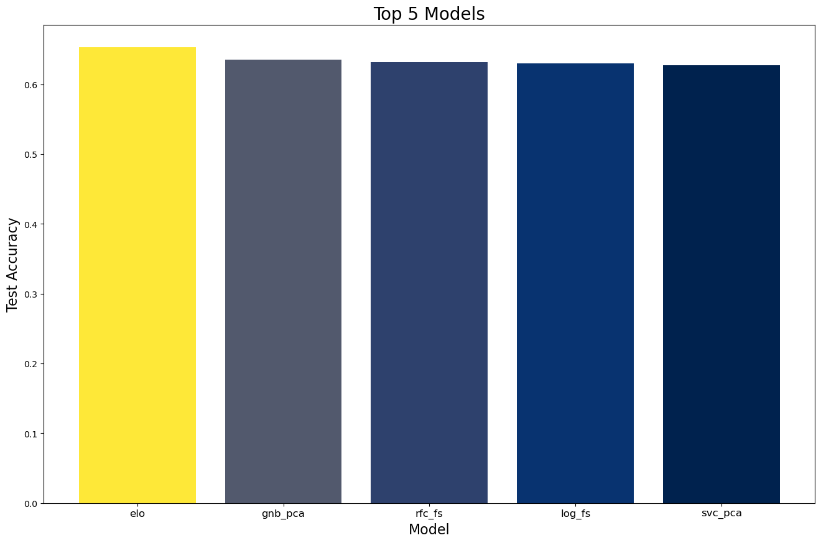
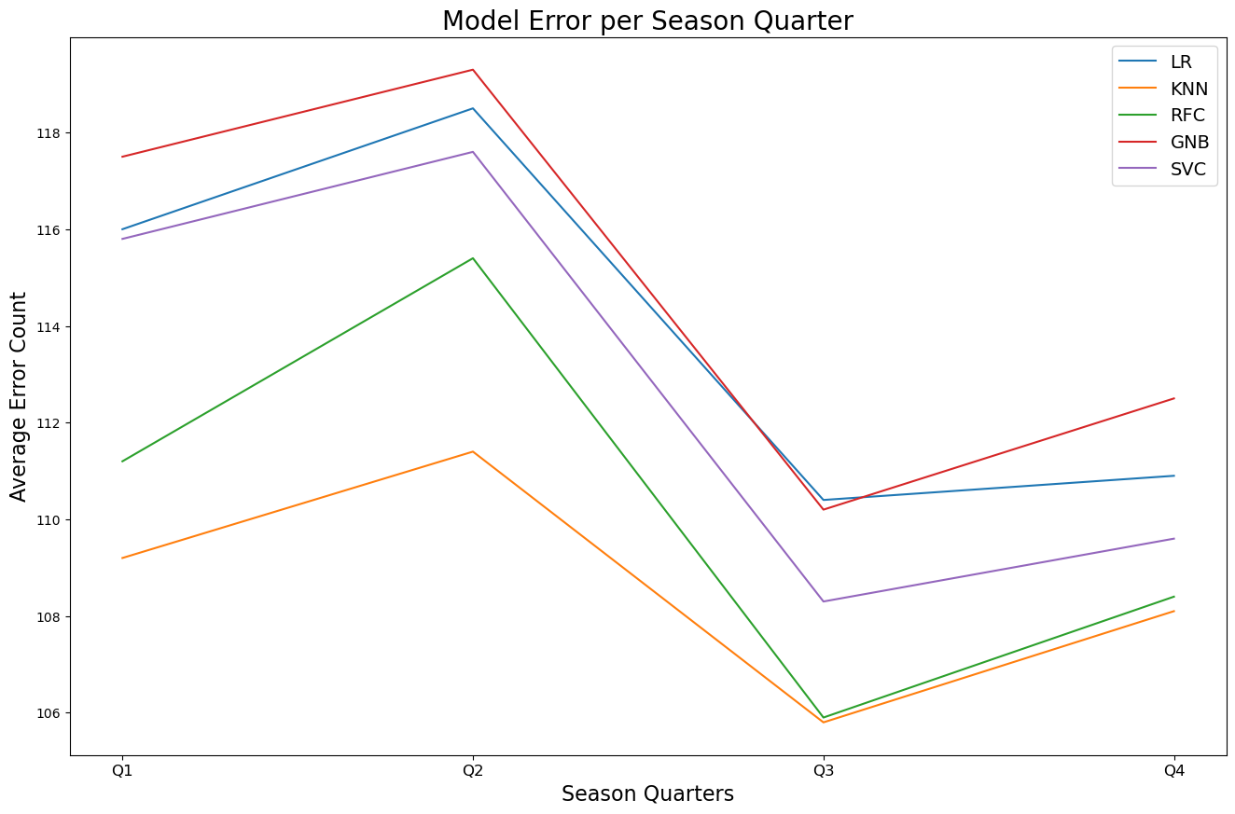
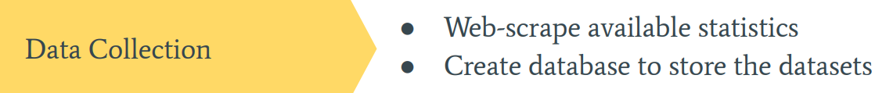
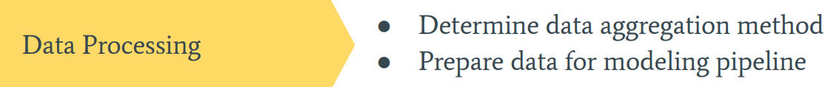
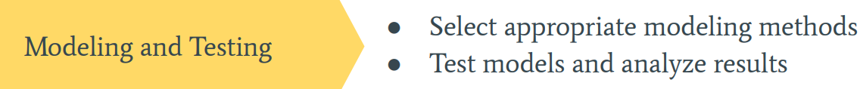
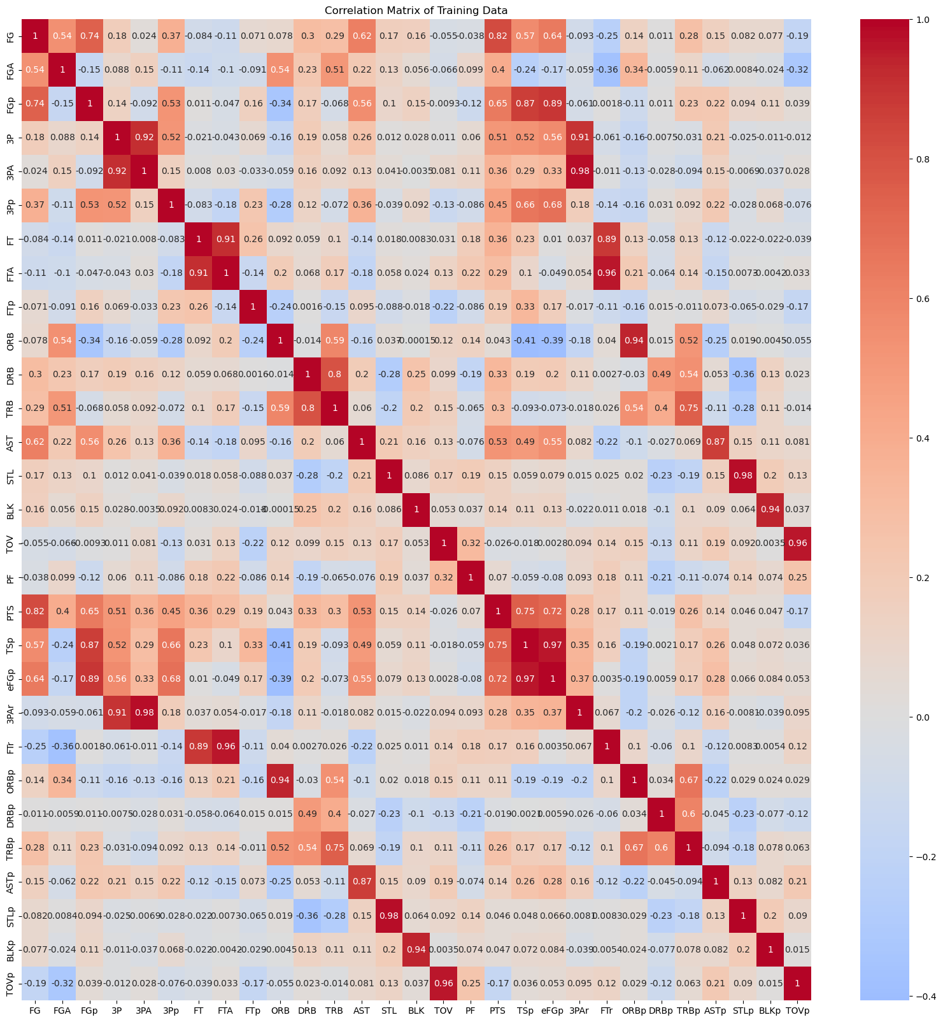
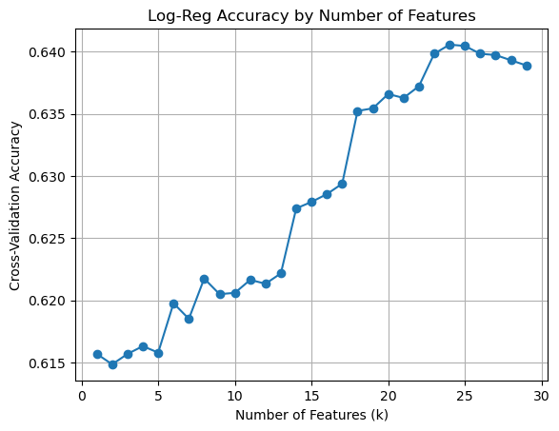
Powered By:
Presented by:
Baheer Noori (nooria@rpi.edu)
Omer Gafar (gafaro@rpi.edu)
Overview
Model Selection
ELO Rating System
● Logistic Regression (LR)
● K-Nearest Neighbors (KNN)
● Random Forest (RF)
● Gaussian Naive-Bayes (GNB) ● Support Vector (SVC)
● Neural Network (NN)
● Elo Rating System
Assumptions:
● Head-to-head
● Winner: gains rating Loser: loses rating
● Zero-sum
Additional Adjustments:
● Margin of Victory
● Seasonal Reset
Performance:
● 65.3% accuracy
This project is to create a machine learning model that can accurately predict the outcome of NBA games using box score statistics from the past 10 seasons.
Data Requirements:
● Team Elo ratings
● Away/Home Team
● Game Outcome
Objective
Results
The project aims to create a model for accurately predicting NBA game outcomes. The stakeholder, a sports news and entertainment start-up, would use this model for-fun NBA betting.
Users will compete against the model, with prizes for top performers. Our role is to develop the best possible model.
Model Comparison
Top Performing Models:
● Elo System 65.3% accuracy
● GNB 63.5% accuracy
● RFC 63.2% accuracy
Top Performing Data:
● 20-game Four Factor dataset
● Baseline Model:
○ Accuracy: 57.2%
● Models behaved similarly:
○ Accuracy: 59-62%
○ Error Distribution
● Higher error in the first half of a season
Materials and Methods
Next Steps
Feature Selection
Overall, the project was a success. I was able to collect the data, create and compare models and datasets, and select a model suitable for the stakeholder. The results did not meet the original goal of 68% accuracy, but there are several promising leads for future iterations of this project:
● more extensive data collection
● player aggregated data
● additional model adjustments
● Despite colinearity, high feature counts increased accuracy
● The key here is that there are a number of similar stats that are highly colinear. For example, the various shooting and scoring stats are highly correlated, as are the various rebounding stats. This will have implications on judging feature importance later.
Scope: Box score data from the past 10 regular seasons Source: Basketball-Reference.com Method: Web-scraper
SQLite Database: ● 3 tables: Game Info, Player Stats, Team Stats
● 11,979 NBA games ● 341,669 observations
● 46 features
Processing: Aggregation modeling, responsiveness, feature selection

