Slide 1
MARKETING
Final Project

Slide 2
GROUP MEMBERS
Rimsha Akhtar (190021)
Neha Malik (190029)
Abdullah (190176)
Wardah Asif (190030)
Nooria Milad (190033)
Moin Asif (190036)

Slide 3
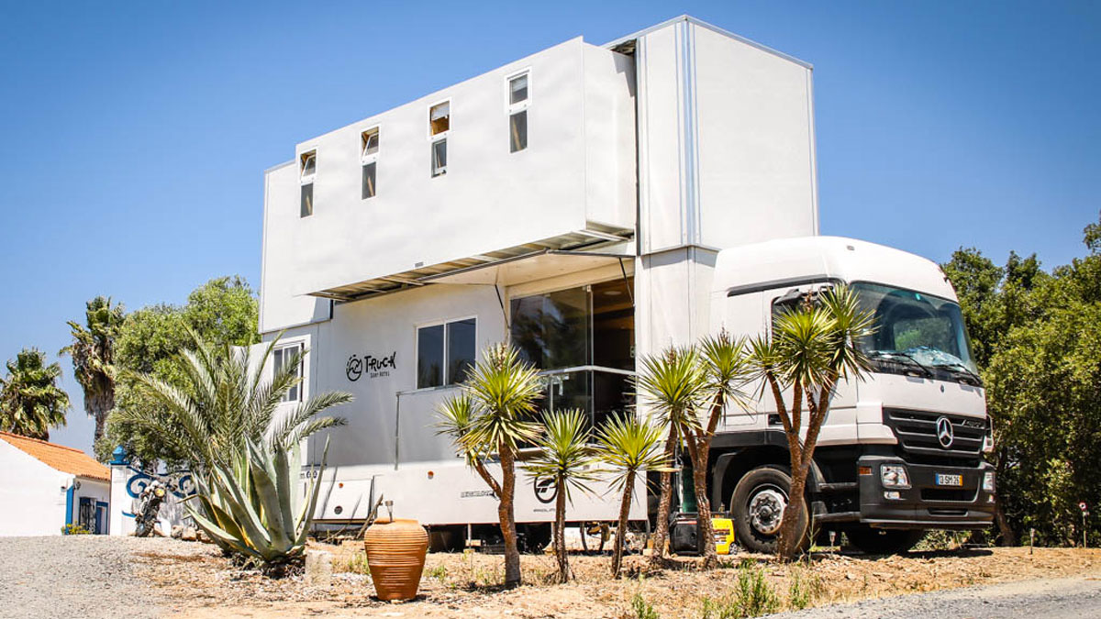
TRUCK SURF HOTEL
Introduction to the business idea:
Tourist
Inconveniences
Provision of luxurious trucks consisting of
furnished one and two bedrooms on rent
Four major cities of Pakistan

Slide 4
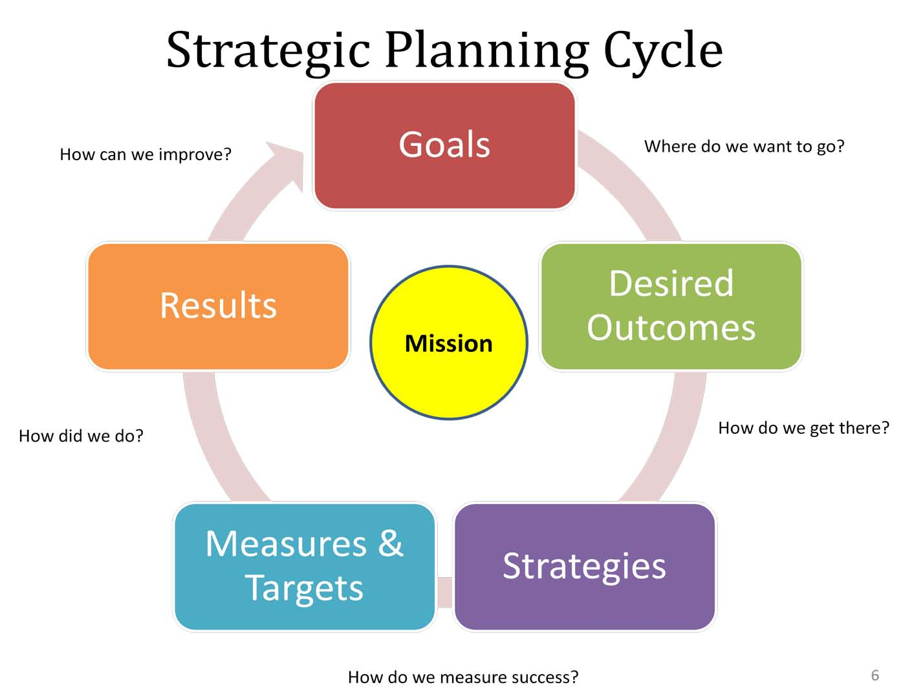
STRATEGIC PLANNIG
OBJECTIVE:
Large sales
Productivity
Excellent customer service
Reaching customers i-e advertising
To Maintain cash flow
GOALS:
To Aware people
Spread business in every city of pakistan

Slide 5
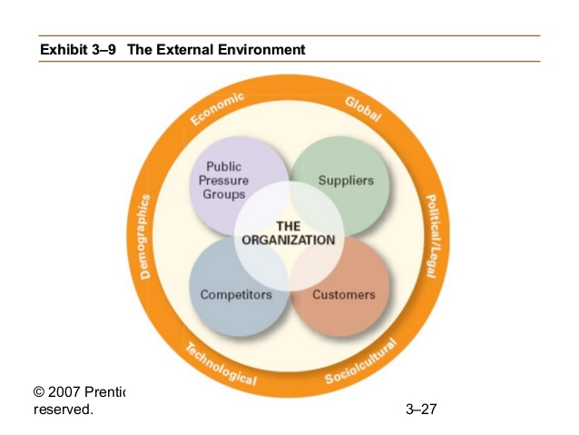
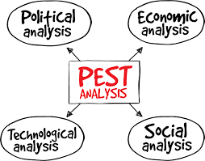
ENVIRONMENTAL ANALYSIS
MICRO ANALYSIS:
Company: Customer oriented
Supplier: Shortage and delay can effect business
Competitors: No competition
Customers: Providing services and customer care
MACRO OR PEST ANALYSIS:
Political factor: Change in tax laws
Economic factor: High production and low purchasing
Social factor: Comfortability and ease for tourists
Technological factor: technical opportunity that will lead to adventure and profit

Slide 6
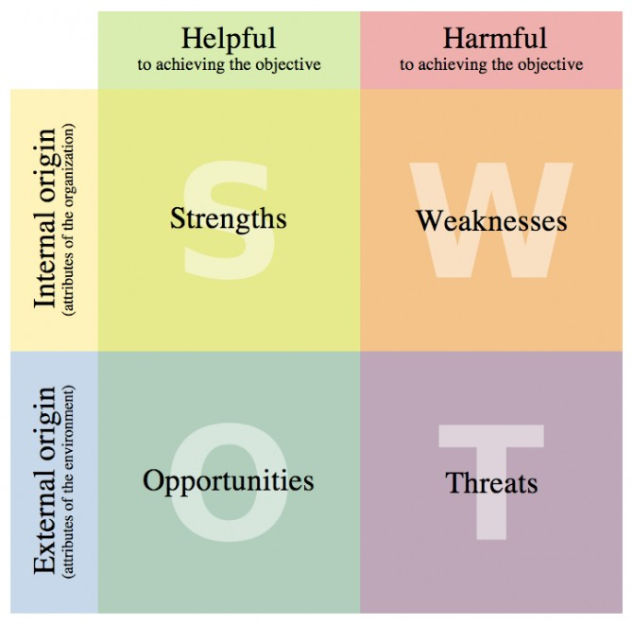
INTERNAL ANALYSIS
SWOT ANALYSIS
Strengths:
No existing business
Weaknesses:
Security crises in Pakistan
Opportunities:
better service and profit margin
Awareness
Online space for customers opinion
Threats:
Introduce our product to business market
Brand awareness
Deal with shifting economy

Slide 7
FINANCIAL ANALYSIS
INVESTMENT: Rs. 150,000,00 /-,
NUMBER OF TRUCKS: Total 8 trucks (4 double story and 4 single story)
Double story cost Rs. 1700000/- per truck (Rs. 6800000/- for 4 trucks)
Single story cost Rs. 9000000/- per truck (Rs. 3600000/- for 4 trucks)
Each city has two trucks i-e one double and one single story
Remaining 46 lakhs will be used in buying equipment's
Contacts: Europe and America
Equipment cost: Kitchen equipment's, furniture, Wi-Fi, LCD etc.
Delivery network:
Online website
Main offices

