Slide 1

POWER BI PROJECT
Bank Loan Default Risk Dashboard
Summer Training — Power BI | [Chandigarh College of Engineering]
Presented by
Course
Guided by
Date
Harnoor Kaur | 2405039380
BTECH CSE
[Mentor Name]
01/07/26

Slide 2
Agenda
01
Problem Statement & Objective
06
Dashboard Walkthrough
02
Dataset Overview
07
Key Insights & Findings
03
Data Model — Star Schema
08
Publishing to Power BI Service
04
Power Query — Cleaning Steps
09
Challenges & Learnings
05
DAX Measures
10
Conclusion & Q&A
2 / 14

Slide 3
01 Problem Statement
What problem does this dashboard solve?
The risk team needs to monitor default rates by loan grade, borrower income band, and loan purpose to flag high-risk segments.
Find which types of borrowers are more likely to miss loan payments.
Help the risk team make better loan approval decisions using data.
3 / 14

Slide 4
Problem Statement & Objectives
The Problem
Target User
Banks provide loans to thousands of customers every year. It becomes difficult for the risk team to manually monitor all loan records and identify borrowers who may default on their loans.
- Loan Managers
- Bank Management
- Risk Management Team
Project Objectives
Import and clean the Lending Club loan dataset using Power BI.
Analyze loan data by Grade, Income Band, Loan Purpose, and Loan Status.
Create DAX measures
Help the bank identify high-risk borrower segments for better decision-making.
Build an interactive dashboard with KPI cards, charts, and slicers.
4 / 14

Slide 5
02 Dataset Overview
Source, structure, and key fields
5 / 14

Slide 6
Dataset Overview
Kaggle
CSV
10,000 Rows
55
Columns
Key Columns Used
Loan Amount - Total amount of money borrowed by the customer.
Annual Income - Borrower's yearly income.
Grade - Credit grade assigned based on the borrower's risk profile
Loan Purpose - The reason for taking the loan
Loan Status - Current status of the loan, such as Fully Paid, Current, or Charged Off.
Interest Rate - Percentage of interest charged on the loan.
Income Band (Created) - Groups borrowers into income categories (Low, Medium, High, Very High).
Default Flag (Created) - Indicates whether a loan has defaulted (1 = Default, 0 = No Default).
6 / 14

Slide 7
04 Dashboard Walkthrough
Pages, visuals, and interactivity
11 / 14

Slide 8
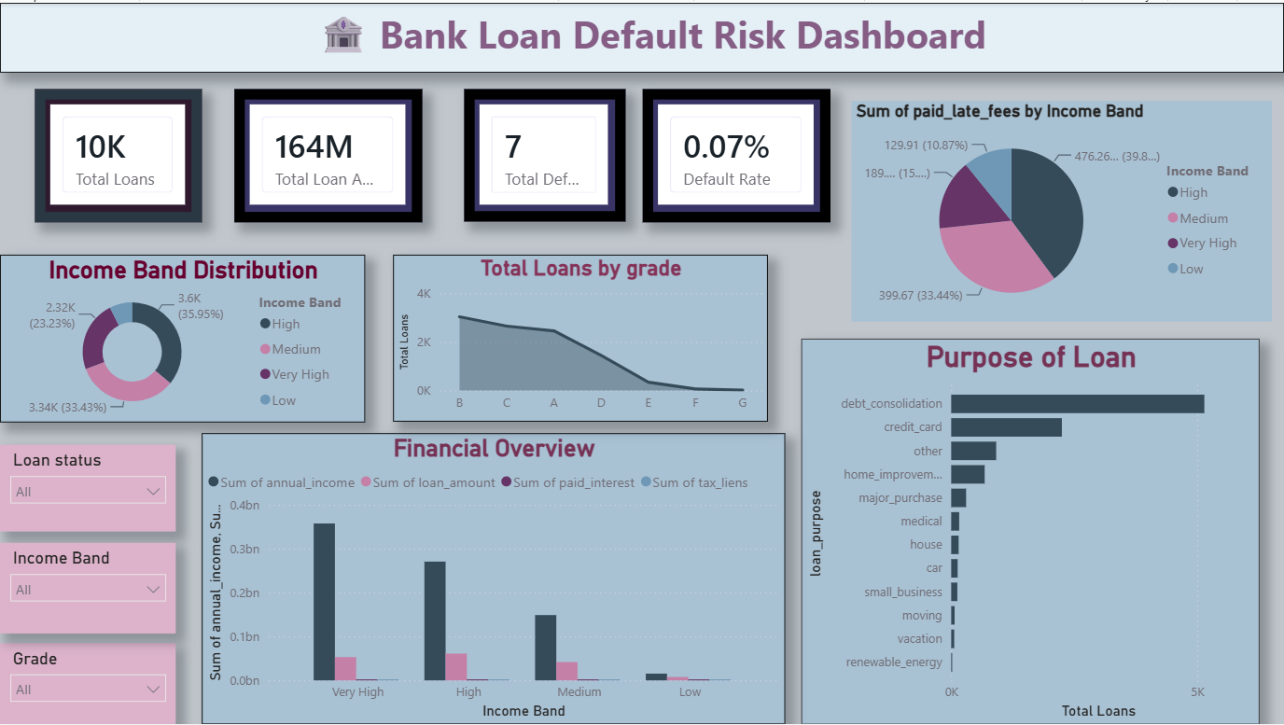
Dashboard — Overview
Visuals on this page
KPI Cards : - Total Loans
- Total Loan Amount
- Total Defaults.
- Default Rate
Income Band Distribution: Shows how borrowers are distributed across different income groups. (Donut Chart)
Purpose of Loan: Shows the most common reasons for taking loans.(Clustered bar chart)
[ Screenshot — Overview Page ]
Financial Overview:Compares Annual Income, Loan Amount, Paid Interest, and Tax Liens across different income bands.
Key Insight
An interactive Power BI dashboard designed to track loan performance, monitor default risk, and analyze borrower trends for effective risk management.
12 / 14

Slide 9
Key Findings & Insights
Low Default Rate-The overall loan default rate is 0.07%, indicating that very few borrowers defaulted in the given dataset.
Financial Trends- Borrowers in higher income bands have larger loan amounts and contribute more in paid interest.
01
04
Income Distribution- Most borrowers belong to the High and Very High income bands.The Low income band has the fewest borrowers.
Loan Purpose- Debt Consolidation is the most common reason for taking a loan.
02
05
Loan Grade Analysis:Most loans are issued to borrowers with better credit grades (A–C).Lower credit grades receive comparatively fewer loans.
03
13 / 14

Slide 10
Thank you
Questions & Feedback Welcome
14 / 14

