Slide 1
Teaching a Converter to Read:
PDF to Markdown with a Local AI Model
Bachelor thesis — Development of a Multimodal System for Converting PDF Documents into Structured Markdown
Noor Martini · Hochschule Mannheim · Team presentation
Notes:
Hi everyone, thanks for joining. I recently finished my bachelor thesis and [boss] suggested I give you a short tour of it.
One sentence version: I built a system that converts PDF documents into clean, structured text that AI systems can actually work with — and it decides page by page how to do that best.
Don't worry if you're not deep into AI — the first half needs no technical background at all, and I'll flag when it gets nerdy.

Slide 2
The problem: PDFs are pictures of documents
Why converting them is harder than it looks
A PDF stores where each character sits on the page — nothing more.
No concept of headings, paragraphs, lists, or tables
The structure you see is an illusion your eyes create
Software has to reverse-engineer that structure. It often fails.
Tables fall apart, headings become plain text
Formulas and code listings get mangled
And it matters more than ever:
AI assistants and search over company documents need clean, structured input
Garbage in — garbage out: bad extraction caps answer quality
What a PDF actually contains:
“T” at (72, 310)
“a” at (81, 310)
“b” at (89, 310)
“l” at (96, 310)
“e” at (100, 310)
…
No table. No heading.
Just letters at coordinates.
2
Notes:
Everyone knows PDFs — they look identical everywhere, which is exactly why the format wins. But that reliability comes from storing the document as, essentially, a picture: each letter is placed at an x/y coordinate, and that's it.
The box on the right is not a joke — that is genuinely what's inside the file. The word 'Table' exists only in our heads.
Why care now? Because everyone is building AI assistants and search on top of their document archives. Those systems are only as good as the text you feed them. If your extraction turns a table into word soup, no AI model downstream can fix that.

Slide 3
The target: Markdown
Plain text that keeps its structure
Markdown is plain text with tiny structural markers
# for headings, - for lists, | for table columns
Readable by humans without any special software
Perfect input format for AI pipelines
Structure survives: a heading stays a heading
Works with version control (Git) — diffs, history
The de-facto standard for feeding documents to LLMs
# Quarterly Report
## Revenue
Revenue grew by 12% …
| Region | Q1 | Q2 |
|--------|-----|-----|
| EMEA | 4.1 | 4.6 |
3
Notes:
So what do we convert PDFs into? Markdown.
For the non-technical folks: Markdown is just normal text with a few extra characters that mark structure. A hash sign means 'this is a heading'. A dash means 'this is a list item'. You can read it as-is — see the example.
The key point: unlike a PDF, the structure is explicit. A machine reading this knows exactly what's a heading, what's a table, what's body text. That's why practically every AI document pipeline speaks Markdown internally.

Slide 4
The idea: stop treating every page the same
The core contribution of the thesis
Existing tools pick ONE method and apply it to the whole document.
A text extractor fails on scans and diagrams; sending every page to an AI vision model is slow and expensive
My system looks at each page first, then picks the right tool for that page.
TEXT
TABLE
IMAGE
FORMULA
MIXED
EMPTY
prose pages
tabular data
figures, charts
dense math
a bit of everything
nothing to do
Plain text pages skip the AI model entirely — fast and exact.
Visually complex pages go to a vision-language model that can actually see the layout.
4
Notes:
Here's the actual idea of the thesis, and it fits in one sentence: don't treat every page the same.
A 60-page thesis might have 50 pages of plain prose, a few pages with tables, one full-page diagram, some formulas. Existing tools pick one strategy for the entire document. That's either overkill or underpowered, depending on the page.
My system classifies every page into one of these six types — using simple, fast rules, no machine learning needed for this step — and routes each page to the method that suits it. Prose goes through a fast, exact text extractor. Complex pages go to an AI model that looks at a picture of the page.
For the technical folks: the classifier reads structural signals from the PDF — image count, vector paths, character count, table detection — and is fully deterministic.

Slide 5
How it works
From PDF to Markdown in four steps
Text path
PDF
Classify
direct extraction — no AI call
Clean-up
MD
one page
at a time
six page types,
rule-based,
< 1 ms per page
49 automated
repair passes
clean
Markdown
Vision path
page image → local AI model
The AI model runs on our own hardware via LM Studio — no cloud API, no data leaves the machine
Tables get a smart shortcut: if the text extractor already got the table right, skip the AI call
The clean-up stage fixes what both paths get wrong: broken headings, split tables, mangled code listings
5
Notes:
The whole pipeline in one picture.
Each page gets classified, then routed. The green path — plain text — costs nothing: a library reads the text layer directly, in about 150 milliseconds. The blue path renders the page as an image and asks a vision-capable AI model to transcribe it into Markdown.
Important for us as a company: the AI model is self-hosted. I used LM Studio, which runs open models on your own machine. No document ever goes to OpenAI or any cloud service. For confidential documents that's not a nice-to-have, it's the whole game.
And the last box matters more than it looks: raw output from both paths is messy. I built 49 automated clean-up passes — covered by 182 unit tests — that repair headings, tables, code listings and so on. Hold that thought; it comes back in the plot twist at the end.

Slide 6
Did it work? The experiment
Measuring quality honestly
3
90
4
360
7
real thesis documents
pages evaluated
strategies compared
conversions scored
quality metrics
Four competitors:
Text-only (fast baseline) · Image-only (AI sees every page) · Hybrid (AI gets text + image) · Adaptive (my system)
Ground truth written by hand:
I manually wrote the “perfect” Markdown for all 90 pages — every conversion is scored against that
Seven separate metrics instead of one blurry score:
text accuracy, headings, lists, tables, code blocks, paragraphs, vocabulary — failures can't hide in an average
6
Notes:
How do you prove a converter is good? You need an answer key.
I took three real bachelor theses — 90 pages total — and wrote the correct Markdown for every single page by hand. Tedious, but it's the only way to get a trustworthy reference: if you generate the reference with another tool, you're just measuring agreement between two broken tools.
Then every page was converted four ways: a plain text extractor as baseline, two strategies that send every page to the AI model, and my adaptive system. 360 scored conversions in total.
One design decision I'd defend anywhere: seven separate metrics instead of one similarity score. A conversion can look 95% fine overall while every heading is broken. Separate metrics make each kind of failure visible.

Slide 7
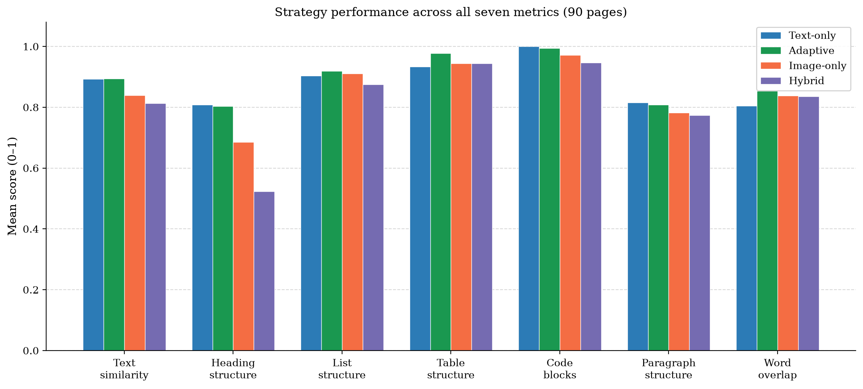
Results: quality
Adaptive matches the best — and wins where structure matters
Adaptive (green) beats both pure-AI strategies on every metric
Neck-and-neck with the text baseline on prose
Clear win on tables: 0.98 vs 0.93
Hybrid's weak spot: headings (0.52)
7
Notes:
The quality results, all seven metrics, all four strategies.
Three things to take away. First: green — my adaptive system — beats the two always-use-AI strategies on every single metric. Routing pays.
Second: against the plain text baseline it's essentially a tie on prose metrics. That's expected — most thesis pages ARE prose, and for those, adaptive literally uses the same fast path.
Third, the interesting one: tables. 0.978 versus 0.933. That gap is exactly the pages where the text layer falls apart and the vision model reads the table from the page image instead. That's the adaptive idea earning its keep.
If someone asks about hybrid's heading score: giving the model text AND image sounds smarter but actually confuses it — the two inputs disagree about layout, and it trusts the picture. More input is not always better.

Slide 8
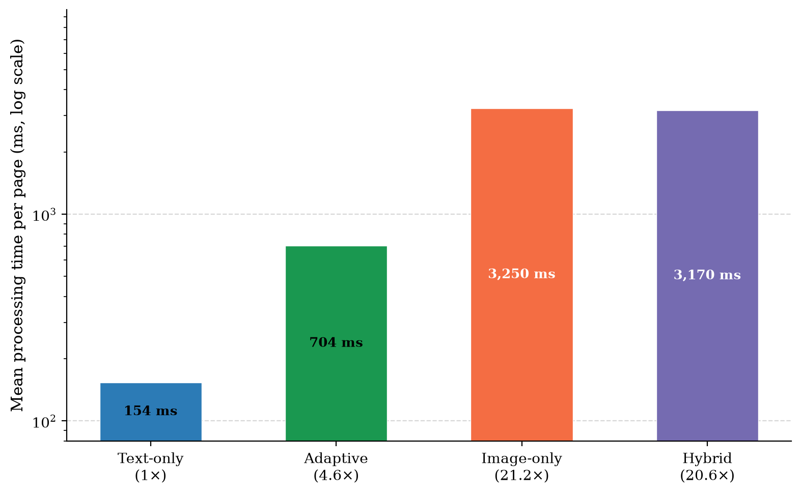
Results: cost
Same quality for a quarter of the compute
Adaptive skips the AI model on 67 of 90 pages
Only 23 pages actually need vision
75% fewer tokens than image-only
≈ 4.5× faster than the pure-AI strategies
Scales with document size: a 300-page manual costs ~1.1M tokens with image-only, ~280K with adaptive
8
Notes:
Quality is only half the story — the other half is cost, and this is where adaptive really wins.
Of the 90 pages, 67 were classified as plain text and never touched the AI model at all. Only 23 pages needed vision. That's a 75 percent reduction in token consumption compared to sending every page to the model, and roughly 4.5 times faster end to end.
For anyone thinking about production use: this is the difference between a pipeline you can afford to run over a whole document archive and one you can't. And the savings grow linearly with document length — the projection for a 300-page manual is about 1.1 million tokens versus 280 thousand.

Slide 9
The plot twist: my evaluation was grading the wrong thing
The most valuable lesson of the whole project
For months, the results told a different story:
“AI strategies collapse on code blocks (0.25) and paragraphs (0.16) — vision models can't transcribe”
Then I found the bug — in the measuring stick, not the system:
The evaluation scored the RAW model output — before my 49 clean-up passes ever ran
Real users get the cleaned output; the benchmark graded a draft nobody ever sees
After fixing the evaluation:
Code blocks: 0.25 → 0.97 · Paragraphs: 0.16 → 0.78 — the “collapse” never existed
Bonus finding: a bigger AI model (7B → 35B parameters) barely moved the results
Better headings, slightly worse tables, everything else flat — model size was not the bottleneck
9
Notes:
This is my favourite slide, because it's the most honest one.
For most of the project, my numbers said the AI strategies catastrophically failed at code blocks and paragraphs. I built a whole narrative around it. It felt right — everyone knows language models paraphrase.
Then, while investigating something else, I discovered my evaluation script was scoring the model's raw output — before the 49 clean-up passes ran. The product ships cleaned output. My benchmark was grading a draft that no user ever sees.
After the fix, the collapse disappeared. 0.25 became 0.97.
And a second twist: I rented a big GPU and re-ran everything with a model five times the size. Almost nothing changed. Everyone's instinct — 'just use a bigger model' — was wrong here. The bottleneck was the pipeline around the model, and the measurement itself.
The transferable lesson for any of our projects: measure what the user actually receives, end to end. A wrong benchmark is worse than no benchmark, because you'll optimise the wrong thing with full confidence.

Slide 10
Three things to remember
1
Route, don't brute-force
Looking at each page first and picking the right tool beats applying one method everywhere — same quality, 75% less compute.
2
Local AI is enough
A self-hosted open model on our own hardware handled this. No cloud APIs, no data leaving the machine, no per-call bill.
3
Grade the product, not the draft
My biggest 'failure' was a measurement bug. Evaluate what users actually receive — end to end — or your numbers will lie to you.
Thanks! Questions welcome — technical or not.
Notes:
To wrap up, three takeaways.
One: routing beats brute force. Classify first, then pick the tool. Same quality, a quarter of the compute.
Two: you don't need a cloud AI service for this class of problem. A self-hosted open model did the job, and for confidential documents that's the only acceptable setup anyway.
Three — the one I'll carry into every future project: grade the product, not the draft. My scariest-looking result was a bug in the measurement, and I only found it by tracing the full path from input to what a user actually gets.
Happy to take questions — and if you want the gory technical details on any part, the thesis has 77 pages of them.

