Slide 1
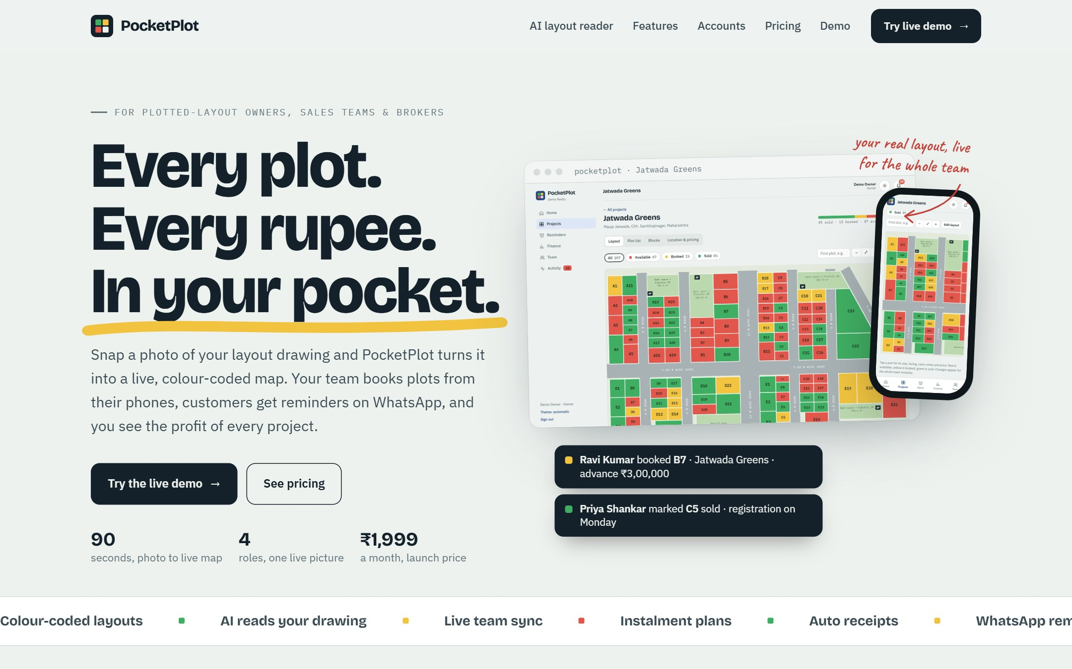
Plotskart
Every plot.
Every rupee.
In your pocket.
Investor plan: what it costs, what we need, and when the money comes back
Ask ₹40 L · ideal case needs ₹15.1 L · investment back by M7
Coimbatore · Chennai · Madurai · Dindigul | October 2026

Slide 2
Raise ₹40 L. Use ₹15.1 L. Back by M7
THE ASK IN ONE SLIDE
₹40 L
₹15.1 L
M2
M7
committed by the investor (ideal need + 3 months of fixed costs as buffer)
actually drawn in the ideal case: startup costs, 2 build months, month 1
first month with a profit; from here the business pays its own way
every rupee invested has come back as profit (ideal case)
If sales come slower
Case | Money needed | Self-funding from | Investment back | Cash generated by M36
Ideal: 20 Team + 2 Business sales a month | ₹15.1 L | M2 | M7 | ₹4.28 Cr
Realistic: ramps to the same by month 7 | ₹33.0 L | M6 | M13 | ₹3.45 Cr
Slow: half the sales | ₹52.3 L | M13 | M30 | ₹47.0 L
Notes:
The investor commits ₹40 L but only ₹15.1 L is drawn in the ideal case. The rest is a reserve, released only if sales are slower. ₹40 L covers the realistic case with ₹7.0 L to spare.

Slide 3
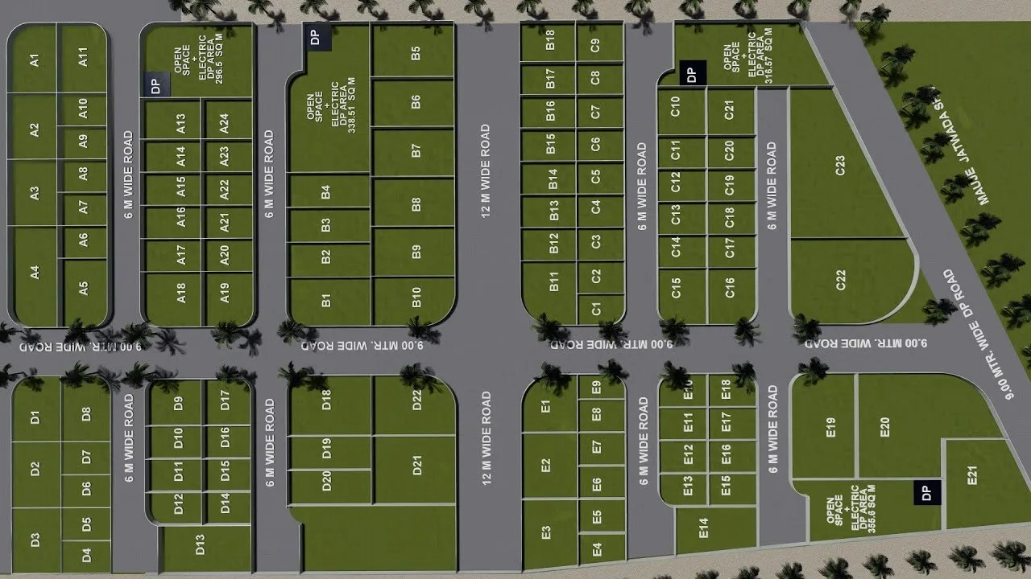
Layout owners run crores of sales on paper, Excel and WhatsApp
THE PROBLEM
1
Which plot is free?
The printed layout is marked by pen. Sales staff and brokers call the office to check, and two people book the same plot.
2
Who still owes money?
Instalments sit in a notebook or Excel. Dues and registration dates slip, and nobody reminds the buyer.
3
Is the project making money?
Land, approvals, roads, broker commission and salaries are spread across bank, cash and memory. Profit is a guess.

Slide 4
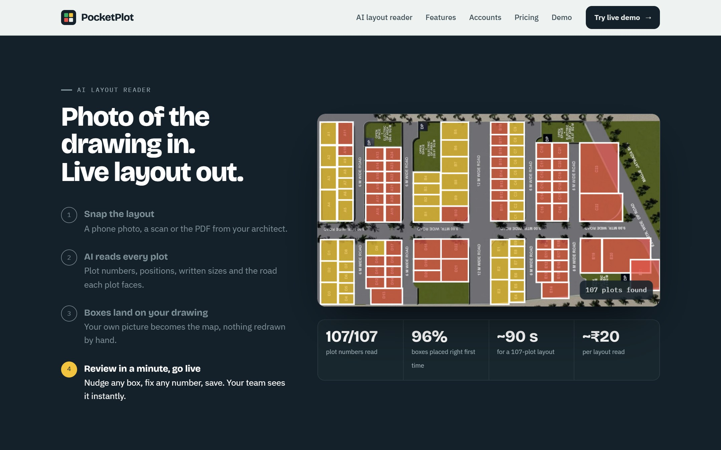
Photo of the drawing in, live colour-coded layout out in 90 seconds
WHAT MAKES US DIFFERENT
107/107
plot numbers read on a real drawing
96%
boxes placed right first time
~90 s
photo to live map
No competitor reads a layout drawing. Everyone else makes the owner type every plot in.

Slide 5
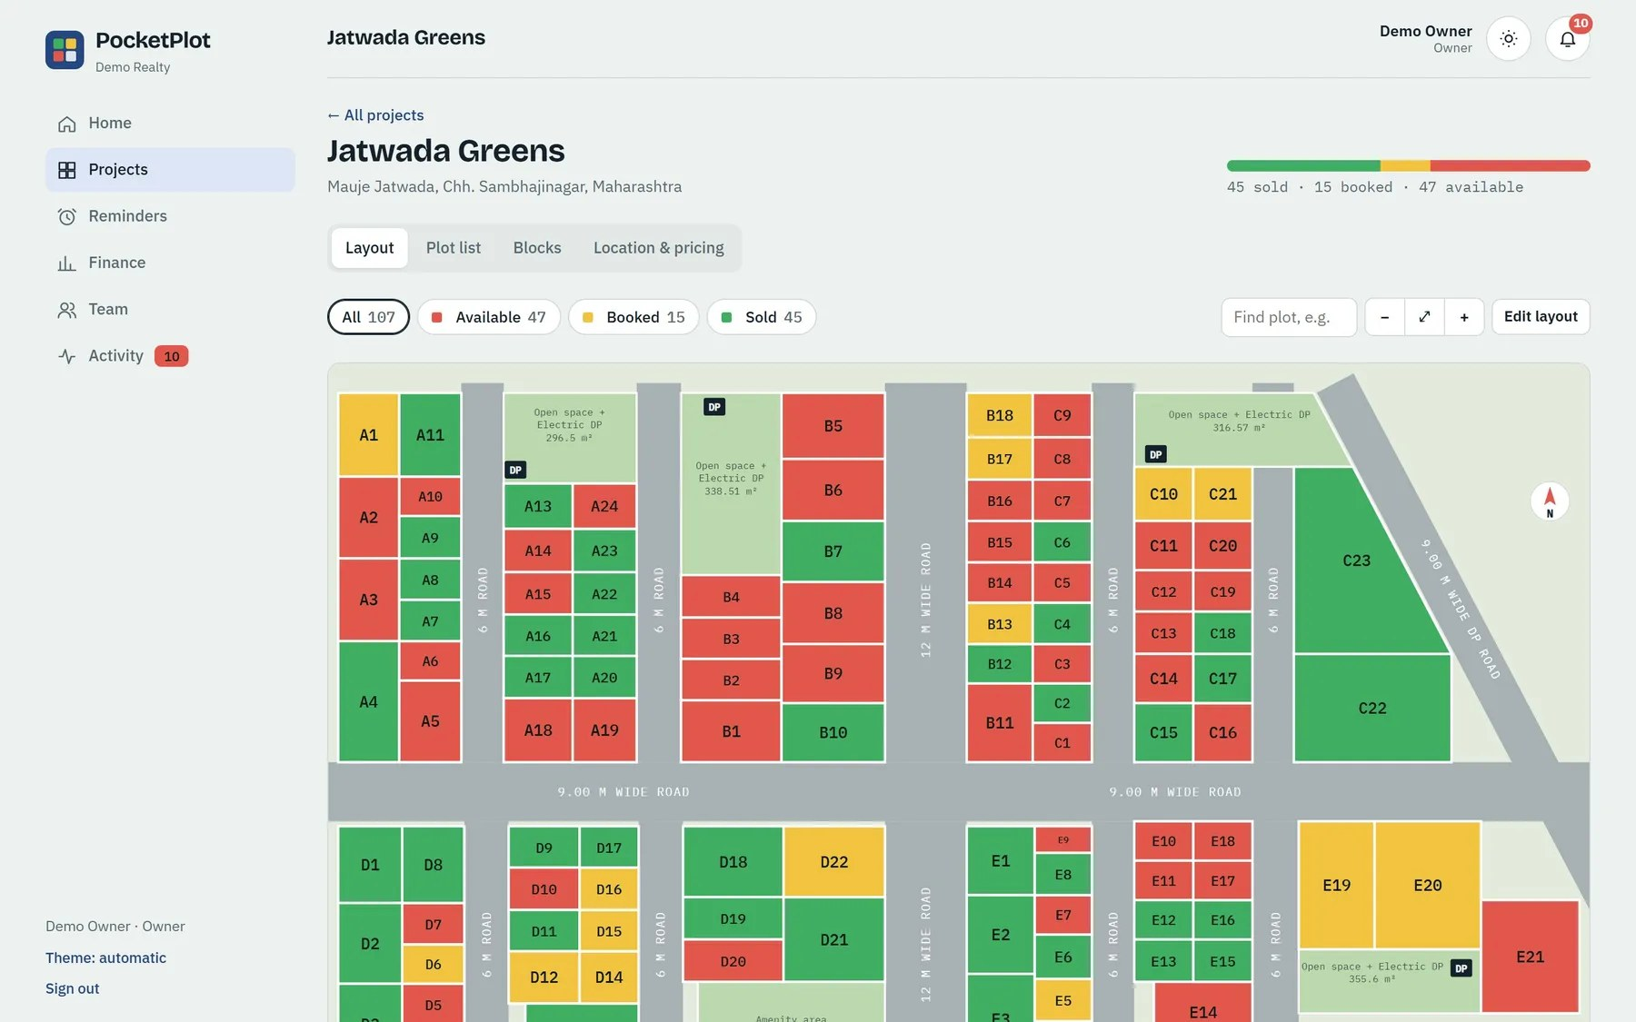
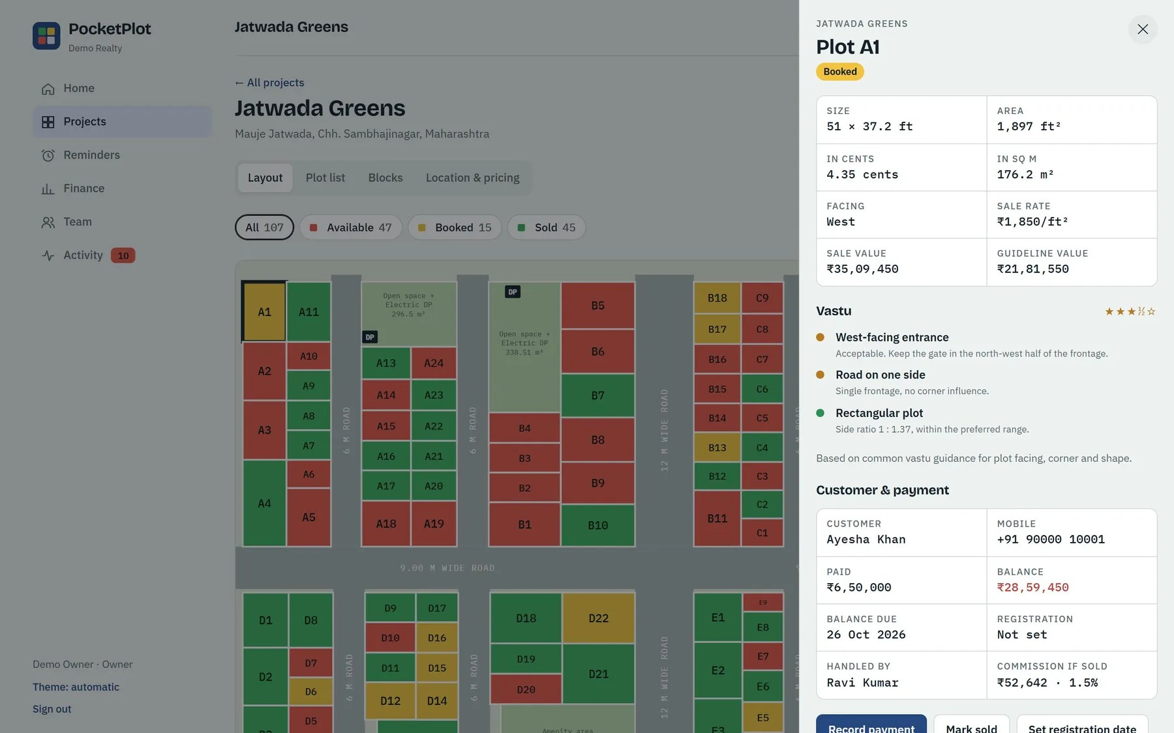
Every plot live for the whole team, with size, facing, vastu and price
PRODUCT TOUR · SALES
Green sold, yellow booked, red available. Book or sell from a phone; everyone sees it at once.
Each plot: sq ft and cents, road facing, vastu, guideline value, sale price, customer, instalments.

Slide 6
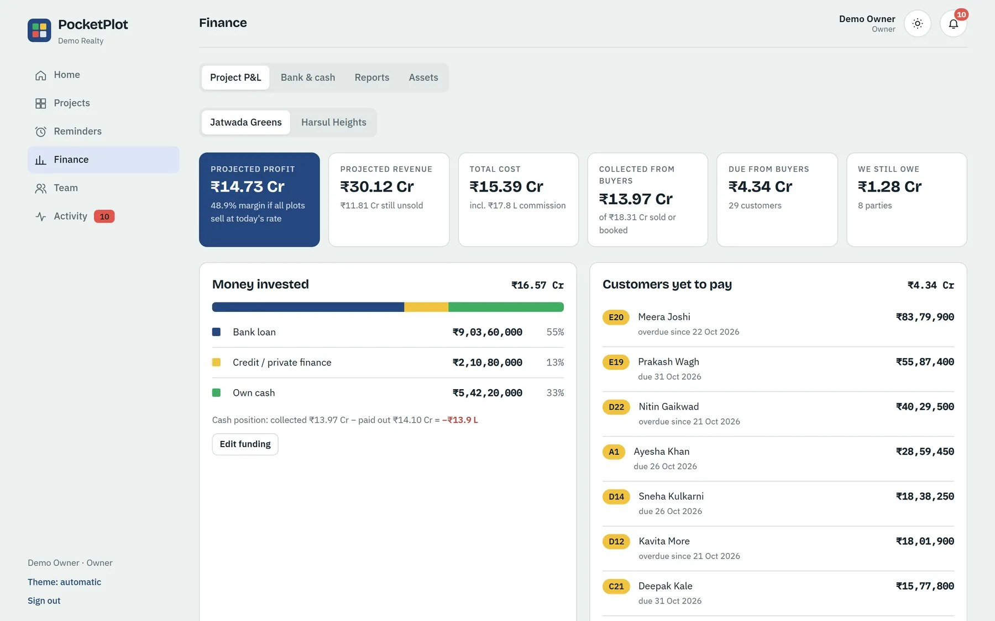
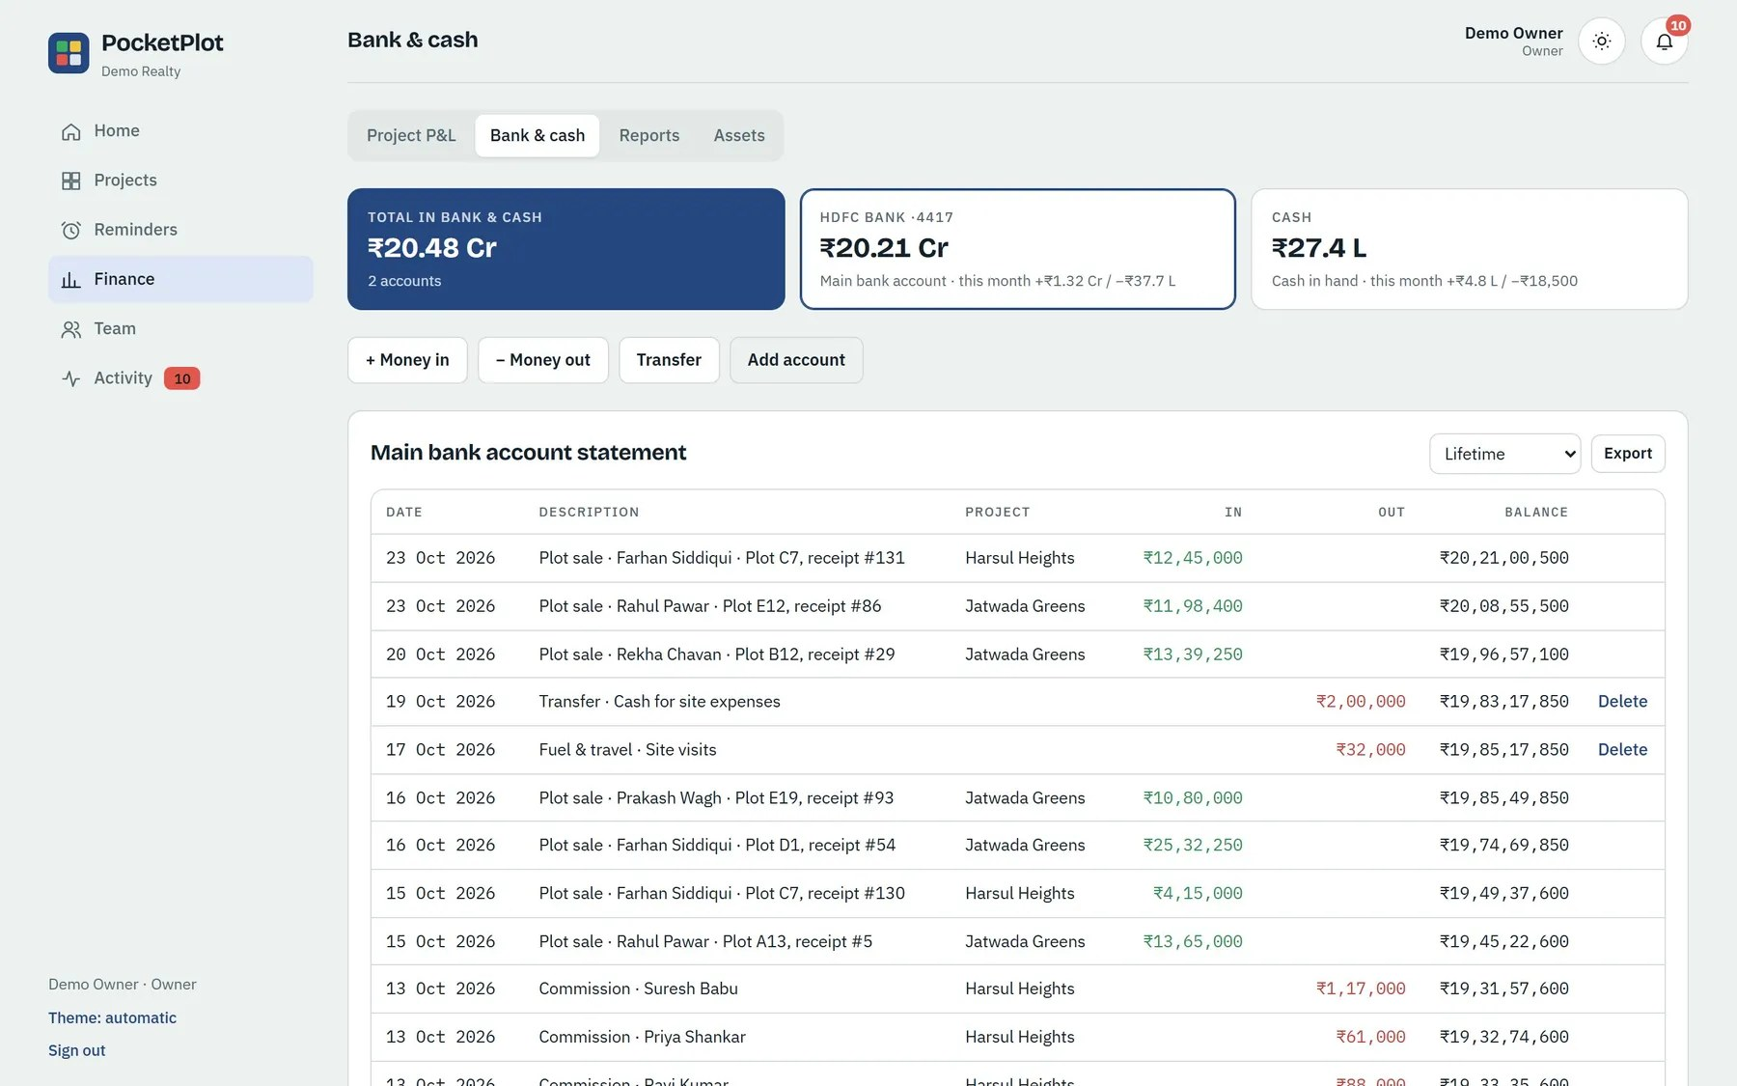
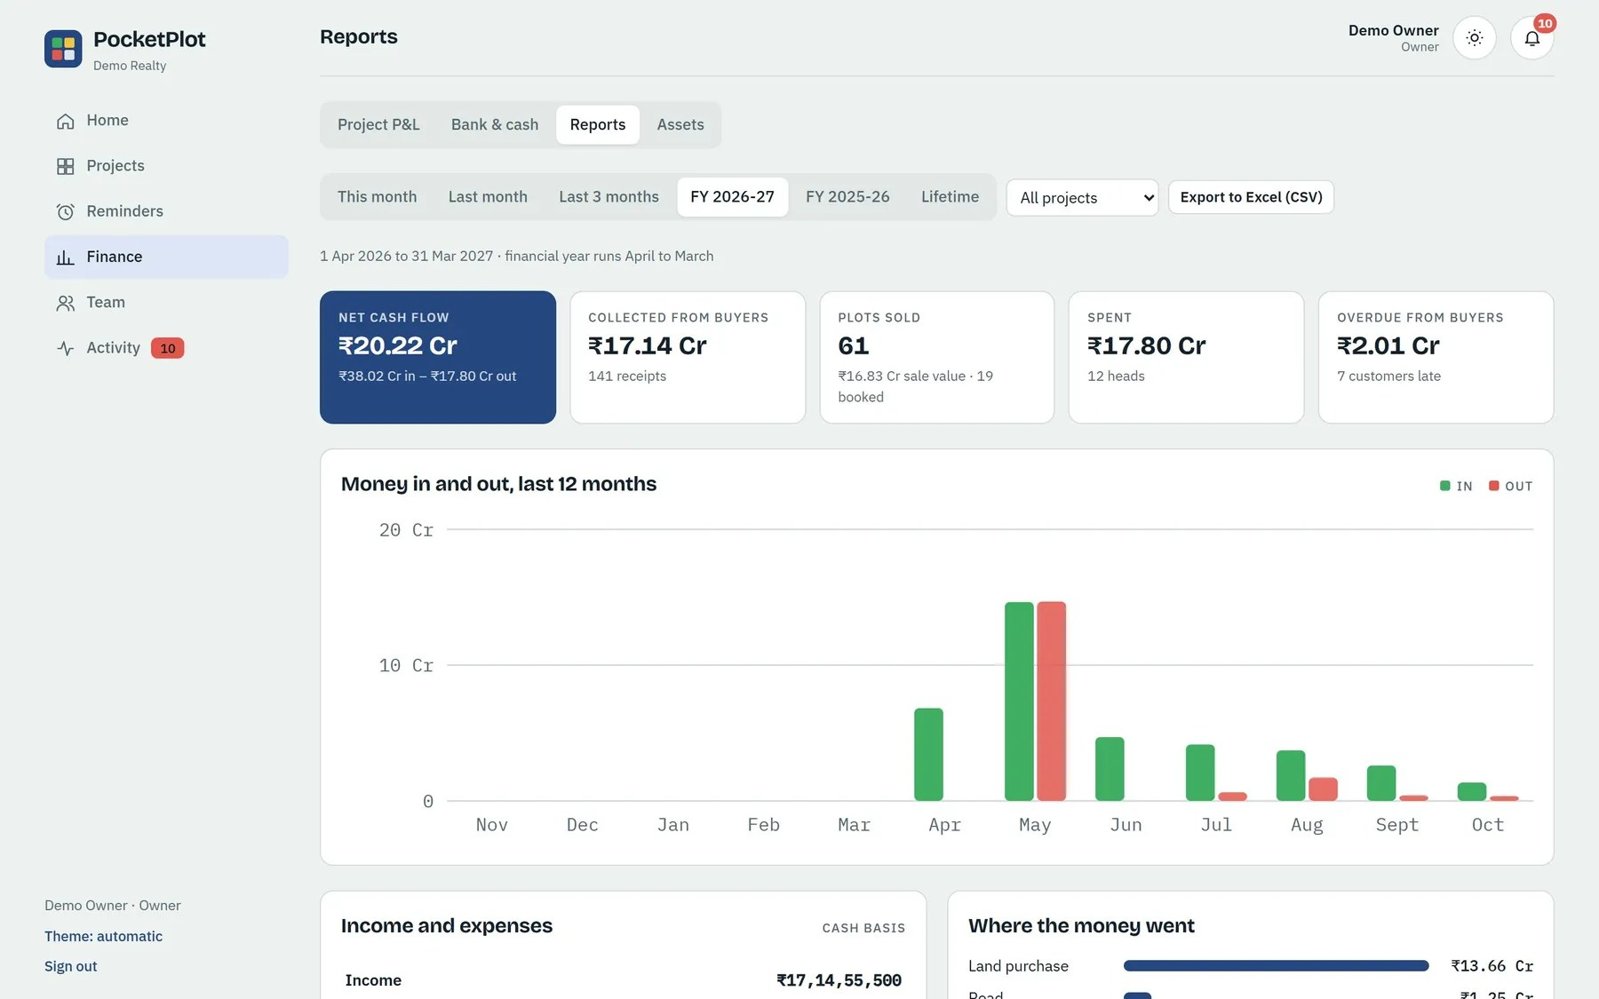
Project profit, bank and cash, and reports the owner can trust
PRODUCT TOUR · MONEY
Profit per project
Every rupee in a ledger
Reports by Indian FY
Land, approvals, roads, marketing, commissions and salaries against what buyers paid.
Bank, credit and cash accounts. Payments, expenses and transfers post themselves.
Month, year or lifetime: cash flow, overdue buyers, team return on cost.

Slide 7
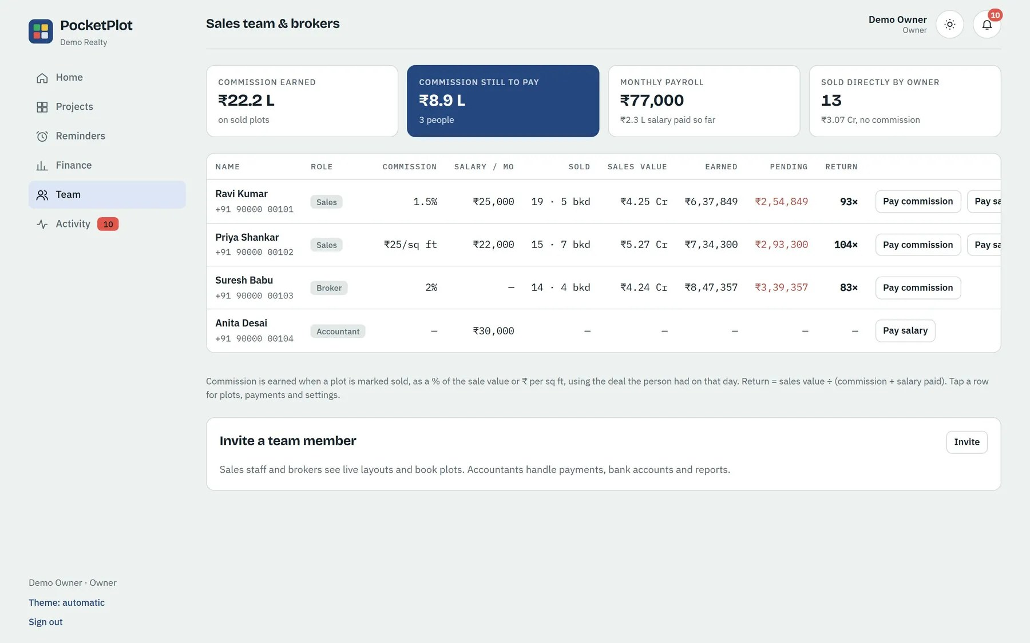
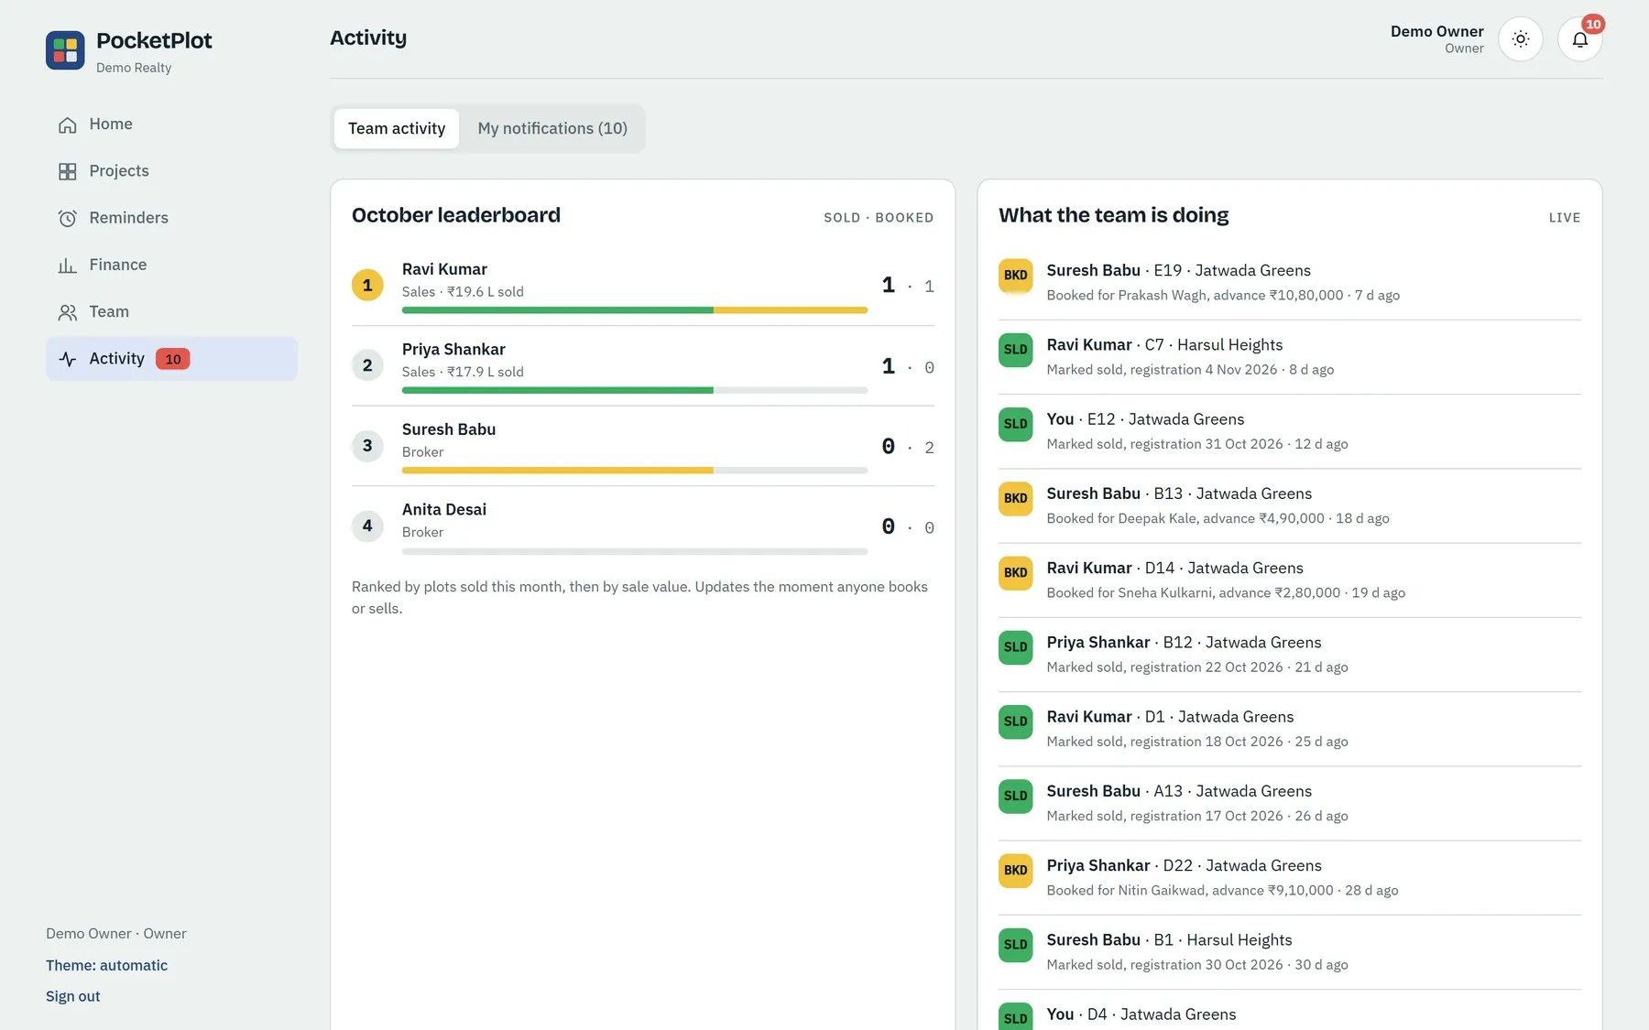
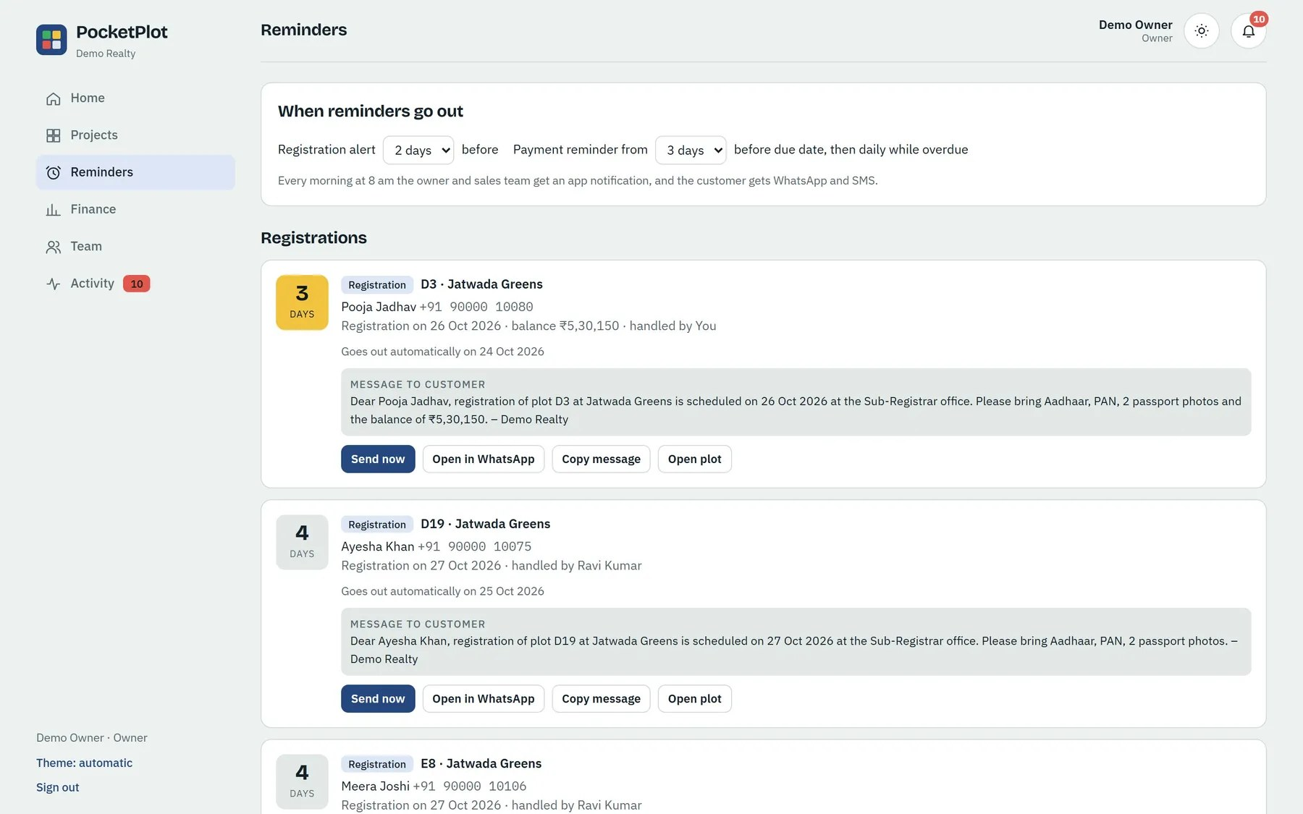
Commissions, leaderboard and reminders keep the team selling
PRODUCT TOUR · TEAM
Commission your way
Monthly leaderboard
Nothing slips
A % of the sale or ₹ per sq ft, per person. Earned on sale, tracked until paid.
Who booked and sold the most, live. Owners see effort and return per person.
Registration alerts 2 days ahead, payment reminders before each due date, to team and buyer.

Slide 8
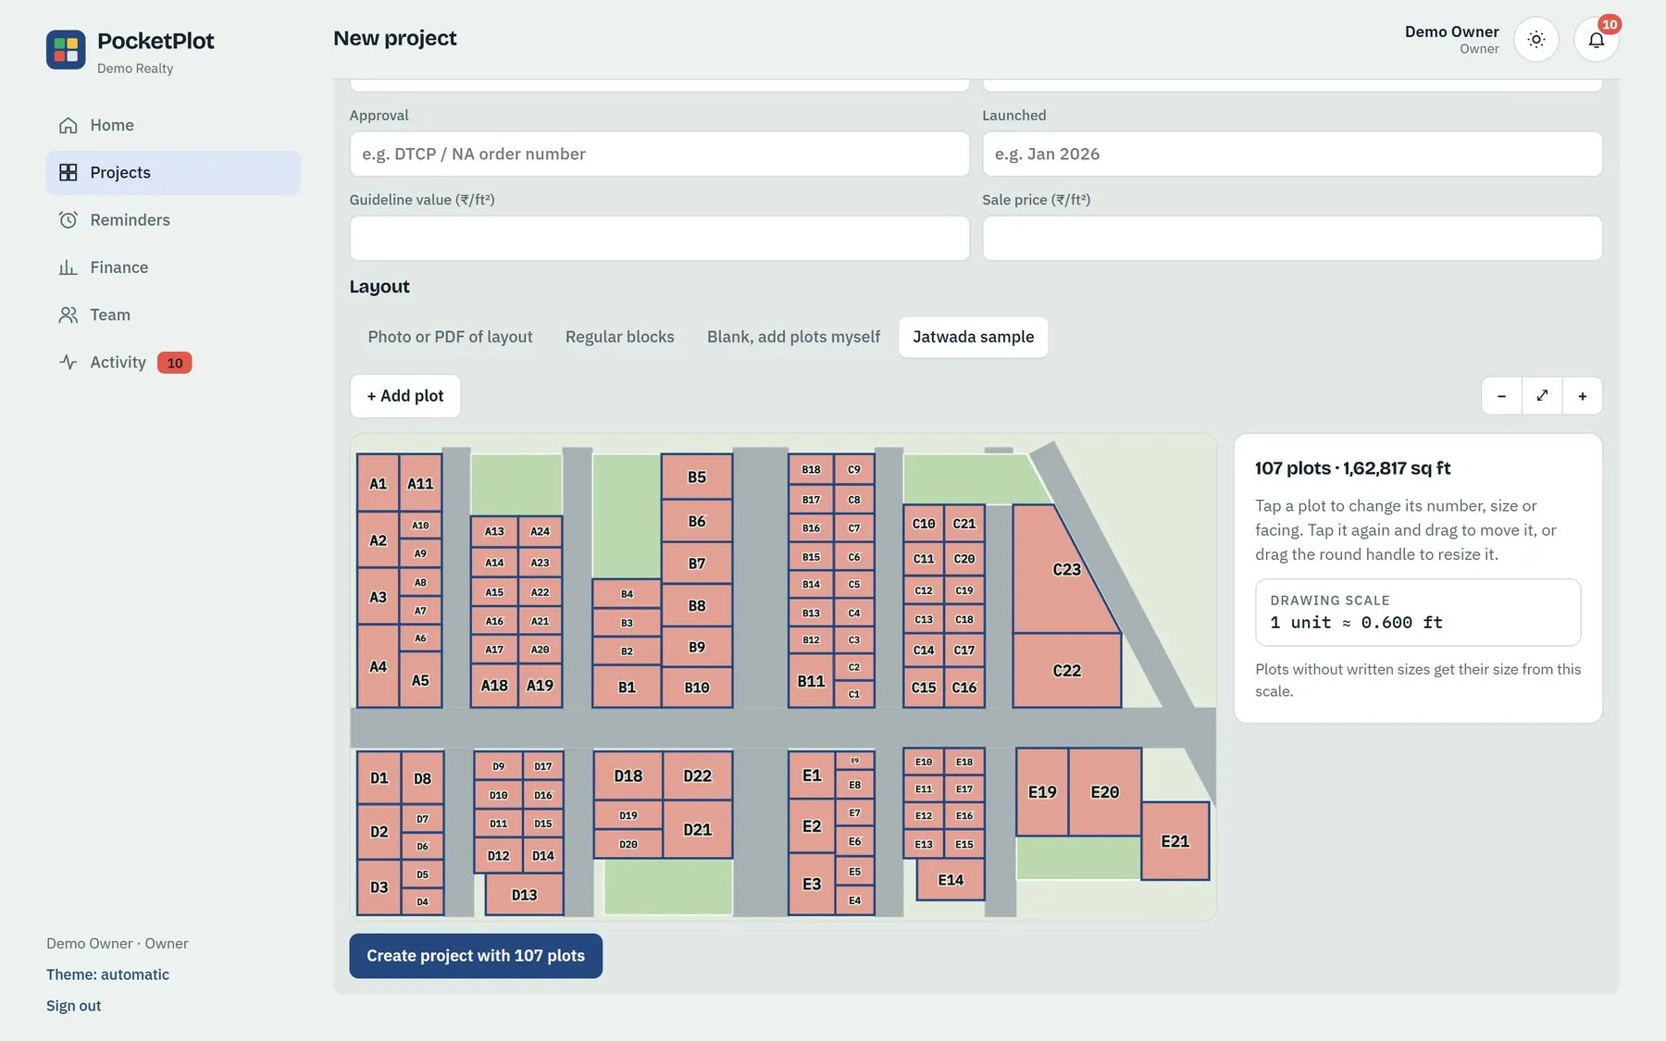
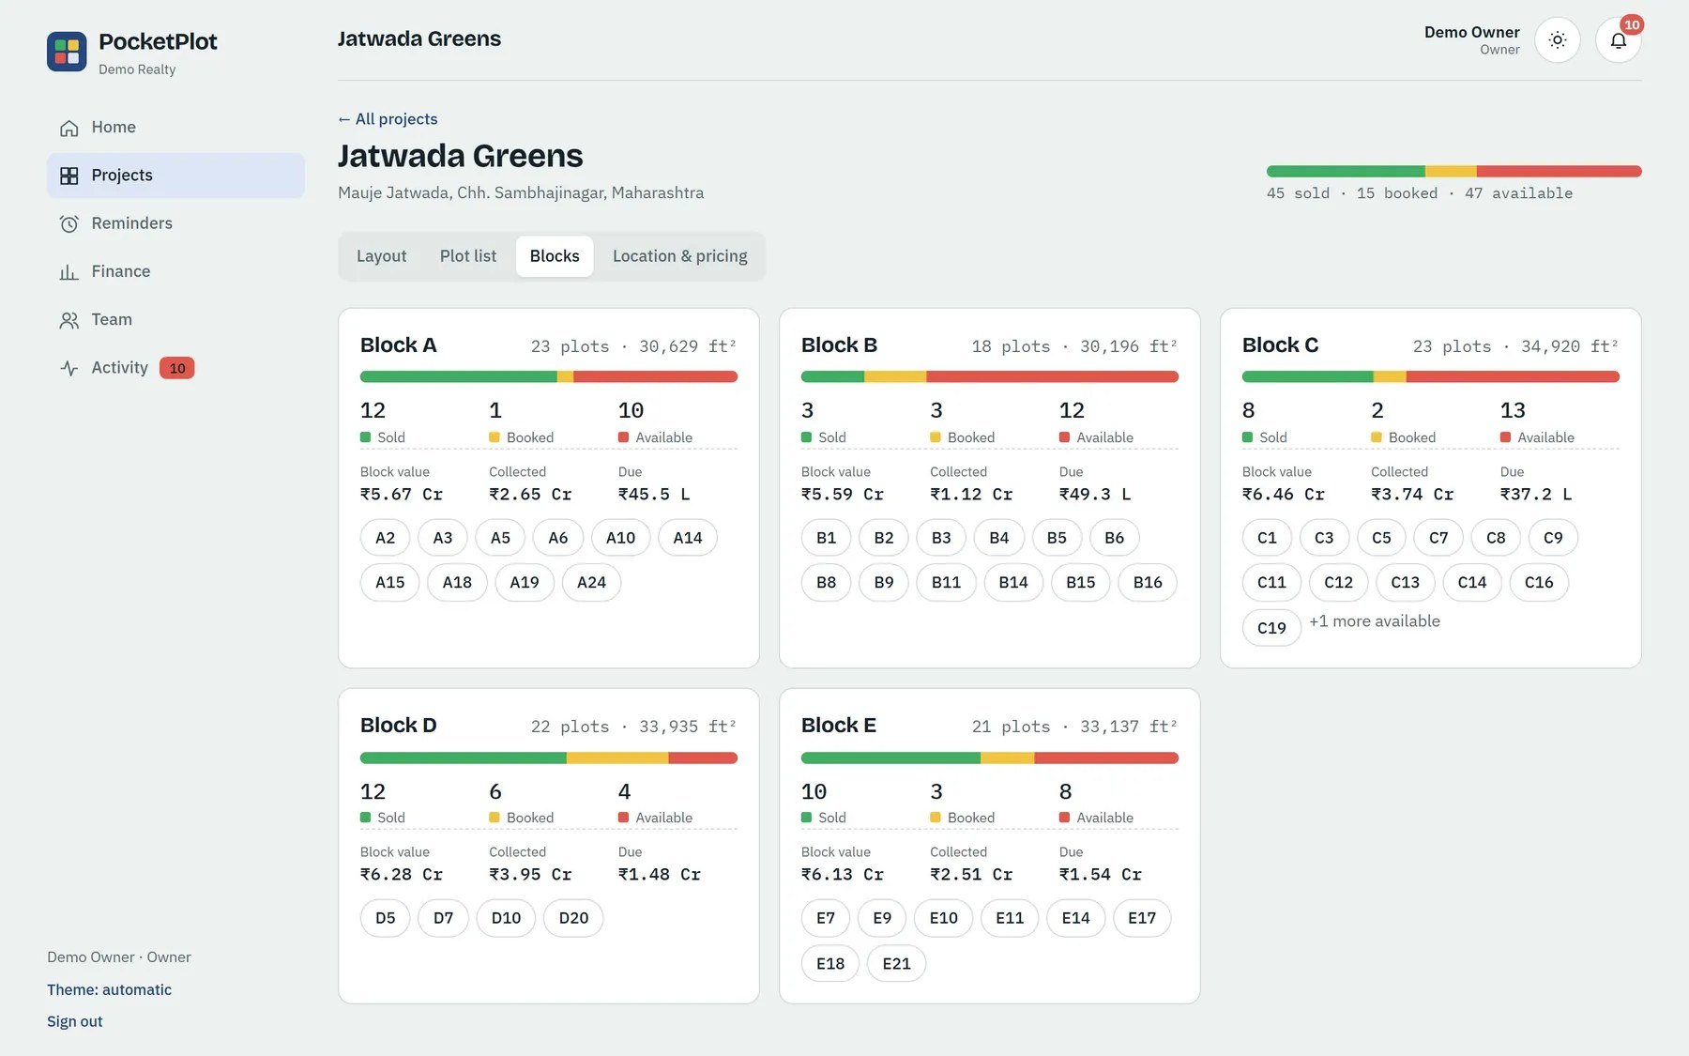
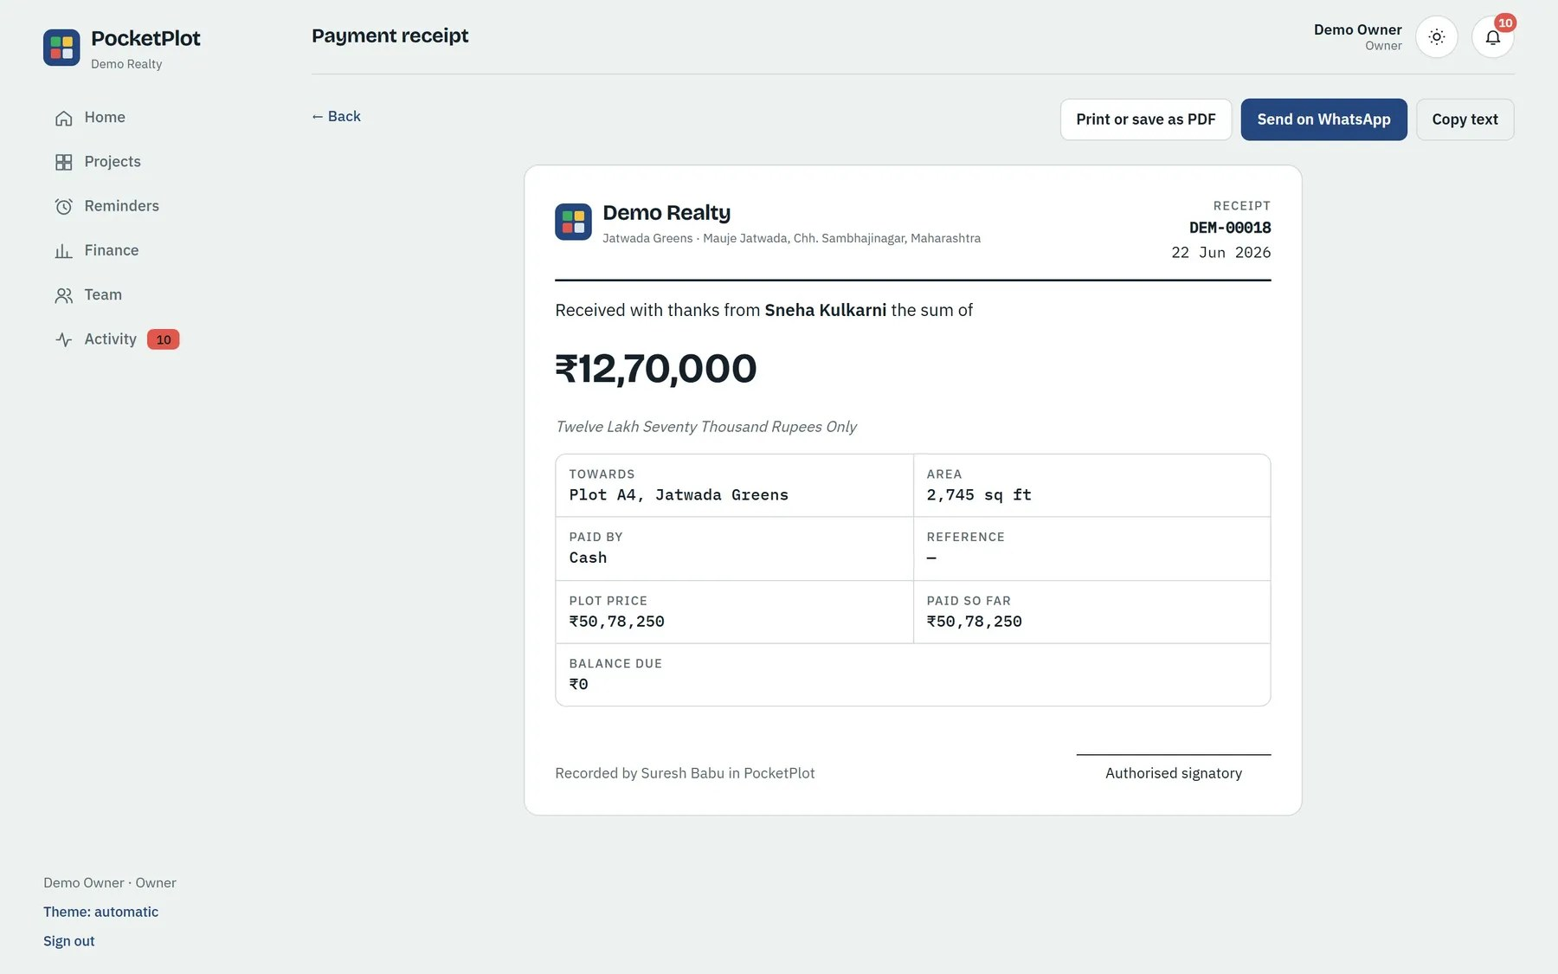
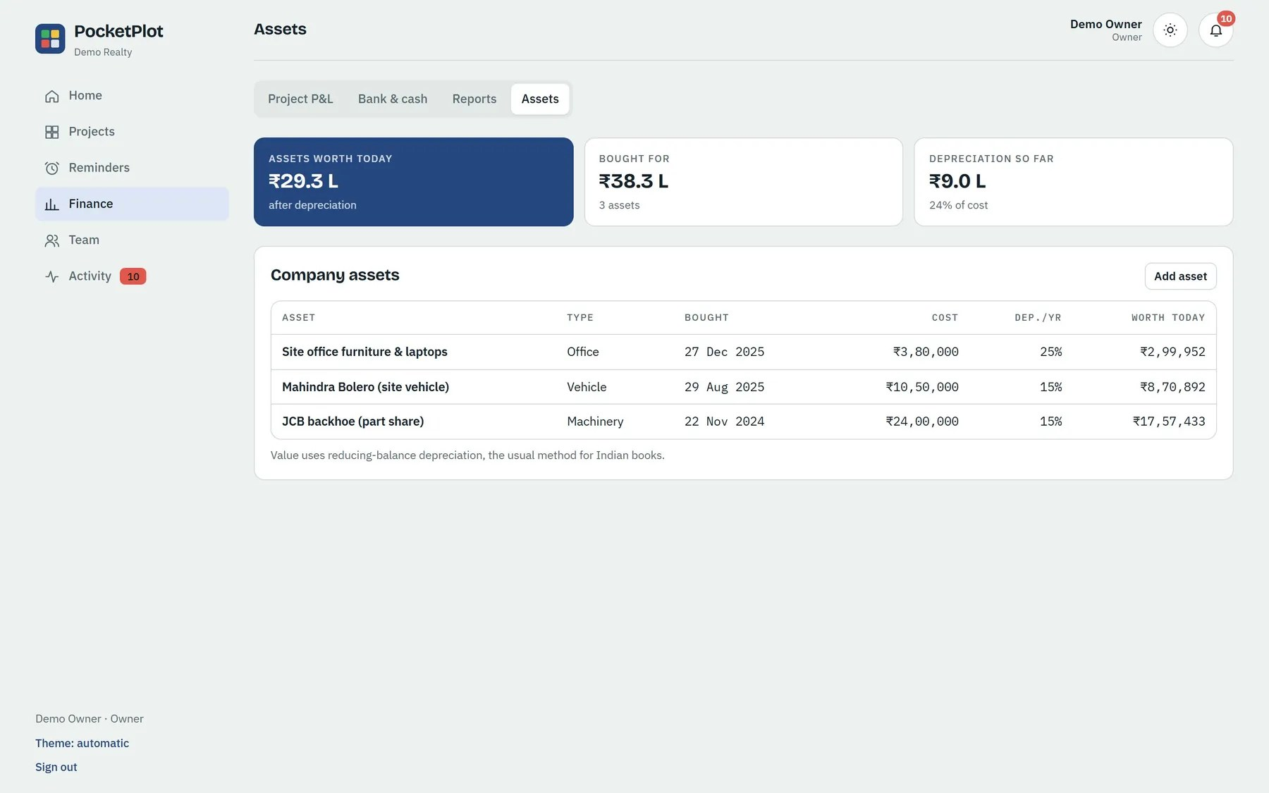
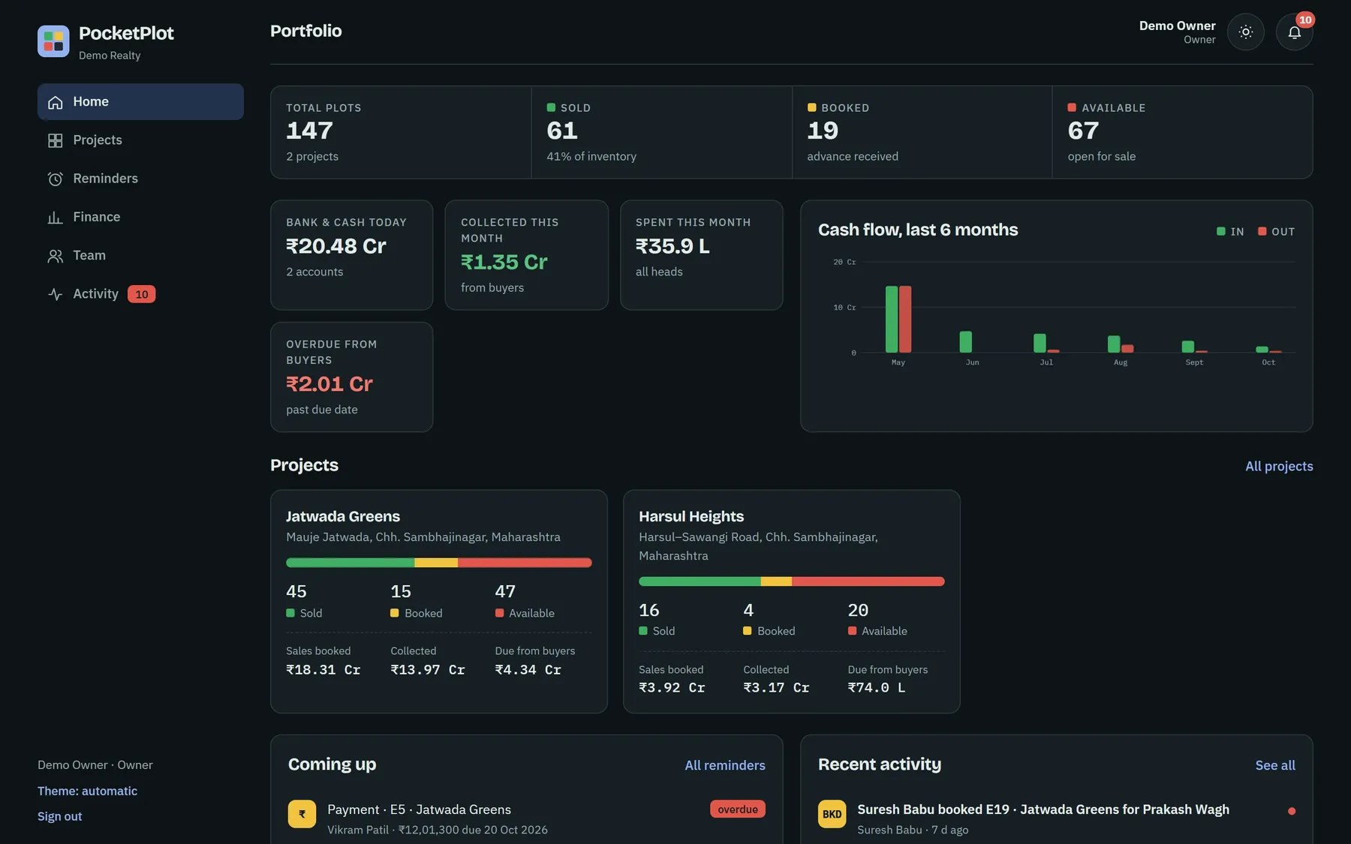
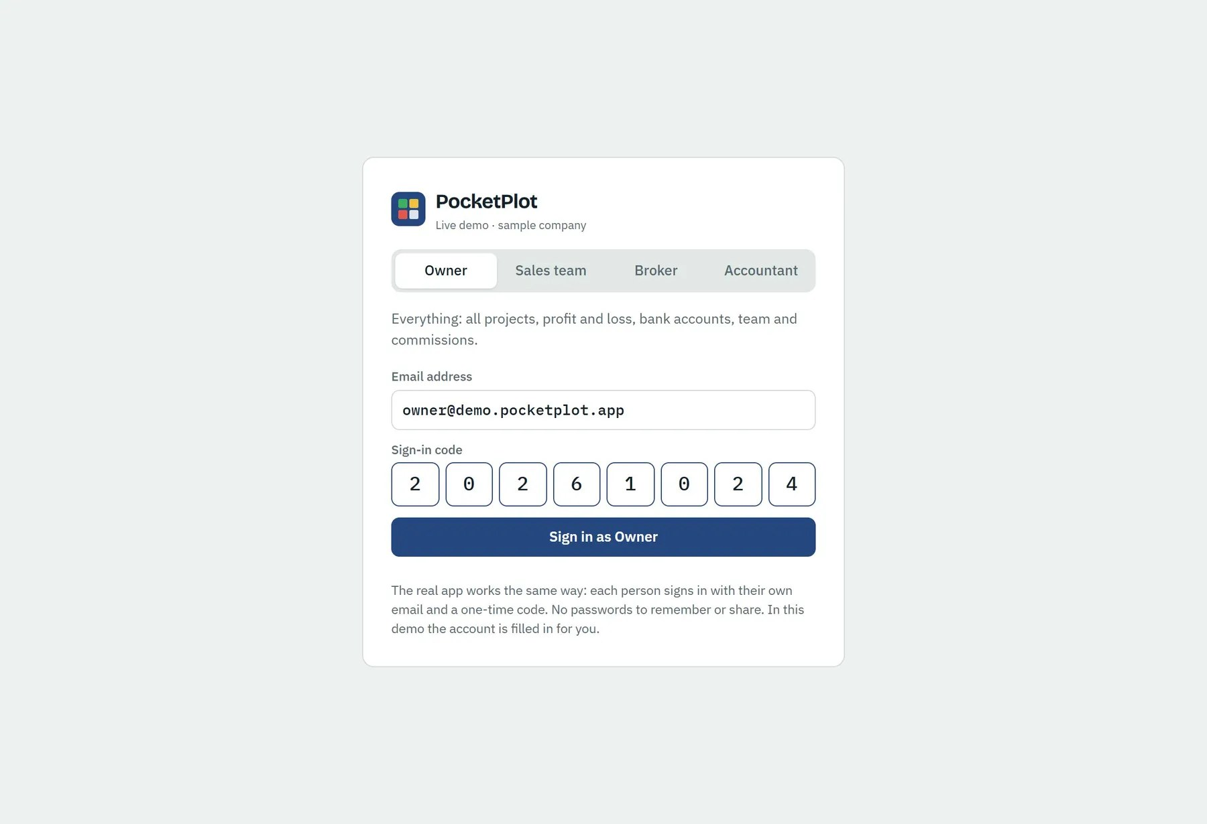
Receipts, instalments, assets and a layout editor are already built
PRODUCT TOUR · EVERYTHING ELSE
Layout editor: fix any plot the AI read
Block-wise view of a project
Numbered receipt, rupees in words
Company assets and their value
Owner home in dark mode
One-click live demo for every role

Slide 9
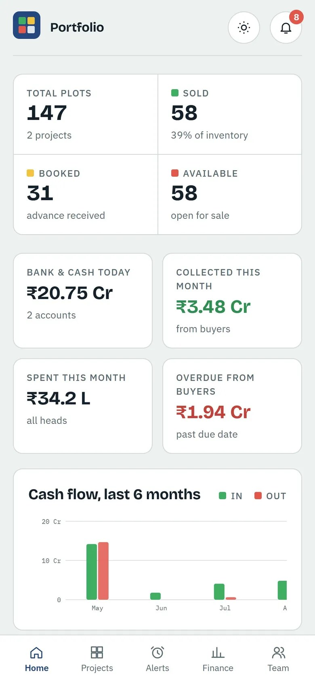
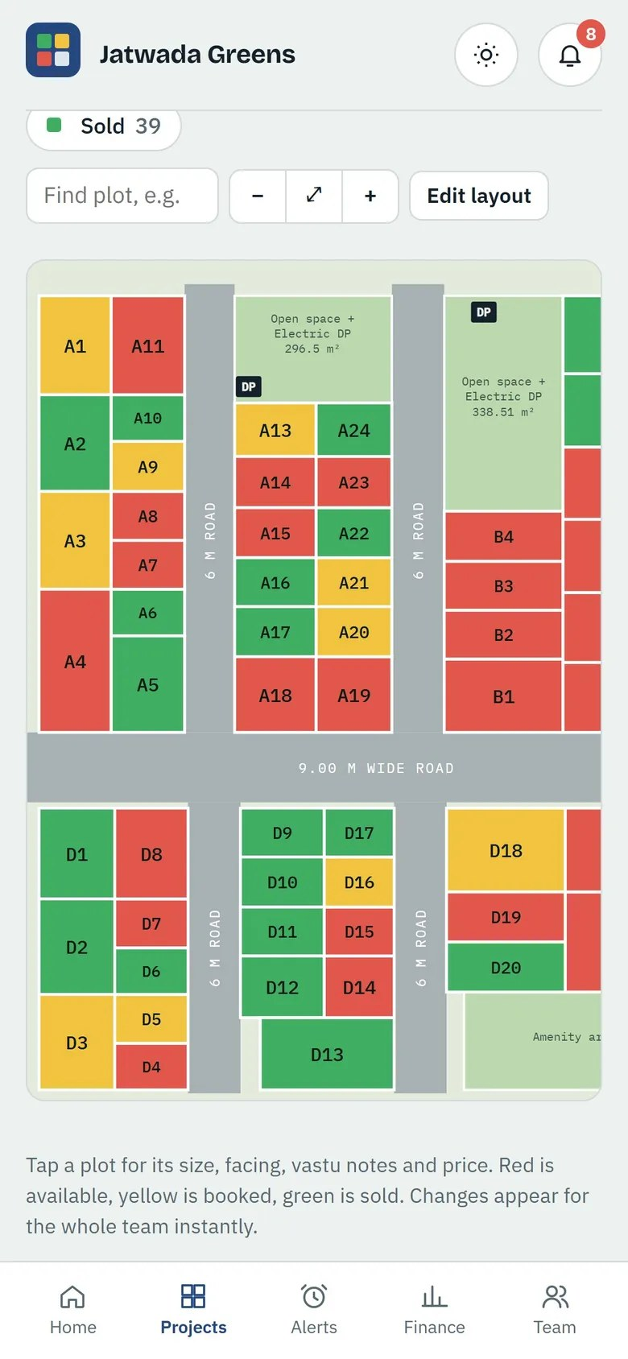
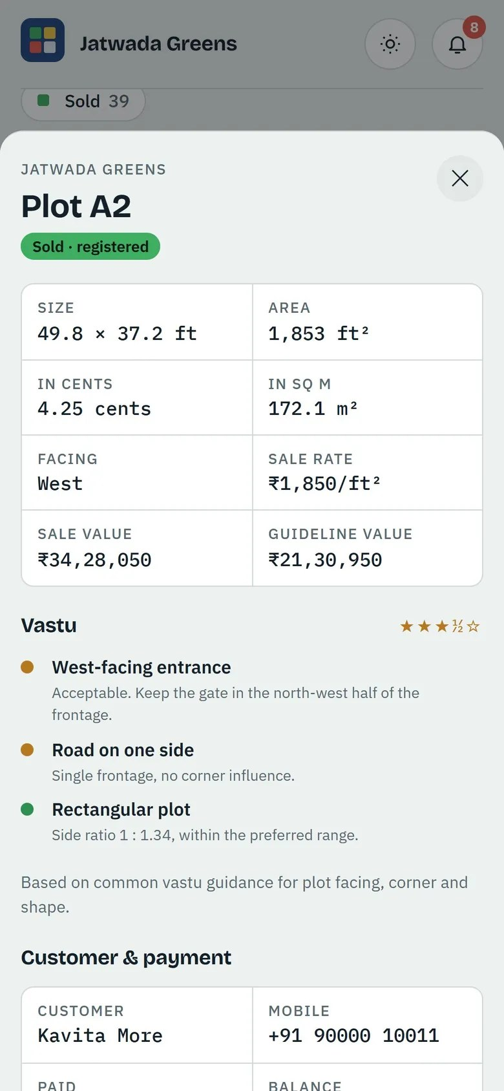
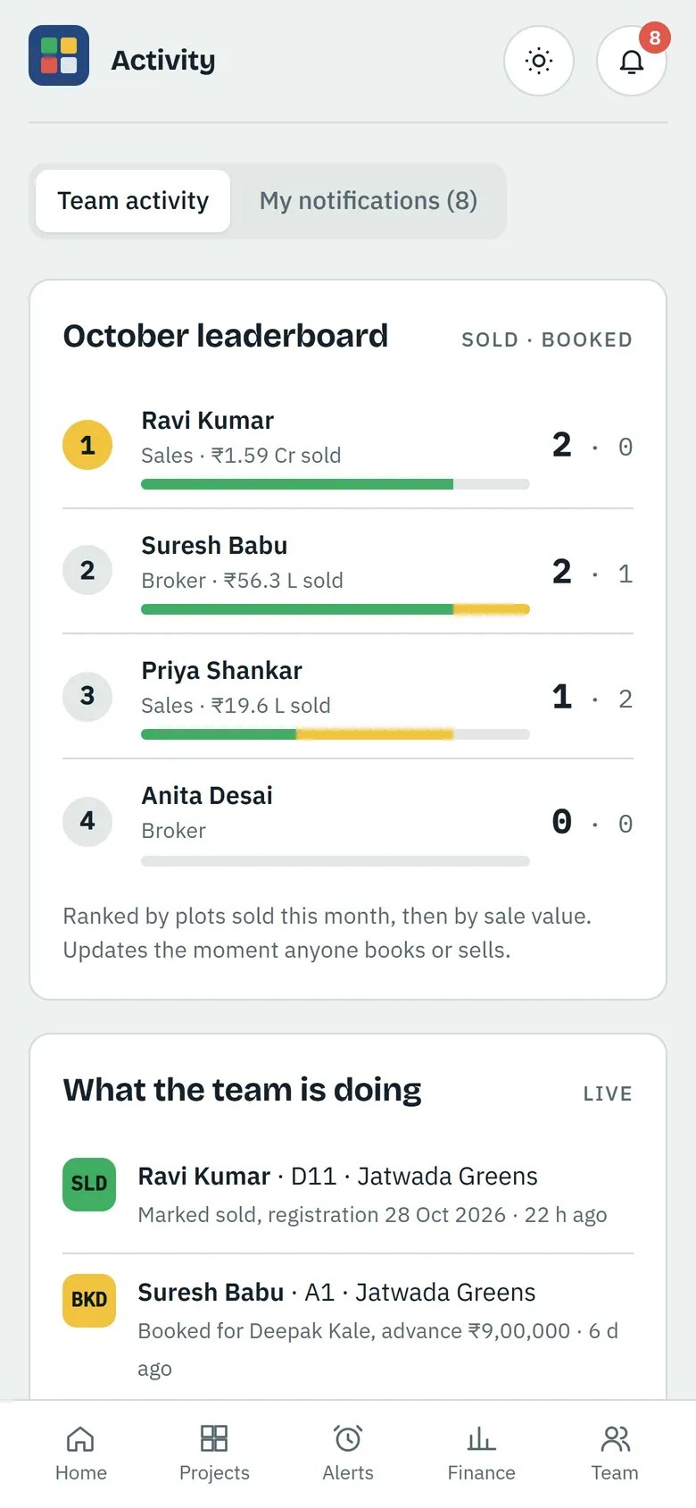
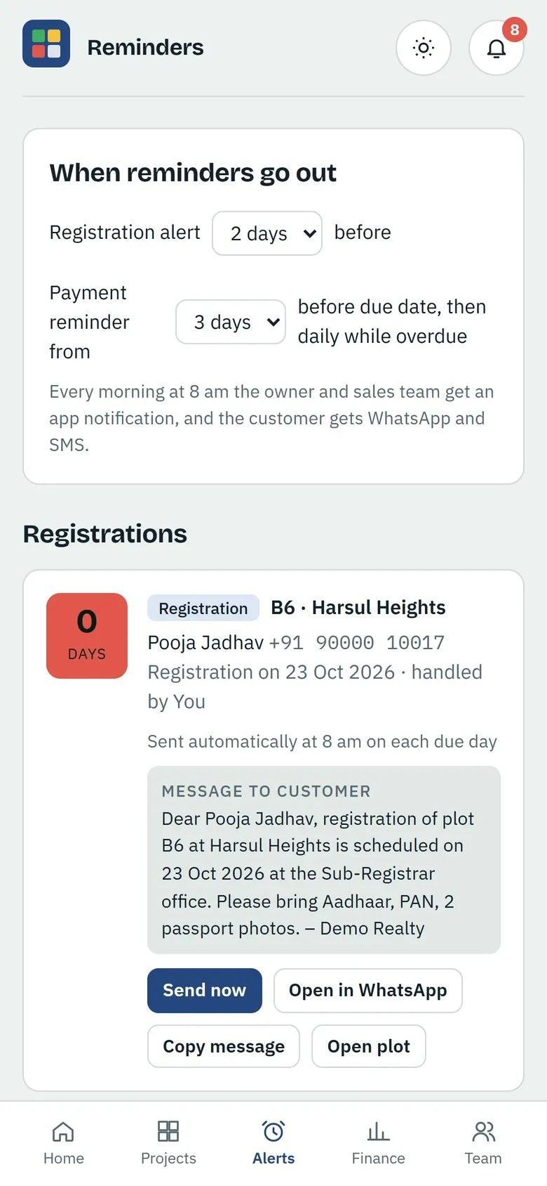
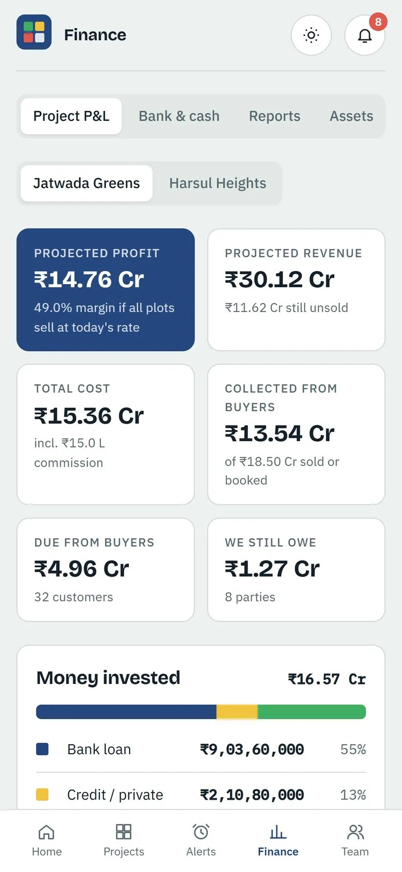
Built for the site visit: Android, iPhone and any browser
ON THE PHONE
Sales staff carry a ₹15,000 tablet or their own phone and show buyers the live layout at the site. Owners and accountants work from the office computer. One login per person, four roles.

Slide 10
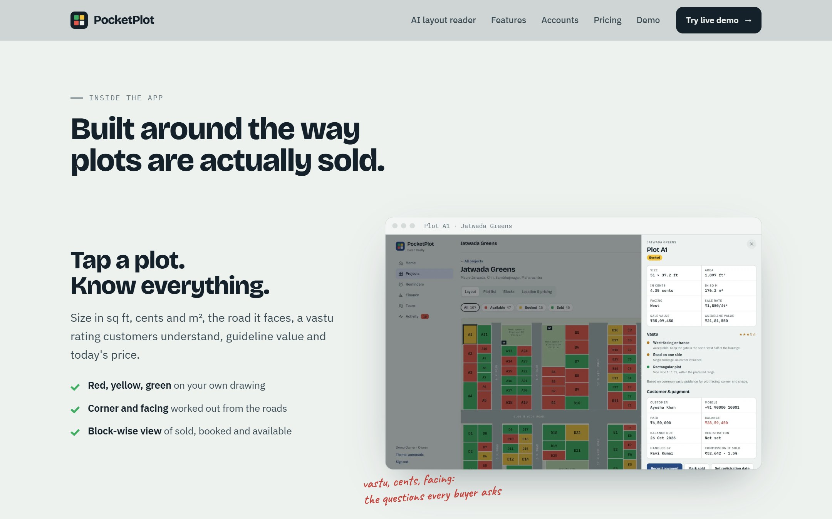
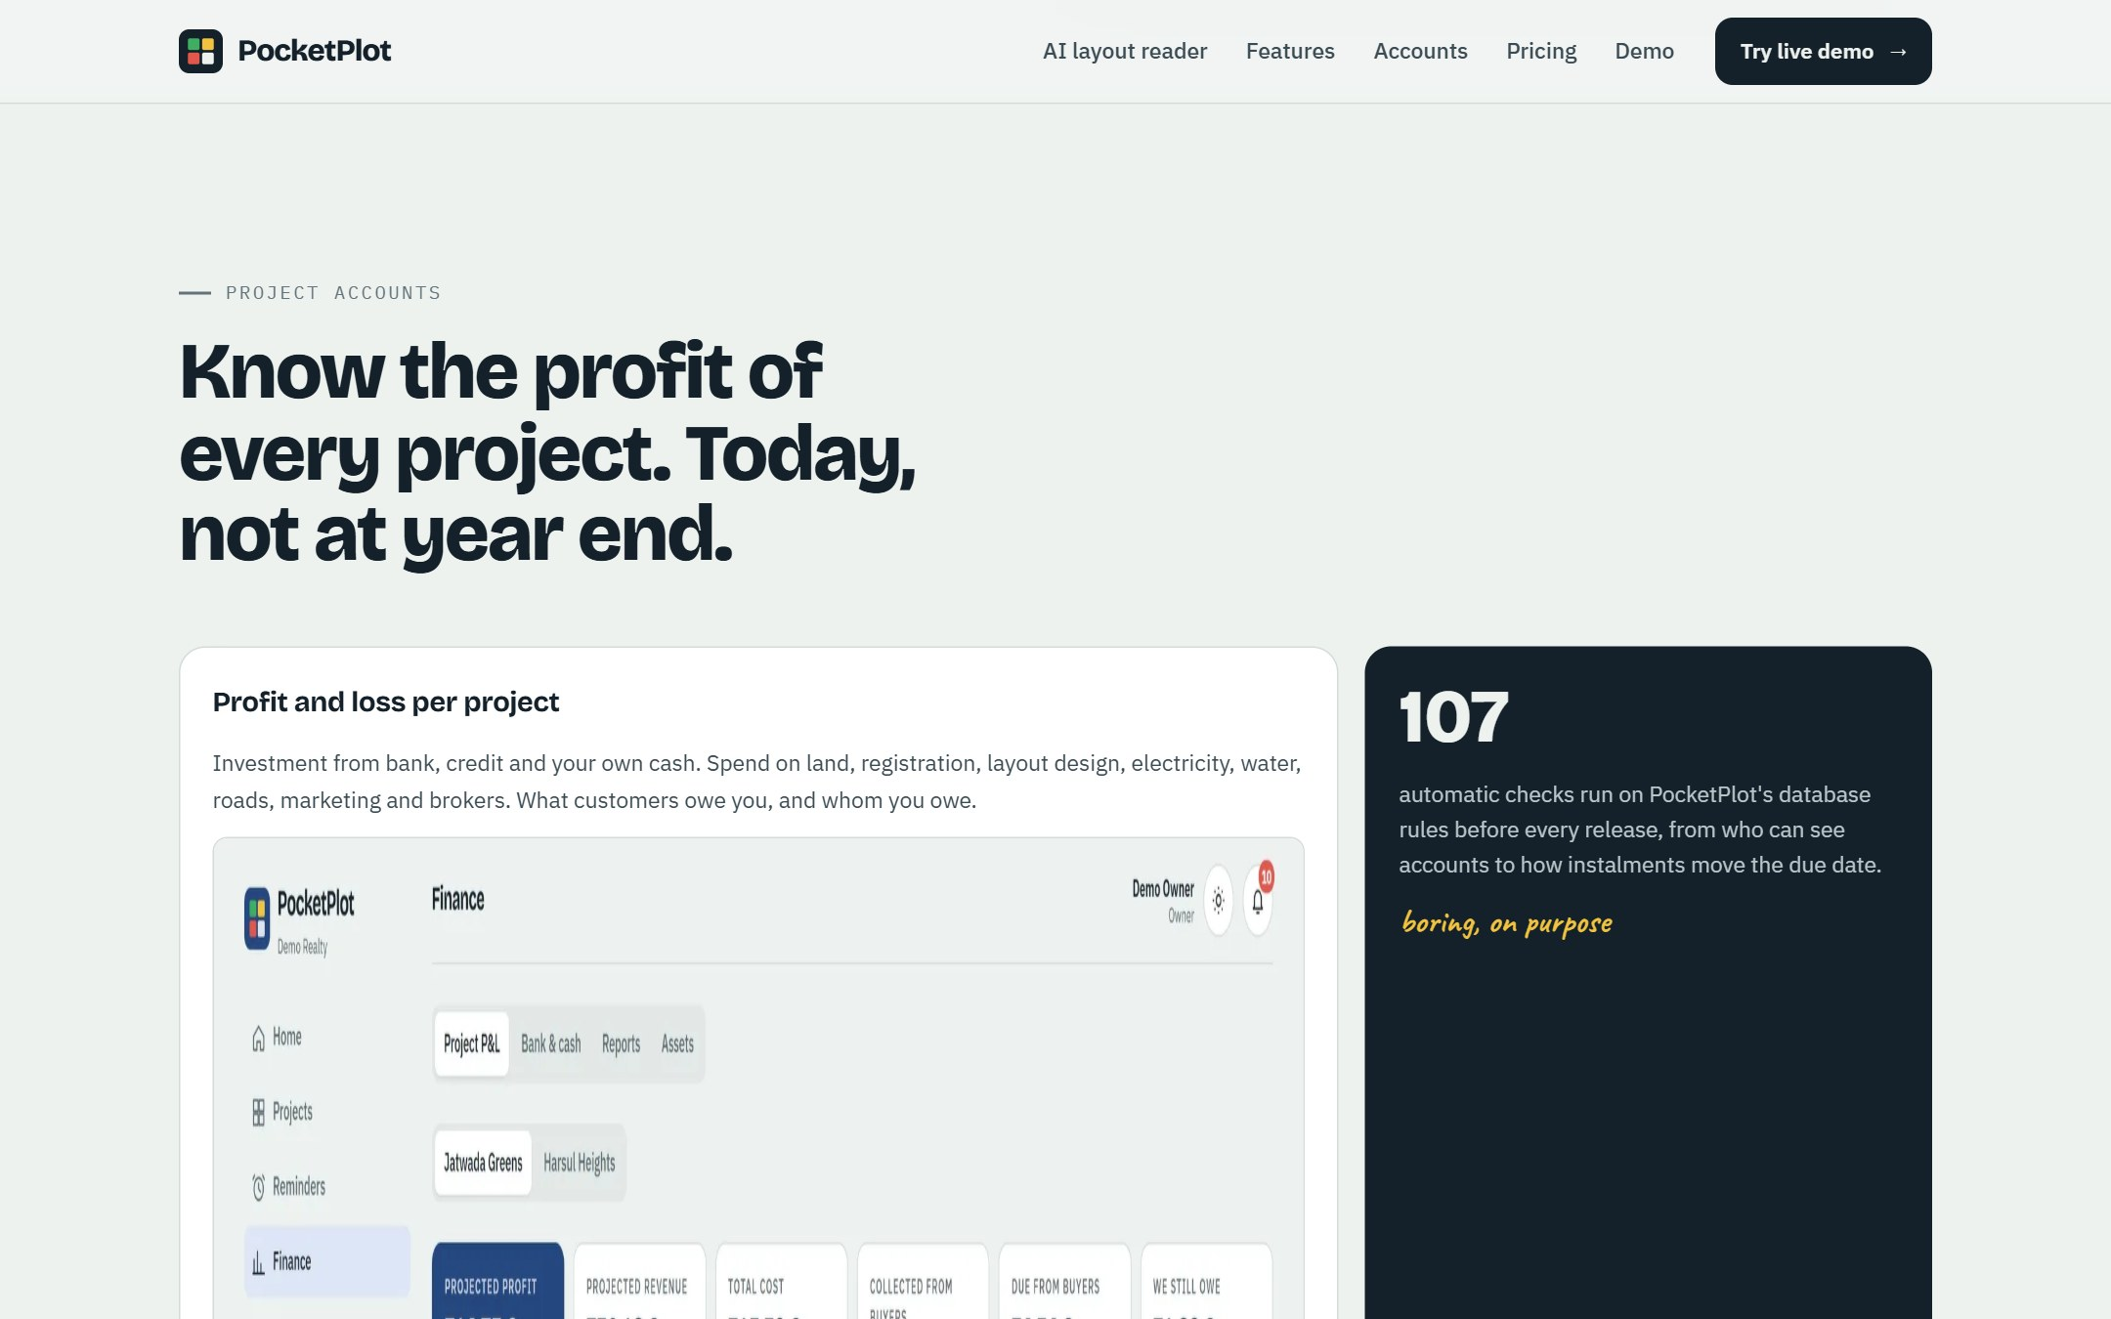
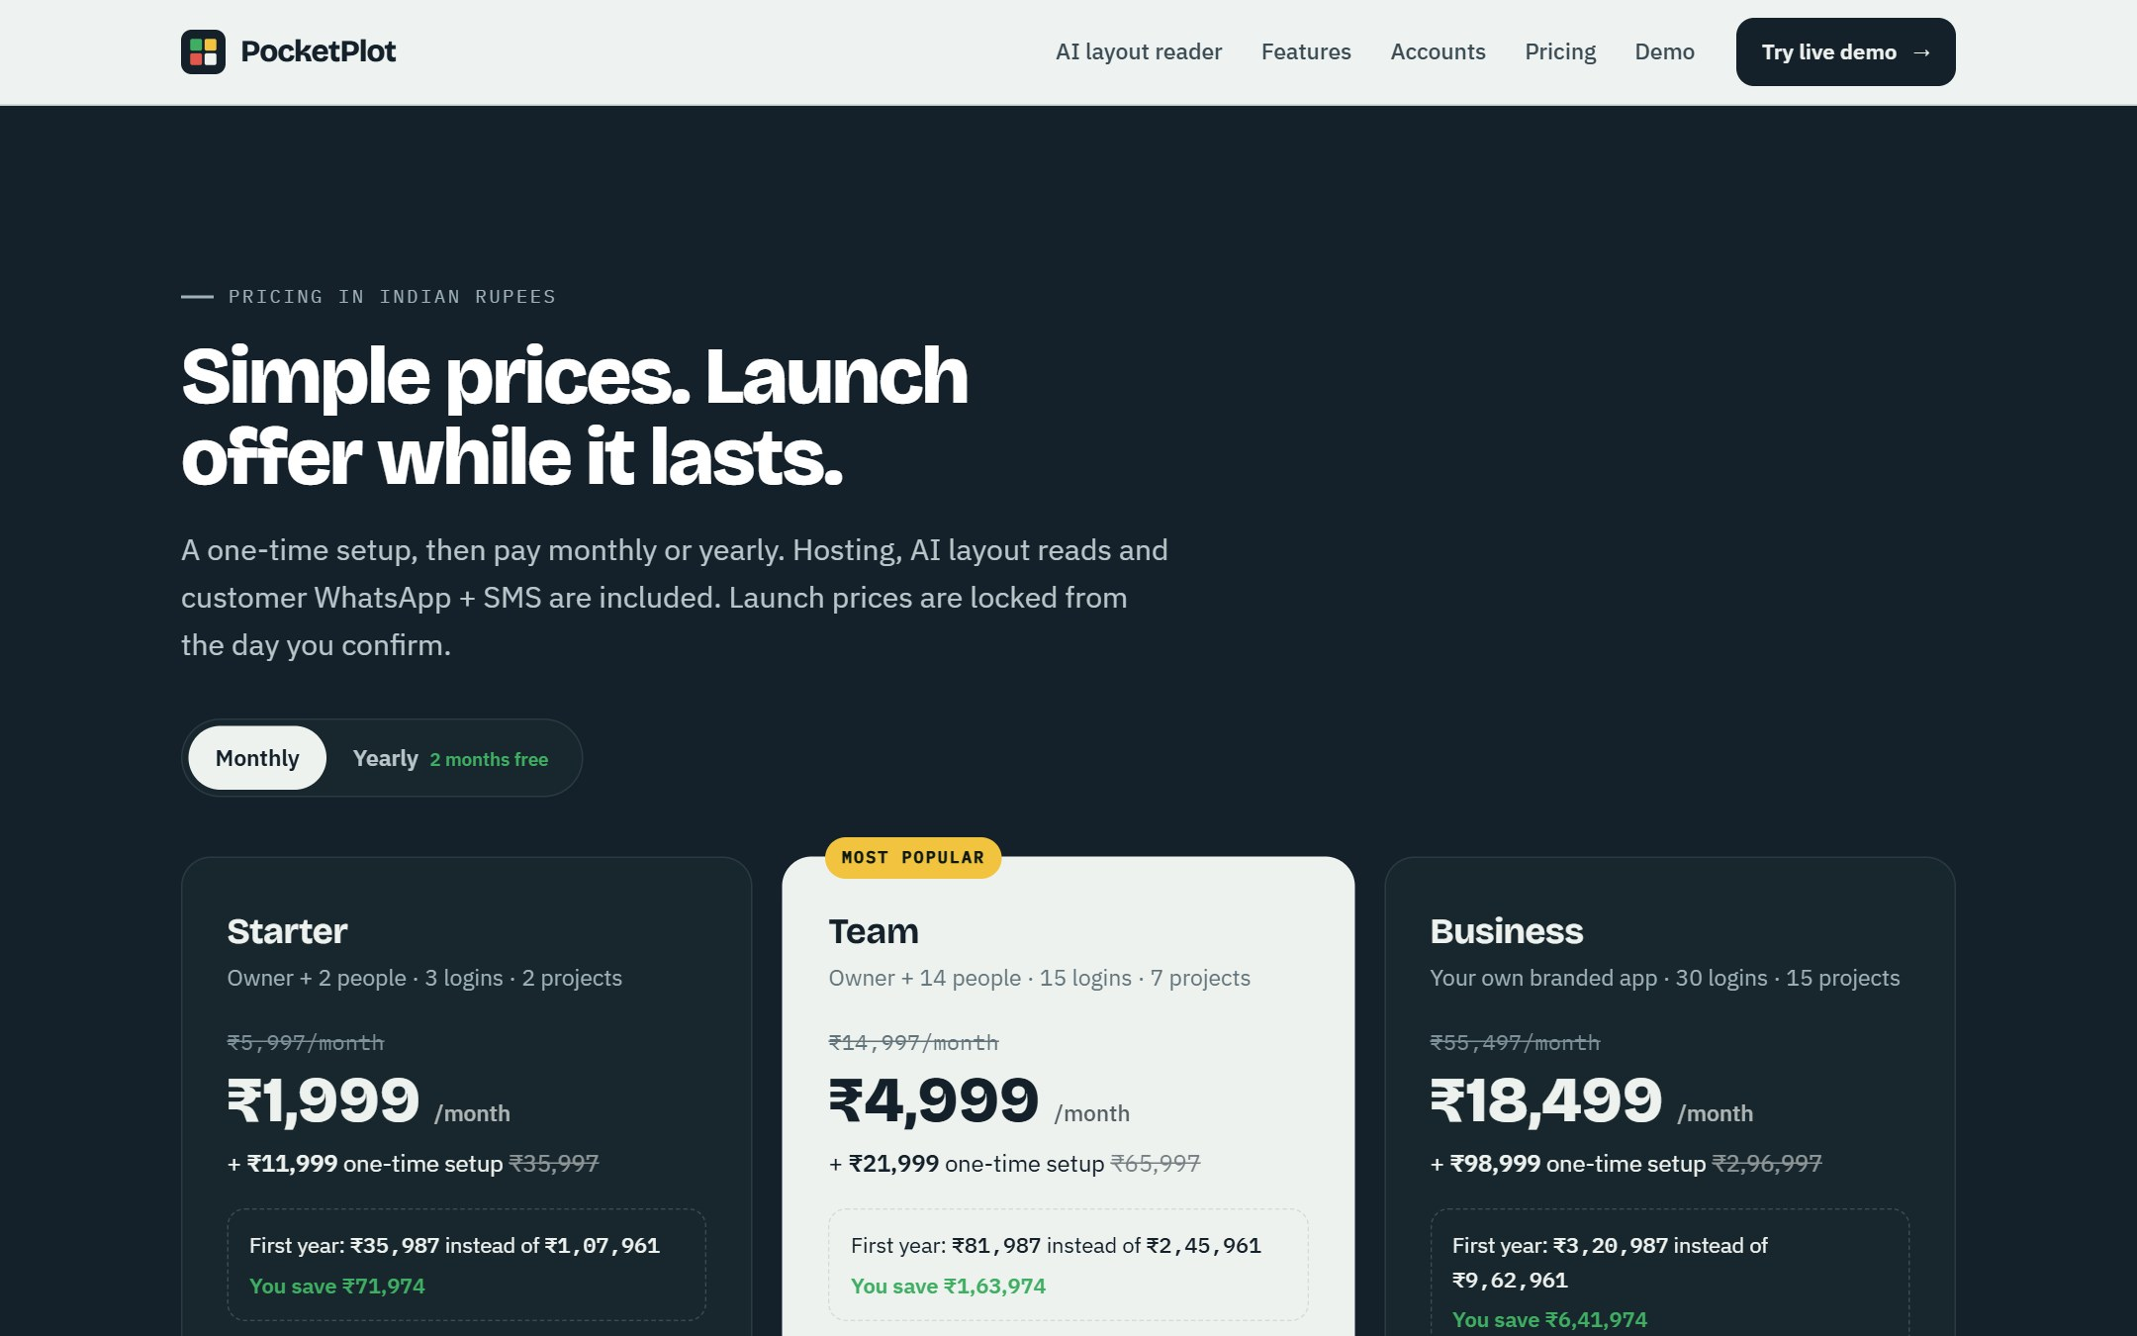
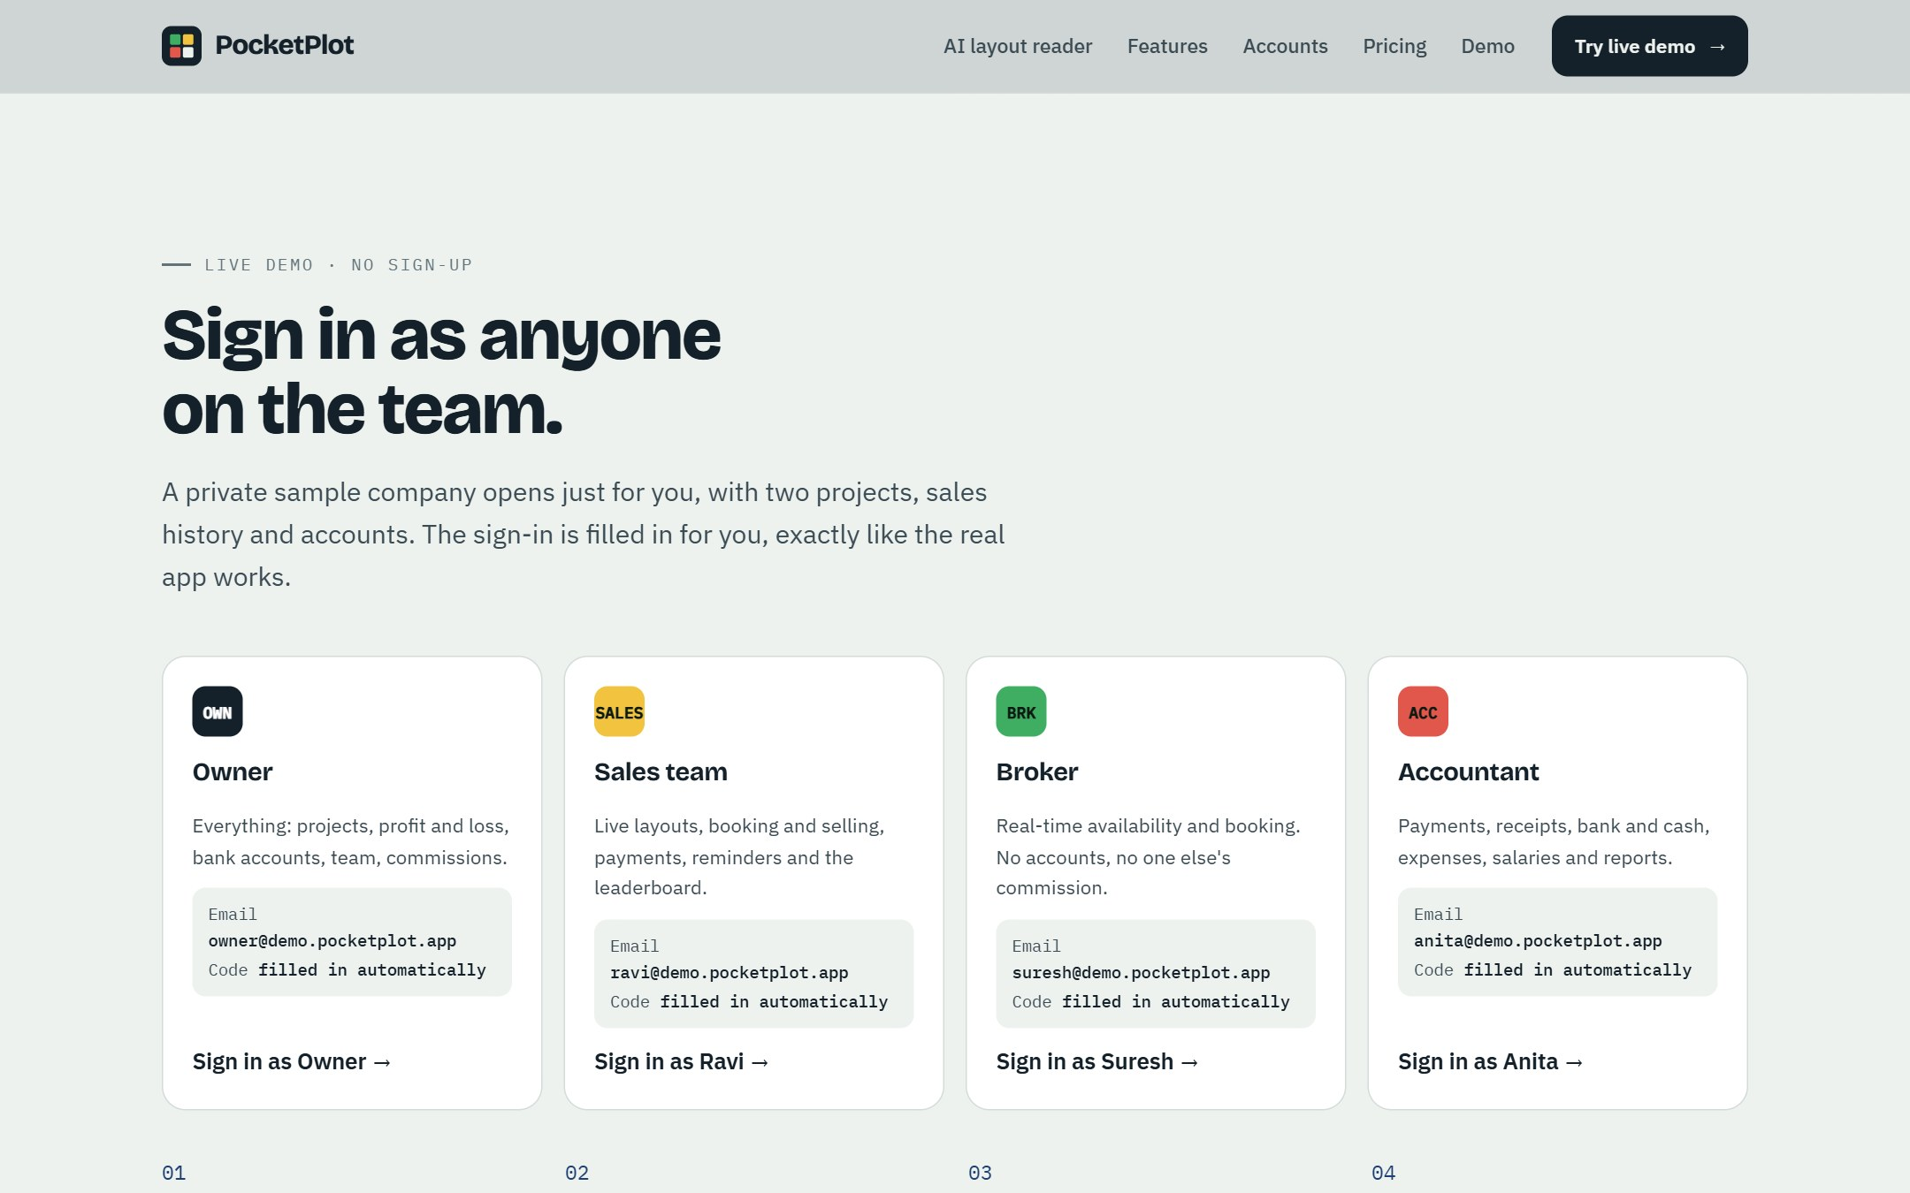
Sales website, pricing and a live demo anyone can try today
ALREADY LIVE
plotskart.in: the sales site with plans, launch offer and an enquiry form that alerts us by email
plotskart-n2r.netlify.app/?demo: a private sample company per visitor, in any of the four roles
The app, database, AI reader, reminders and accounts are built. What is left is billing, store releases and WhatsApp/SMS approvals

Slide 11
Big CRMs and ERPs serve large builders; layout owners make do with Excel
COMPETITOR ANALYSIS
Who | What they have | What they miss for layout owners | Price
Excel, paper layout, WhatsApp, Tally | Free, familiar | No live plot status, no reminders, no project profit; errors and double bookings | Free
Kylas (sales CRM) | Leads, pipeline, WhatsApp add-on, unlimited users | No plot inventory or layout map, no instalments or project accounts | ₹12,999/mo flat; WhatsApp +₹3,500/mo
LeadSquared (CRM) | Lead capture, portal integrations, automation | Built for big sales teams; 20-user minimum; implementation fees | ₹2,500–6,500 per user/mo; ₹85k–4L setup
Sell.Do (real-estate CRM) | Leads, inventory (IRIS), bookings, channel partners | Apartment-builder focus, 5-user minimum, quote-only pricing | Quote; ~$35 per user/mo
Farvision / real-estate ERPs | Land, legal, construction, sales, accounts (350+ builders) | Heavy ERP, months to implement, desktop-first, no AI layout reading | Quote; lakhs per year
Local custom plot apps | A layout map built for one promoter | One-off build, no updates or support, no accounts | ₹1–5 L one-time
Plotskart | AI layout from a photo, live map, bookings, instalments, receipts, reminders, commissions, ledger, project P&L | Lead capture from portals and Tamil language still to come | ₹4,999/mo for 15 users
Sources: kylas.io; LeadSquared partner and competitor pages; Sell.Do pricing terms; Capterra (Farvision); vendor listings. Prices are as published or quoted by third parties, October 2026.

Slide 12
Made for plotted layouts, priced for a 15-person team
WHAT WE HAVE THAT THEY MISS
AI reads the layout
Plot-first, not lead-first
Money end to end
A photo or PDF becomes the live map in about 90 seconds. Competitors need every plot typed in.
Sq ft and cents, road facing, vastu, guideline value and customer-specific prices on every plot.
Instalments, numbered receipts, bank and cash ledger, expenses, commissions, salaries and project P&L.
Buyers are reminded
Live for the whole team
Fraction of the price
WhatsApp + SMS for bookings, instalments and registration dates, included in the plan.
Owner, sales, brokers and accountant see one picture with the right permissions, on phone or computer.
₹4,999 a month for 15 users is about ₹333 per user, against ₹867–6,500 per user elsewhere.

Slide 13
Three plans, launch offer at one-third of the regular price
PRICING
Starter
Team
Business
3 logins · 2 projects
15 logins · 7 projects
Own brand · 30 logins · 15 projects
₹5,997/mo
₹14,997/mo
₹55,497/mo
₹1,999
₹4,999
₹18,499
a month
a month
a month
+ ₹11,999 setup ₹35,997
+ ₹21,999 setup ₹65,997
+ ₹98,999 setup ₹2,96,997
Yearly ₹19,990 (2 months free)
Yearly ₹49,990 (2 months free)
Yearly ₹1,84,990 (2 months free)
Why these prices: each is the cost of serving a customer plus a share of the office, founder and support, divided by (1 − 30% margin). With 22 sales a month the cost-based Team price is now ₹5,999 a month and ₹27,999 setup; we launch at ₹4,999 and ₹21,999 (24% margin) to win the first customers, and can move up after the launch offer. All prices exclude 18% GST.

Slide 14
Each Team customer pays ₹4,999 a month and costs ₹1,223 to serve
UNIT ECONOMICS · ONE TEAM CUSTOMER
₹3,676
left each month after the costs of serving one customer and the card fee
₹21,999
setup fee, paid once; covers sales, marketing and onboarding
187
paying Team customers cover all fixed costs (₹6.8 L a month) without any setup fees

Slide 15
₹6.8 L a month to run the business, people first
OPERATING COSTS AFTER LAUNCH
What is in it
Shared workspace in Coimbatore: 4 seats at ₹8,000, power and internet included
CA and accountant ₹10,000: ROC filings, GST returns, TDS and books
Founder / CEO ₹2 L from launch; nothing during the 2 build months
Supabase, hosting, email, app stores and tools under ₹10,000 at this size
AI reads, WhatsApp and SMS grow with customers and are costed per customer

Slide 16
₹12.3 L once, before launch
ONE-TIME STARTUP COSTS
Item | ₹
App work left: billing, sign-up, store releases, WhatsApp/SMS approvals, phone sign-in, testing (60 days × ₹6,000) | ₹3,60,000
Security test ₹60,000 · Mac for iPhone builds ₹1,00,000 | ₹1,60,000
Launch dinners: Coimbatore, Chennai, Madurai, Dindigul (4 × ₹50,000) + brand kit | ₹2,60,000
4 sales tablets ₹60,000 · 3 basic laptops ₹90,000 · hiring ₹40,000 · workspace deposit ₹32,000 | ₹2,22,000
Pvt Ltd registration, trademark (2 classes), terms and privacy policy | ₹60,000
Apple and Google accounts, SMS DLT, first WhatsApp/SMS/AI credits, domains | ₹59,504
Miscellaneous and contingency (10%) | ₹1,12,150
Total | ₹12,33,654

Slide 17
Launch in four cities with dinners for layout owners, then 22 sales a month
GO-TO-MARKET
Coimbatore
Madurai
Dindigul
Chennai
Home base, first dinner in launch week
Dinner in launch month 1
Dinner in launch month 1
Dinner in launch month 2
1
2
3
4
Build (2 months)
Launch dinners
Field sales
Steady state
Finish billing and store releases, get WhatsApp and SMS approved, register the company, hire the team.
40–60 layout owners per city see their own layout go live from a photo, on the spot.
4 sales staff with tablets visit sites; brokers and surveyors refer owners for a commission.
20 Team + 2 Business sales a month; support loads every layout within 48 hours.
Launch dinners are budgeted at ₹50,000 per city (₹25,000–50,000 range). 5% of customers are assumed to choose the yearly plan.

Slide 18
Revenue passes costs in M2; ₹1.81 Cr in year 1
IDEAL CASE · 36 MONTHS
 | Year 1 | Year 2 | Year 3
Revenue | ₹1.81 Cr | ₹3.34 Cr | ₹4.49 Cr
Profit | ₹36.2 L | ₹1.56 Cr | ₹2.36 Cr
Year 1 profit is after the one-time costs and the two build months.
565
paying companies by month 36
₹34.9 L
subscription revenue a month by month 36

Slide 19
Money is drawn only until the business funds itself
WHICH MONTH NEEDS HOW MUCH
Month | Ideal | Realistic
Build 1 (incl. one-time) | ₹13.57 L | ₹13.57 L
Build 2 | ₹1.23 L | ₹1.23 L
M1 | ₹26,171 | ₹6.07 L
M2 | – | ₹5.20 L
M3 | – | ₹3.50 L
M4 | – | ₹2.33 L
M5 | – | ₹1.09 L
Total | ₹15.06 L | ₹32.98 L

Slide 20
Investment earned back by M7 (ideal) or M13 (realistic)
RETURN OF INVESTMENT
How the partnership could work
One Pvt Ltd company with both of you as directors
Investor brings the capital as share capital, drawn month by month as above; the unused reserve stays with the investor
CEO brings the product, technology and daily operations: sweat equity that vests over 4 years, plus salary from launch
Example: investor 60%, CEO 40%. From payback, half of each month's profit is paid out and half kept for growth. The investor then receives about ₹58.8 L by month 24 and ₹1.30 Cr by month 36 (ideal), or ₹1.05 Cr by month 36 (realistic)
Have a CA draft the shareholder agreement; dividends are taxed in the investor’s hands

Slide 21
What has to go right, and how we will know by month 3
BEST CASE TO SUCCEED
✓
First 20 customers from the launch dinners
Milestones (ideal case)
Show each owner their own layout going live from a photo. Offer the launch price only that week.
Month 1
22 customers, 4 cities launched
✓
Layouts live within 48 hours
Month 2
first profitable month
Support loads every project with the AI reader, so customers see value before the first bill.
Month 3
65 paying customers
✓
Referral partners
Brokers, surveyors and DTCP consultants earn a share of the setup fee for every owner they bring.
Month 7
investment earned back
Month 12
239 paying customers
✓
Stickiness from money features
Once instalments, receipts and the ledger run in Plotskart, customers rarely leave.
Month 36
565 customers, ₹34.9 L a month

Slide 22
If sales are slow, a lean team breaks even at half the size
FALLBACK PLAN
Warning signs
What we do, in order
Why we can recover
Fewer than 40 paying customers by month 3
Bank balance below 3 months of fixed costs
More than 5% of customers leaving a month
Launch dinners converting under 10%
Cut ads to ₹20,000 and marketing to ₹60,000; focus on Coimbatore and Madurai
Pay sales mostly on commission (₹70,000 base)
Founder salary halved to ₹1 L
Push the yearly plan (2 months free) to bring cash forward
Sell services: loading old layouts and payment history, branded apps
109
paying Team customers cover the lean costs (₹4.0 L a month), against 187 at full costs
Every customer pays more than it costs to serve, so a smaller team is still profitable. The product is built and the money is drawn monthly, so the most at risk early is the ₹14.8 L spent before launch.

Slide 23
More ways to earn from the same customers and their buyers
OTHER REVENUE STREAMS
Usage top-ups
Done-for-you setup
Project microsite
Lead generation
Extra AI layout reads at ₹99 and reminders at ₹1 each.
Load old layouts, bookings and payment history: ₹5,000–15,000 per project.
A public live layout for buyers with an enquiry form: ₹1,999 per project a month.
Run Facebook and Google campaigns for promoters for 15% of their ad spend.
Collections
Partner referrals
Print from the live map
Branded apps
UPI payment links on every instalment reminder, sharing the gateway fee.
Home loans, legal and registration, surveyors and vastu consultants pay for referrals.
Layout brochures, hoardings and site boards designed from the live layout.
Custom builds for larger developers from ₹3.5 L, plus a yearly maintenance fee.

Slide 24
The next 90 days
NEXT STEPS
Week 1–2
Week 2–8
Week 8–10
Week 10–13
Agree the partnership terms; register the Pvt Ltd; open the bank account; file the trademark and DPIIT recognition.
Build billing and sign-up; release on Play Store and App Store; WhatsApp templates and SMS DLT approved; hire sales, marketing and support.
Launch dinners in Coimbatore, Madurai and Dindigul; first 22 customers live within 48 hours each.
Chennai launch; referral partners signed; review the month-3 warning signs and adjust.
Ask: ₹40 L committed, drawn monthly. Ideal case uses ₹15.1 L, self-funding from M2, investment back by M7.
Figures come from Plotskart_Pricing_Model.xlsx; every assumption there can be changed and the plan recalculates.

Slide 25
Key assumptions behind the numbers
APPENDIX
Assumption | Value | Assumption | Value
Sales a month (ideal) | 20 Team + 2 Business | Customers paying yearly | 5% (10 months for 12)
Team size per customer | 10–15 users, costed at 15 | Projects per customer | 6–7, costed at 7
Customers leaving a month | 2% | Build months before launch | 2, no founder salary
AI layout read | $0.34 (₹33), 15 a month | WhatsApp / SMS | ₹0.145 / ₹0.22 + 18% GST
Supabase | Pro $25 + compute, scales per 50 customers | Exchange rate | ₹96 per $
Sales / marketing / support | ₹1 L / ₹1.5 L / ₹60,000 a month | Ads | ₹60,000 a month
Workspace | 4 seats × ₹8,000 | CA and accountant | ₹10,000 a month
Founder / CEO | ₹2 L a month from launch | Contingency | 10% on all costs
Payment gateway | 2% of collections | Sales incentive | 5% of setup fees
Taxes | GST and income tax pass through, not modelled | Prices | As published on the sales site
Sources: supabase.com/pricing; AiSensy (WhatsApp utility rate); MSG91; Infobip and Fast2SMS (DLT fee); taxaj.com and agileregulatory.com (company registration); IP India fee guides (trademark); measured AI cost on a real 107-plot drawing.

