Slide 1
Digital Portfolio
STUDENT NAME: MOHAMED NOORUSSALAM
REGISTER NO AND NMID:2428C0153 AND C69EB4075F74557BEE641D14B85695C0
DEPARTMENT: B.Sc.Artificial Intelligence and Machine learning .
COLLEGE: COLLEGE/ UNIVERSITY: Adithya College of Arts And Science/Bharathiyar University.

Slide 2
PROJECT TITLE
Digital portfolio

Slide 3

AGENDA
Problem Statement
Project Overview
End Users
Tools and Technologies
Portfolio design and Layout
Features and Functionality
Results and Screenshots
Conclusion
Github Link
3/21/2024 Annual Review

Slide 4

PROBLEM STATEMENT
In today's digital era, traditional resume alone are not enough to showcase skills and projects effectively.
Many students and professionals lack a structured online presence to highlight their work.
A Digital portfolio provides an interactive and accessible platform to present achievements, skills,
and experiences.

Slide 5

PROJECT OVERVIEW
A Detailed summary of my project.
It contains About us, Project, Skill, Contact.
Main idea: Showcase Personal Achievements, skills, Certifications.

Slide 6

WHO ARE THE END USERS?
Students.
Job seekers.
Beginners.
Professionals.

Slide 7

TOOLS AND TECHNIQUES
HTML - Structure the webpage.
CSS - Style the page.
JS - Develop interactivity between user & developer.
Use visual studio code or codepen for coding.Hosting
paltform on github.

Slide 8
POTFOLIO DESIGN AND LAYOUT
Section Include:
Home/About us
Projects
Skills
Contacts
Responsive Layout(mobile,desktop view)

Slide 9
FEATURES AND FUNCTIONALITY
Navigation with smooth scrolling.
Project showcase with images.
Interactive Elements.
Contact form.

Slide 10

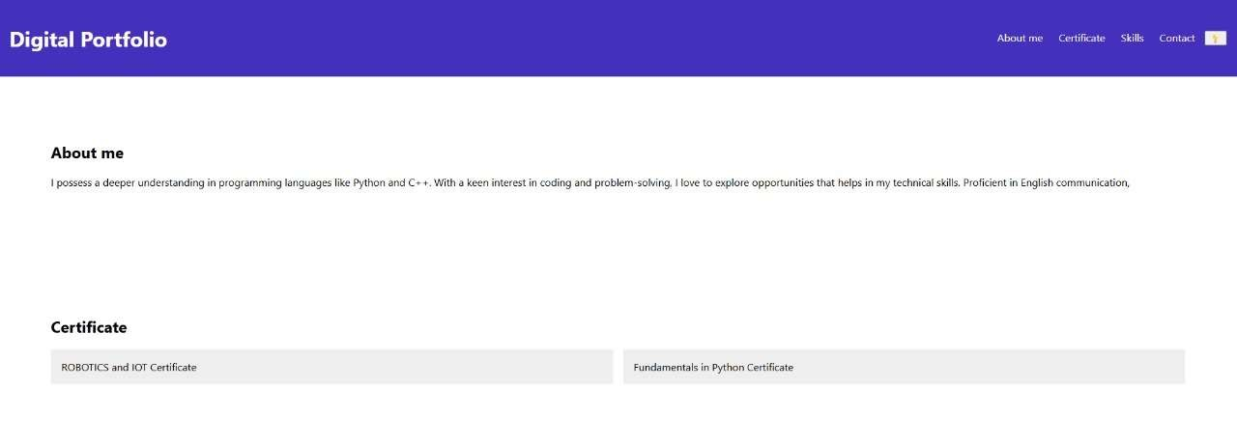
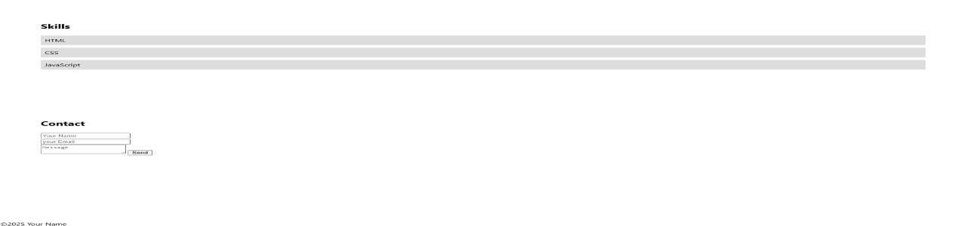
RESULTS AND SCREENSHOTS
3/21/2024 Annual Review

Slide 11

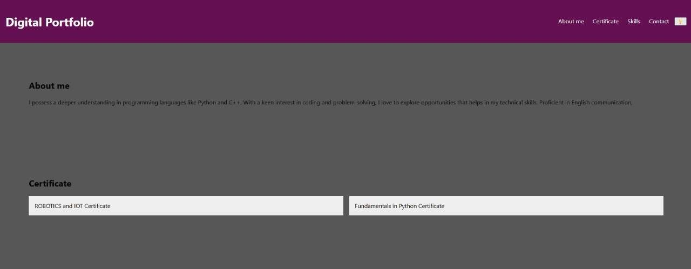
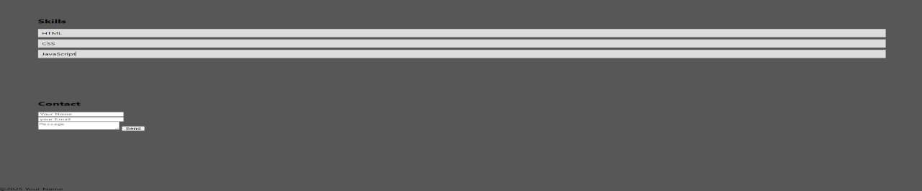
RESULTS AND SCREENSHOTS:
3/21/2024 Annual Review

Slide 12
CONCLUSION
It will help you to develop your personal portfolio easily. It defintely helps the people to introduced them formally to the professionals.

