Slide 1
DIGITAL INTEGRATED CIRCUITS • LOW-POWER SEQUENTIAL DESIGN
Low-Power CMOS D Flip-Flop
and 4-bit Register / Counter
Baseline → Enable-Controlled Design → Quantitative Comparison
Noor Shawamreh (1232243) · Nidal Abu Hammad (1231481)
Samir Hazboun (1230807) · Abdalrahman Basil (1230567)
Dept. of Electrical & Computer Engineering
Birzeit University
5 V
C5
4-bit
Electric + LTspice
VDD
CMOS models
Register + Counter
Tools

Slide 2
PROJECT MOTIVATION
02
Why this design flow?
The problem
OUR DESIGN FLOW
Sequential storage is everywhere, but clock switching and internal activity directly affect energy. A useful design must preserve correct state while controlling delay and power.
1
CMOS gates
2
D latch
Our question
3
Baseline DFF
Can an enable-controlled DFF suppress unnecessary clock activity while keeping the same storage behavior?
4
4-bit systems
5
Clock-gated DFF
6
Compare
ENCS3330 • Digital Integrated Circuits

Slide 3
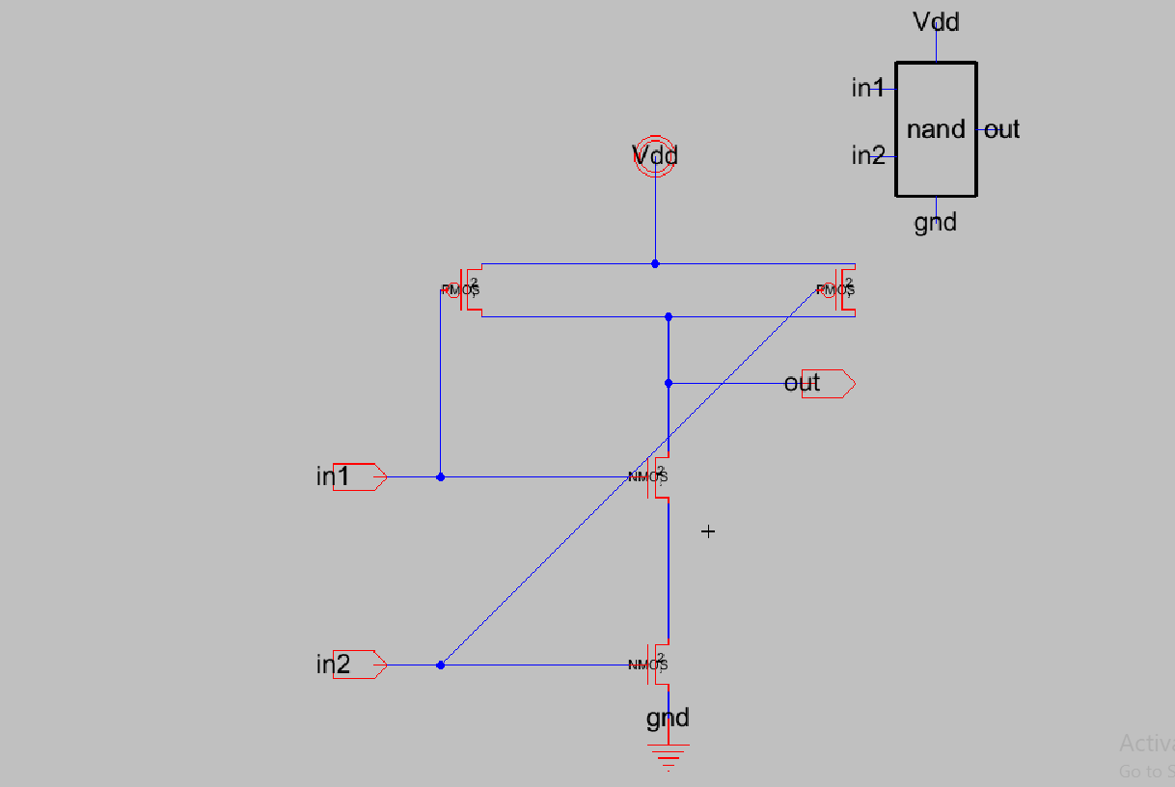
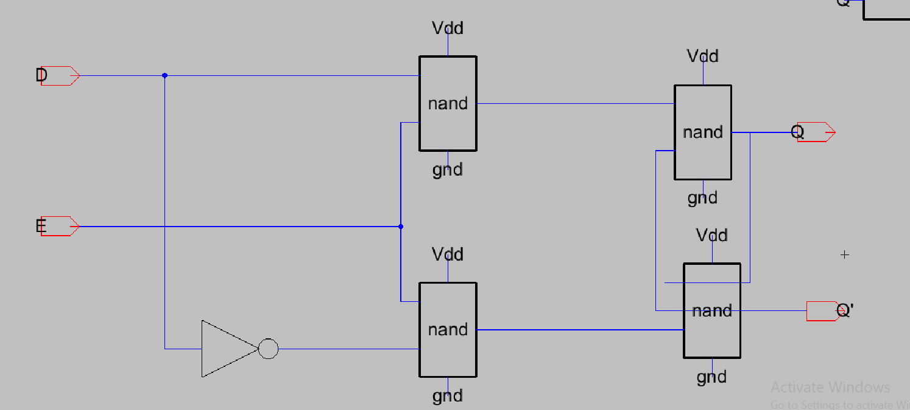
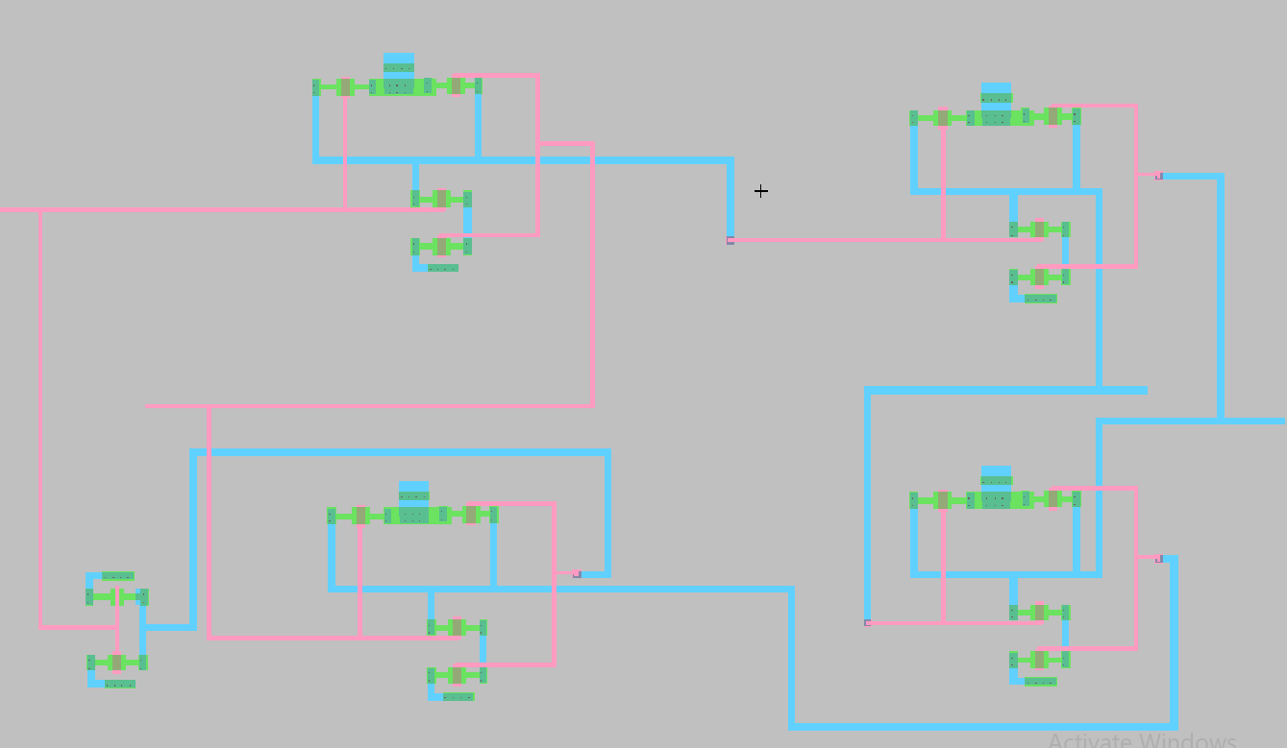
BASELINE BUILDING BLOCKS
03
From CMOS gates to a level-sensitive latch
2-input CMOS NAND schematic
D-latch schematic
D-latch layout
Inverter
NAND2
D latch
2 MOSFETs
Used for data inversion and clock phase generation.
4 MOSFETs
Two PMOS in parallel + two NMOS in series.
18 MOSFETs
1 inverter + 4 NAND2 gates.
ENCS3330 • Digital Integrated Circuits

Slide 4
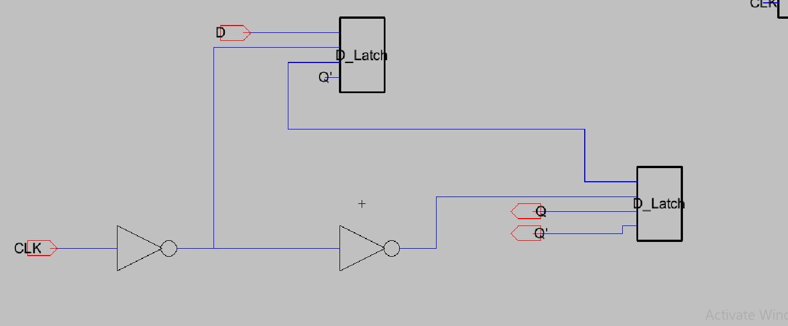
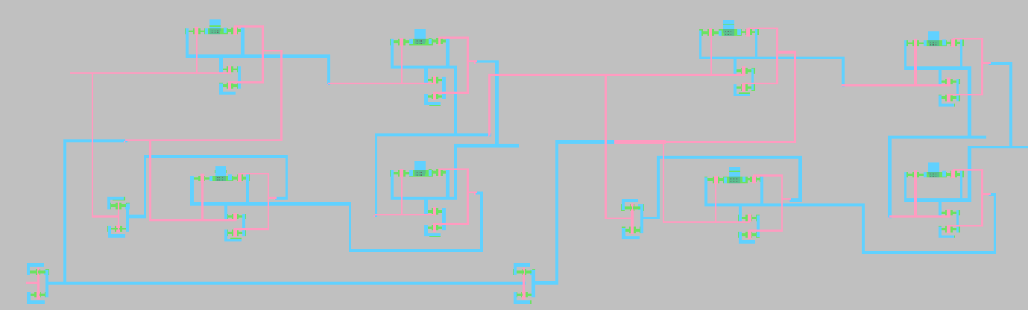
BASELINE D FLIP-FLOP
04
Positive-edge storage using two latch stages
Baseline DFF schematic
Baseline DFF layout
Architecture
Function
Complexity
Master latch transparent for CLK = 0; slave latch transparent for CLK = 1.
Q captures D at the active rising edge and retains the stored value between edges.
40 transistors
2 × 18-transistor latches + 2 clock inverters.
ENCS3330 • Digital Integrated Circuits

Slide 5
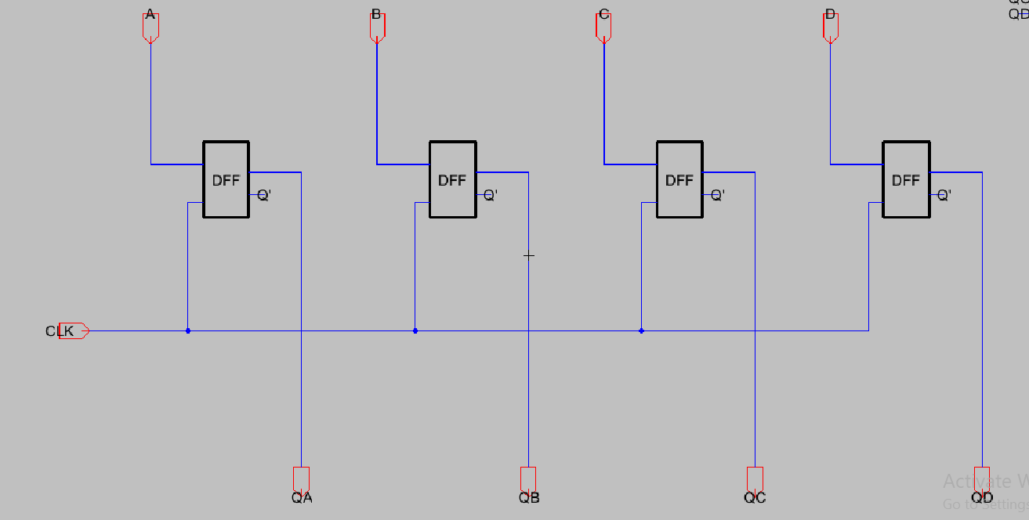
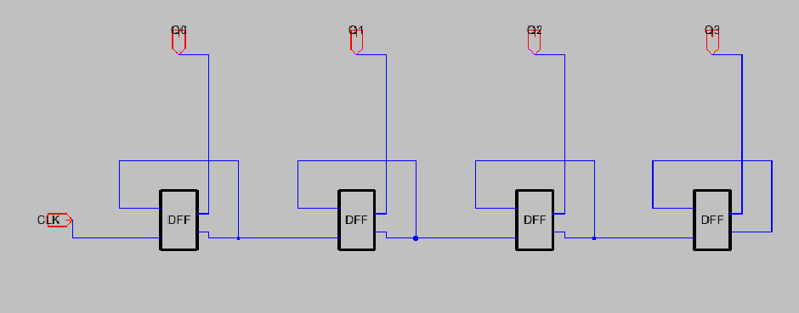
BASELINE 4-BIT SYSTEMS
05
Register and ripple counter built hierarchically
4-bit parallel register
4-bit ripple counter
Parallel register
Ripple counter
Four DFFs share one clock. All four input bits are sampled on the same active edge.
Q of each stage clocks the next stage. Simple structure, but propagation delay accumulates across stages.
ENCS3330 • Digital Integrated Circuits

Slide 6
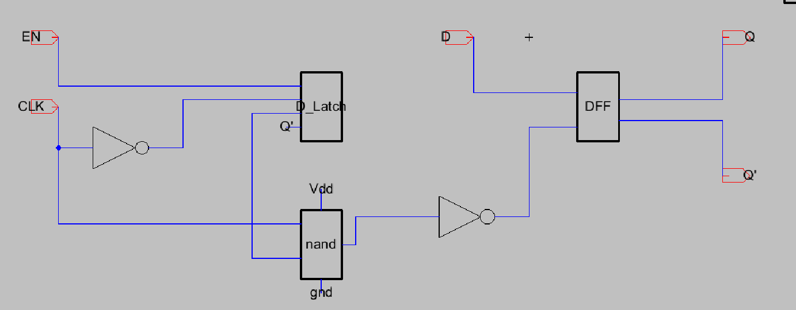
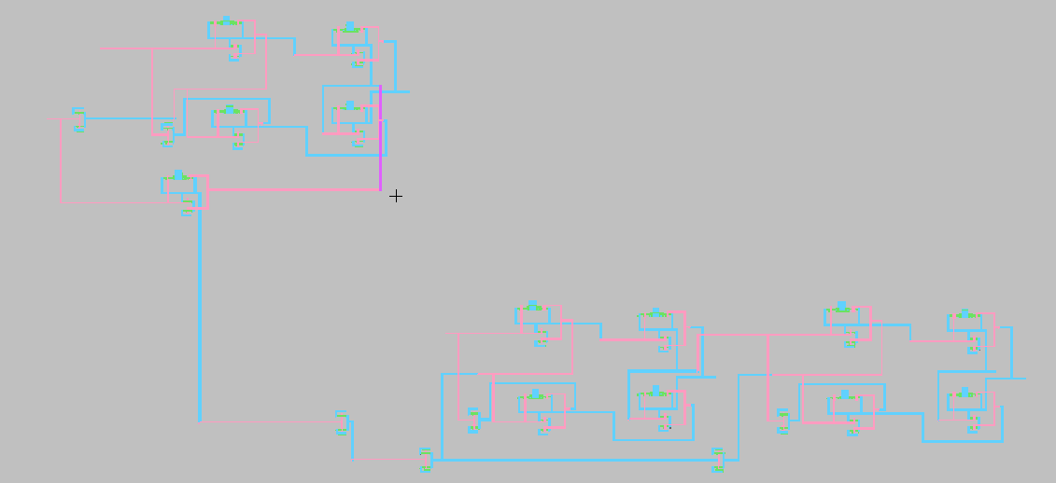
PROPOSED ENABLE-CONTROLLED DESIGN
06
Clock gating added ahead of the baseline DFF core
Optimized DFF schematic
Optimized DFF layout
EN = 1
EN = 0
Trade-off
Clock reaches the DFF core; normal edge-triggered operation.
Clock activity is suppressed; Q holds its stored state.
66 transistors. Added gating logic can reduce switching, but also adds area, delay and power overhead.
ENCS3330 • Digital Integrated Circuits

Slide 7
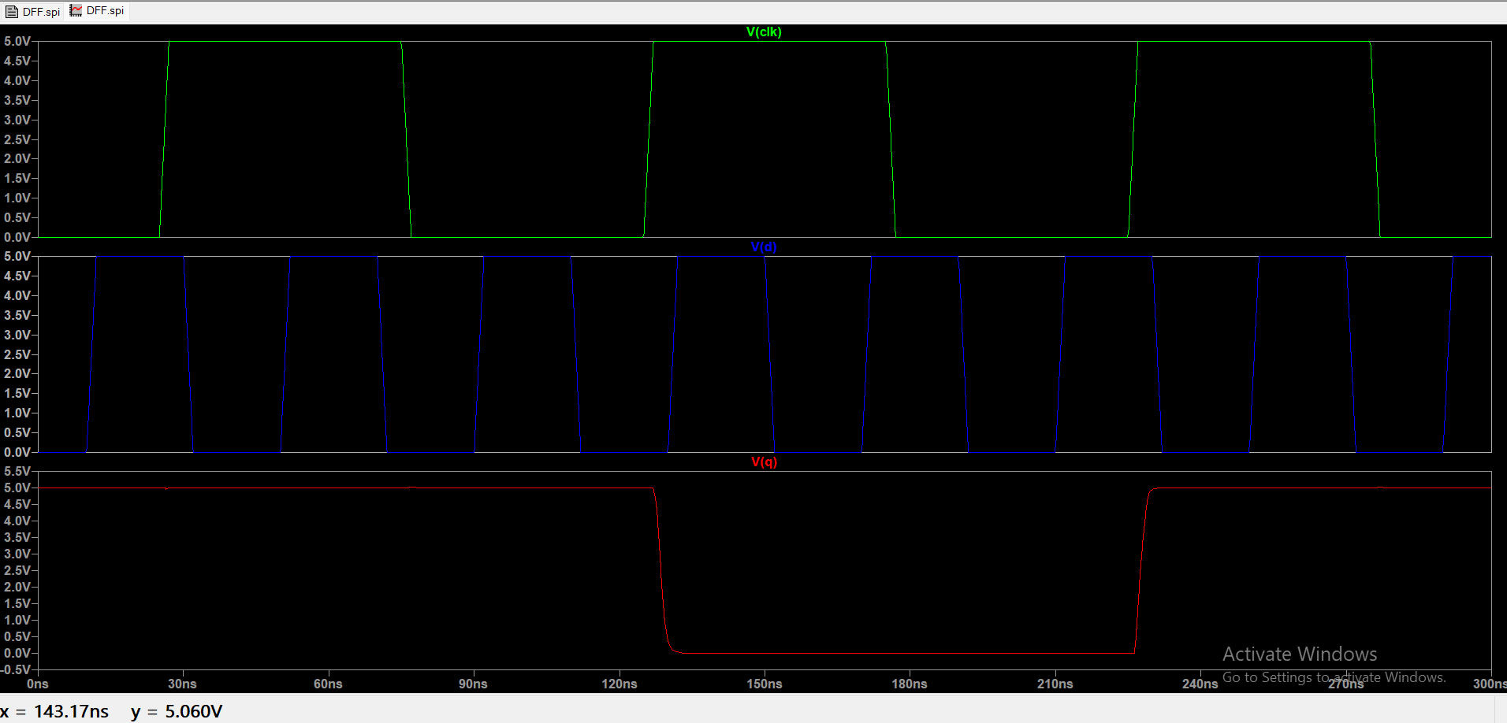
RESULTS
08
Baseline DFF — functionality, timing and power
1.457 ns
2.491 ns
tCQ rise
tCQ fall
133.322 µW
37.330 pJ
Average power
Energy / 280 ns
0.3321 pJ
40
PDP
Transistors
Functional verification: Q samples D on the rising clock edge
Worst-case tCQ = 2.49096 ns
ENCS3330 • Digital Integrated Circuits

Slide 8
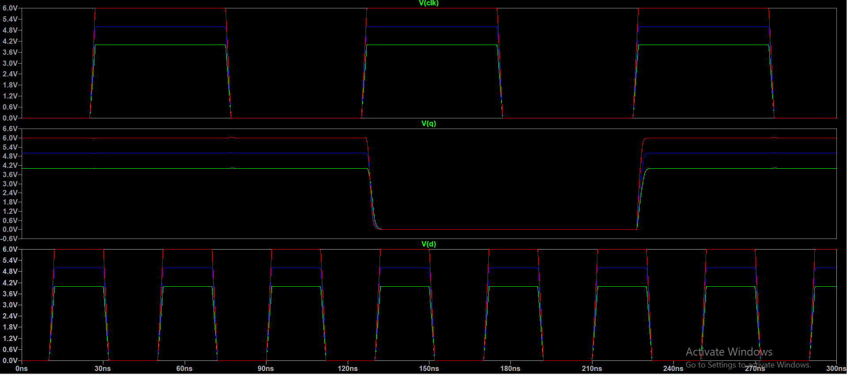
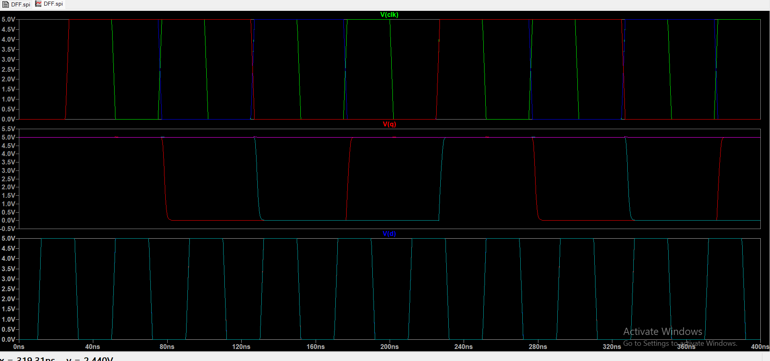
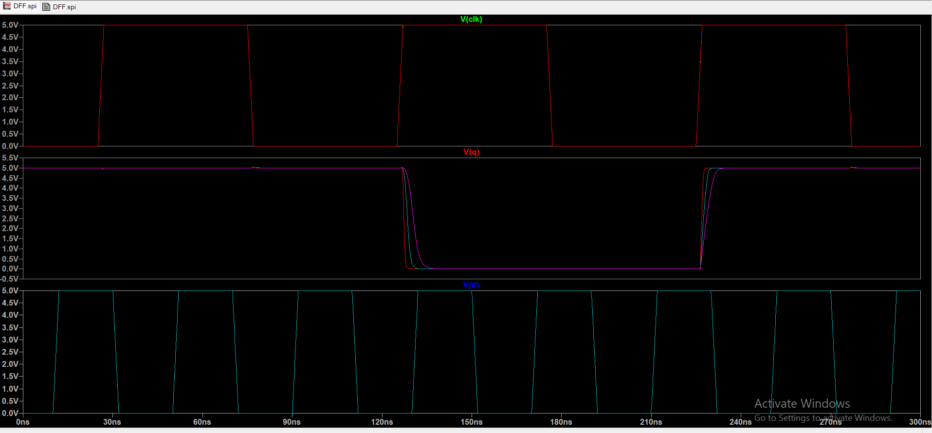
RESULTS
09
Timing boundary and robustness checks
VDD sweep: 4 / 5 / 6 V
Clock sweep: 5 / 10 / 20 MHz
Load sweep: 100 / 250 / 500 fF
Setup boundary
Hold boundary
Area
PASS at 0.25 ns; failure at simultaneous 50% crossings.
Reported conservatively: 0.25 ns.
Correct retention at −0.25 ns; failure by −0.50 ns.
Reported conservatively: −0.25 ns.
Measured bounding box:
1920 × 660 = 1,267,200 layout units.
Note: the final report should use screenshots that match the stated setup/hold boundary runs.
ENCS3330 • Digital Integrated Circuits

Slide 9
METHODOLOGY
07
How we characterized the designs
1 Functionality
2 Timing
Transient waveforms: CLK, D, Q / Q′.
tCQ at 50% VDD crossings; setup and hold by moving D around the active edge.
3 Power & energy
4 PDP
Average supply power over a fixed window; energy = Pavg × Δt.
PDP = Pavg × worst-case tCQ.
5 Robustness
6 Physical design
Selected sweeps: VDD = 4/5/6 V, clock = 5/10/20 MHz, load = 100/250/500 fF.
Hierarchical Electric schematic/icon/layout cells and DRC verification.
ENCS3330 • Digital Integrated Circuits

Slide 10
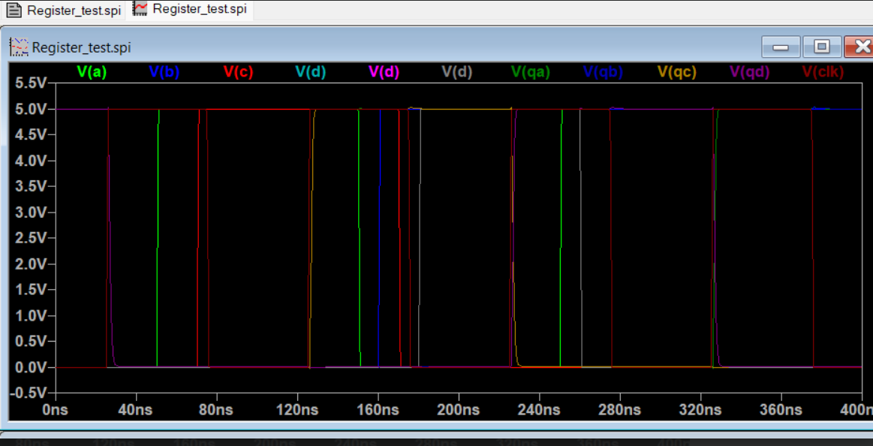
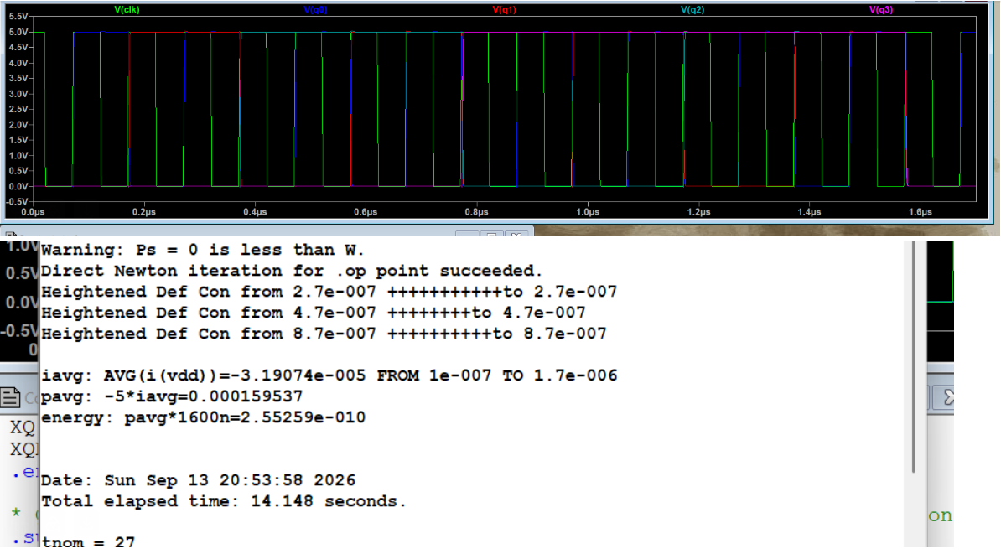
RESULTS
10
4-bit integration — register and counter behavior
Register input/output waveform
Baseline ripple-counter waveform
Register — normal
Register — low activity
Counter
252.27 µW
95.863 pJ / 380 ns
124.871 µW
47.451 pJ / 380 ns
≈ 50.5% lower power
Baseline: 159.537 µW
Optimized test: 166.42 µW
No measured power win in that run.
ENCS3330 • Digital Integrated Circuits

Slide 11
FINAL RESULTS & COMPARISON
11
Baseline vs enable-controlled design
Metric
Baseline DFF
Optimized DFF
Interpretation
Transistors
40
66
Gating adds hardware
tCQ rise
1.457 ns
1.600 ns
Optimized is slower
tCQ fall
2.491 ns
2.634 ns
Optimized is slower
Average power
133.322 µW
224.696 µW (EN=1)
No absolute power win
PDP
0.3321 pJ
0.5918 pJ
Baseline is lower
Reduced activity
—
185.706 µW
17.35% below optimized EN=1
System-level results:
Register: 252.27 → 124.871 µW under lower activity (≈50.5% reduction). Counter: 159.537 µW baseline vs 166.42 µW optimized test.
Clock gating demonstrated an activity-dependent reduction, but the optimized DFF did not beat the baseline in absolute power under the reported conditions.
ENCS3330 • Digital Integrated Circuits

Slide 12
CONCLUSION
12
A complete baseline-to-clock-gated CMOS design flow
40 → 66
17.35%
0.25 ns
−0.25 ns
DFF transistor count
Power reduction inside optimized DFF
Conservative setup
Conservative hold
What worked
Main design lesson
Baseline DFF, register and counter were implemented and verified. Timing, power, energy, PDP and selected robustness sweeps were characterized.
Clock gating can suppress unnecessary switching, but the added gating network has overhead. Its value depends strongly on activity.
Physical design
Before final submission
Hierarchical Electric cells were created for baseline and enable-controlled systems, including layouts.
Verify the final .jelib contains optimized cells and include the required transmission-gate building block.
Birzeit University • ENCS3330 • Low-Power CMOS DFF Project

