Slide 1
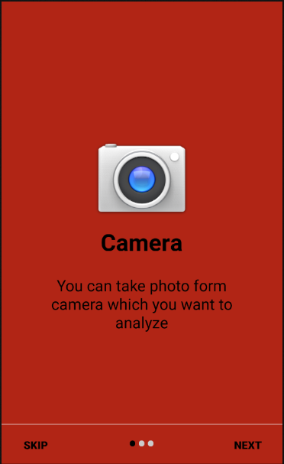
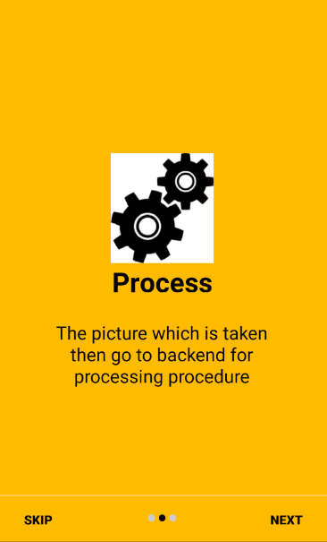
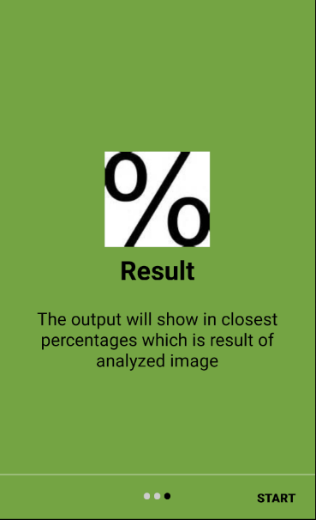

User can skip also these guide second time if he want and straight move to camera screen
12:38
12:38
12:38
This is first screen of the application which shows the guide of camera using
This is second screen of the application which shows the guide of picture processing
This is third screen of the application which shows the guide of output of picture

Slide 2
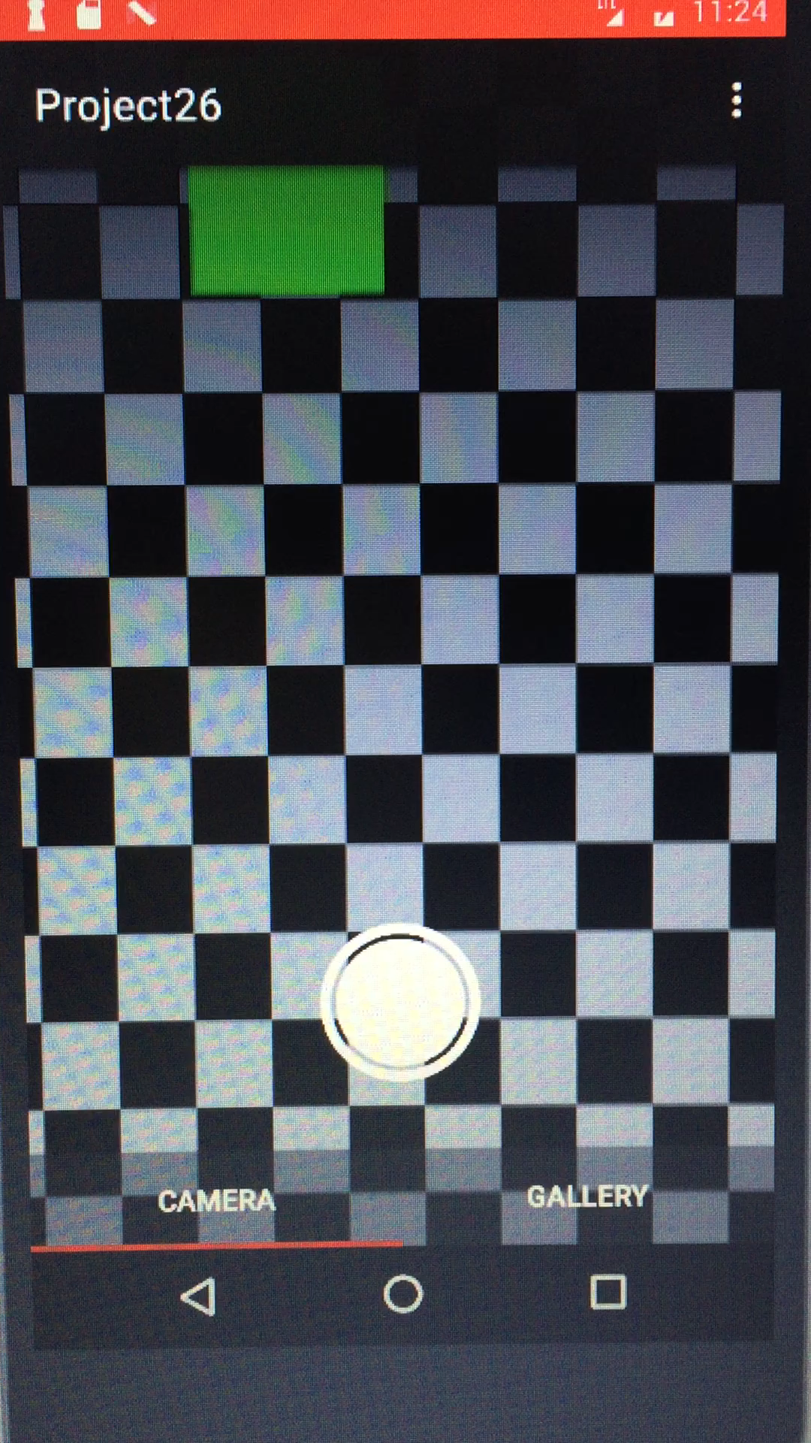
12:38
This is the camera screen , in which the user can take picture which he need to be recognized

Slide 3
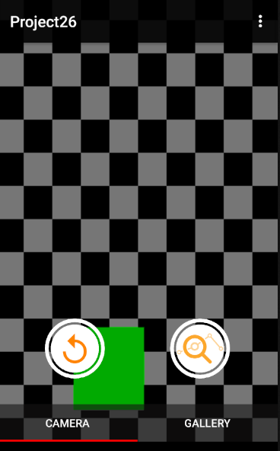
12:38
When the picture is taken it shows two options whether you want to take photo again or you want to sent that taken photo to server

Slide 4
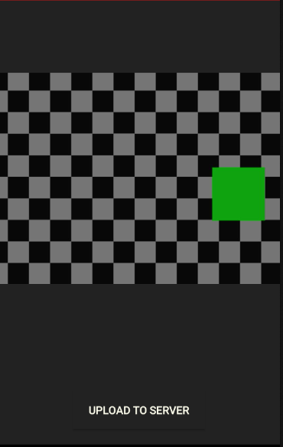
12:38
This is screen when you will upload the picture to server , when click the upload , it will show the result

Slide 5
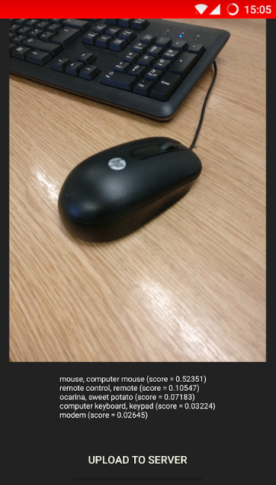
12:38
This is output screen as seen it shows the result in percentage close to accuracy of image
Example: Mouse is more close to accuracy which is correct

Slide 6
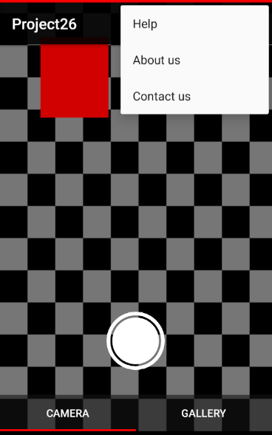
12:38
This is the menu appearance screen in which users can see the guide to use application , they can read about our history and also they can contact us if they feel any problem regarding application.

Slide 7


