Slide 1
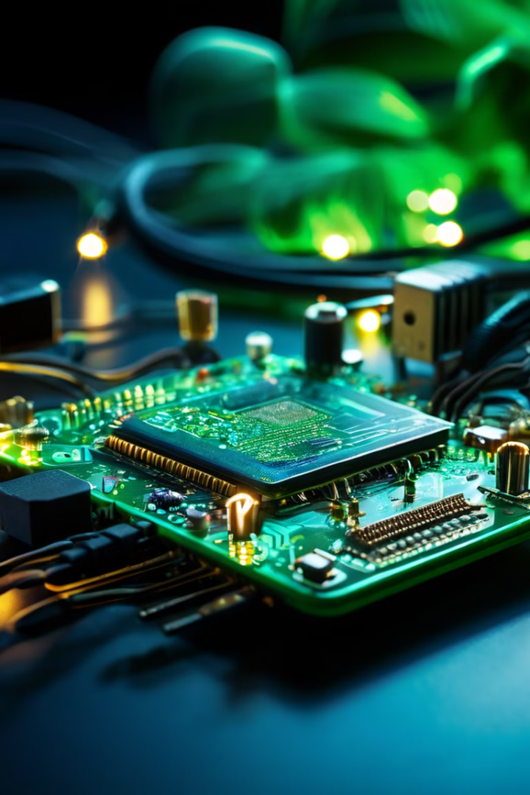
Emergency SOS Alert System
ITD 4101 (INTERNET OF THINGS)
Noorul Hassan(210081601045)
Muhammed Thahir(210081601039)

Slide 2

Objective
1
Immediate Communication
Emergencies demand rapid communication to ensure safety.
2
Simple SOS Alert System
This project addresses the need for a straightforward SOS alert system.
3
Safety Applications
The system is useful for women's safety, child safety, and elderly care.
4
Quick Help
It enables quick access to help in critical situations.

Slide 3
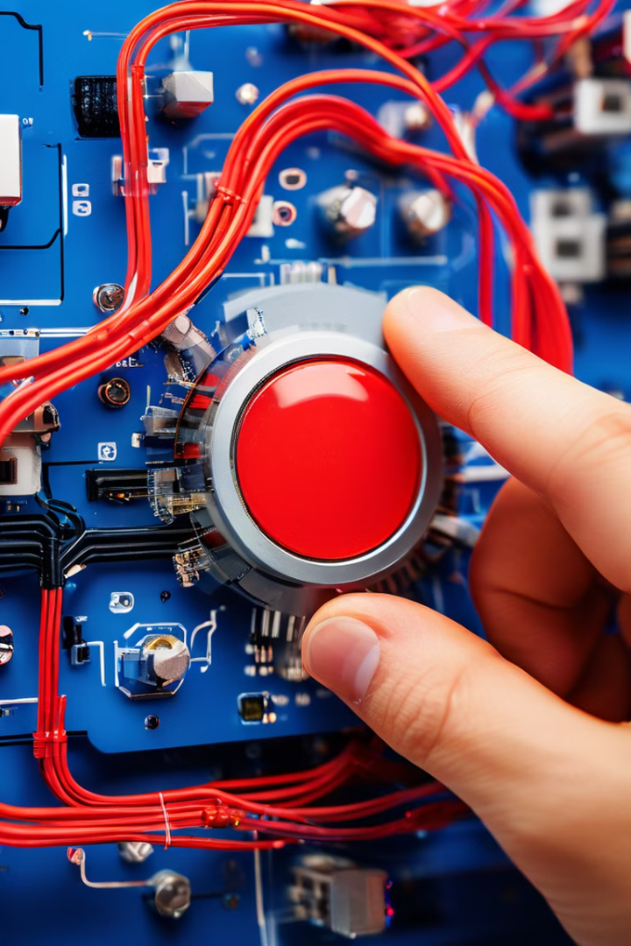
Abstract
SOS Alert System
This project involves the development of an SOS alert system using the NodeMCU ESP32 microcontroller and SIM800L GSM module.
SOS Message Transmission
When a push button is pressed, the system sends an SOS message to predefined contacts.
Simple and Cost-Effective
The system is designed to be simple, compact, and cost-effective.

Slide 4
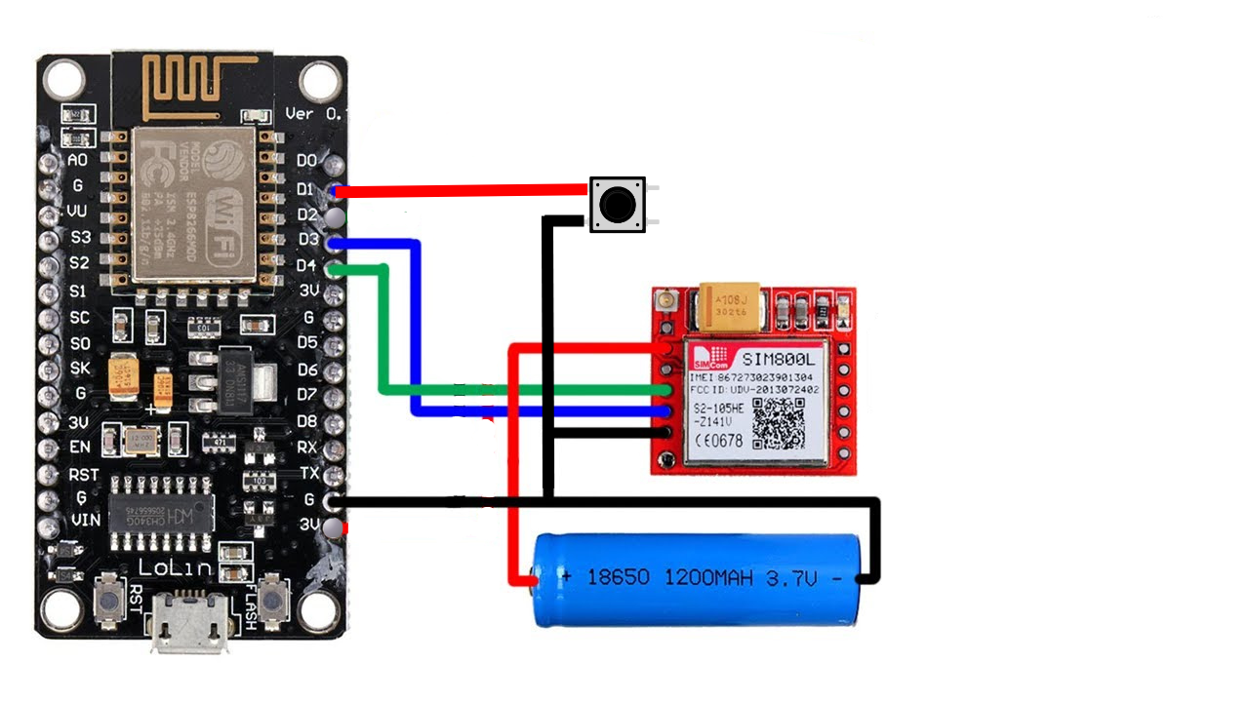
Circuit & Components
NodeMCU ESP32
SIM800L GSM Module
Push Button
Power Supply
LED

Slide 5
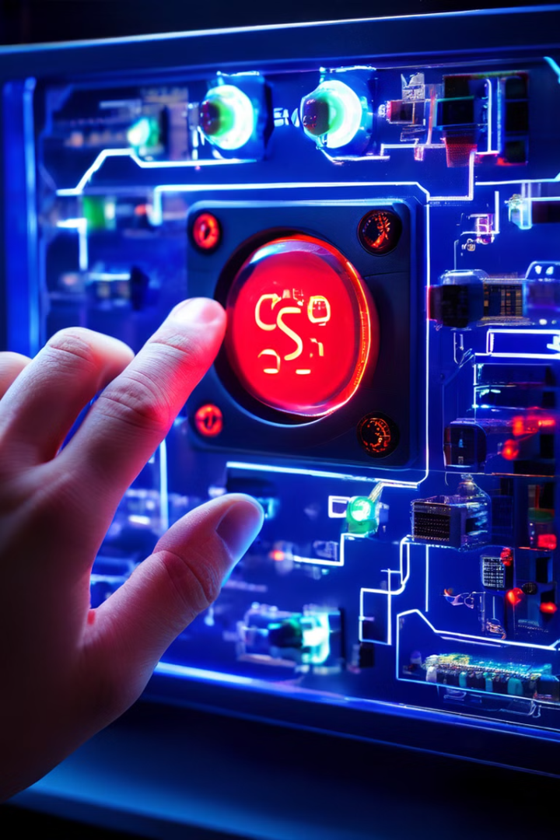




Working Principle
Button Press
The user presses the push button during an emergency.
Signal to NodeMCU
The button press sends a signal to the NodeMCU.
SMS Transmission
The NodeMCU commands the SIM800L module to send an SMS to predefined contacts.
Status Indication
The LED lights up, confirming that the message was sent.

Slide 6
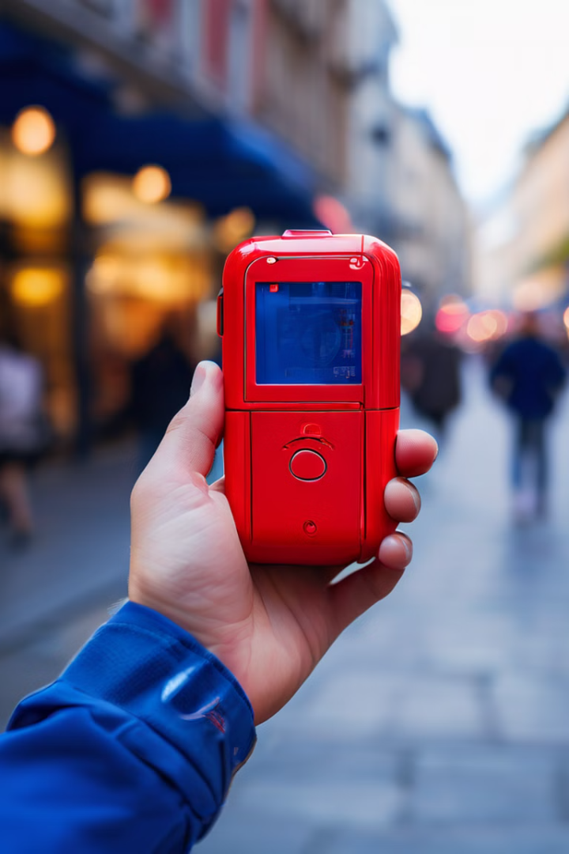
Applications
Women's Safety
Provides a quick alert mechanism in dangerous situations, empowering women to seek help.
Child Safety
Allows parents or guardians to monitor and protect children, ensuring their safety.
Elderly Care
Enables elderly individuals to easily request help in emergencies, providing peace of mind for them and their families.

Slide 7
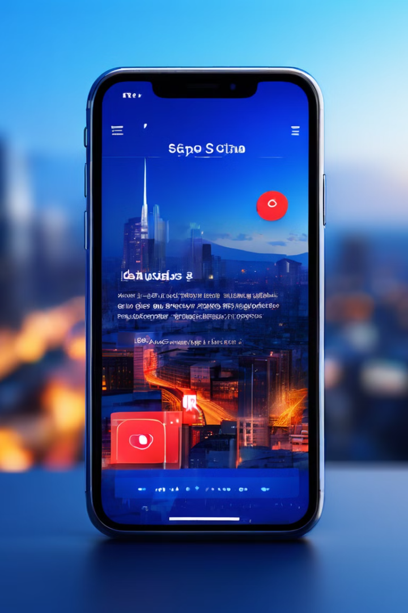
Future Enhancements
1
Automated Calls
Integrating automatic call functionality for faster and more direct communication.
2
Mobile App Integration
Developing a mobile application to enhance user control and customization options.
3
GPS Integration
Integrating GPS capabilities to provide accurate location information for emergency responders.

Slide 8

Thank You!
For your time and consideration. We hope you found this presentation informative.

