Slide 1

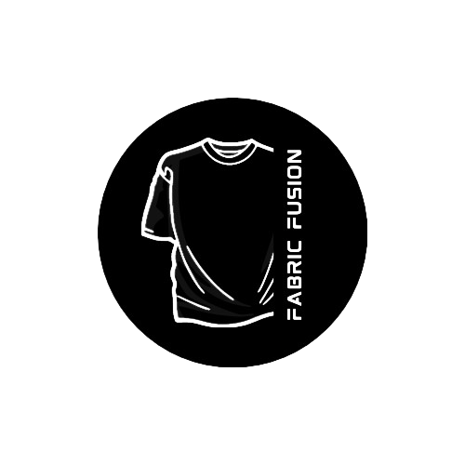
FABRIC FUSION

Slide 2

Venture Description
At Fabric Fusion, we redefine the art of personalized fashion by seamlessly blending cutting-edge technology with your unique sense of style. Our revolutionary approach combines the craftsmanship of fabric design with the power of Artificial Intelligence, giving you the ultimate platform to express yourself like never before.
2

Slide 3

Problem Definition
In today's market more time is being consumed for designing an unique and attractive output
Many of the designs are outdated, featuring old-fashioned styles and repetitive patterns that are used across multiple T-shirts.
Current fashion offerings restrict customers from freely mixing and matching designs, colors, and patterns to create a truly personalized look.
The representation of Tamil fashion through dialogues are less compared to the popularity seen in comics and anime trends.

Slide 4
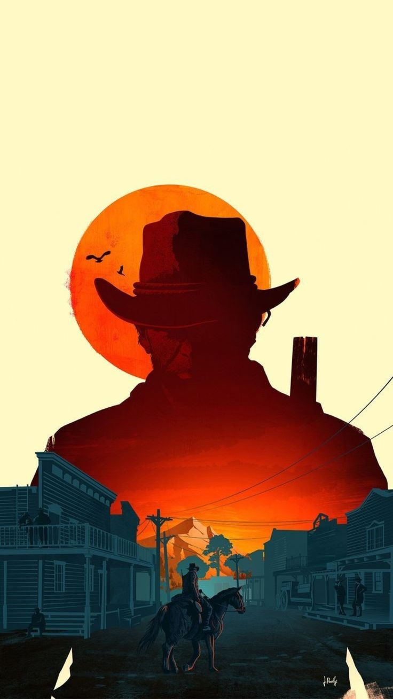
Solution
Designing unique and appealing outputs takes too long in today's market. Fabric Fusion solves this with AI integration, ensuring a quicker and efficient process for personalized designs.
Liberate fashion choices with Fabric Fusion's user-friendly platform, enabling effortless mix-and-match customization for a truly unique and personalized look.
Boost Tamil fashion representation in dialogues by creating captivating designs and promoting them widely to increase awareness and appreciation, addressing the current disparity compared to comics and anime trends.
7

Slide 5

About Us
As three passionate IT students, we, under the banner of Fabric Fusion, are on a mission to redefine fashion. With a keen eye for design and a drive for innovation, we're committed to reshaping personal expression through uniquely crafted T-shirts.
Fabric Fusion is not just a name; it's a promise to seamlessly integrate technology with creativity, ensuring that each printed design becomes a canvas for individuality and style. Join us at Fabric Fusion.

Slide 6
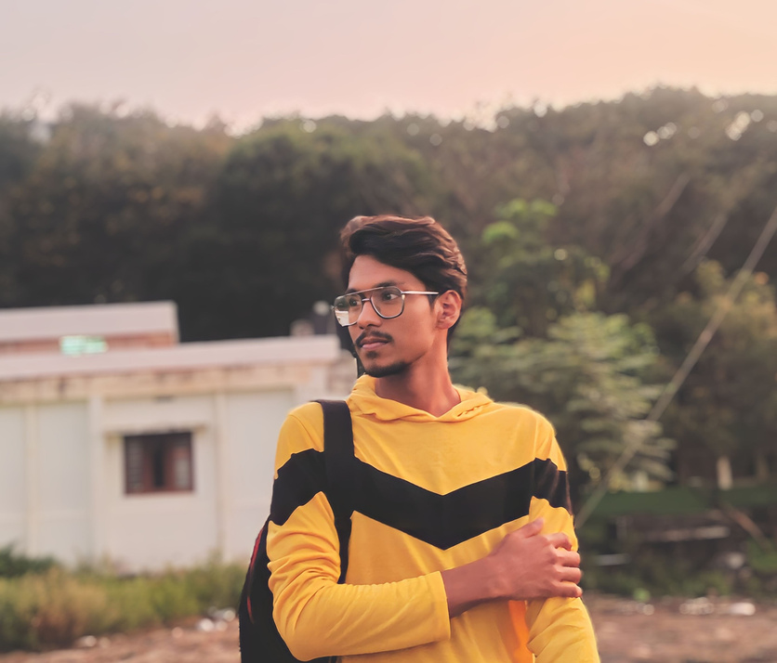
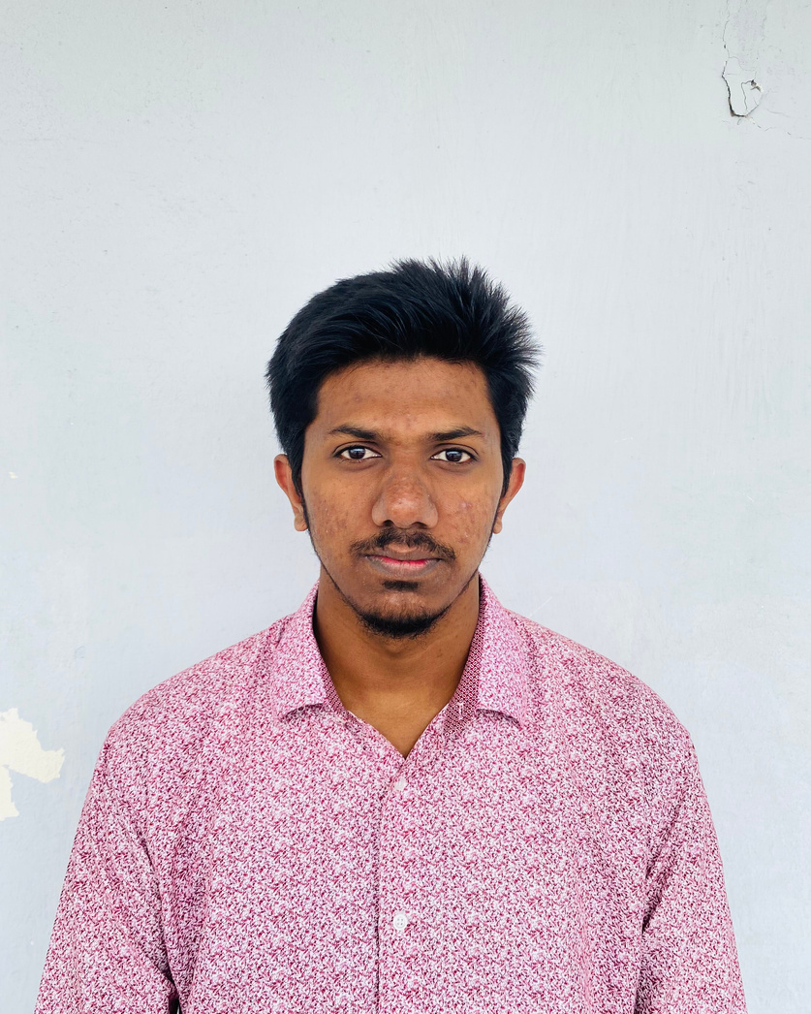

Our Team
Thahir
Noorul
Hamzah
CEO
COO
member
4

Slide 7


Thank you
for listening!

