Slide 1
3RD PROJECT REVIEW · KLH UNIVERSITY
CareerConnect
Internship and Placement Management System
Database Systems Engineering and Distributed Backend Development
Noor Ul Huda – 2520030240
P. Jaahnavi – 2520030441
Guide: Purushotham Muniganti, Assistant Professor

Slide 2
Project Overview
A central platform connecting candidates and employers
Problem and solution
Modules implemented
Jobs and applications are scattered across chats, e-mails and sheets
No clear tracking of application status
CareerConnect keeps users, jobs and applications in one database
Candidates apply online; employers review and update status
Candidate: register, login, browse jobs, profile, apply
Employer: dashboard, company profile, post jobs, job listings
Application: apply, view applications, update status
Notification: new and pending applications

Slide 3
Architecture and Technology Stack
Monolithic application, running locally
Frontend
Backend
ORM + Driver
Database
→
→
→
HTML · CSS · JavaScript
Python + FastAPI (REST)
SQLAlchemy + PyMySQL
MySQL
Frontend and backend
Security
JavaScript calls the API with fetch() and shows JSON on the page
FastAPI routers + Pydantic validation
bcrypt password hashing
JWT token with role-based access (candidate / employer)

Slide 4
Database and REST APIs
3 tables, JSON endpoints, documented in Swagger
MySQL tables
Main APIs
Users – candidates and employers (role column)
Jobs – posted by an employer (employer_id)
Applications – candidate + job + status
One employer → many jobs → many applications
Unique (job, candidate): no duplicate apply
POST /auth/register, /auth/login
GET /jobs · POST /jobs
POST /applications · GET /applications/me
GET /employer/applications
PUT /applications/{id}/status
GET /employer/notifications

Slide 5
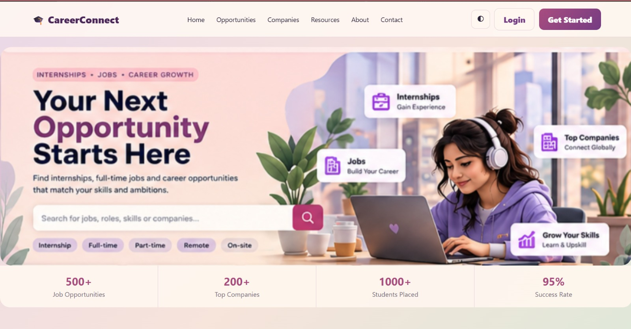
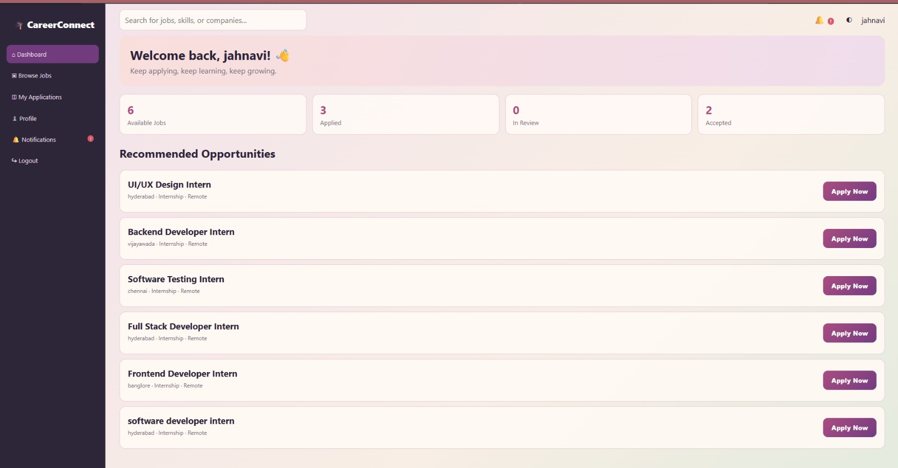
Application Screenshots
Landing page and candidate dashboard
Landing page – search, job-type filters, Login / Get Started
Candidate dashboard – statistics, recommended jobs, Apply Now

Slide 6
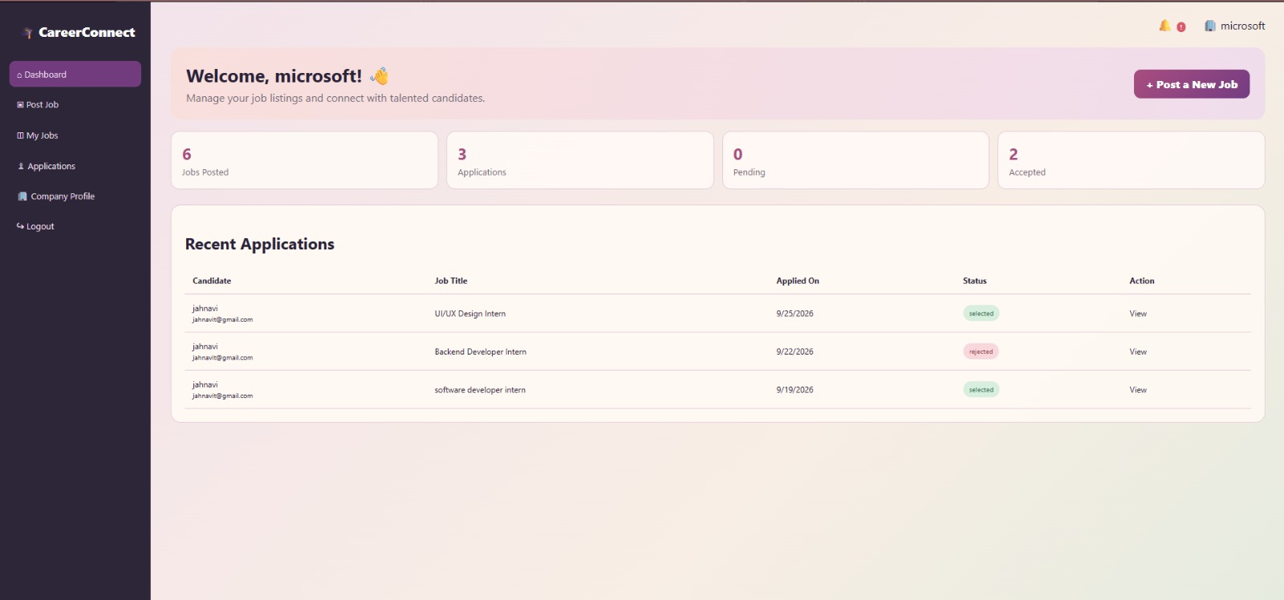
Employer Dashboard and Testing
Jobs, applications and status in one view
Testing with Swagger UI
Login, copy token, click Authorize
Try it out on every endpoint
No token → 401
Candidate posting a job → 403
Duplicate apply rejected
Employer dashboard – jobs posted, application statistics, recent applications with status

Slide 7
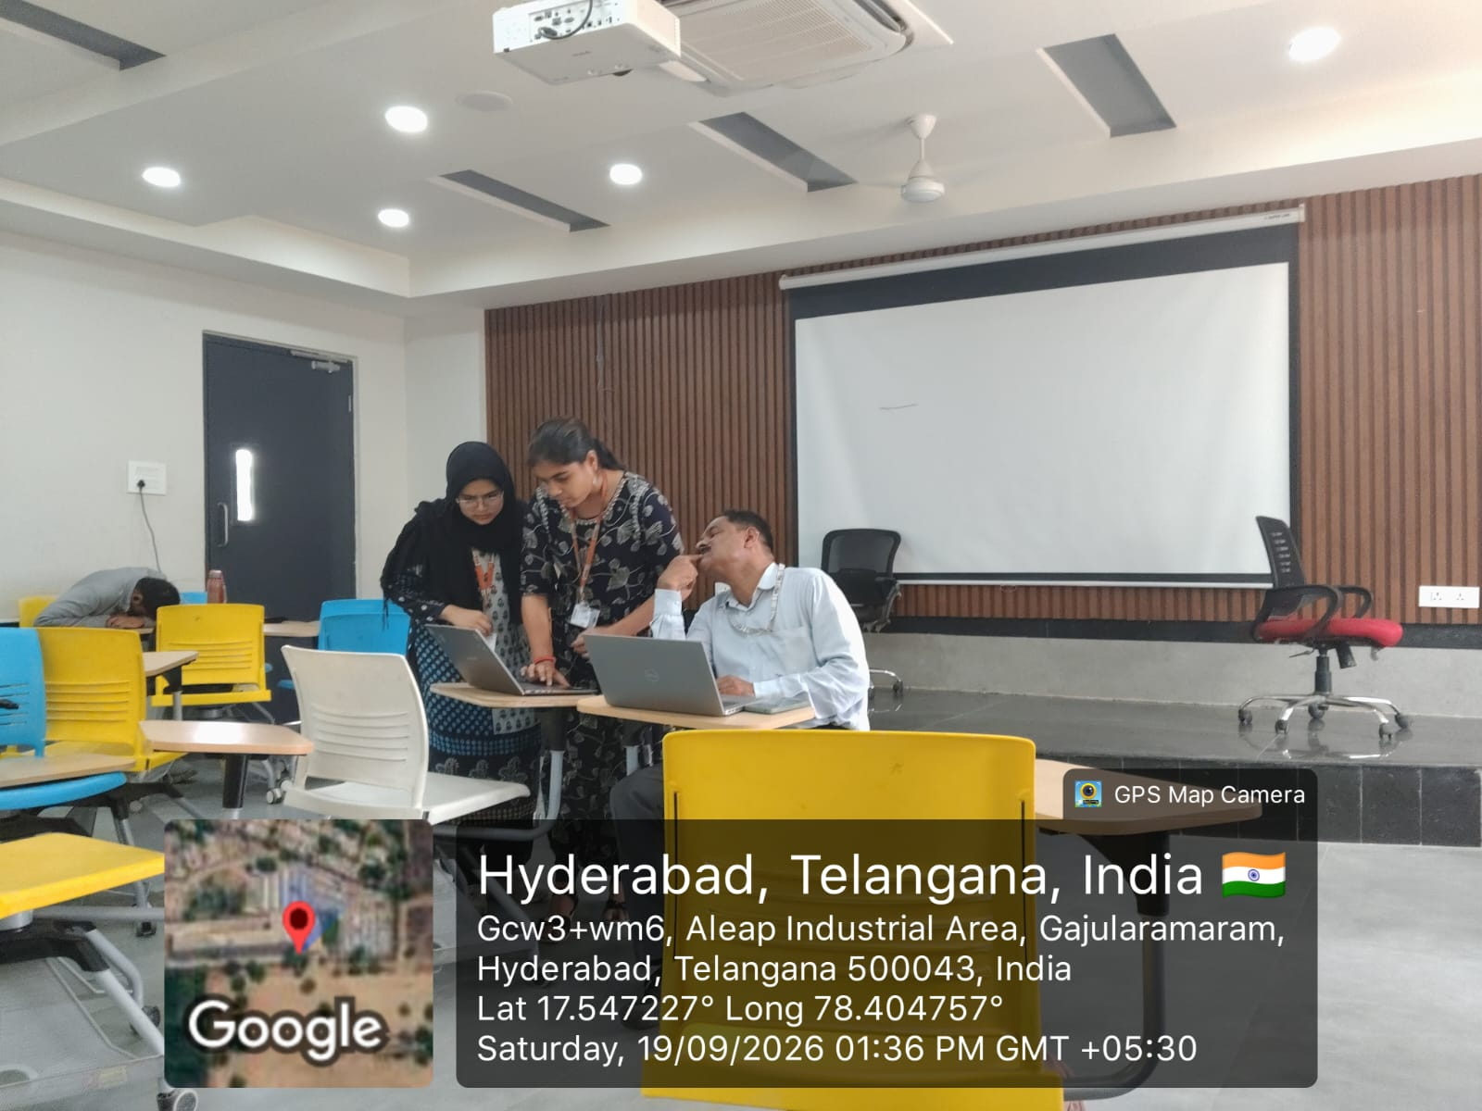
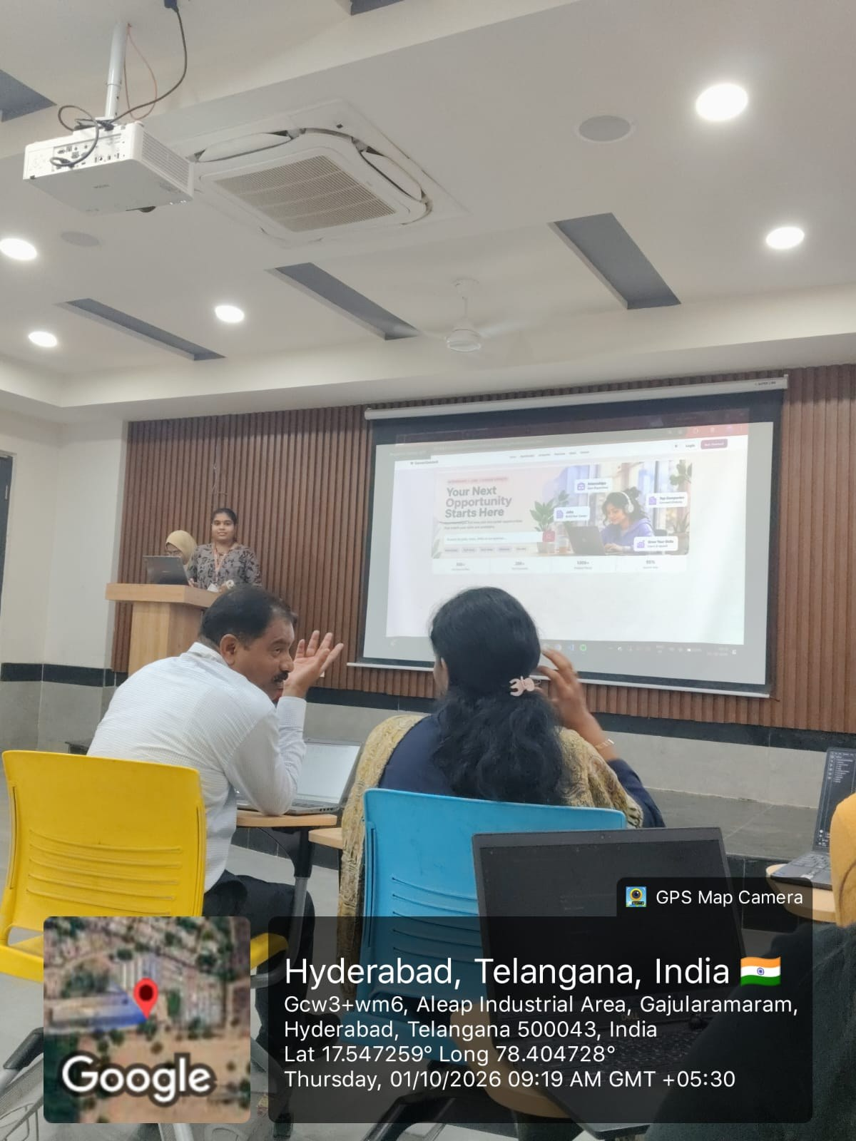
Geo-tagged Photos
Project work with the guide and the review presentation
Working on the project with the guide – 19/09/2026, Hyderabad
Project review presentation – 01/10/2026, Hyderabad

Slide 8
Conclusion and Future Scope
Conclusion
Future scope
Working platform for candidates and employers
Secure login with JWT and bcrypt
Applications tracked from Pending to Selected / Rejected
Clean REST API, tested in Swagger
Modular base for new features
Placement officer module and reports
Eligibility-based filtering
E-mail notifications
AI job recommendations, resume analysis
Interview scheduling, cloud deployment

