Slide 1


Terraform for Snowflake
Migrating from GitLab CI/CD & Flyway
A beginner’s guide to Infrastructure as Code
13 September 2025

Slide 2
Agenda
Introduction to Terraform & IaC
Terraform Cloud & state management
Integrating Terraform with GitLab CI/CD
Flyway & schemachange migration
Modules, Workspaces & best practices
Workflow overview & conclusion
[1] [2]

Slide 3
Terraform fundamentals
Terraform is a declarative IaC tool that builds, changes and versions resources across cloud and on‑premises systems.
Uses providers to interact with APIs; the Snowflake provider can manage warehouses, databases, roles and grants.
Tracks infrastructure state locally or remotely; applies desired configuration by reconciling the state.
Configurations are modular and reusable via modules; inputs and outputs make code composable.
# Snowflake provider configuration provider "snowflake" { account = var.account region = var.region } resource "snowflake_warehouse" "compute_wh" { name = "COMPUTE_WH" warehouse_size = "XSMALL" }
[3] [4] [5]

Slide 4
Terraform Cloud & State Management
Remote backend stores state centrally and locks it during runs.
Workspaces represent environments (dev/stage/prod) with isolated state.
Remote operations run in disposable VMs with cost estimation and policy enforcement.
Collaboration features: version control integration, notifications and RBAC.
State is locked during runs
Workspaces isolate environments
[6] [7] [8]

Slide 5
GitLab CI/CD Integration
Store Terraform code in your GitLab repository and use Git as the single source of truth.
Define stages in .gitlab-ci.yml: init → plan → apply.
Configure the backend to point at Terraform Cloud with your organisation and workspace.
Inject Snowflake credentials and API tokens via CI/CD variables or environment variables.
Enable branch protection and merge request reviews to enforce quality.
# .gitlab-ci.yml stages: [init, plan, apply] init: script: - terraform init plan: script: - terraform plan -out=tfplan apply: script: - terraform apply -auto-approve tfplan
[9] [10]

Slide 6
Schema vs Infrastructure
 | Flyway/schemachange (Imperative) | Terraform (Declarative)
Approach | Executes SQL scripts sequentially | Defines desired state and lets Terraform reconcile
State | No state file – manual tracking | Maintains state file and history
Idempotency | Handled manually via scripts | Automatic idempotency & diff
Resource deletion | Not supported | Deletes resources removed from code
Use case | Schema migrations | Infrastructure provisioning
Tools | Python-based CLI | HCL & providers
Flyway/schemachange manages database changes while Terraform manages the platform and access.
[11] [12] [13]

Slide 7
Modules, Variables & Workspaces
Organize Snowflake resources into reusable modules (e.g., warehouse, database, role).
Define variables for account, region, naming conventions and access roles.
Outputs expose identifiers for cross‑module references (e.g., warehouse ID).
Workspaces support multiple environments using the same configuration without code duplication.
Use Terraform Cloud’s workspace variables to inject environment‑specific values and secrets.
Reusable modules
Isolated workspaces
[14] [15]

Slide 8
Best Practices & Governance
Use version control (Git) and GitLab merge requests for all IaC changes.
Always configure a remote backend (Terraform Cloud) to protect state and enable locking.
Leverage modules and variables to avoid duplication and enforce standards.
Store secrets in GitLab CI/CD variables or encrypted state, never hard‑code credentials.
Enable cost estimation and policy checks (Sentinel/OPA) on Terraform Cloud.
Implement continuous integration: run terraform fmt, validate and plan on every commit.
[16] [17]

Slide 9
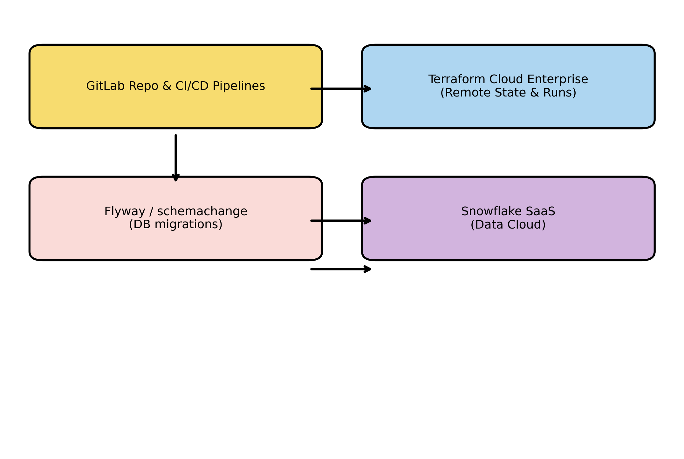
CI/CD & Terraform Workflow
GitLab triggers Terraform runs in Terraform Cloud; Flyway applies DB migrations; both target Snowflake.
[18] [19]

Slide 10
Conclusion & Next Steps
Terraform empowers Snowflake teams to manage cloud resources as code, providing automation, versioning and reproducibility.
By migrating from Flyway-only workflows to a dual‑approach you maintain reliable schema migrations while automating platform provisioning.
Leverage Terraform Cloud for shared state, runs and policy enforcement; integrate your pipelines within GitLab for end‑to‑end automation.
Next steps: set up your TFC organisation and workspaces, convert existing resources to code, refine modules and review with your team.
[20] [21]

