Slide 1
My variant: 7, Balochistan urban
Registration no.: FA24-BEDS-039 (39 = 4 x 8 + 7)
Data: PSLM 2019-20, person file merged with household file; earners aged 15-64, weighted by hhweight
486 earners; weighted median Rs 250,000 (unweighted Rs 264,000)
Weighted 10th to 90th percentile: Rs 96,000 to Rs 540,000, a ratio of 5.62
Name: <YOUR NAME>

Slide 2
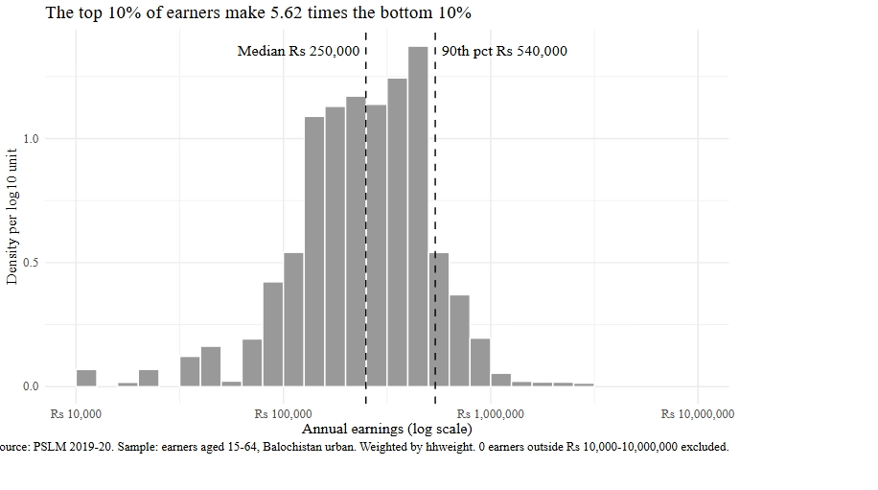
Top earners make 5.6 times the bottom earners
Insert figures/histogram.svg here
(Insert > Pictures), then delete this note
Right-skewed: most earners between Rs 96,000 and Rs 540,000
Thin tail up to Rs 3,000,000
Weighted median is lower than unweighted: weights give more share to lower-earning households

Slide 3
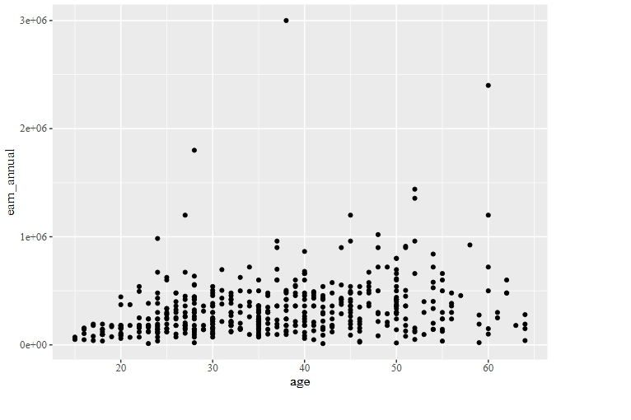
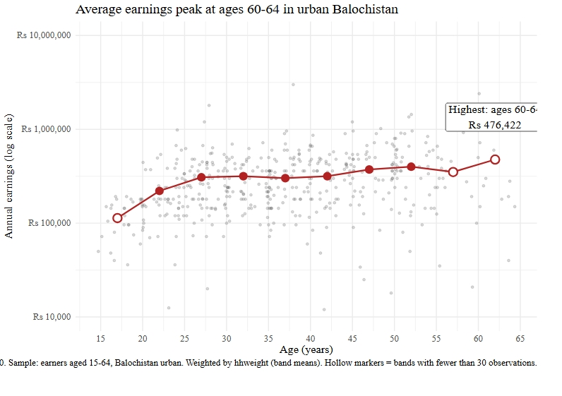
The makeover: default vs redesign
Insert figures/default.svg here
Insert figures/redesign.svg here
R default: points overlap, linear axis
Redesign: log axis in rupees, jitter + transparency, weighted band means, finding title

Slide 4
Key finding: earnings triple by the late 20s
Weighted mean: Rs 113,382 at ages 15-19, Rs 307,994 at 25-29
Rs 372,723 at 45-49 and Rs 399,250 at 50-54
Highest band 60-64 (Rs 476,422) has only 16 earners, so it is unreliable
Limit: one cross-section cannot show how one person's earnings change with age
Source: PSLM 2019-20, Balochistan urban earners aged 15-64, weighted by hhweight.

