Slide 1

Display
Devices
Types, Technologies and real world applications
Presented by nowreen naaz
BCA

Slide 2


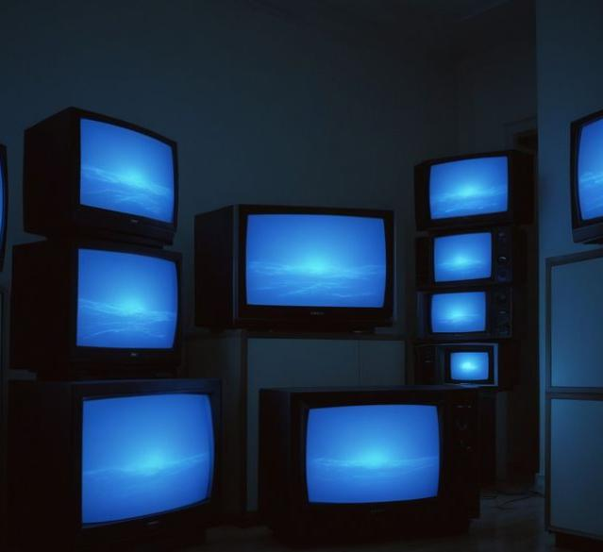
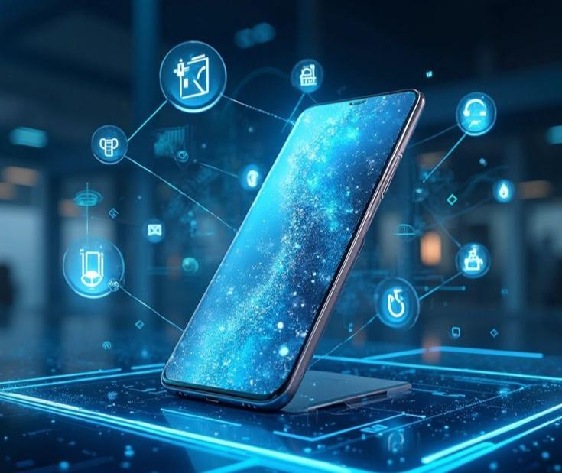

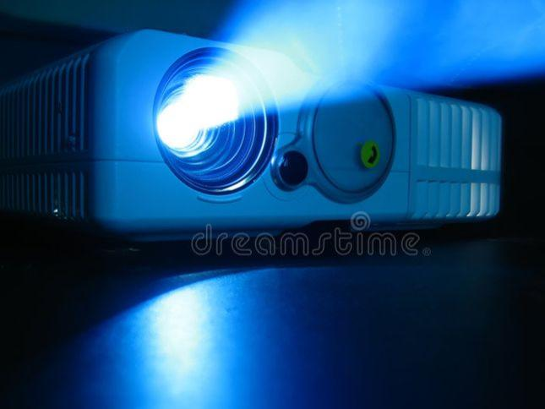
What are Display Devices?
A display device is an output device that presents information from a computer or another electronic system in a visual form, such as text, pictures, graphics, and video.
In simple words
Computer processes information → display device shows you the result.
Monitors
Smartphones
Laptop screens
Projectors

Slide 3

How do they work?
Computer / processing unit
Display
Device
Display connection
Carries image information
Shows text, images and video
Processes
data
Example: when you open a powerpoint, the computer processes the slide information and the display device shows it on the screen

Slide 4

TYPES
OF
DISPLAY DEVICES

Slide 5

CRT DISPLAYS
(Cathode Ray Tube)
Uses electron beams to create images on a phosphor-coated screen.
Bulky and heavy design.
Common in older televisions computers
Advantage:
Good color and viewing angles
Disadvantage:
Large size and high in power

Slide 6

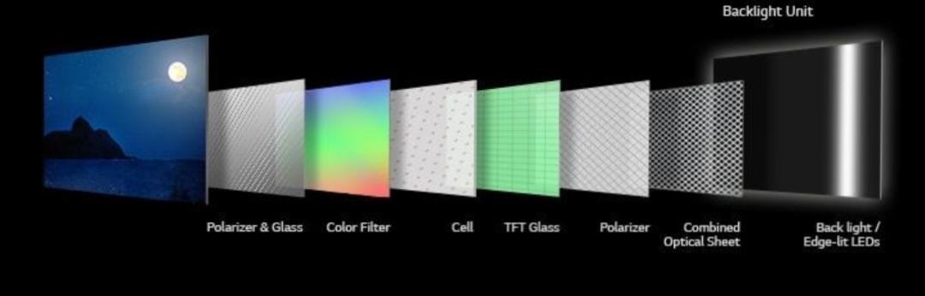
LCD AND LED DISPLAYS
LCD (liquid crystal Display) uses liquid crystals to control light from a backlight.
LED is usually and LCD pannel with LED backlighting (or LED uses directly in larger displays)
Examples:
Laptop screens
Monitors
TVs

Slide 7

OLED DISPLAYS
Each pixel produces its own light.
No backlight needed
Deeper blacks, higher contrast and vibrant colors
Example:
Smartphones
Premium TVs

Slide 8

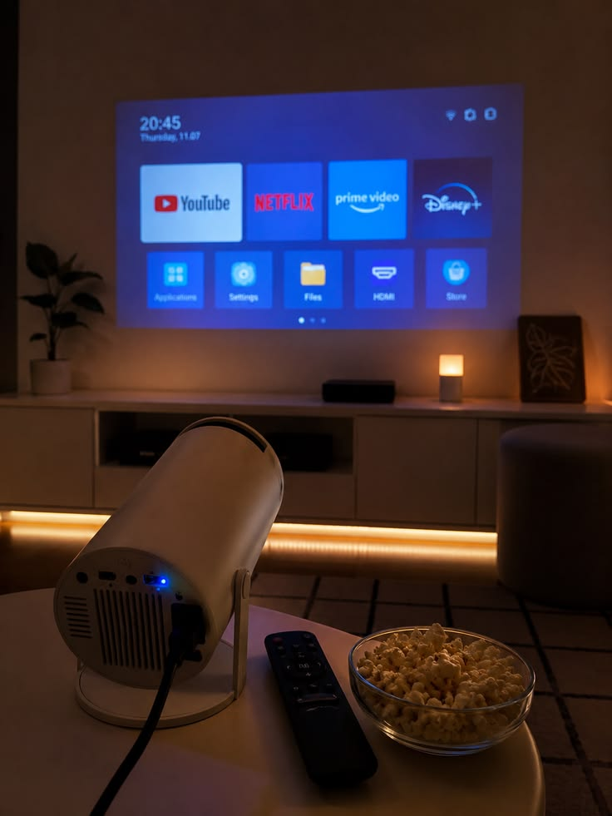
Projectors
Uses light source and lens to project an image onto separate surfaces.
Can display larger images.
Common in classrooms, cinemas and conference rooms.
Examples:
Classrooms, cinemas and offices

Slide 9

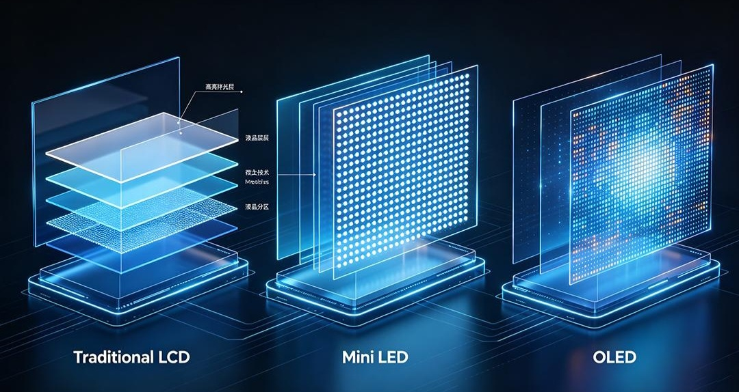
Comparison of display technologies
Smaller backlight LEDs
Separate backlight
Self emitting pixels

Slide 10

Emerging and Advanced Technologies

Slide 11

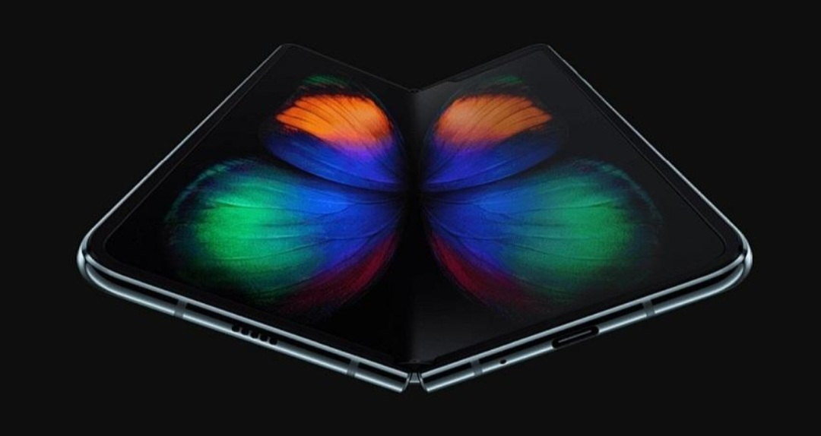

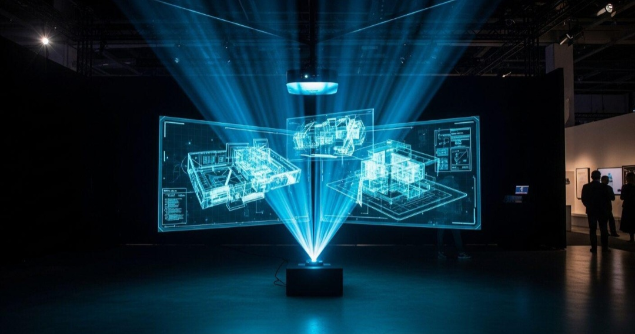
MicroLED
Tiny LEDs that produce their own light; offers high brightness and contrast.

Slide 12
Flexible displays
Screens that can bend or fold, as in foldable smartphones.

Slide 13
E-Ink
Paper-like displays used in e-readers such as Kindle.

Slide 14
3D displays
Technologies that create a sense of depth; some can work without special glasses.

Slide 15

Key Performance Metrics
What makes a display good?
1.Resolution
2. Refresh rate
3. Response time
4. Aspect ratio
5. Brightness and contrast

Slide 16

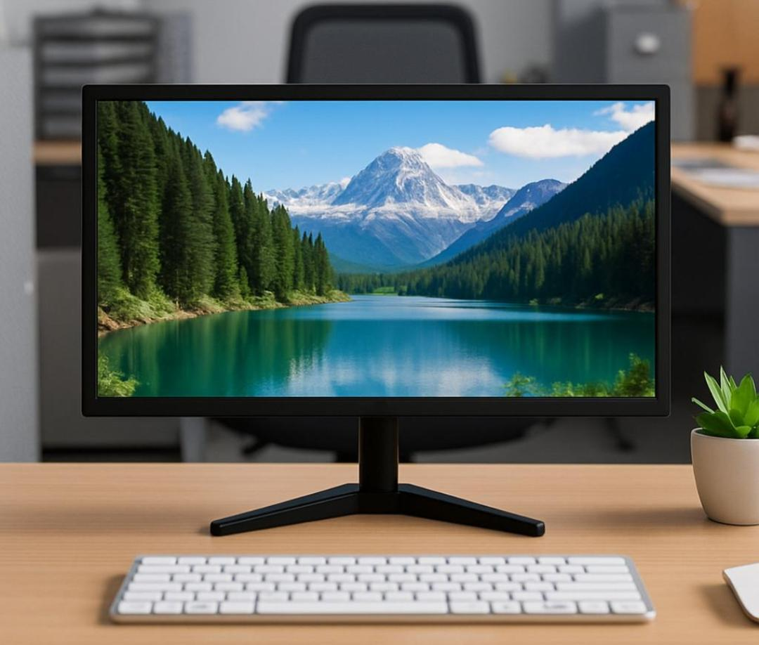
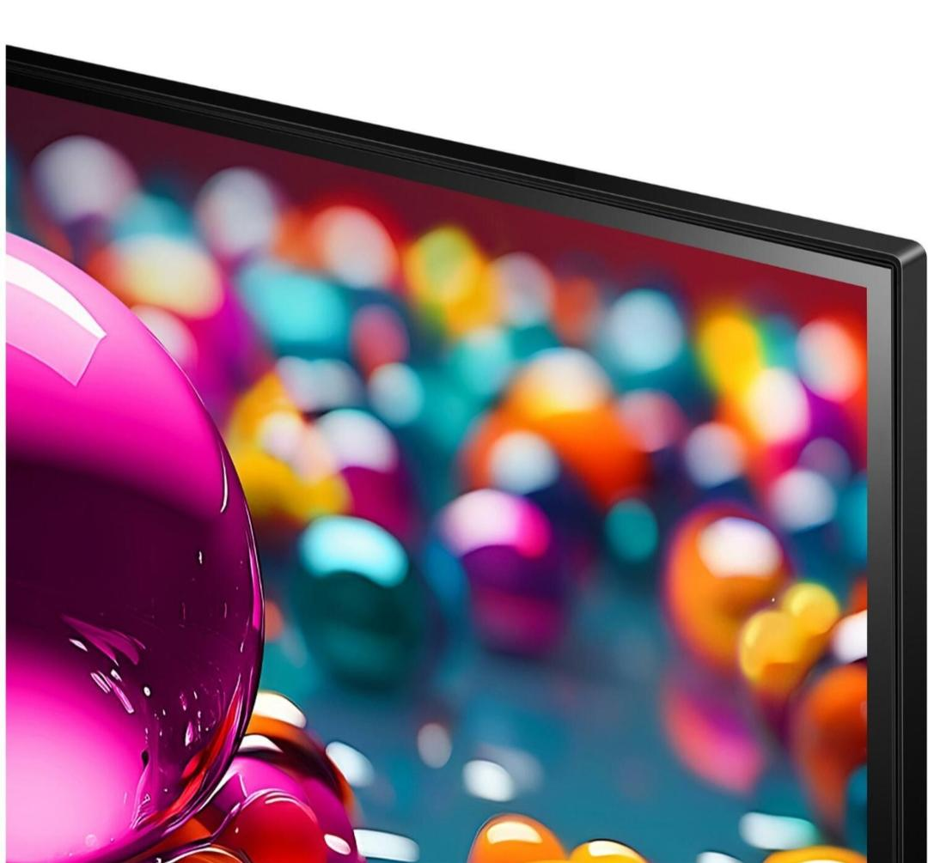
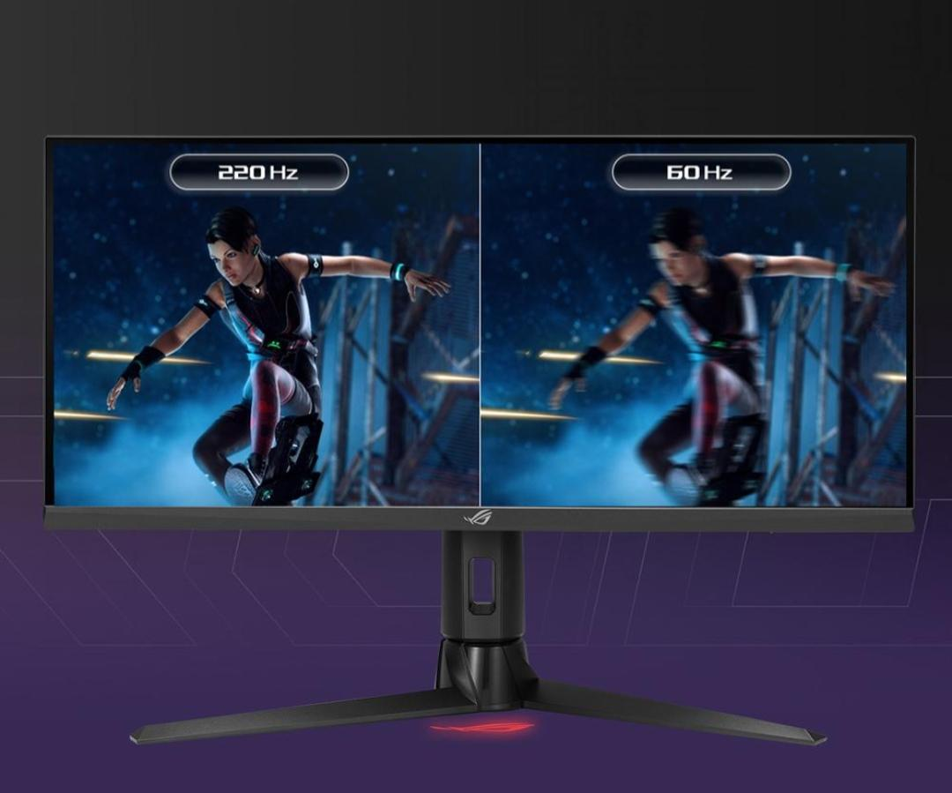
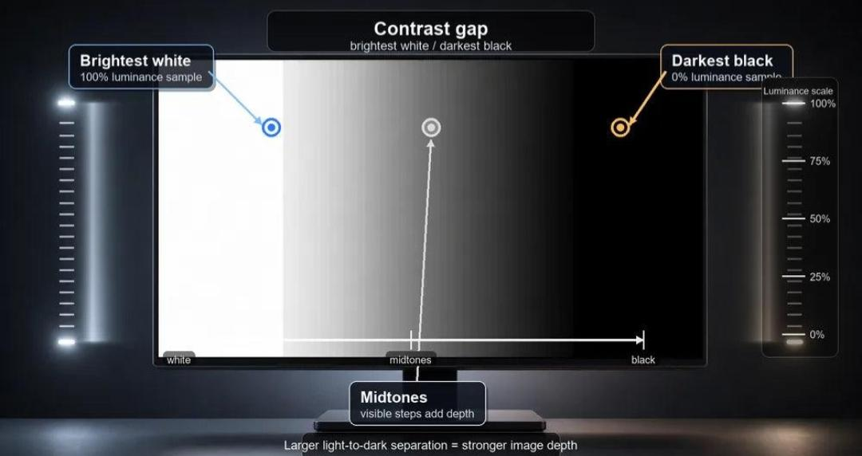

Slide 17

Resolution:
The number of pixels used to form an image, such as Full HD or 4K.

Slide 18


Slide 19

Aspect ratio:
The proportional relationship between screen width and height, such as 16:9.

Slide 20


Slide 21

Response time:
How often the screen refreshes or how quickly pixel changes from one state to another.

Slide 23

Brightness and contrast:
How bright the display can get and how clearly it distinguishes light from dark.

Slide 24

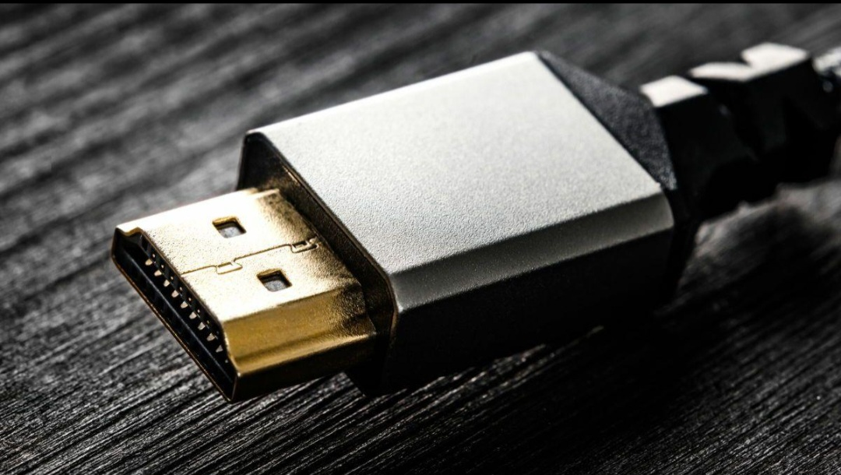
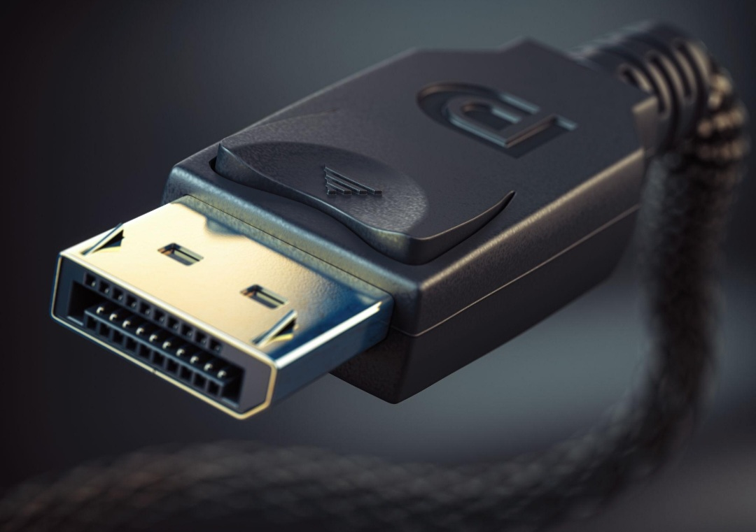
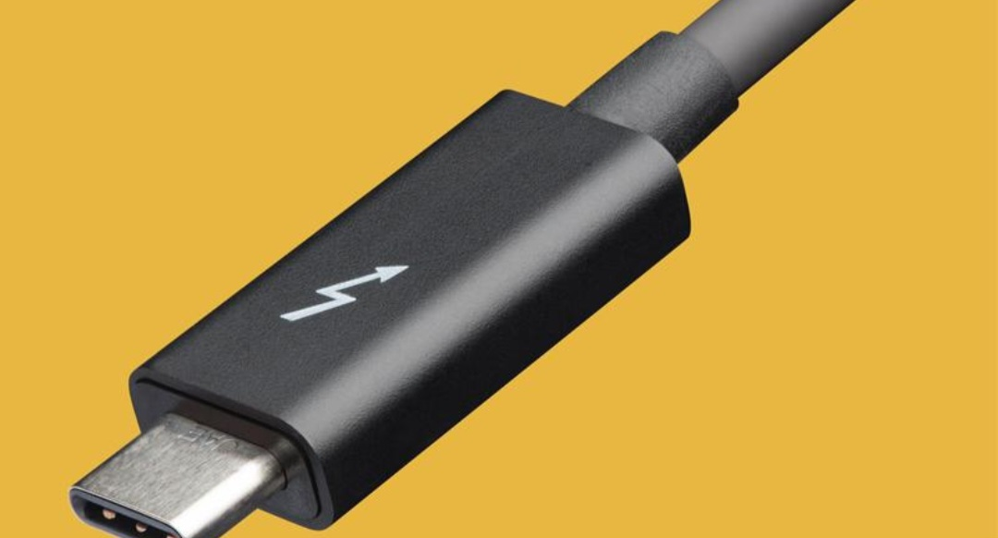
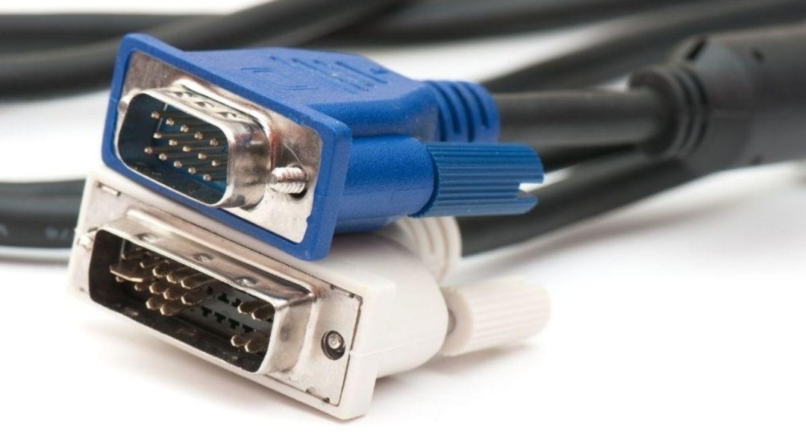
Display Interfaces and Connectivity
DisplayPort:
Commonly used with computer monitors.
HDMI:
Common for TVs, PCs and consoles.
USB-C / Thunderbolt:
Can carry video and data, and power.
VGA / DVI:
Older display connection standards.

Slide 25

DISPLAY DEVICES IN
EVERYDAY LIFE

Slide 26
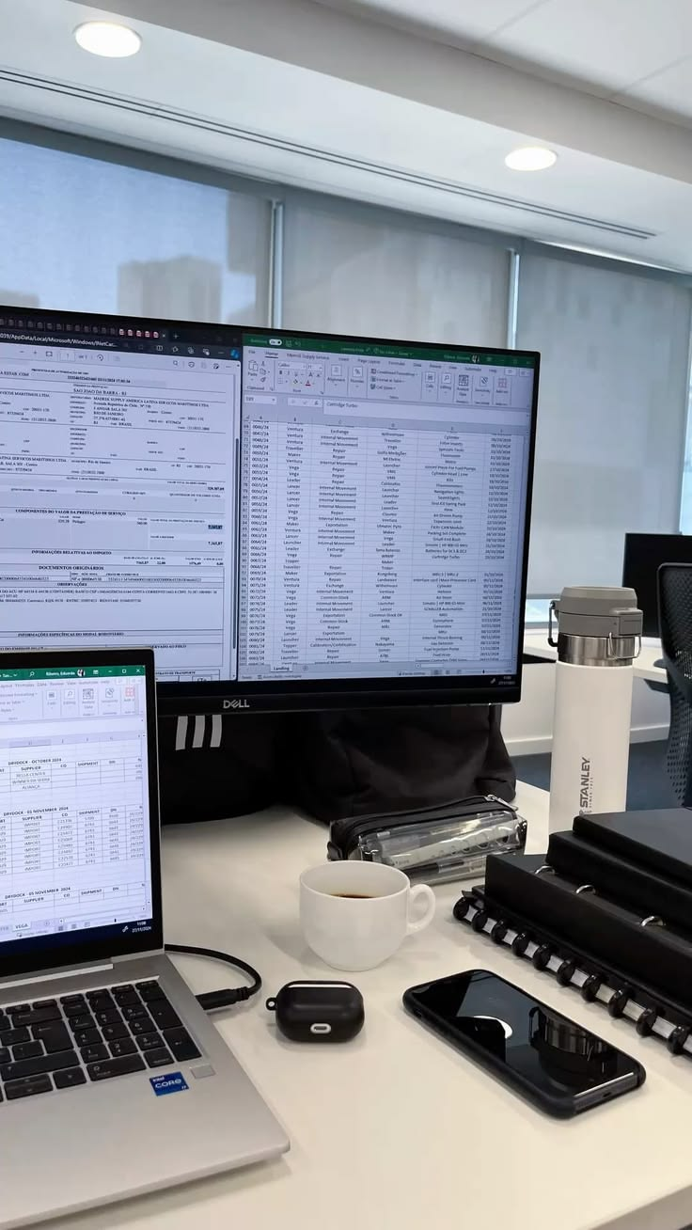
OFFICES
Displays documents, spreadsheets and presentations.
Supports communication and data analysis.

Slide 27
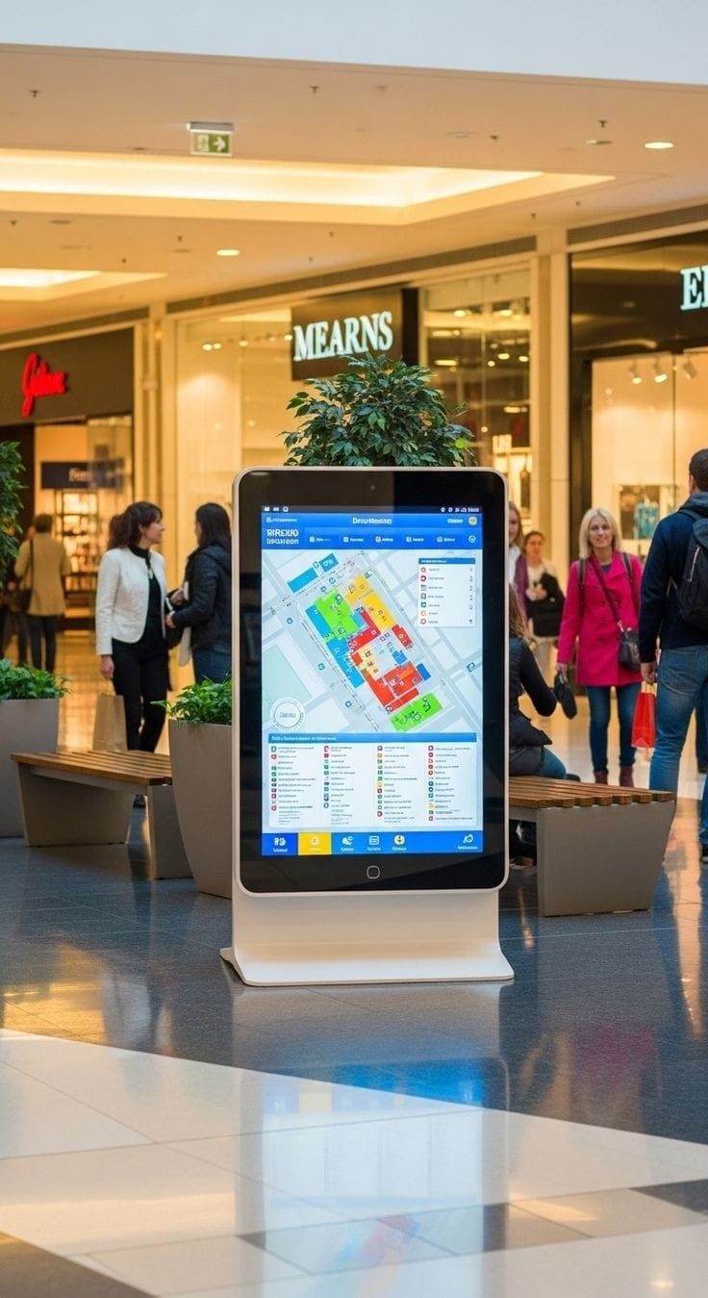
PUBLIC INFORMATION
Shows directions, announcements and schedules.
Used in airports, railway stations and shopping centres.

Slide 28
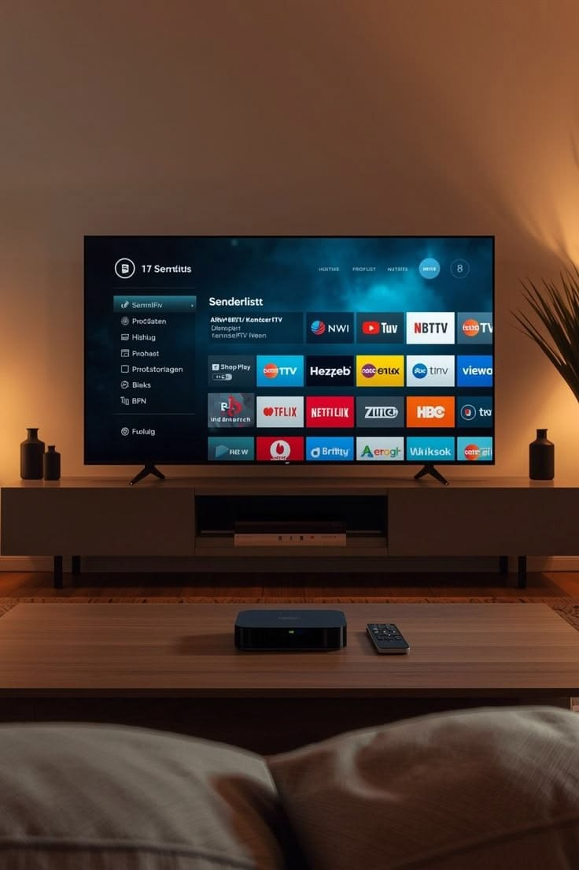
ENTERTAINMENT
Displays films, games and streaming content.
Used in televisions, gaming monitors and cinemas.

Slide 29
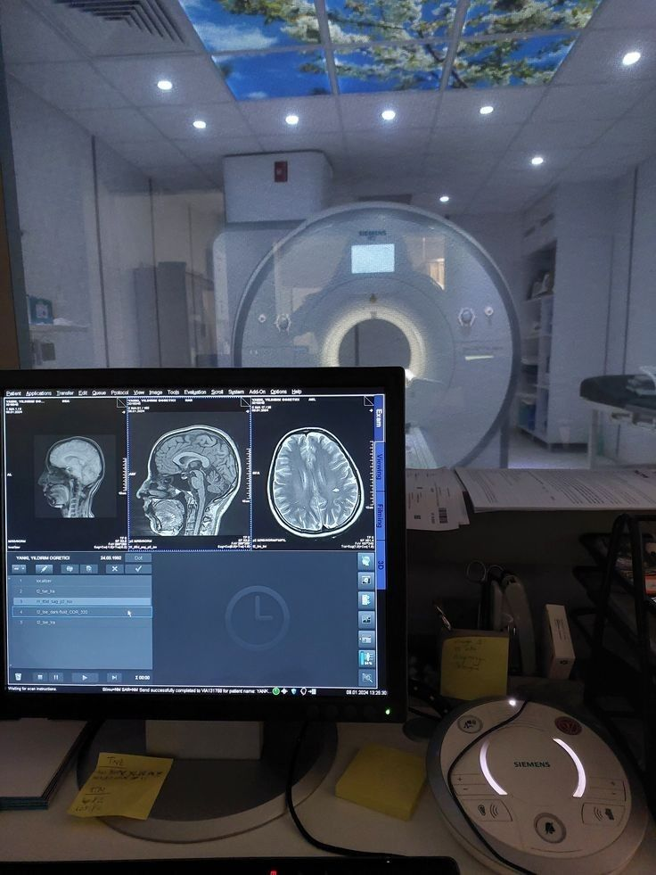
HEALTHCARE
Displays medical images and patient-monitoring data.
Helps healthcare professionals examine information.

Slide 30
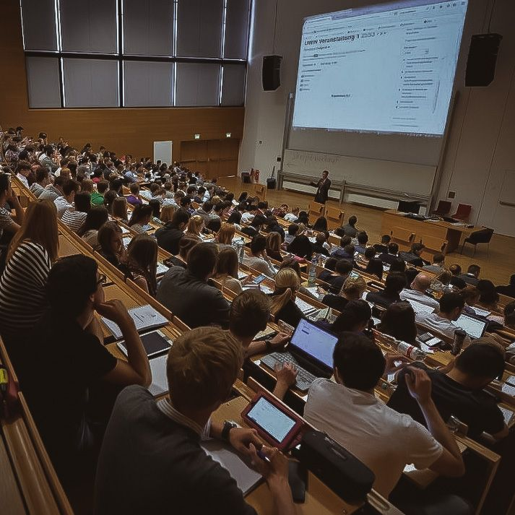
EDUCATION
Supports visual learning and classroom presentations.
Used in smart classrooms, laboratories and online learning.

Slide 31
CONCLUSION
Display devices are essential computer output devices.
Different technologies offer different features and benefits.
CRT, LCD/LED, OLED and projectors serve different purposes.
The best display depends on its intended use.

Slide 32

THANKYOU

