Slide 1

Display
Devices
Types, Technologies and real world applications
Presented by: nowreen naaz, 2606010
BCA | Amar Singh college

Slide 2

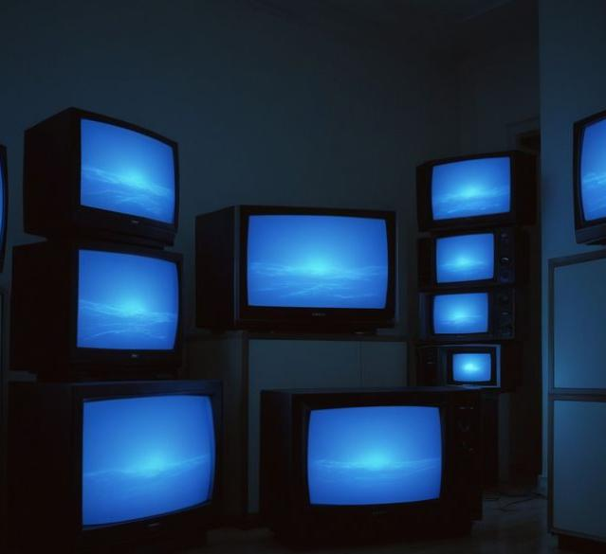


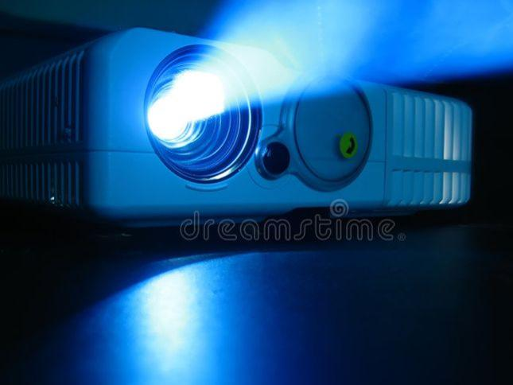
What are Display Devices?
A display device is an output device that presents information from a computer or another electronic system in a visual form, such as text, pictures, graphics, and video.
In simple words
Computer processes information → display device shows you the result.
monitors
smartphones
Laptop screens
projectors

Slide 3

How do they work?
Display
Device
Computer / processing unit
Display connection
Carries image information
Shows text, images and video
Processes
data
Example: when you open a powerpoint, the computer processes the slide information and the display device shows it on the screen

Slide 4
TYPES
OF
DISPLAY DEVICES

Slide 5

CRT DISPLAYS
(Cathode Ray Tube)
Uses electron beams to create images on a phosphor-coated screen.
Bulky and heavy design.
Common in older televisions computers
Advantage:
Good color and viewing angles
Disadvantage:
Large size and high in power

Slide 6

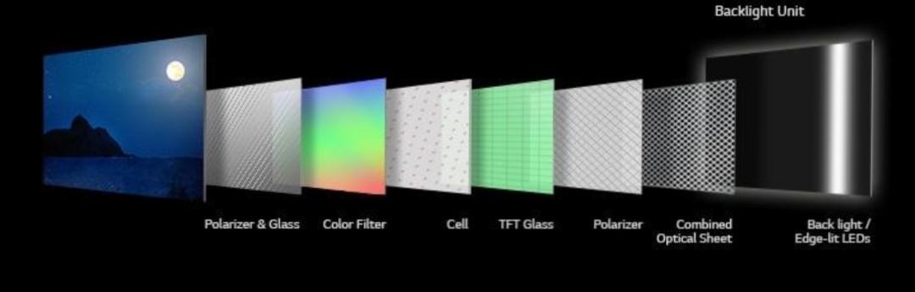
LCD AND LED DISPLAYS
Examples:
Laptop screens
Monitors
TVs
LCD (liquid crystal Display) uses liquid crystals to control light from a backlight.
LED is usually and LCD pannel with LED backlighting (or LED uses directly in larger displays)

Slide 7

OLED DISPLAYS
Each pixel produces its own light.
No backlight needed
Deeper blacks, higher contrast and vibrant colors
Example:
Smartphones
Premium TVs

Slide 8

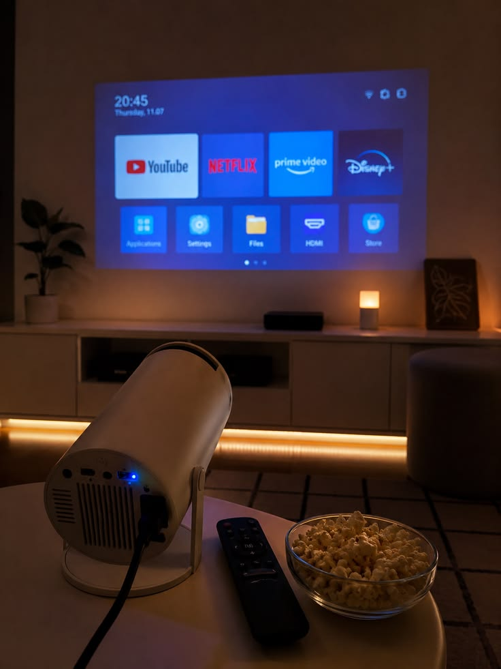
Projectors
Uses light source and lens to project an image onto separate surfaces.
Can display larger images.
Common in classrooms, cinemas and conference rooms.
Examples:
Classrooms, cinemas and offices

Slide 9

DISPLAY DEVICES IN
EVERYDAY LIFE

Slide 10

OFFICES

Slide 11
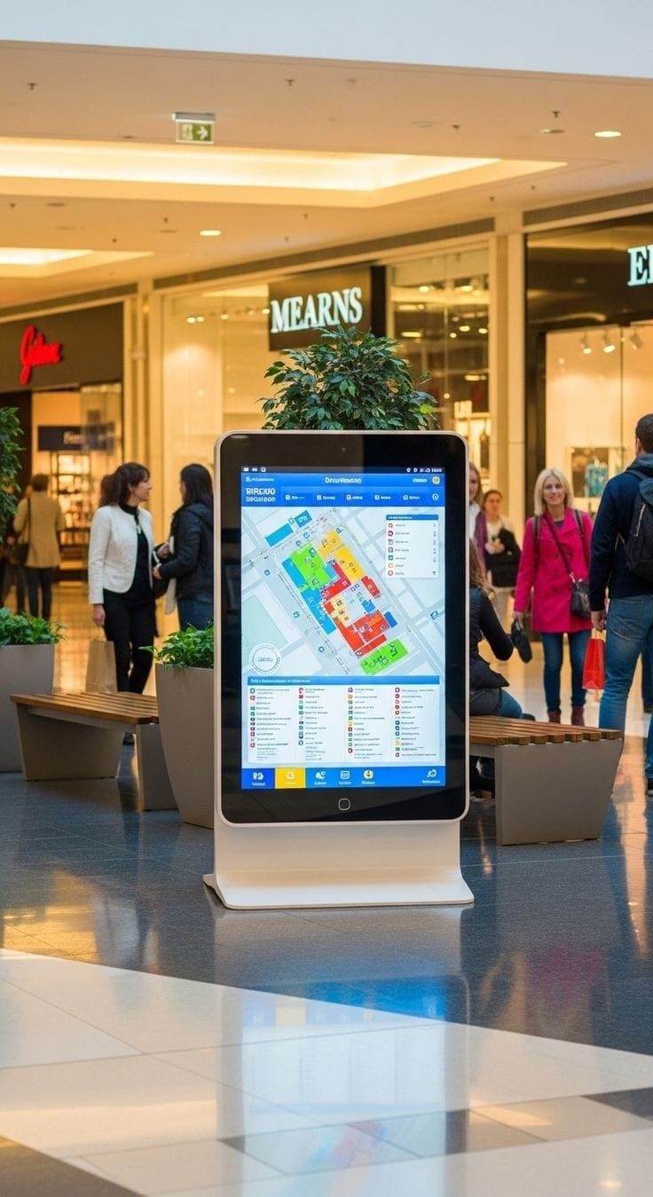
PUBLIC INFORMATION

Slide 12
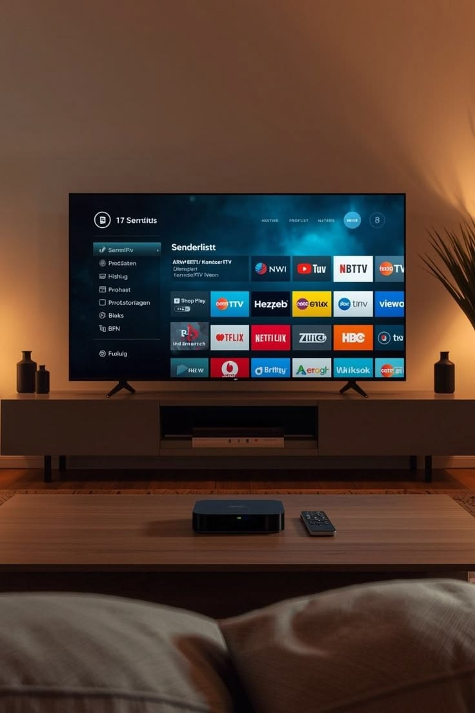
ENTERTAINMENT

Slide 13
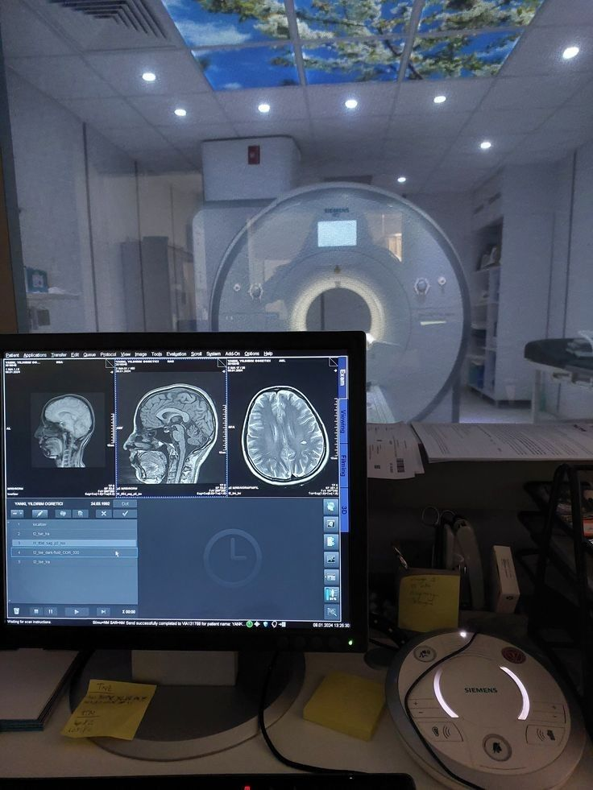
HEALTHCARE

Slide 14

EDUCATION

Slide 15

THANKYOU

