Slide 1

Final Project Big Data Case Study in Mobile Analytics
Waite, Stirling
CSCI E-63 Big Data Analytics
Harvard University Extension School
Prof. Zoran B. Djordjević

Slide 2
Problem Statement
The objective of this project is to build a model that will predict if a longitude/latitude will be present in a companies log data when a user visits a mobile app
Provided is a given the user’s app usage and smartphone properties
This analysis could be used later do behavioral/micro targeting to provide the user with a better advertisement close to their location

Slide 3
Technologies Used
Hardware
MacBook Pro
Processor: 2.5 GHz Intel Core 7
Memory: 16 GB 100 MHz DDR3
Software
Juptyer Notebooks (http://jupyter.org/install.html)
Spark 2.2.1 (https://spark.apache.org/downloads.html)
PySpark (https://spark.apache.org/docs/0.9.0/python-programming-guide.html)
PySpark ML (http://spark.apache.org/docs/2.2.0/api/python/pyspark.ml.html)
Pandas (https://pandas.pydata.org/)
Numpy (https://www.scipy.org/scipylib/download.html)
Matplotlib (https://matplotlib.org/users/installing.html)
Seaborn (https://seaborn.pydata.org/installing.html)

Slide 4
High Level Overview of Steps
Software Needed and Installation
Configuration Steps
Data Description
Exploratory Data Analysis
Data Transformation
Data Modeling

Slide 5
Data Description
Dataset is from a Kaggle Competition
TalkingData is China’s largest third-party mobile data platform.
Using a SDK that’s integrated with smartphone apps they collect events generated by the smartphone user.
This information is used for targeted advertising and mobile analytics

Slide 6
Data Description
Below is the data schema from the Kaggle competition website. See link here: https://www.kaggle.com/c/talkingdata-mobile-user-demographics/data
gender_age_train.csv, gender_age_test.csv - the training and test set
events.csv, app_events.csv - when a user uses TalkingData SDK, the event gets logged in this data. Each event has an event id, location (lat/long), and the event corresponds to a list of apps in app_events.
app_labels.csv - apps and their labels, the label_id's can be used to join with label_categories
label_categories.csv - apps' labels and their categories in text
phone_brand_device_model.csv - device ids, brand, and models
phone_brand: note that the brands are in Chinese (translation courtesy of user from and to)
三星 samsung
天语 Ktouch
海信 hisense

Slide 7
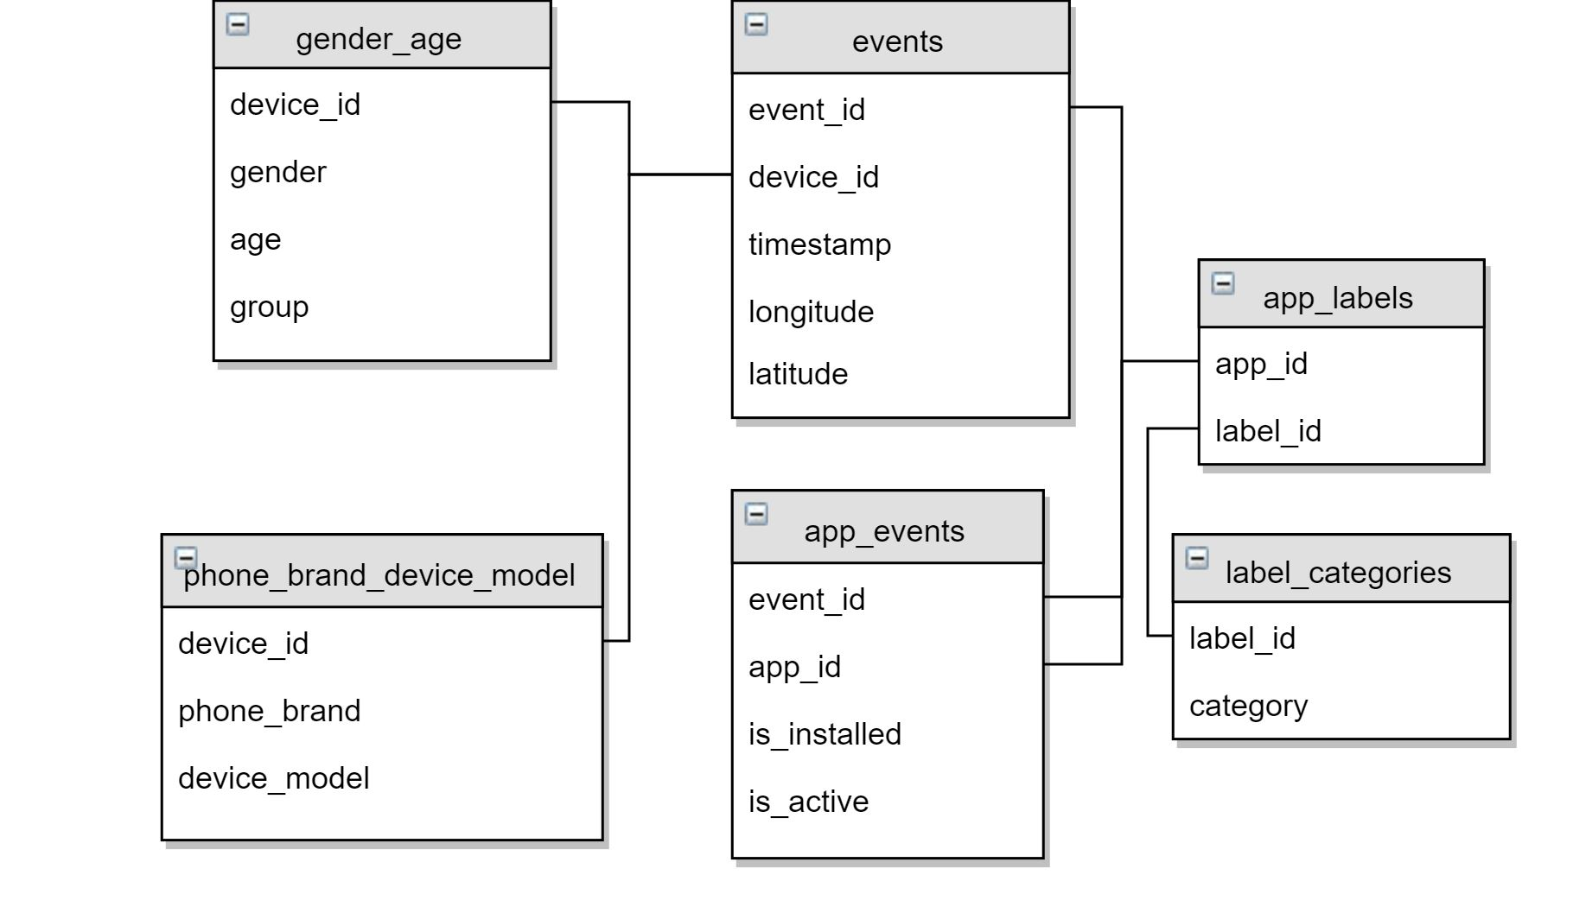
Data Description

Slide 8
Installation Steps
Install Homebrew
/usr/bin/ruby -e "$(curl -fsSL https://raw.githubusercontent.com/Homebrew/install/master/install)”
Install Python
brew install python
Install PIP
sudo easy_install pip
Install Needed Python Modules
python -m pip install --user numpy scipy matplotlib ipython jupyter pandas sympy nose seaborn
Install Apache Spark
brew update brew install scala brew install apache-spark
Start Jupyter Notebooks
Navigate or “cd” into your project folder
Type jupyter notebook into your terminal window

Slide 9
Demo
Big-Data-Case-Study-In-Mobile-Analytics-ExploratoryDataAnalysis.ipynb
Contains visuals, and exploring datasets of users app usage and phone properties
Big-Data-Case-Study-In-Mobile-Analytics-Features-Extraction.ipynb
Combines datasets and extracts key features for modeling
Big-Data-Case-Study-In-Mobile-Analytics-Naive-Bayes.ipynb
Model for classification
Big-Data-Case-Study-In-Mobile-Analytics-Decision-Tree-Classifier.ipynb
Model for classification

Slide 10
Lessons Learned
Give yourself plenty of time to understand dataset before diving into modeling
Exploratory Data Analysis is super useful for understanding what your data is trying to tell you and what you can predict
When modeling start out with small set of features

Slide 11
Thank You!

Slide 12
YouTube URLs, Last Page
Two minute (short):
https://youtu.be/ajY8mxXueoU
15 minutes (long):
https://youtu.be/bdbHq6n-a00

