Slide 1


Smart Green House
Noushin Najafiragheb
Internet of Things
A.Y. 2020-2021

Slide 2
Introduction
SmartGreenHouse aims to monitor and regulate soil humidity, temperature, and light in a greenhouse without human intervention. This is achieved through a system of sensors, actuators, and data processing software.
Smart Lighting project 2

Slide 3
Functionalities
Utilizes two IoT networks: MQTT and CoAP.
MQTT network includes soil sensors reporting humidity, temperature, and light data to a Java collector via a border router. The collector stores data and manages lighting protocols.
CoAP network controls actuators with commands for activating and deactivating lighting and ventilation systems.
Data processing and logic for humidity, temperature, and light regulation are implemented in Java.
MySQL is used for data storage.

Slide 4
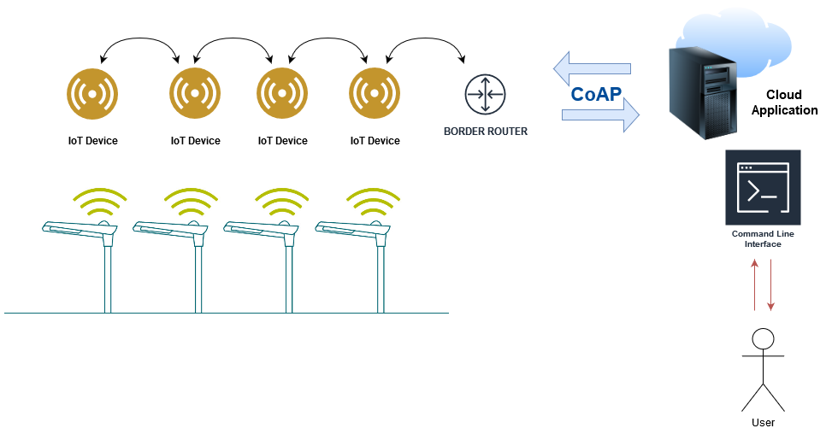
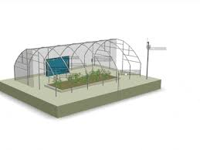
System scheme and structure
Smart Lighting project 4

Slide 5
LLN
MQTT: Sensors send data via an MQTT broker. Humidity, temperature, and light values are transmitted on different ports.
CoAP: Actuators are controlled via CoAP using commands like "on" and "off."
Smart Lighting project 5

Slide 6
MQTT Sensor Integration
Light and temperature values are monitored by the MQTT sensors and sent through the MQTT broker using a publisher/subscriber mechanism. The publisher transmits data periodically on the light topic, with a 30-second interval. The Java collector acts as a subscriber to retrieve these messages. The code snippet below demonstrates this functionality.
Given that there are two types of observable resources, each topic is monitored on distinct ports: port 1883 for light and port 1880 for temperature. In this discussion, we will focus on the details of monitoring the light resource to avoid redundancy. Temperature monitoring follows a similar process.
Smart Lighting project 6

Slide 7
MySQL
For the database part of the application, two tables are used to store all the information,
consisting of four columns for both:
Time: the time of observation.
Date: the date of observation.
Light/Temperature: the value observed.
Smart Lighting project 7

Slide 8
Sql query
Lighting/Ventilation includes 3 possible values:
- Non-Required: The humidity/temperature value is above the threshold.
- Required: The humidity/temperature value is below the threshold.
- Regulated: This should always appear in the record after “Required” as it shows that
the irrigation/heating has been activated and a new humidity/temperature value was
assigned.

Slide 9
DATA ENCODING
For the MQTT publisher, a JSON format was chosen
From the Java application to the CoAP application, a Plain Text format is used as the
commands are simple “on/off”. The message is never processed or used elsewhere than by the node itself, it is concise and self explanatory, so it doesn’t need more structure or space
than that.
Smart Lighting project 9

