Slide 1

Samourai Swaps
Transaction Privacy Tool

Slide 2
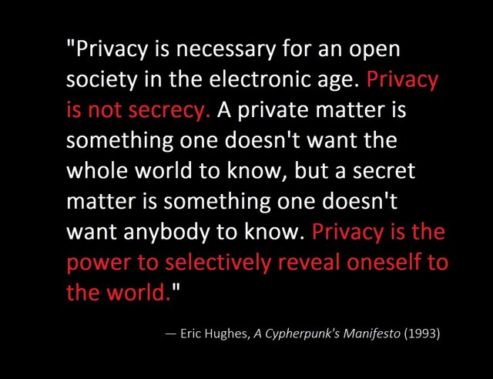
Cypherpunk Ethos

Slide 3
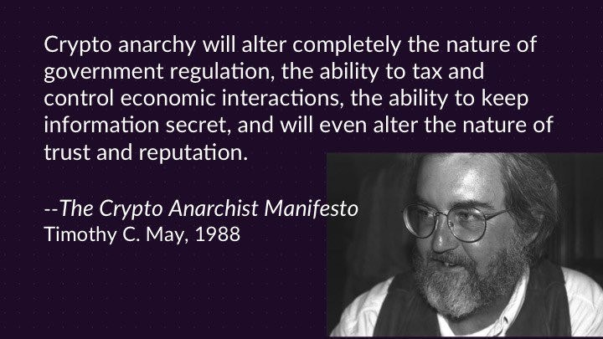
Cypherpunk Ethos

Slide 4

Cypherpunk Ethos

Slide 5
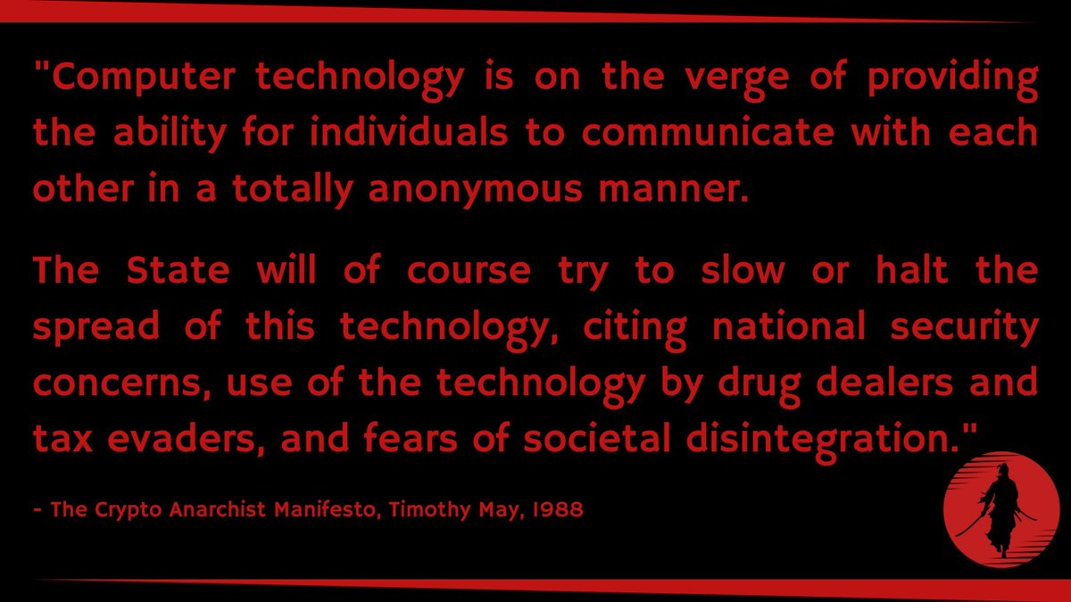
Cypherpunk Ethos

Slide 6
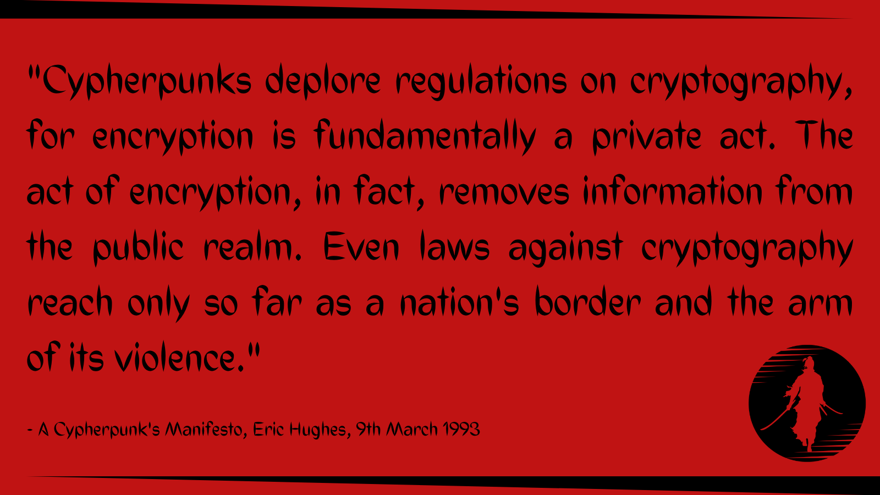
Cypherpunk Ethos

Slide 7
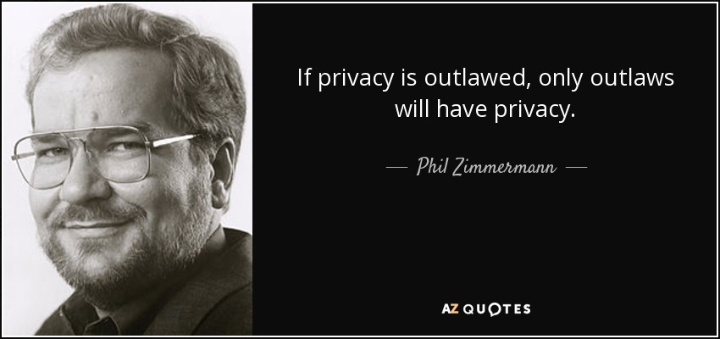
Cypherpunk Ethos

Slide 8

Operational Security
No Privacy, No Freedom
Stealth is Wealth

Slide 9
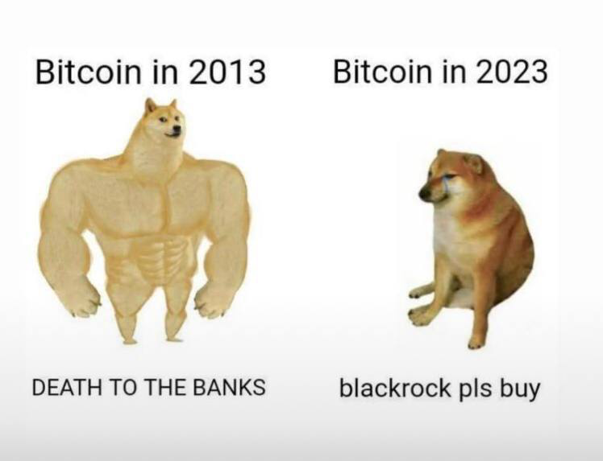

Slide 10
Ideological Allies
Monero Tribe valuable allies
Most in touch with cypherpunk roots
Gold/Silver?

Slide 11
Insurance
More regulatory capture with BTC
  Digital ID (KYC) & Social Credit System
  Custodial (On-Chain & Layer 2)
  ETFs
Escape Hatch / Back Door
Deeper Underground

Slide 13
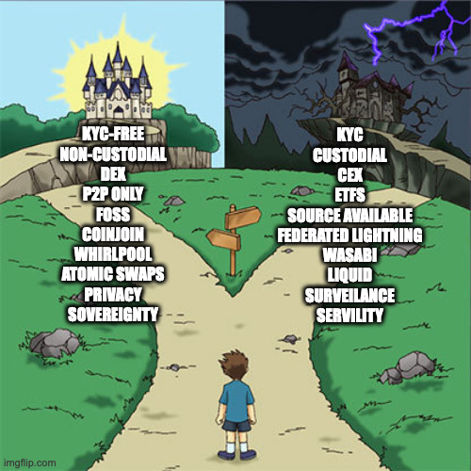

Slide 14
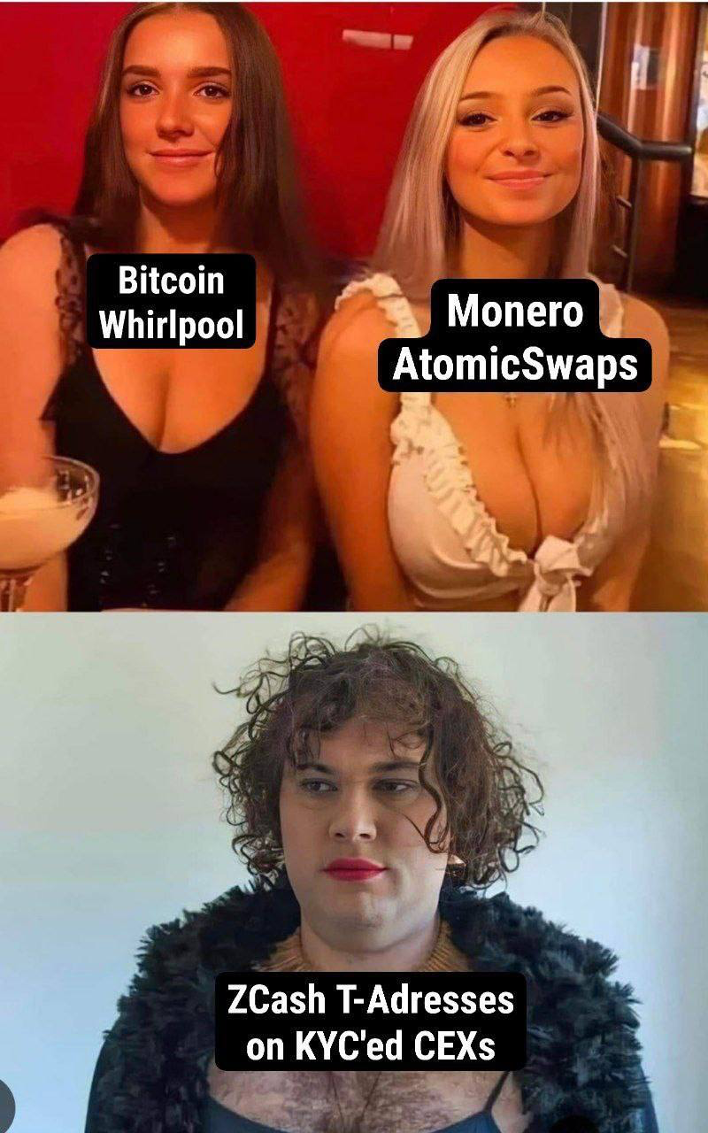


Slide 15
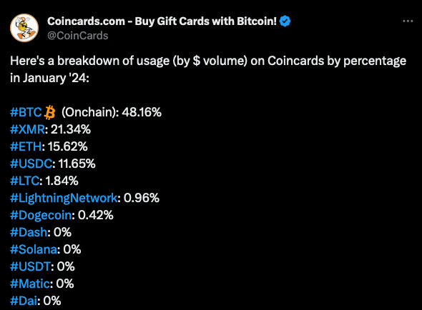

Slide 16
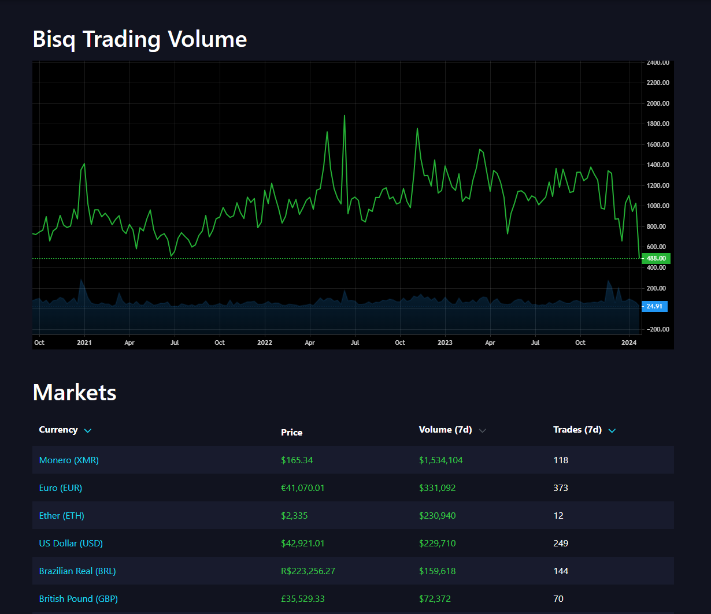

Slide 17
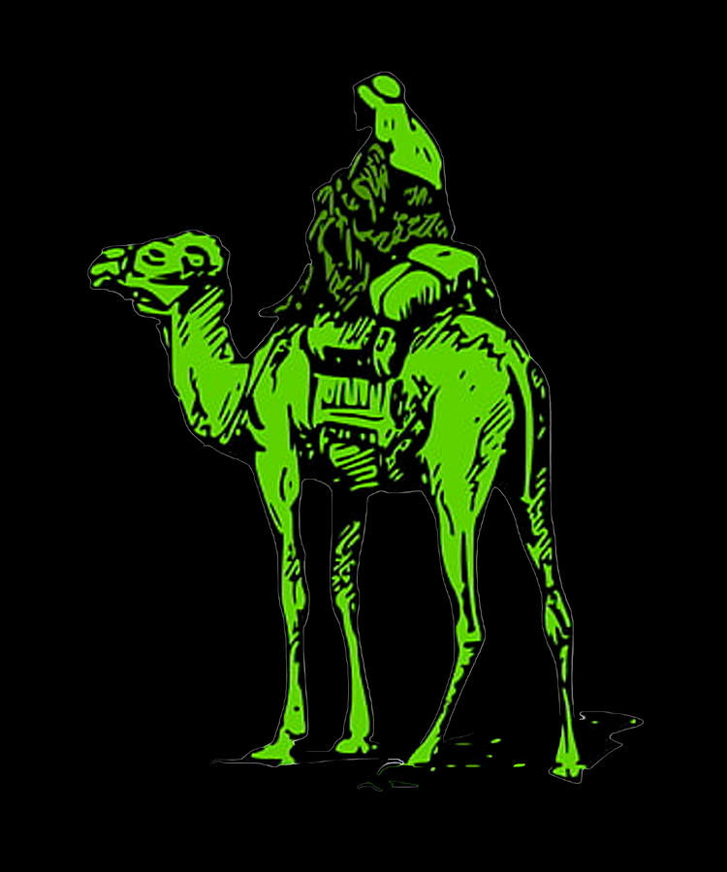
Darknet Markets
Darknet Markets are the Freest Markets
Frontlines of Free Trade
Litmus Test for Freedom/Sovereign Money/Tech
Pure Signal

Slide 18
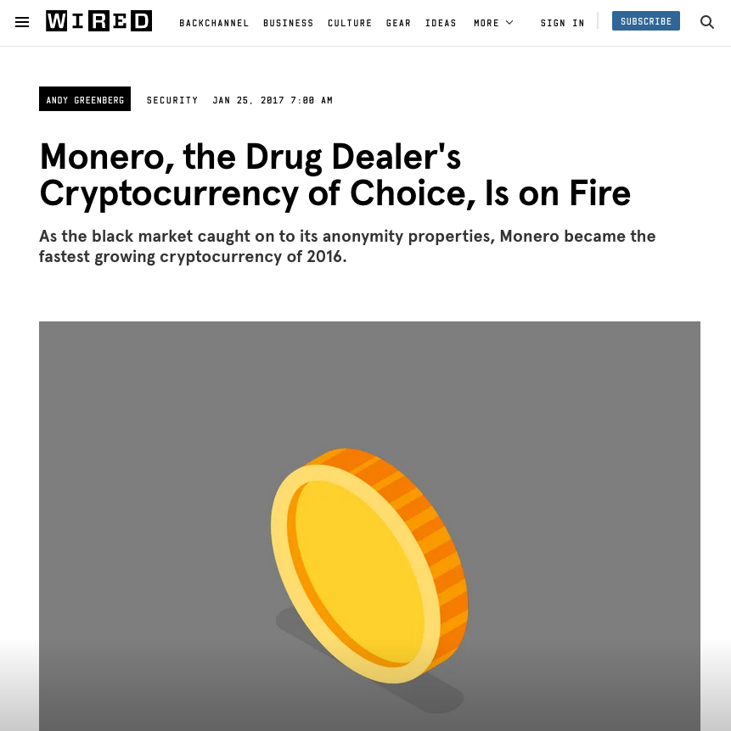
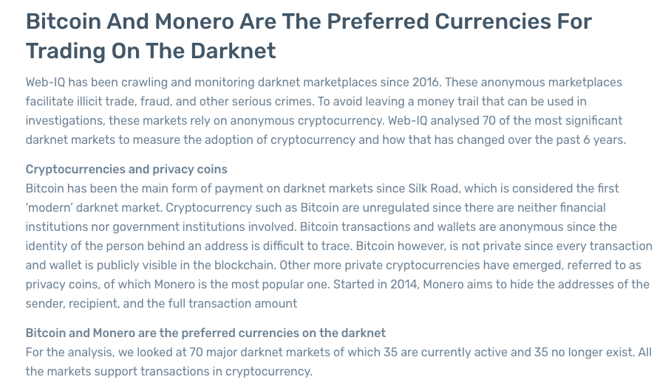
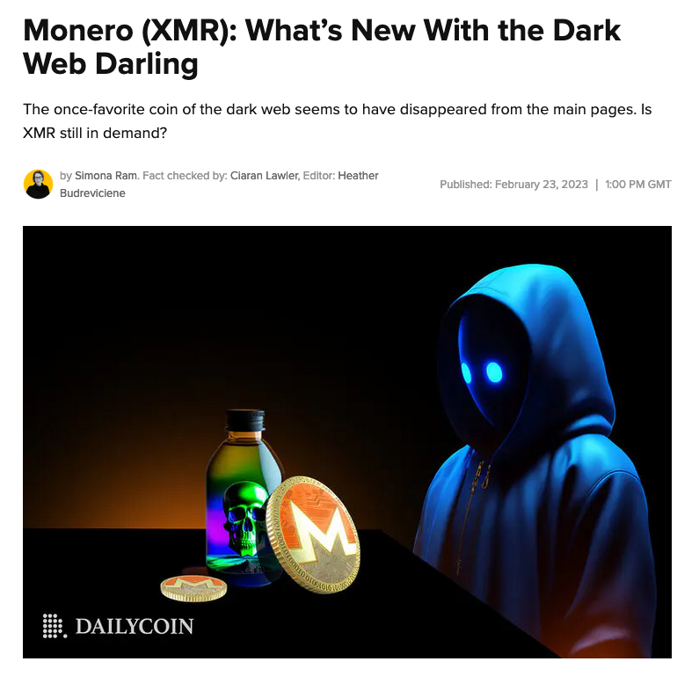
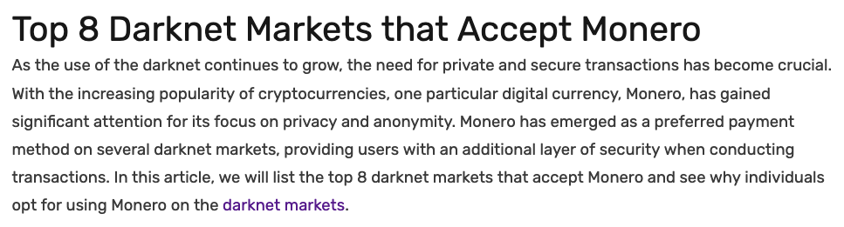
Darknet Markets

Slide 19
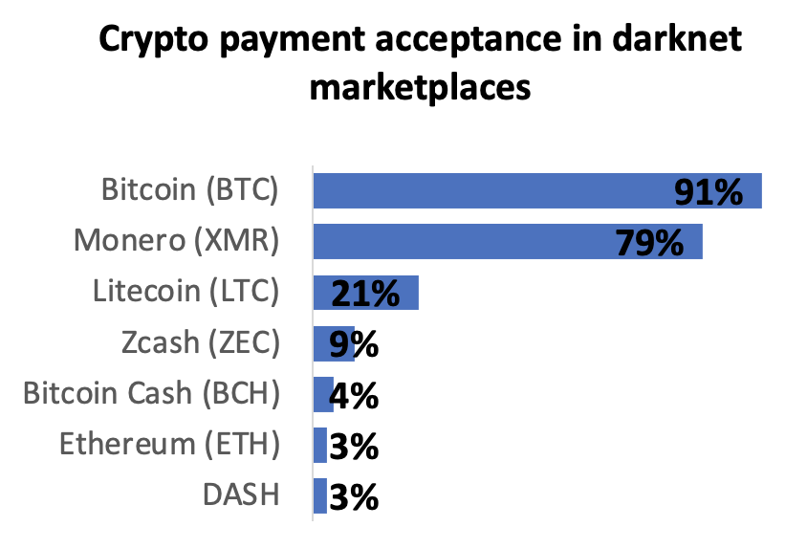
Darknet Markets
XMR becoming recommended
XMR gaining massive market share
XMR Only DNMs
Extra fee to use BTC

Slide 20

Darknet Markets

Slide 21
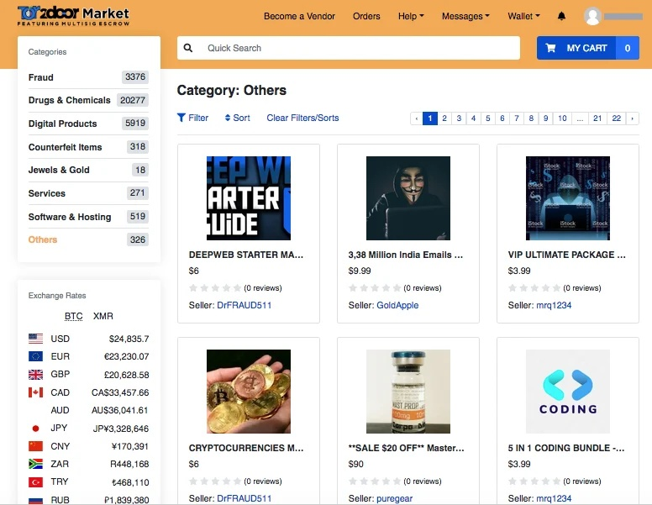
Darknet Markets
Most popular drugs last couple of years:
  Ivermectin
  Hydroxychloroquine
Cheaper generic prescriptions
Disrupts Big Pharma’s Monopoly
Other goods besides Drugs

Slide 22
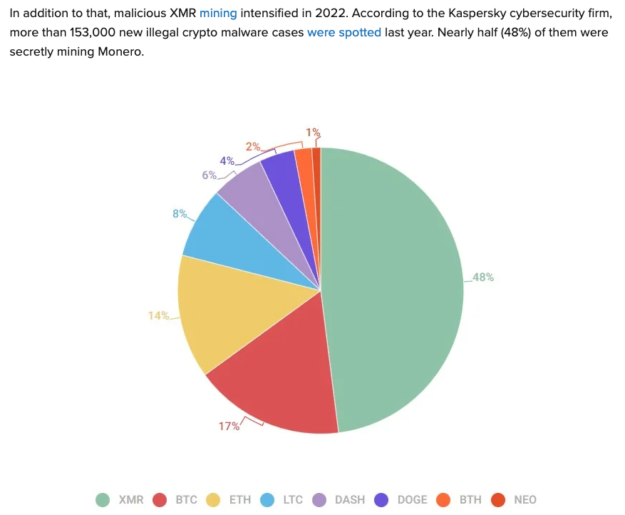
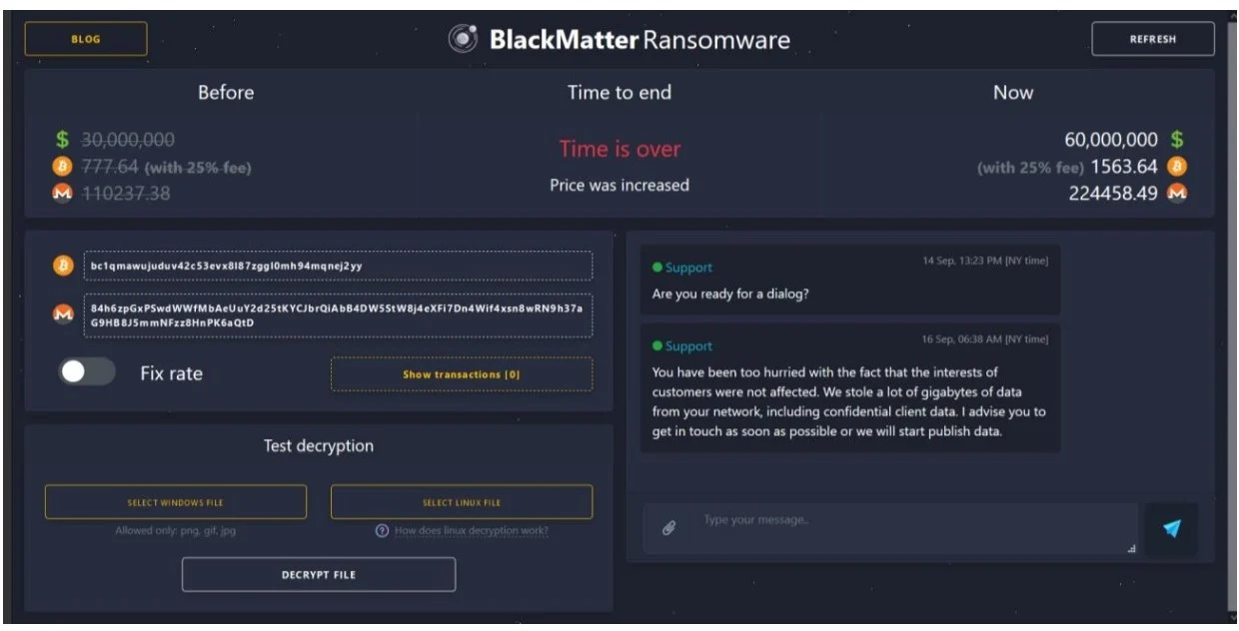
Ransomware/Malware

Slide 23

Why Would I Swap?
Dispose of Bad Bank Doxxic Change
Avoid On-Chain BTC Congestion (Layer 2)
Transaction Privacy
Spend in XMR Economy
Sell XMR for more BTC

Slide 24

Dispose of Bad Bank Doxxic Change
Doxxic Change is result of
Zerolink Coinjoin:
  Break all deterministic links
  Maximize entropy
Allow you to spend without the associated risks
Can accumulate and trade back to BTC once enough to Whirlpool

Slide 25

Avoid On-Chain Congestion (Layer 2)
In high-fee periods, small BTC transactions can become uneconomical
XMR can be used as a layer 2 to achieve lower fees / faster TXs
(Free Float Peg)
More Private, Secure, & Stable than Lightning
More Permissionless & Decentralized than Liquid

Slide 26
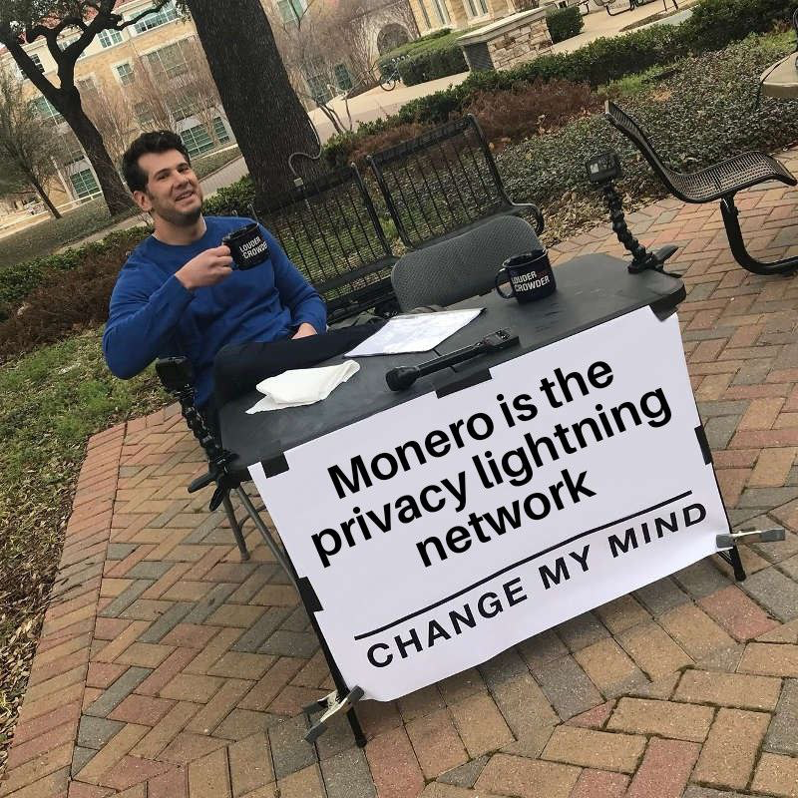
Monero: 70,930 BTC
Whirlpool: 10,650 BTC
Lightning: 4,930 BTC
Liquid: 3,630 BTC

Slide 27

Transaction Privacy (Monero)
Convenience
Stealth Addresses: True recipient's address is never linked to the transaction on the blockchain
Ring Signatures: Sender's identity remains a mystery
RingCT: Amounts transferred are kept confidential

Slide 28
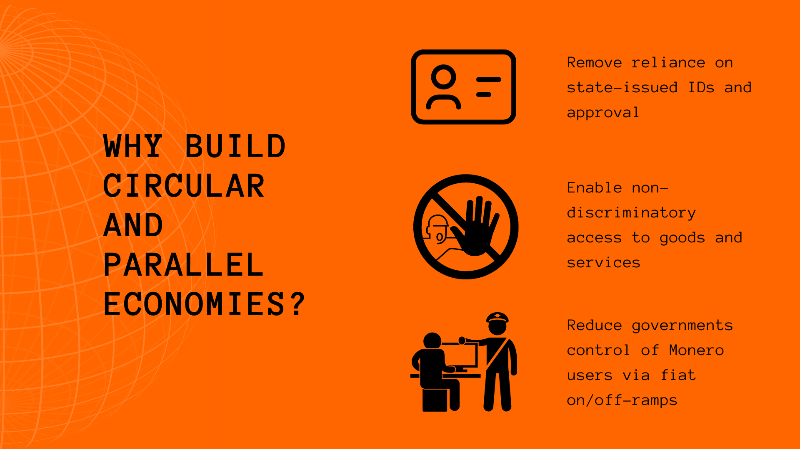
Spend in XMR Economy

Slide 29

Sell XMR for BTC
Sell at Premium Rate
Mine XMR on old computer

Slide 30
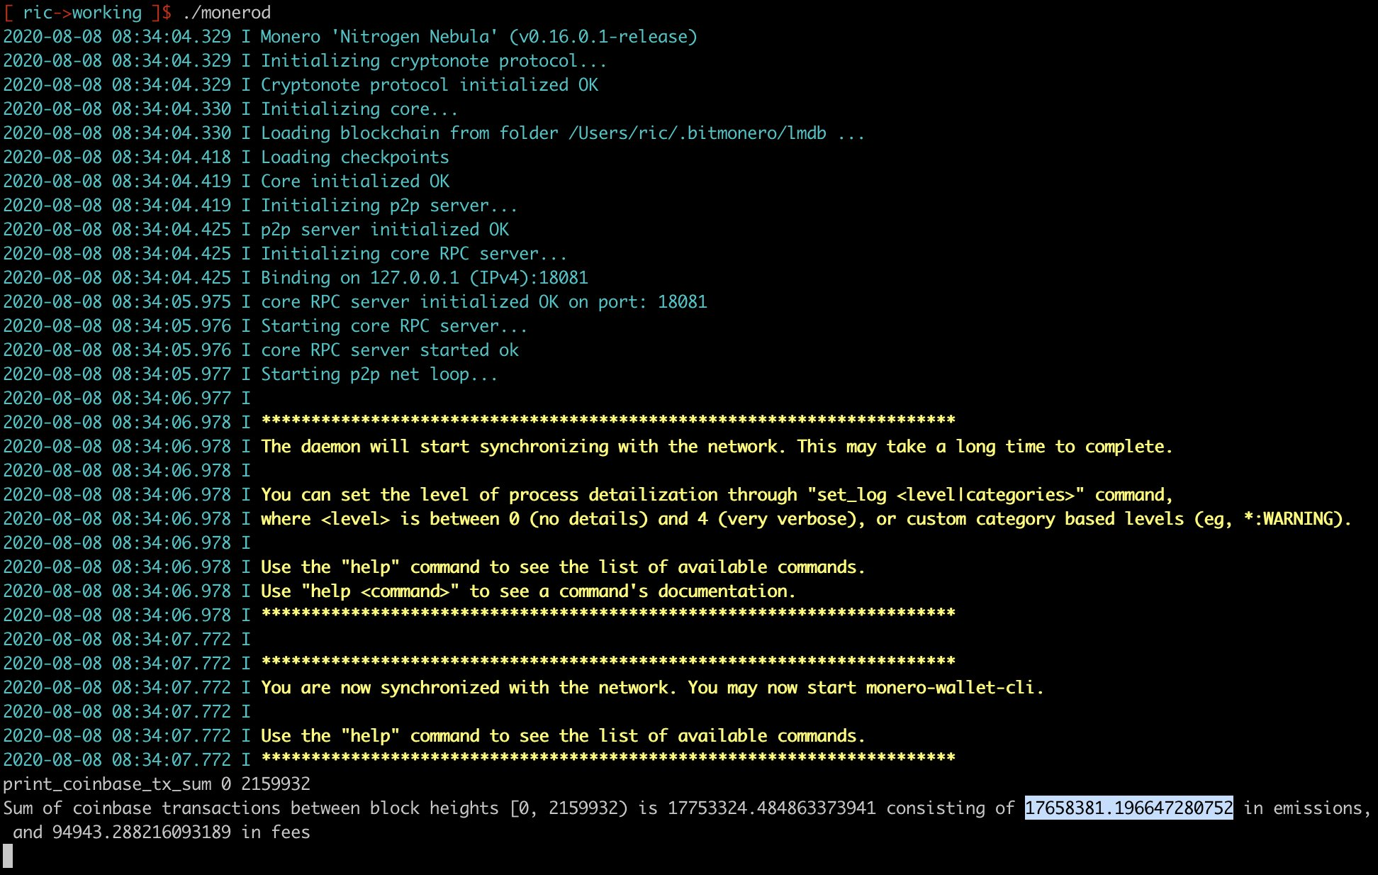
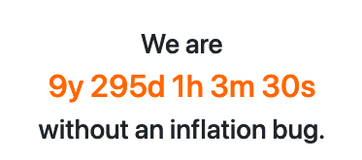
XMR Auditing
Each mined block’s coinbase is transparent
Each TX uses ZK Range-Proofs to verify inputs equal outputs

Slide 31
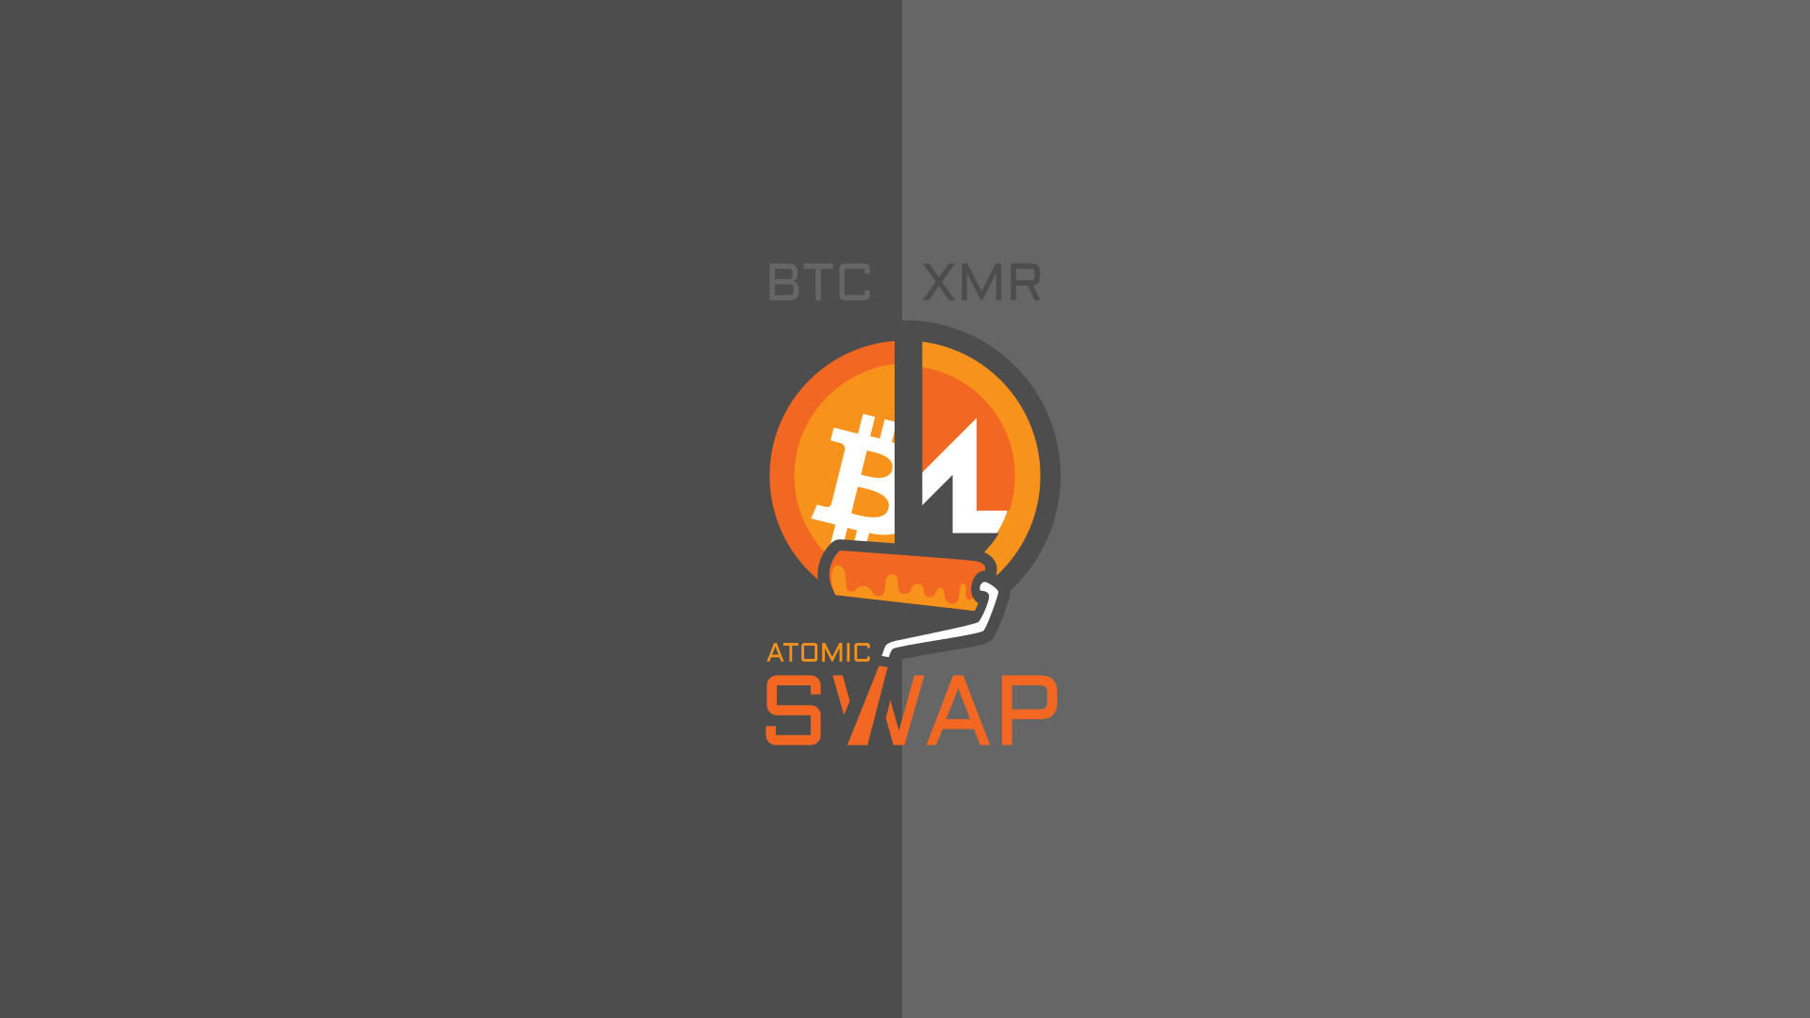
Swaps Architecture
Hash Time-Lock Contracts (HTLCs)
Adaptor Signatures (Scriptless Scripts)

Slide 32

Swaps Architecture
COMIT Network Protocol

Slide 33
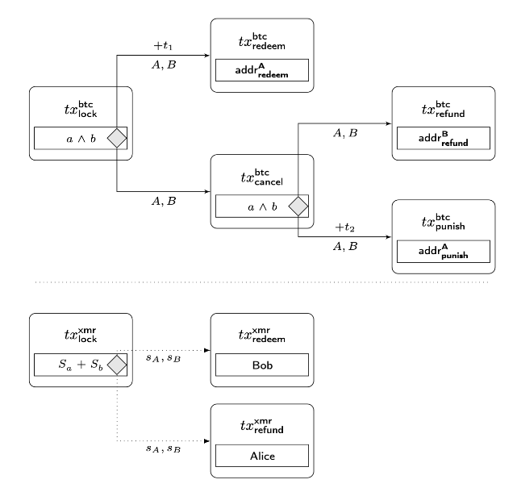
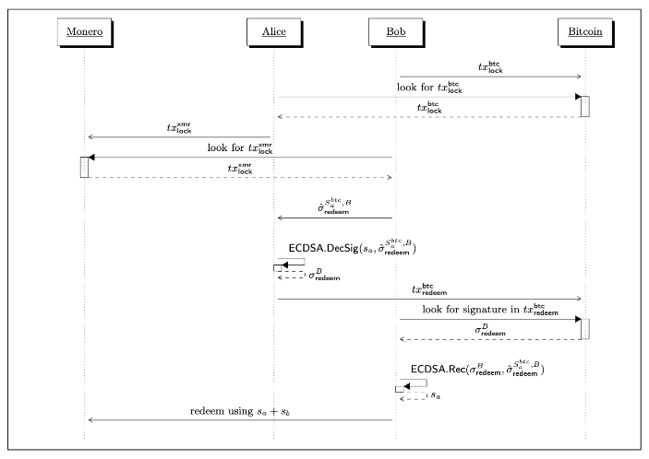
Swaps Architecture

Slide 34
Swaps Architecture
Successful Path:
  SWAPS_DEPOSIT (P2WPKH address) -> LOCK transaction (P2WSH) -> REDEEM transaction to SWAPS_ASB (P2WPKH) -> Bob redeems XMR
Unsuccessful, Refund Path:
  SWAPS_DEPOSIT -> LOCK -> (... 72 confirmations later ...) -> CANCEL transaction (to another P2WSH UTXO) -> REFUND transaction (to SWAPS_REFUNDS, P2WPKH) -> Alice refunds her XMR
Unsuccessful, Punish Path:
  SWAPS_DEPOSIT -> LOCK -> (... 72 confirmations ...) -> CANCEL -> (... 72 confirmations ...) -> PUNISH transaction (to SWAPS_ASB, P2WPKH) -> XMR remains locked currently

Slide 35
Swaps Architecture
Swaps Deposit Account: m/84'/0'/2147483643'
Swaps Refund Account: m/84'/0'/2147483642'
ASB Main Account: m/84'/0'/2147483641'

Slide 36
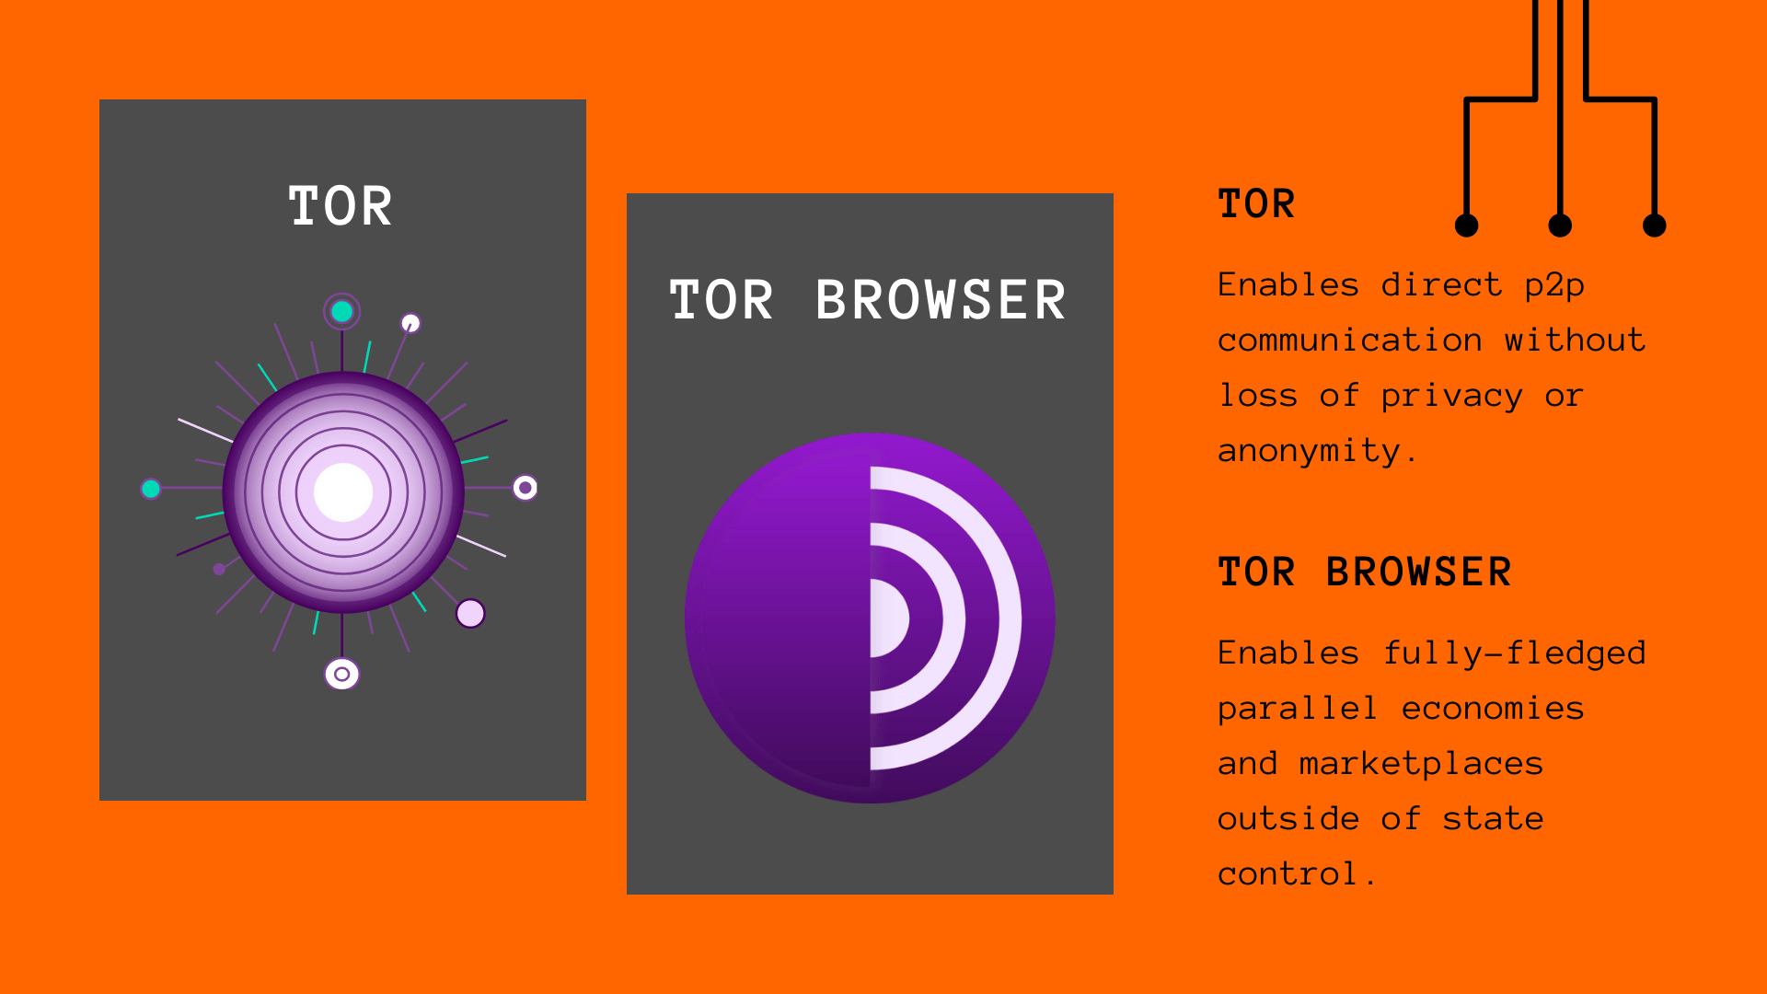
Swaps
All over TOR
Takes 30-40 mins to complete
Need to keep GUI online throughout
(Similar to Sparrow Whirlpool)

Slide 37
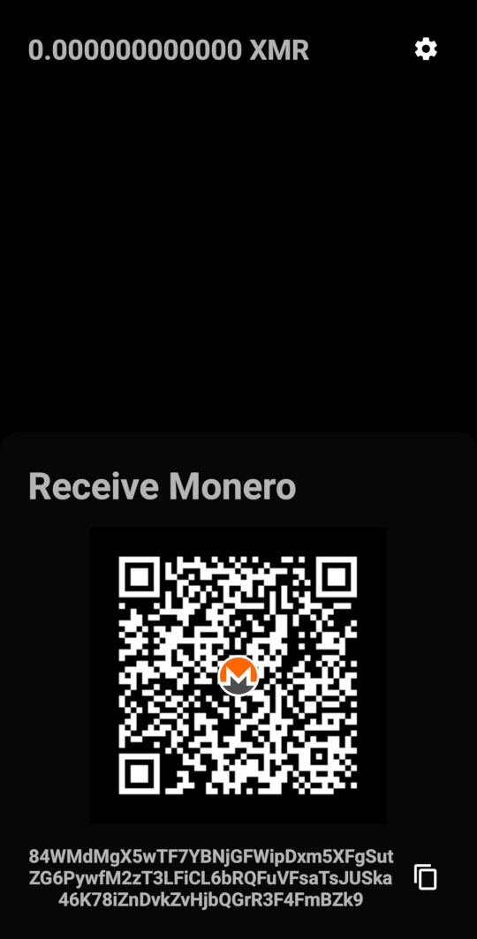
Getting Started
Samourai Swaps GUI
Samourai Wallet
Monero Wallet:
  Mysu
  ANONERO
  Monerujo
  Stack Wallet/Duo
  Feather Wallet
  Samourai Swaps GUI ASB

Slide 38
Getting Started - Testnet/Stagenet
Create Testnet Samourai Wallet:
  Safe Erase & Create New
  Create New Work Profile & Create New
Stagenet Monero Wallet:
  Built into Samourai Swaps GUI ASB
  Feather
  ANONERO
  Monerujo

Slide 39
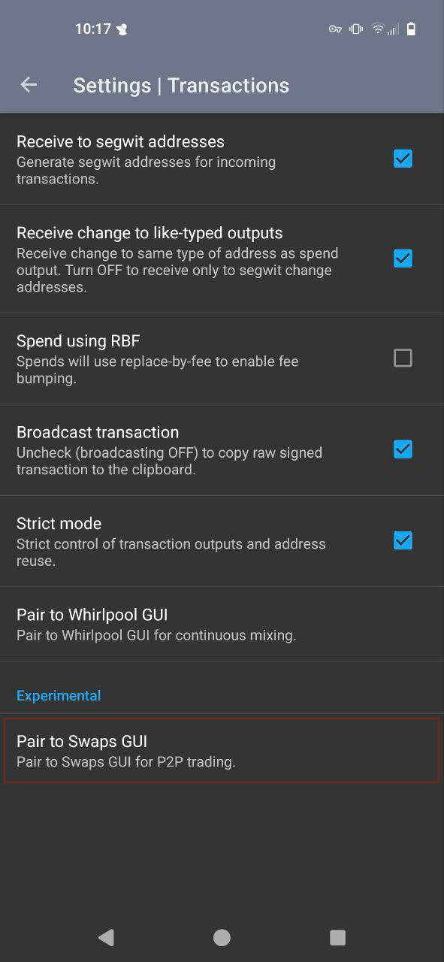
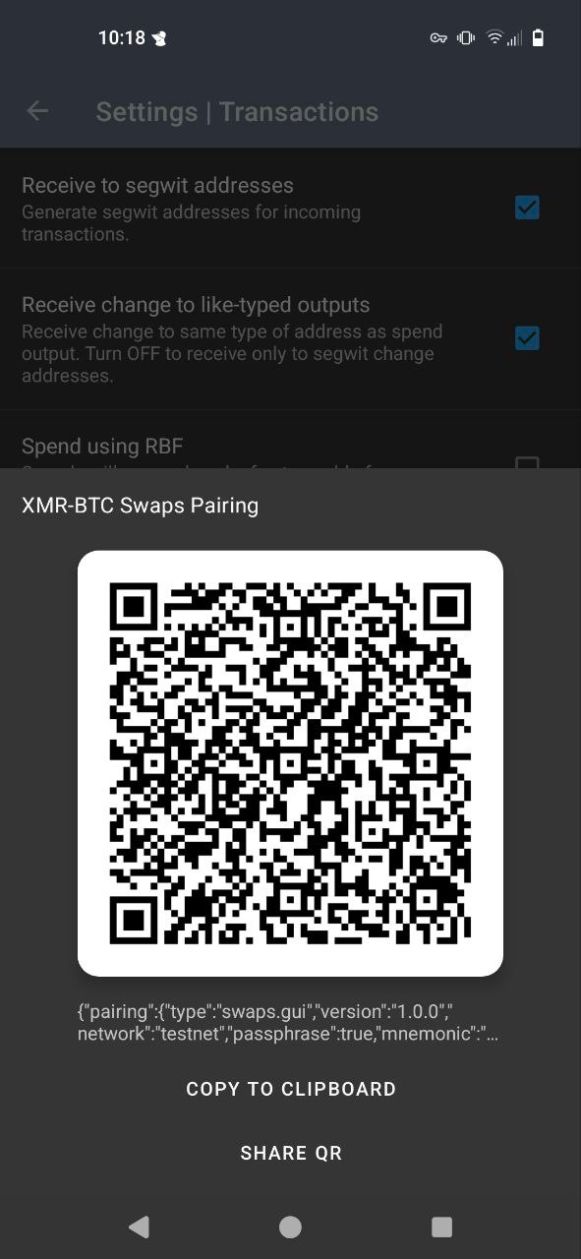
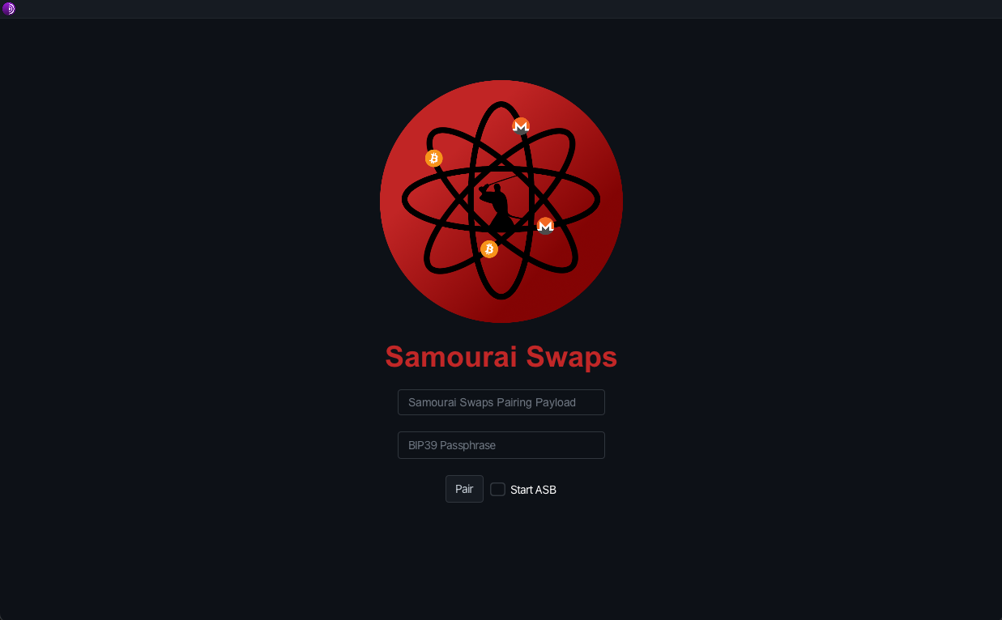
Pair

Slide 40
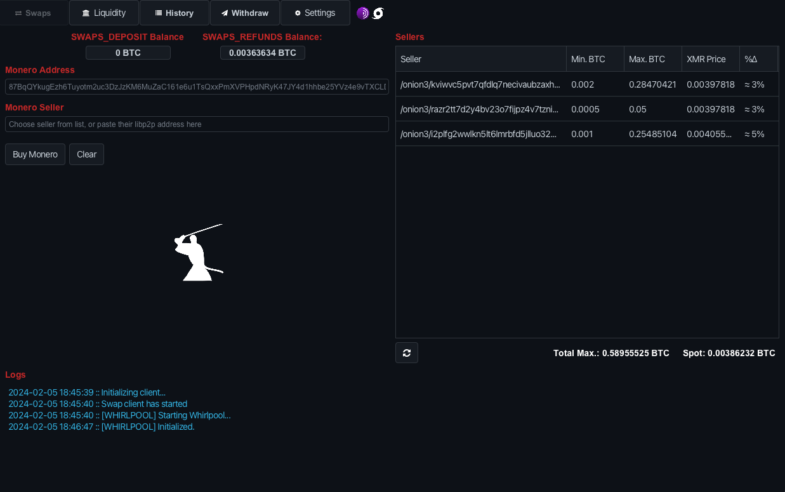
Samourai Swaps

Slide 41
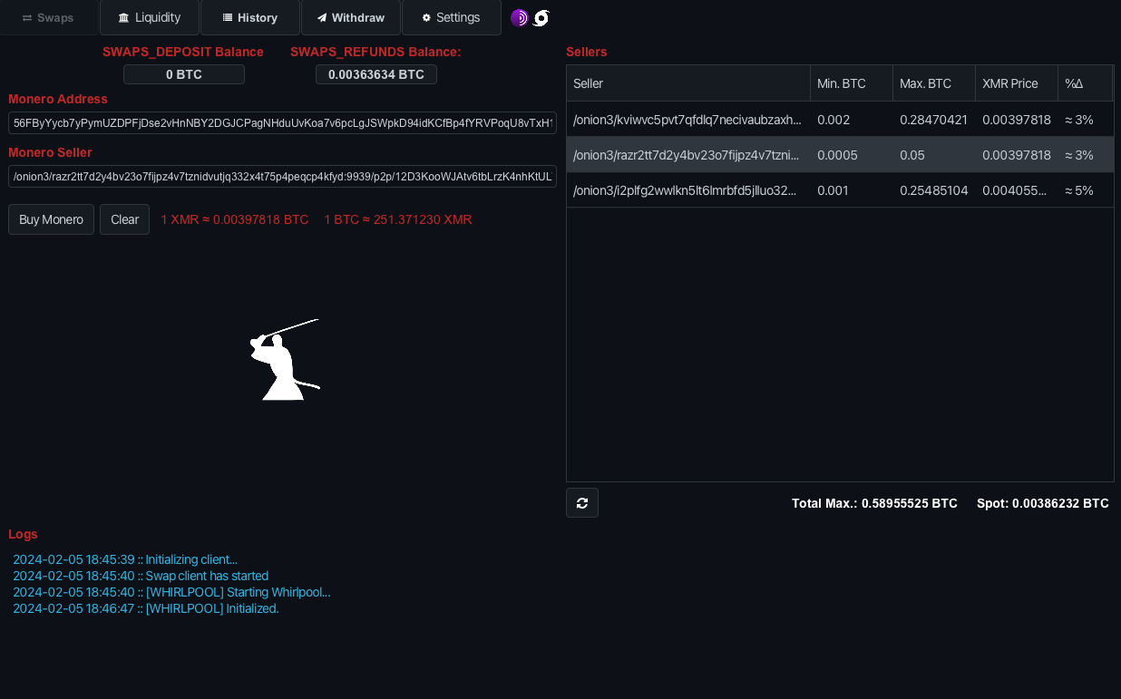
Buy Monero
Enter XMR Address
Select Seller

Slide 42
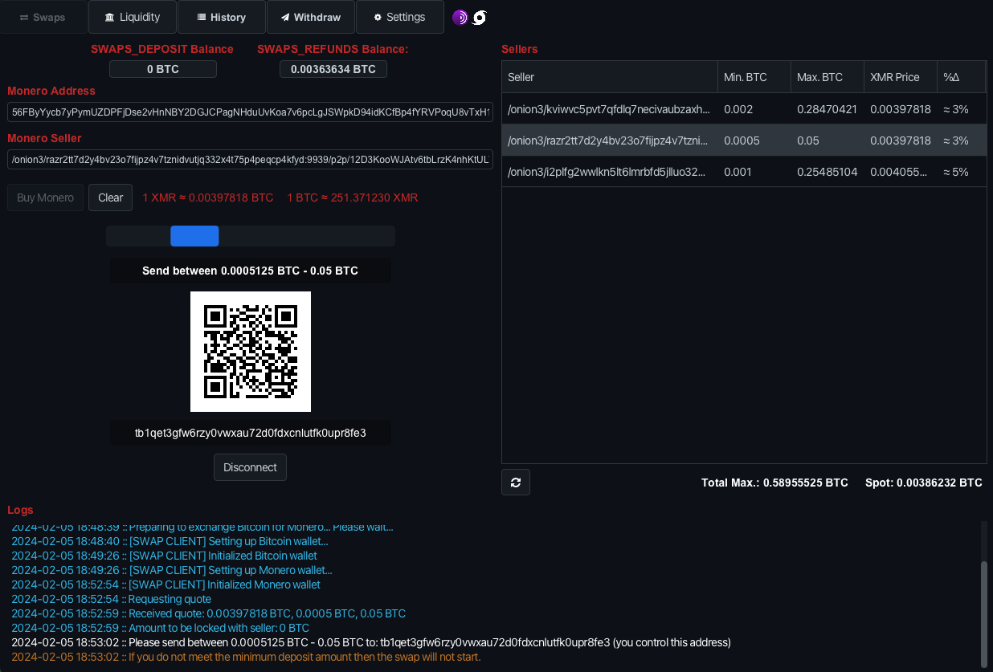
Deposit BTC

Slide 43
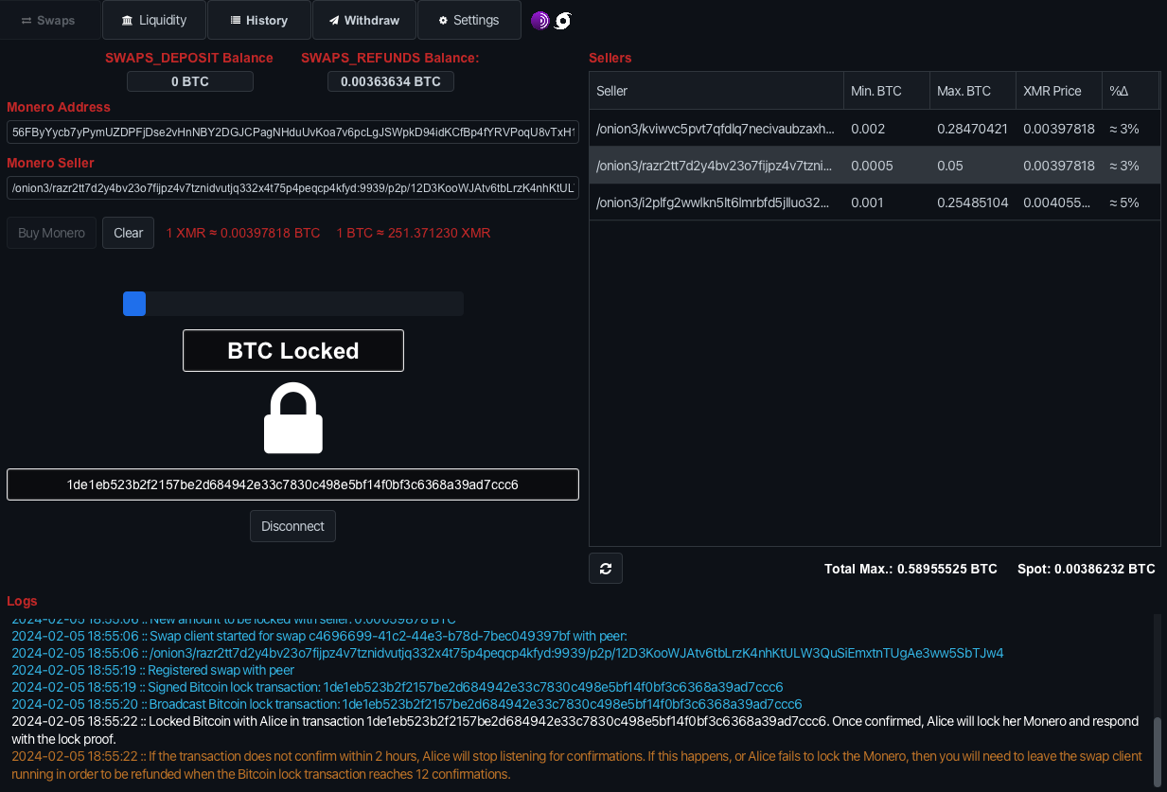
BTC Lock

Slide 44
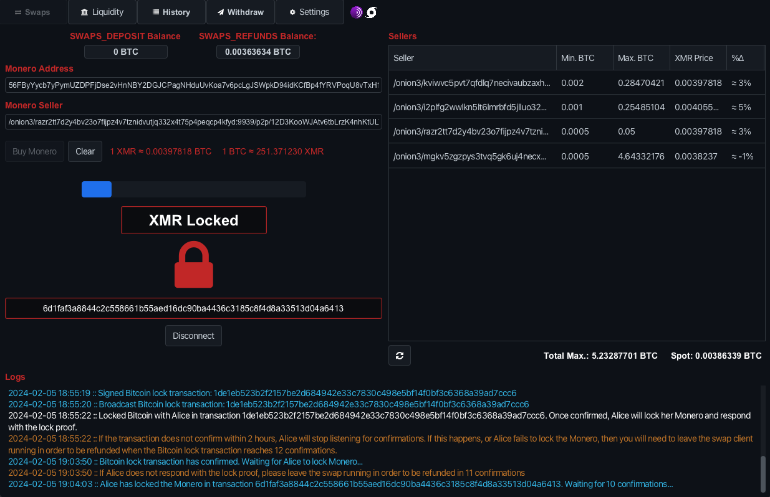
XMR Lock

Slide 45
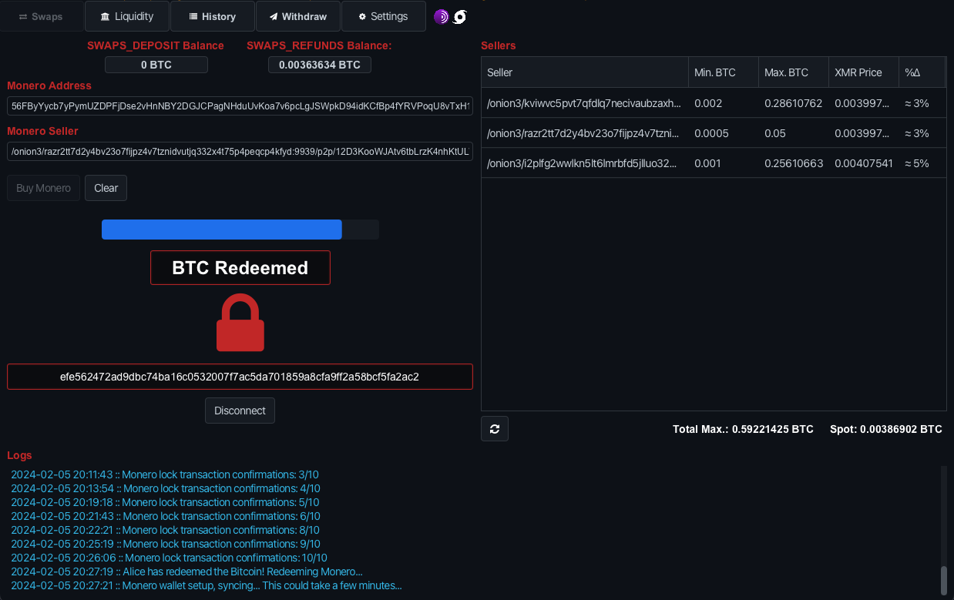
BTC Redeem

Slide 46
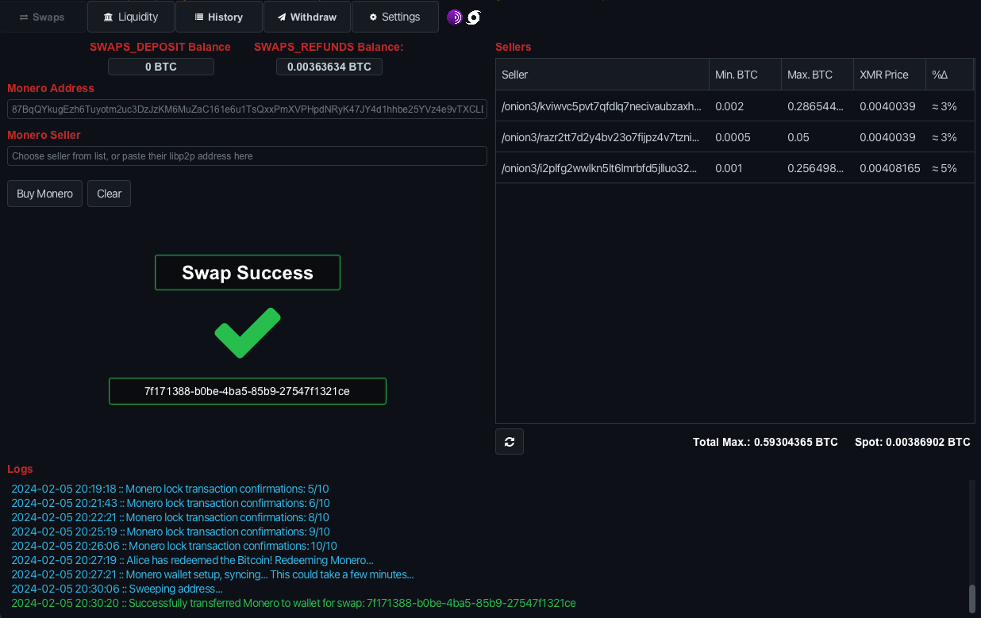
XMR Redeem – Swap Success

Slide 47
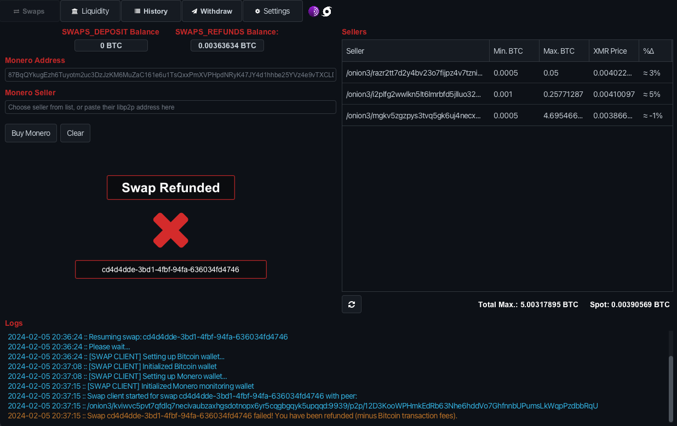
Cancel/Refund TX

Slide 48
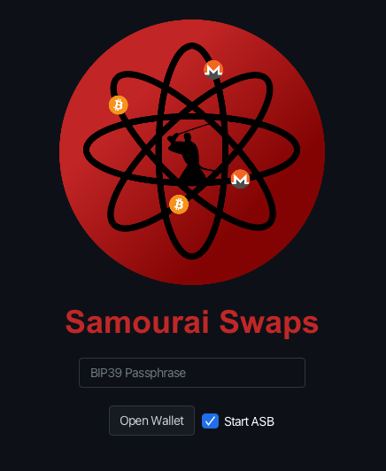
Sell XMR
Automated Swap Backend (ASB) – Market Maker
Check ‘Start ASB’
Set Min/Max BTC
Set XMR Premium Rate
Auto Whirlpool earned BTC

Slide 49
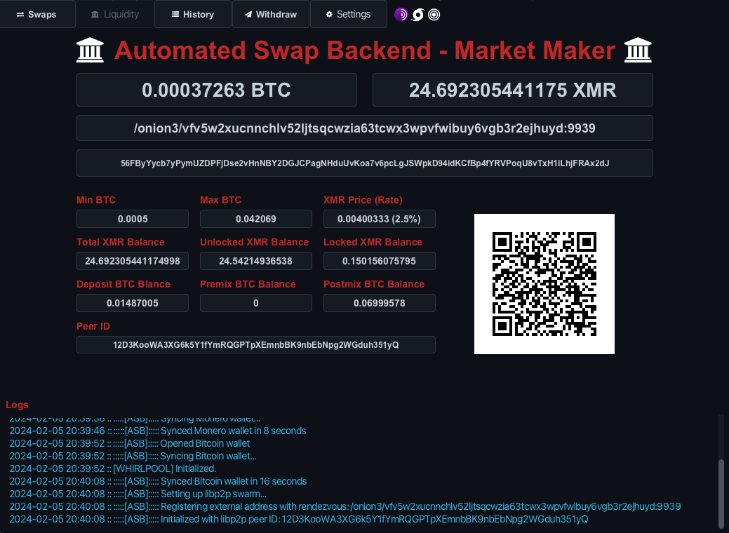
Sell XMR

Slide 50

Questions?

