Slide 1
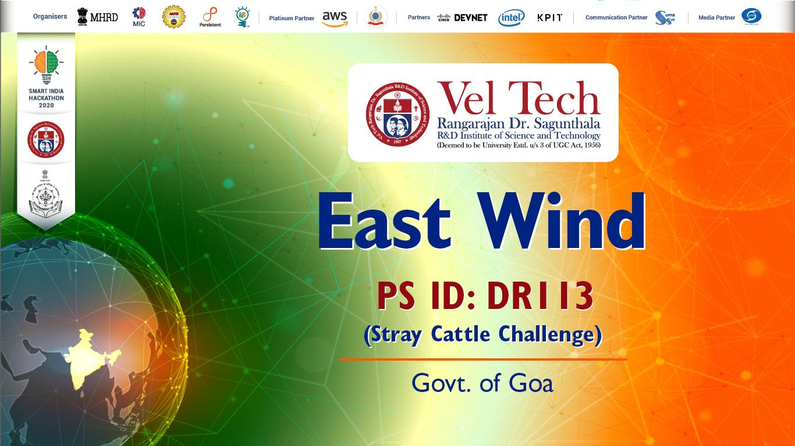

Slide 2
Implementation-
Day 1
Day 2
Day 3
User’s interface including-
Driver’s interface including-
Side Features-
Users’ Login
Users’ Profile
Complaint Registration
Complaint History
Pashu Seva Fund
Drivers’ Login
Drivers’ Pending Requests
Drivers’ Resolved Requests
Nearest Pickup Points
Reporting Unauthentic Requests
News/Blogs Features
Add Pickup Points
Adopt Activity
FAQ & Support
Statistics
Multi-linguistic Feature

Slide 3
Limitations-
The mobility of cattle
Unauthentic Requests upto 2
Delay in Reaching the Location
Compatible Versions Limited

