Slide 1
Heart Disease Prediction

Slide 2

Problem

Slide 3
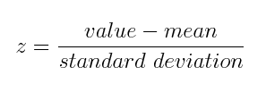
Standardization

Slide 4
PCA
13 attributes
9 attributes
84.97 % total variation explained

Slide 5
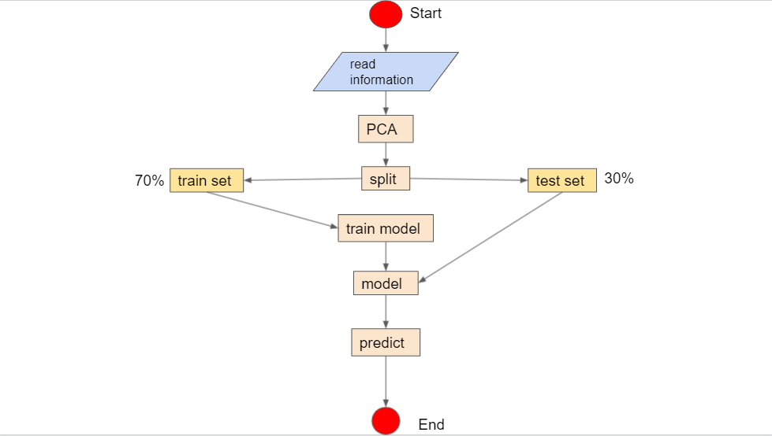
process

Slide 6
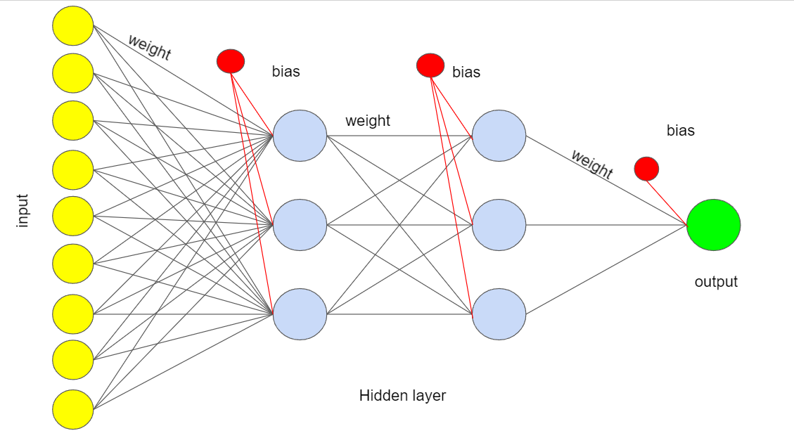
Our Model

Slide 7
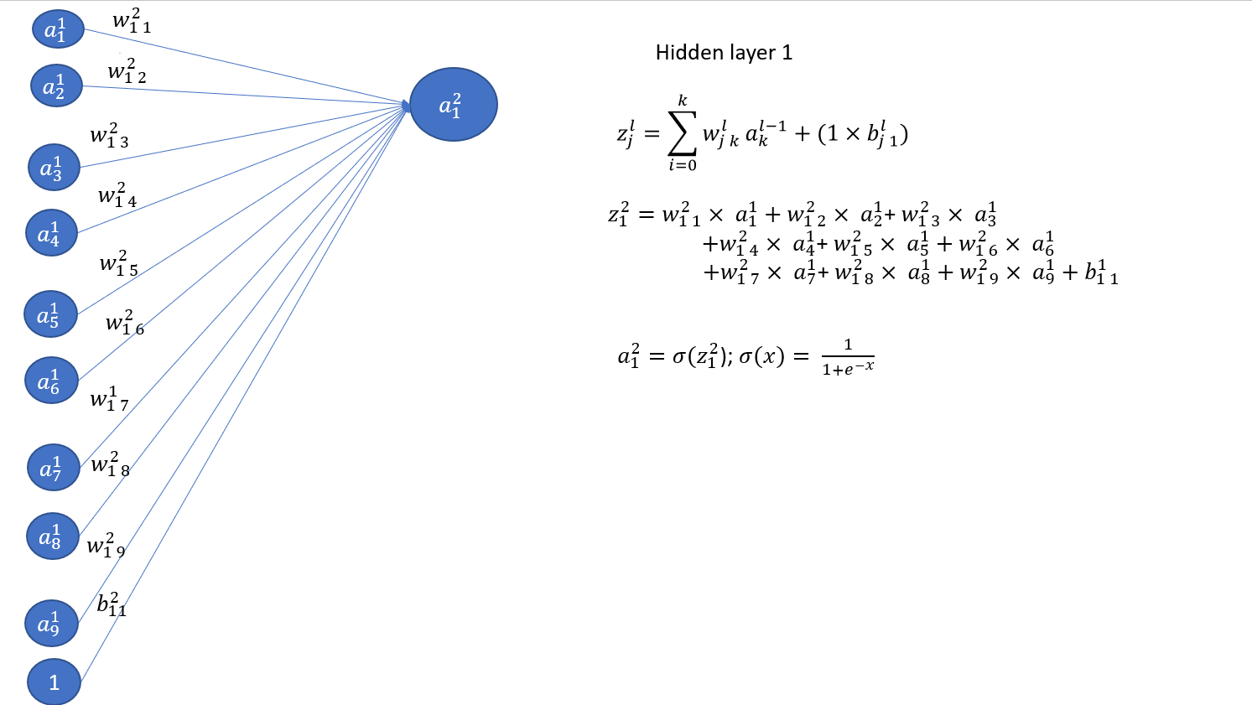
Forward Prapogation

Slide 8
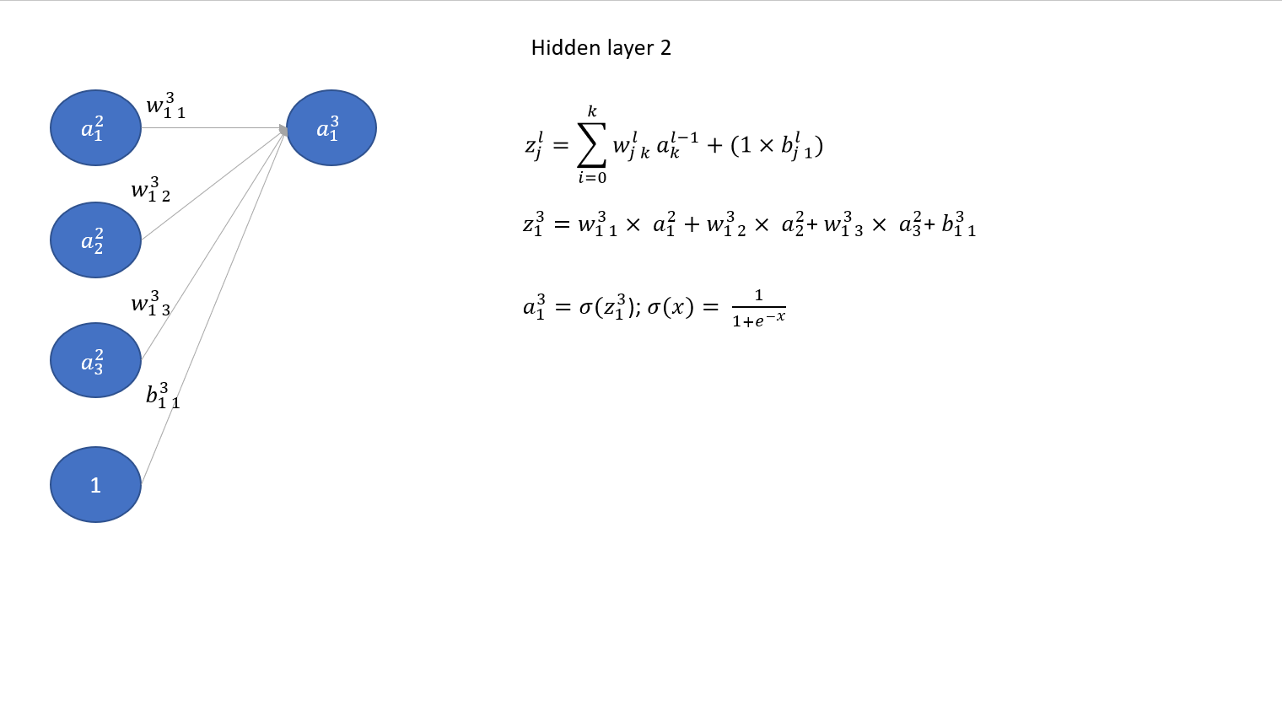
Forward Prapogation

Slide 9
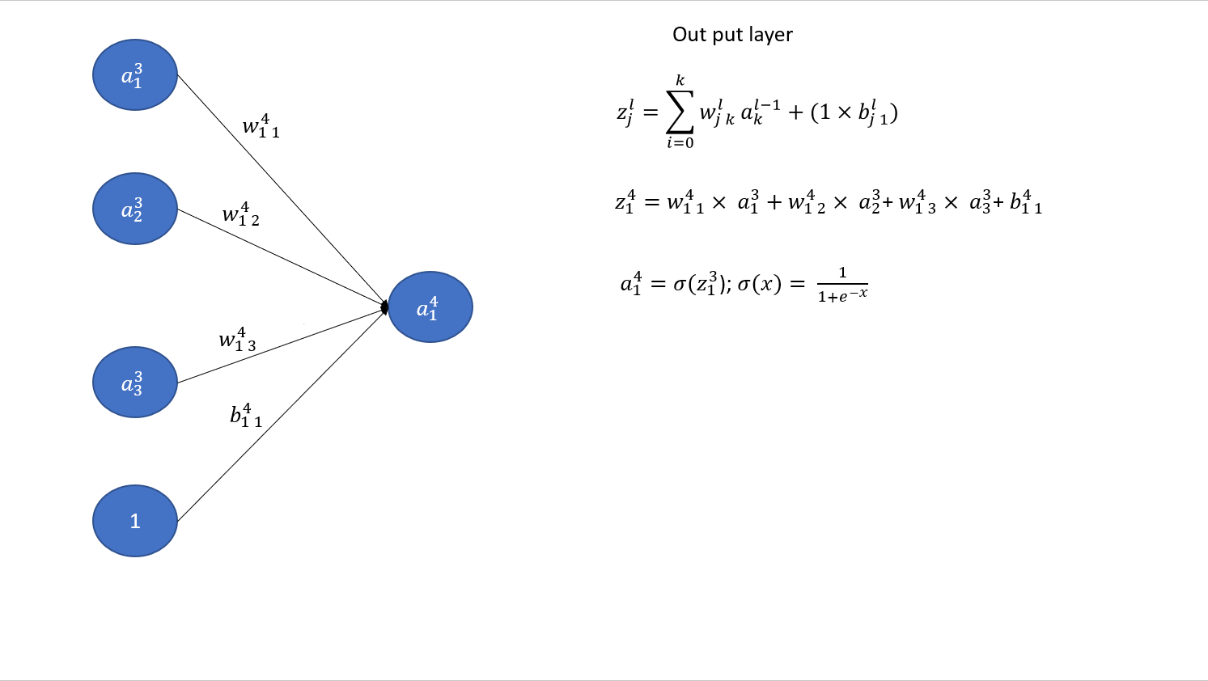
Forward Prapogation

Slide 10
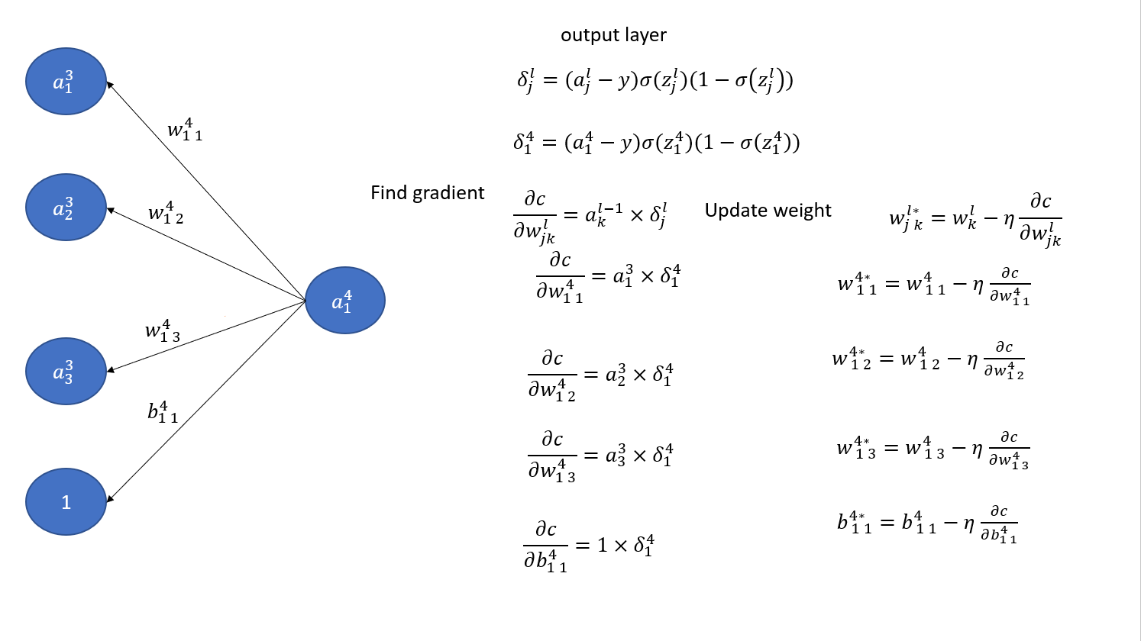
Backward Prapogation

Slide 11
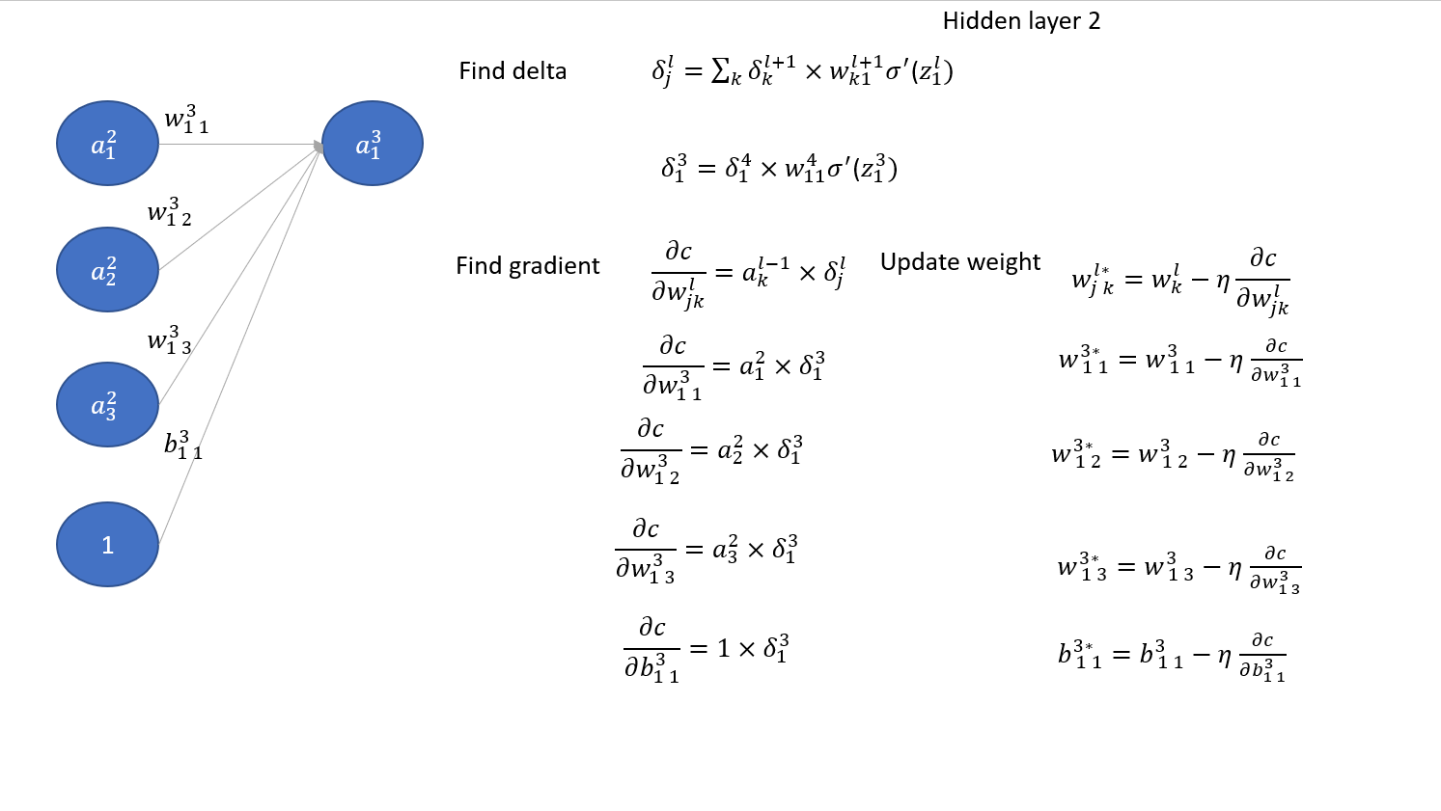
Backward Prapogation

Slide 12
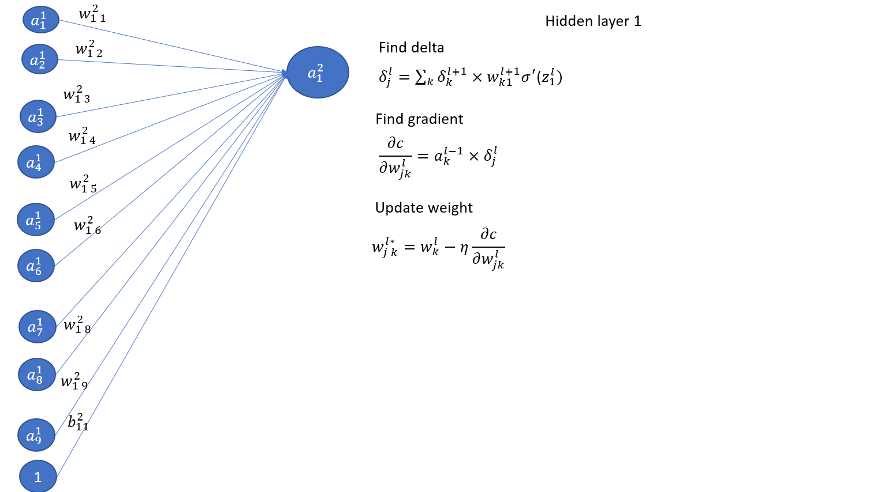
Backward Prapogation

Slide 13
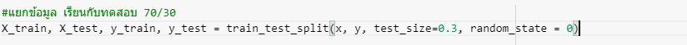

Random
70% Training Set
30% Testing Set

Slide 14
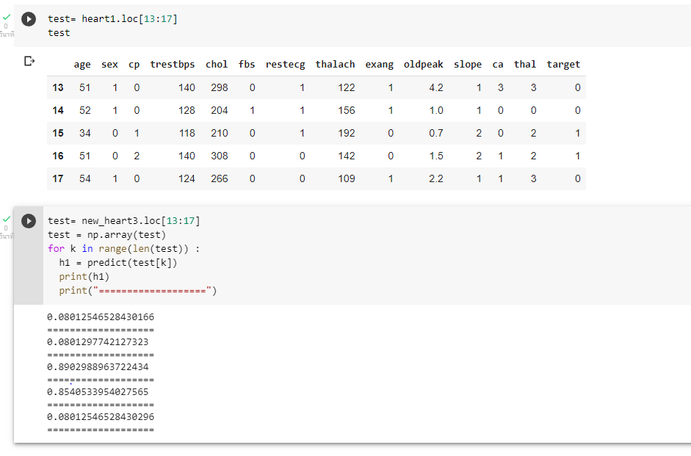
output

Slide 15
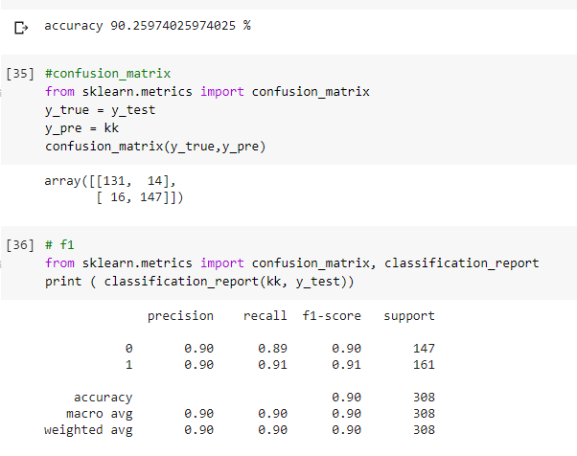
Performance Evaluation

Slide 16
Conclusion

Slide 17
Thank you

