Slide 1
English to Chinese Neural Machine Translation
Christopher White, Nopi Suraminitkul, Zhibo Sheng

Slide 2
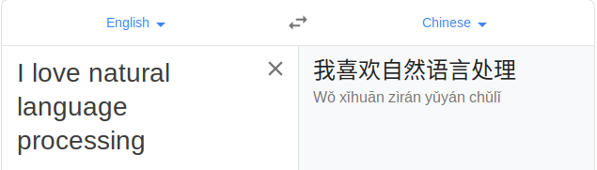
Project Overview
Goal:
Build a natural language processing model for machine translation from English to Chinese.
Develop artificial neural network that predicts the likelihood of a sequence of words
Tools:
Python (Keras, Tensorflow 1.14, NLTK, Scikit-Learn)
Azure (Standard NC6_Promo (6 vcpus, 56 GiB memory, 1 Tesla K80))

Slide 3
Project Overview (cont.)
Dataset:
News Commentary Corpus v11 (2016)
Political and economic commentary
Crawled from the Project Syndicate web site
300,000+ observations
Generated parallel corpora for English-to-Chinese
TensorFlow wmt17_translate
Translate dataset based on the data from Statistical Machine Translation (statmt.org)
Notes:
Source: http://data.statmt.org/news-commentary/v14/training/news-commentary-v14
Source: EMNLP 2017 Second Conference on Machine Translation (WMT17)

Slide 4

Background and Related Work
Notes:
Image source: https://www.freecodecamp.org/news/a-history-of-machine-translation-from-the-cold-war-to-deep-learning-f1d335ce8b5/

Slide 5
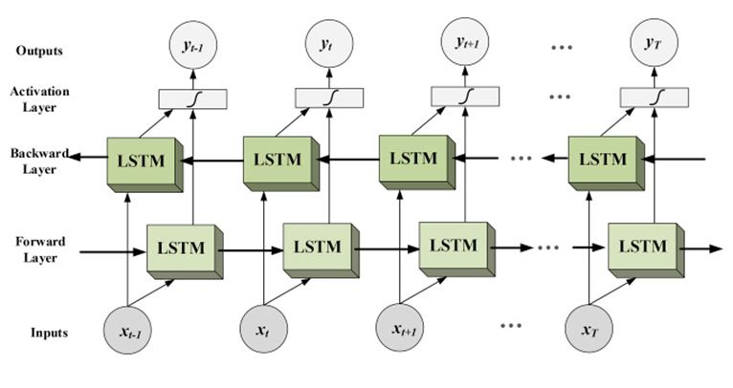
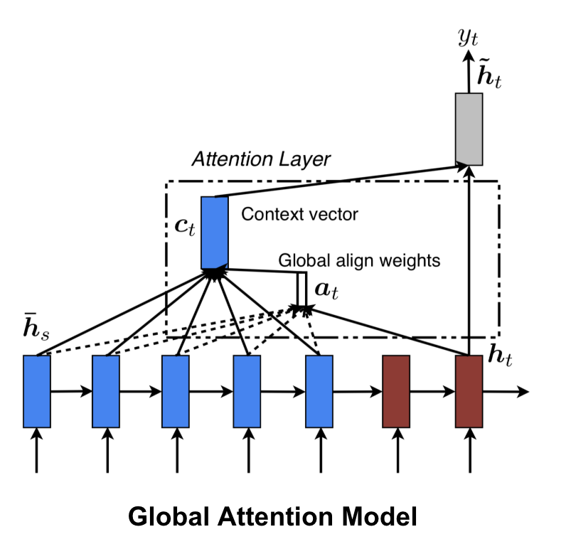
Background and Related Work (cont.)
State-of-the-Art English to Chinese NMT Related Work:
Bidirectional LSTM
Stacked LSTM layers that pass context forwards and backwards
Attention Layers
Allows the decoder to access all the past states of the encoder
Post Editing
Automatically correct common and repetitive errors found in machine translation
Notes:
https://www.i2tutorials.com/technology/deep-dive-into-bidirectional-lstm/

Slide 6
Methodology
Objective
Determine next word based on previous text using sequence to sequence modeling
Preprocessing
Remove punctuation, lowercase
Tokenize sentences
English - NLTK
Chinese - Jieba
Add “<start>” and “<end>” tokens to each sentence
Generate word pairs in the format of English-Chinese
Transform tokenized words into index sequences
Pad variable length sequences to create batches of sentences
Create training and testing sets
Ratio: 80-20

Slide 7
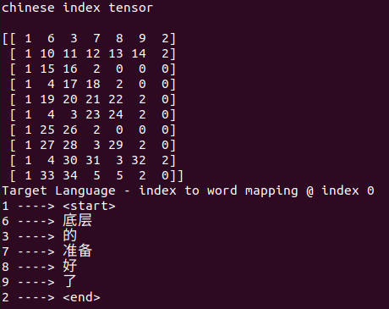
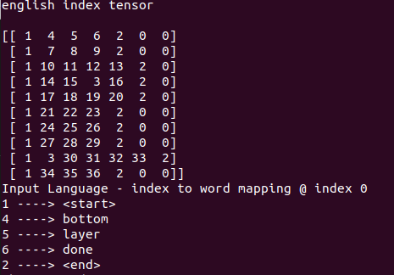
Methodology (cont.)

Slide 8
Methodology (cont.)
NMT model with attention architecture
LSTM models are very suitable for processing sequential relationships
Encoder
Processes the input sequence and compresses the information into a context vector of a fixed length
Decoder
Uses the last state of the encoder network as the decoder initial state and emits the transformed output
Attention
Allows the context vector to be a dynamic length, which grants the network the ability to remember long sentences
Notes:
Image source:https://towardsdatascience.com/light-on-math-ml-attention-with-keras-dc8dbc1fad39
The attention mechanism was born (Bahdanau et al., 2015) to resolve this problem.
Often it has forgotten the first part once it completes processing the whole input

Slide 9
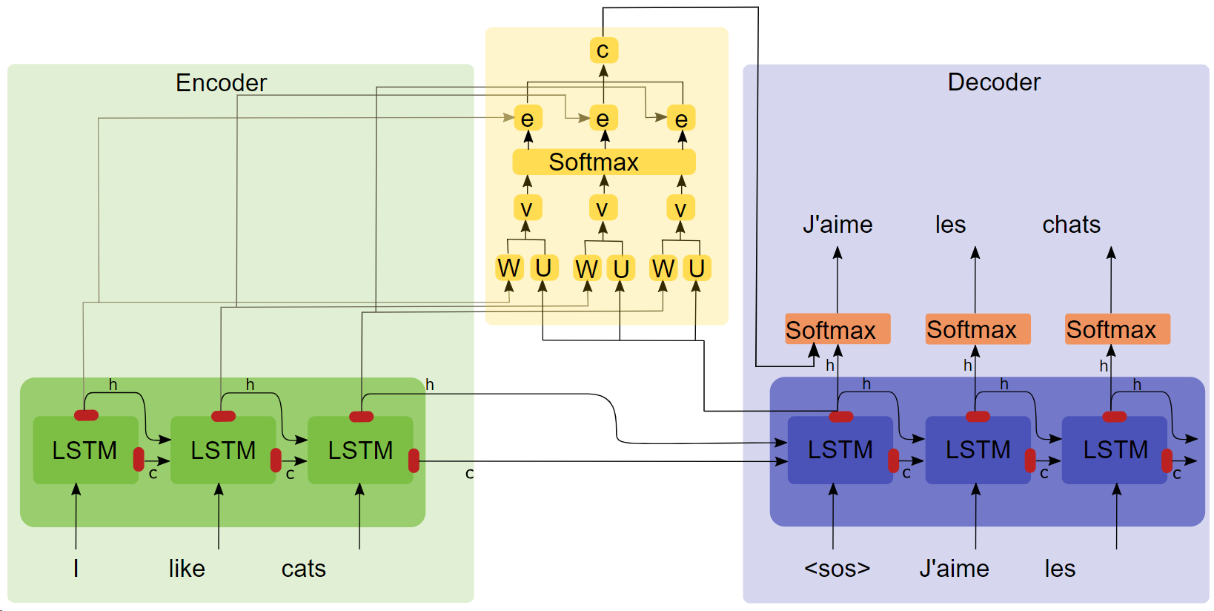
Methodology (cont.)

Slide 10
Experiment and Results
NMT with Attention Layer
30,000 sentences
10 Epochs
Testing Corpus BLEU score: 8.18e-156
Example of translation
English: He could no longer hold back his tears
Ground Truth Chinese: 他 再也 忍不住 自己 的 眼泪
Predicted Chinese: 他 的 (his)

Slide 11
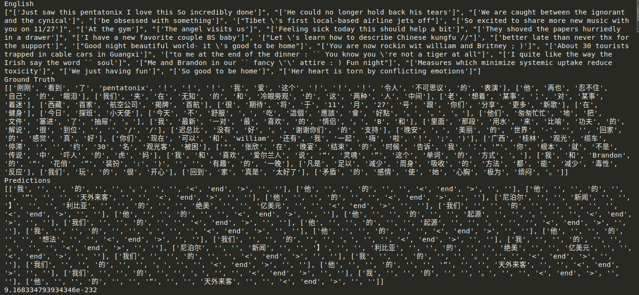
Experiment and Results (cont.)

Slide 12
Conclusion & Future Work
Conclusion
Ran attention model using 10 epochs on 30,000 preprocessed sentences
Qualitative and quantitative assessment demonstrate that the translations can be improved
Future Work
Incorporate bidirectional LSTMs
Explore additional performance metrics
RIBES - Chinese and Japanese
Experiment with different attention layers
Hyper parameter tuning
Preprocessing adjustments
Notes:
http://www.kecl.ntt.co.jp/icl/lirg/ribes/

Slide 13
Questions?

