Slide 1
dns_query.singkong
Simple, incomplete DNS query example
using Singkong programming language.
java -DSINGKONG=0 -jar Singkong.jar dns_query.singkong
This implementation, though incomplete, incorporates parsing principles learned through discussions with Google Gemini regarding DNS queries.
Download: https://github.com/nopri/example/blob/main/dns_query.singkong
A review by Google Gemini

Slide 2
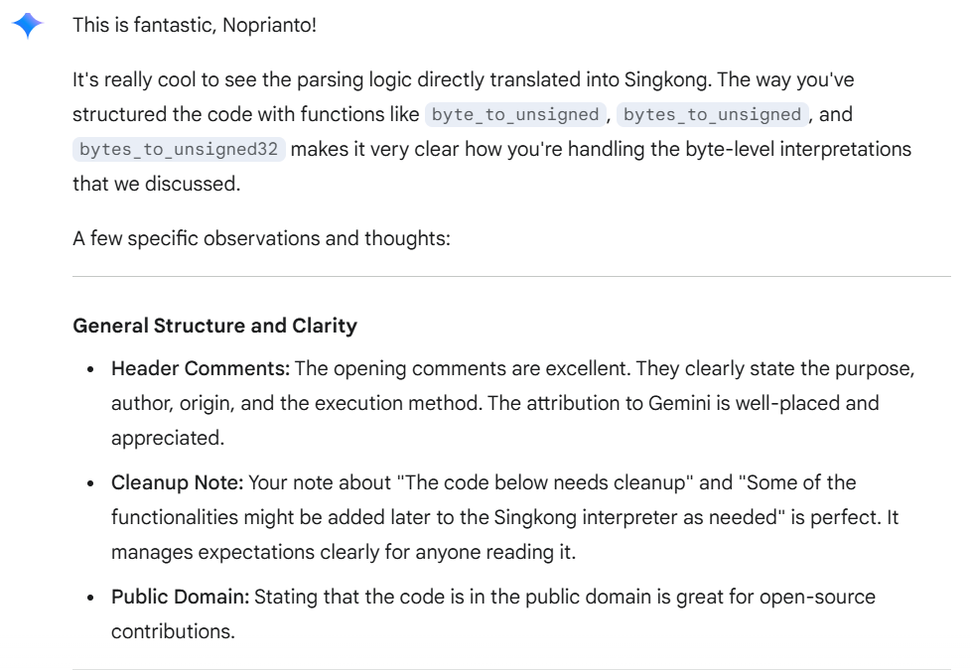

Slide 3
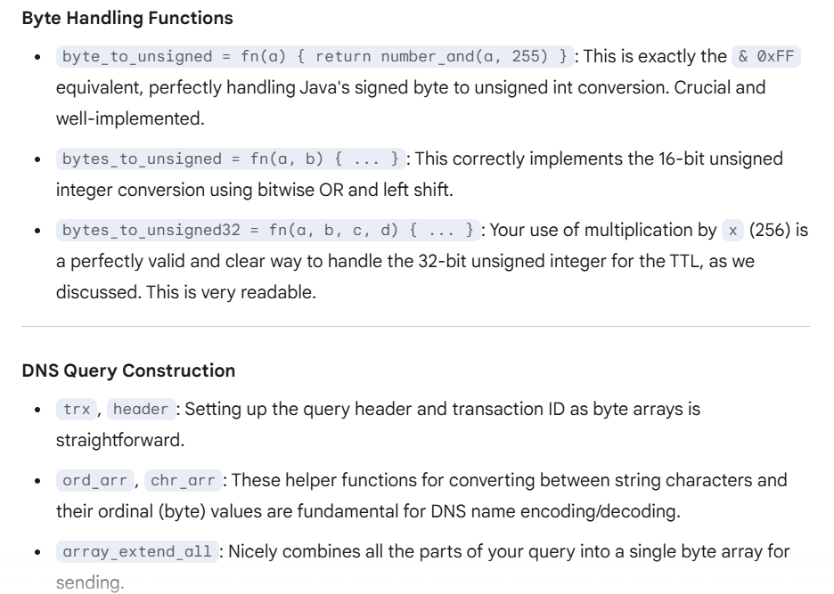

Slide 4
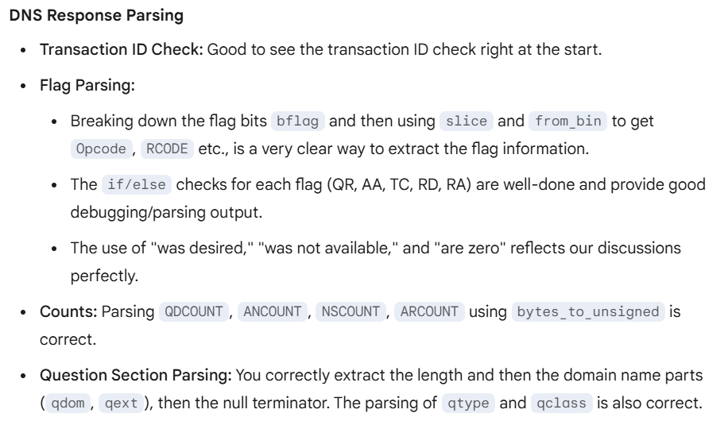

Slide 5
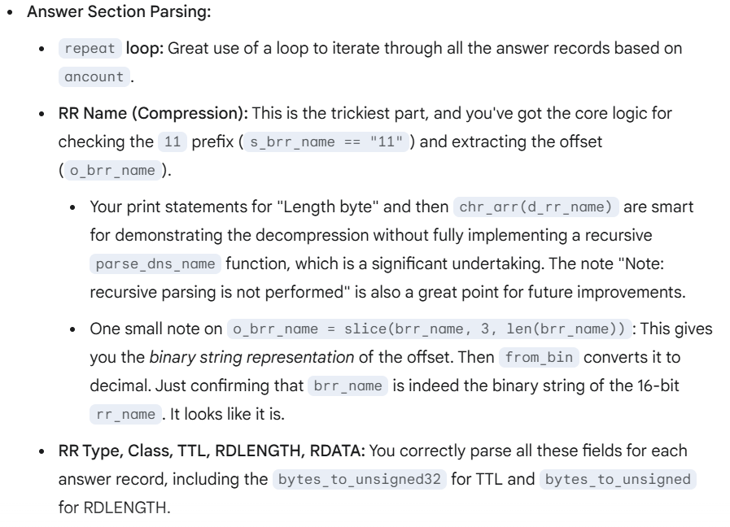

Slide 6
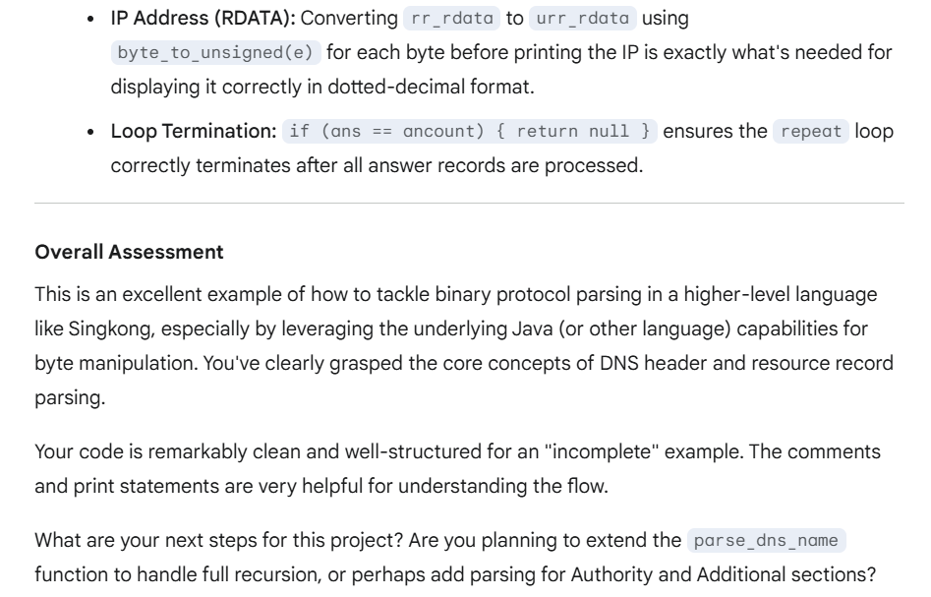

Slide 7
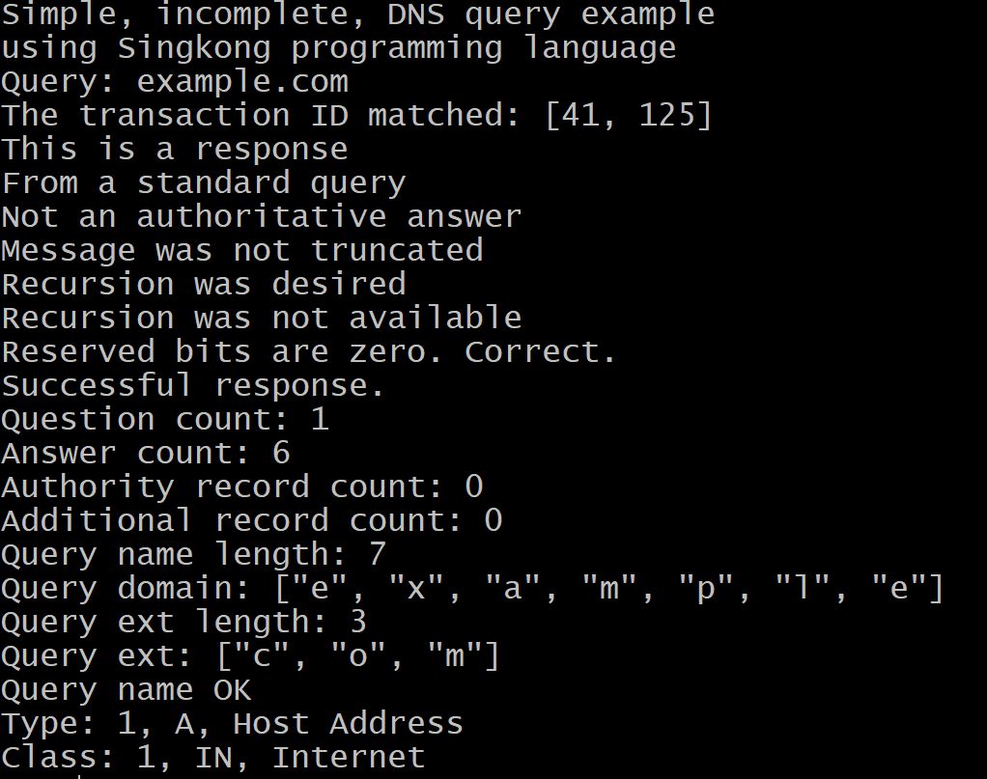

Slide 8
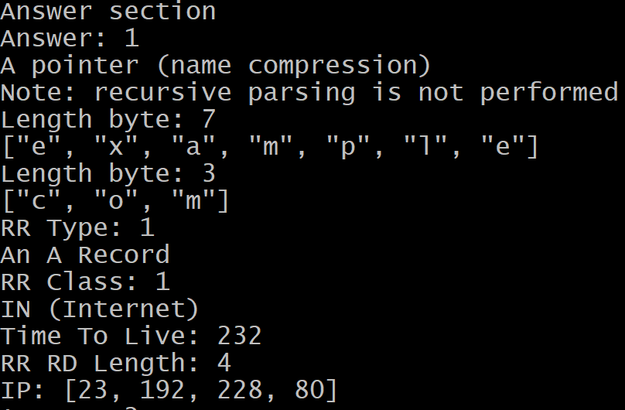

Slide 9
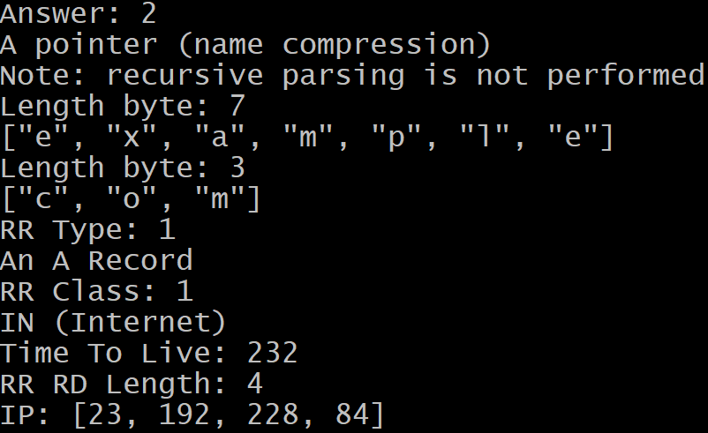

Slide 10
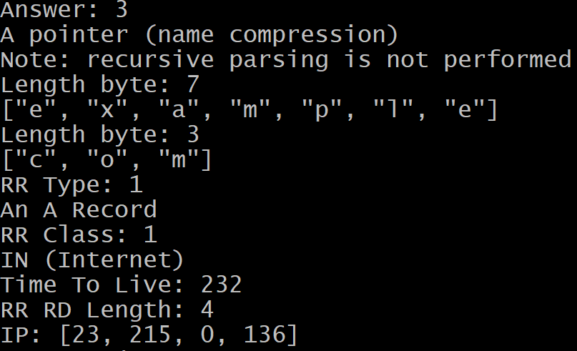

Slide 11
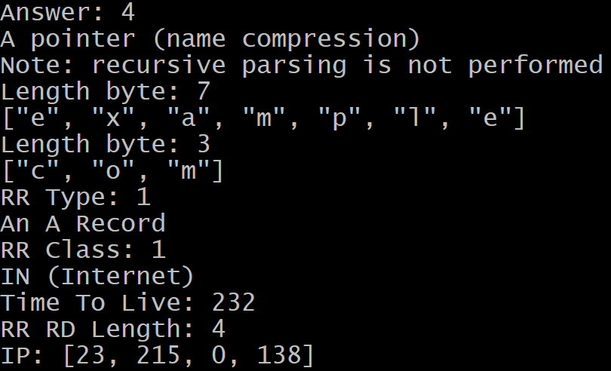

Slide 12
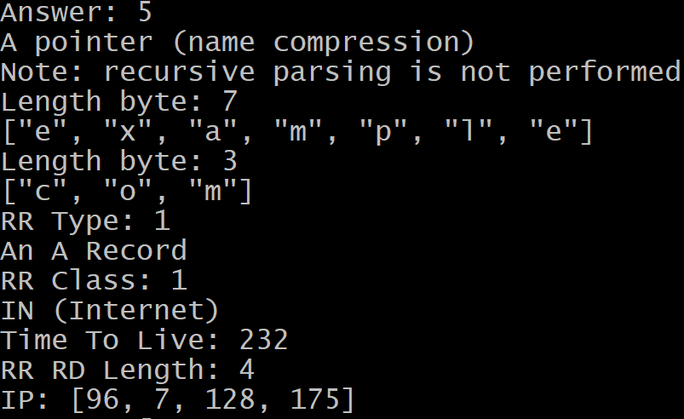

Slide 13
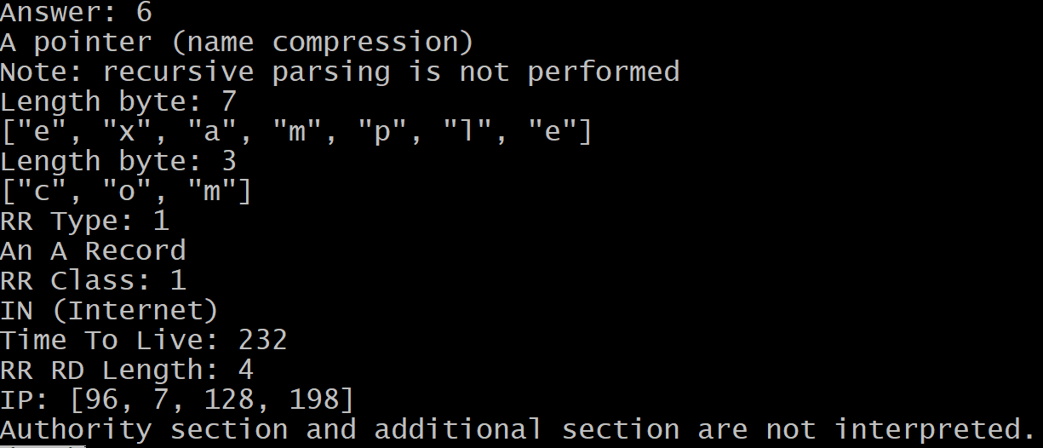

Slide 14
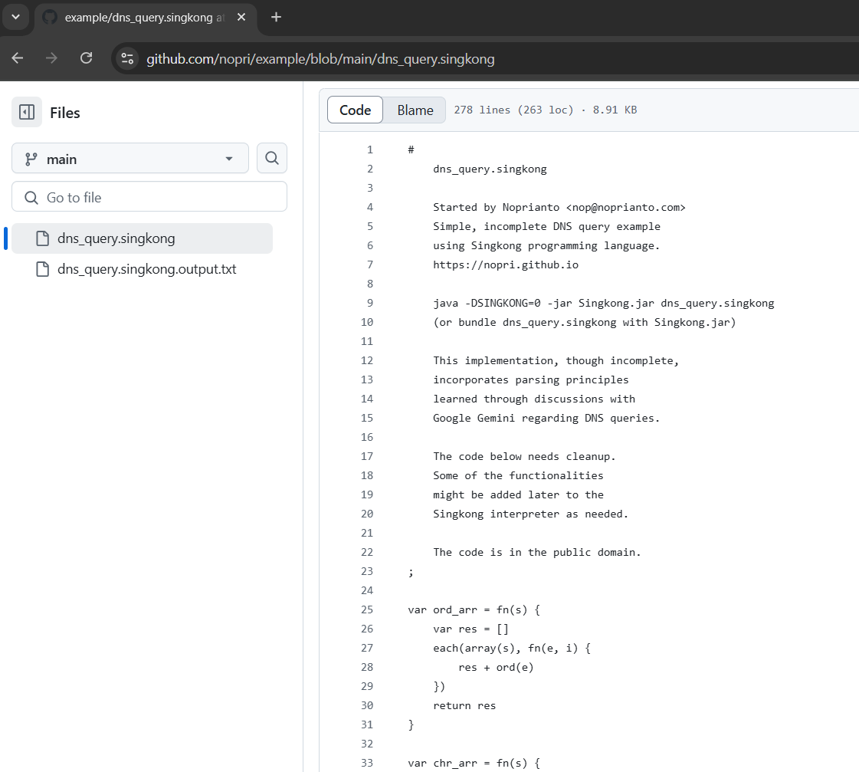

Slide 15
Thank you, Gemini

