Slide 1
Annotasyon
Gokce Avery
@gokcit on GitHub
https://github.com/ompedans/annotasyon Project Owner: @ompedans

Slide 2
Description
Target Client: Ottoman Turkish to Latin Turkish Translators
Supported Language: Ottoman Turkish
Annotasyon tool processes the pdf or image of handwriting using tesseract-ocr. It provides the translated output on a web application to the user.

Slide 3
Features
User Login
Search Engine – search through documents translated by others
Dashboard
Document Management System

Slide 4
User Stories
User will use login credentials to access the web app
User can access documents translated by others using the search engine
User can store their own storage of translated documents on the dashboard
User will help improve the dataset by suggesting translations

Slide 5
Database
User table stores user credentials
Documents table stores images and pdfs of original documents
Translated stores the digitalized and translated documents

Slide 6
Technology Stack
Language – Python and JavaScript
Framework – Flask and Vue.js
Database engine MySQL
Other libraries or components: tesseract-ocr, opencv

Slide 7
Demo

Slide 8
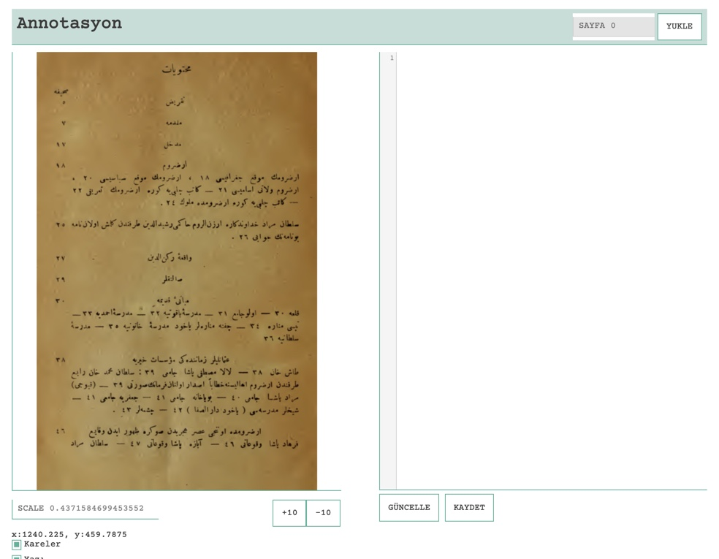

Slide 9
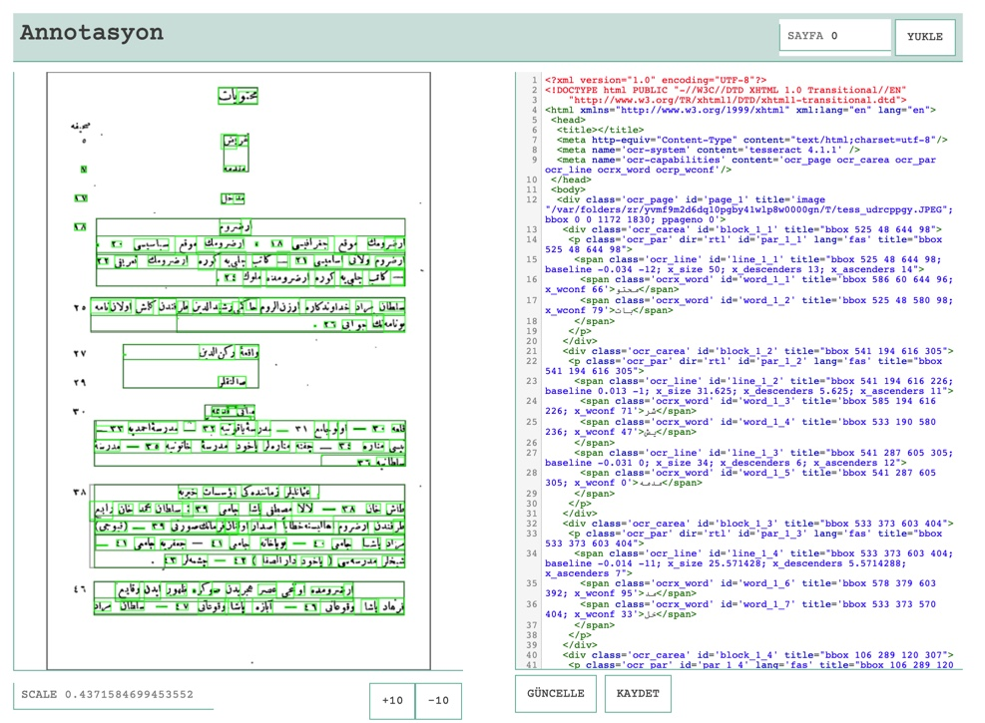

Slide 10
What I Am Learning
Flask and Angular
HTML Parsing into json
Natural Language Processing

Slide 11
What’s Next
Automated Test Frameworks
HTML Parsing into json
Notes:
Be specific! If you mention another feature describe why that features is necessary, or what problem it solves. If you mention changing the UI mention specific technologies, or libraries you will use to do that. If you mention a technology, or feature you don’t know yet tell them how you plan on learning it.

