Slide 1

Music Genre Classification
Presenting: Noorh Alkhraan

Slide 2

TABLE OF CONTENTS
01
02
03
Problem definition
Data gathering and Preprocessing
Model implementation
04
05
Results
Future Work
Describe the problem and the goal to be reach
Information about the dataset and its most important features
Experiments of choosing the best model and tuning its parameters
Illustrating the results with the most important metrics
What’s next?

Slide 3

Problem Definition
01

Slide 4
Music genres
Blues
Rock Music
Usually listened to in a state of agitation or depression
Combines elements of blues, jazz and and the use of electric instruments
Pop Music
Hip Hop Music
Usually played with electronic instruments
consists of rhythmic lyrics making use of techniques like alliteration and rhyme

Slide 5

02
Dataset gathering and processing

Slide 6
Dataset gathering
Data Source
MachineHack Hackathon which is provided by Kaggle
Data Content
17,996 rows with 17 columns, with a target variable of 11 classes
https://www.kaggle.com/purumalgi/music-genre-classification

Slide 7
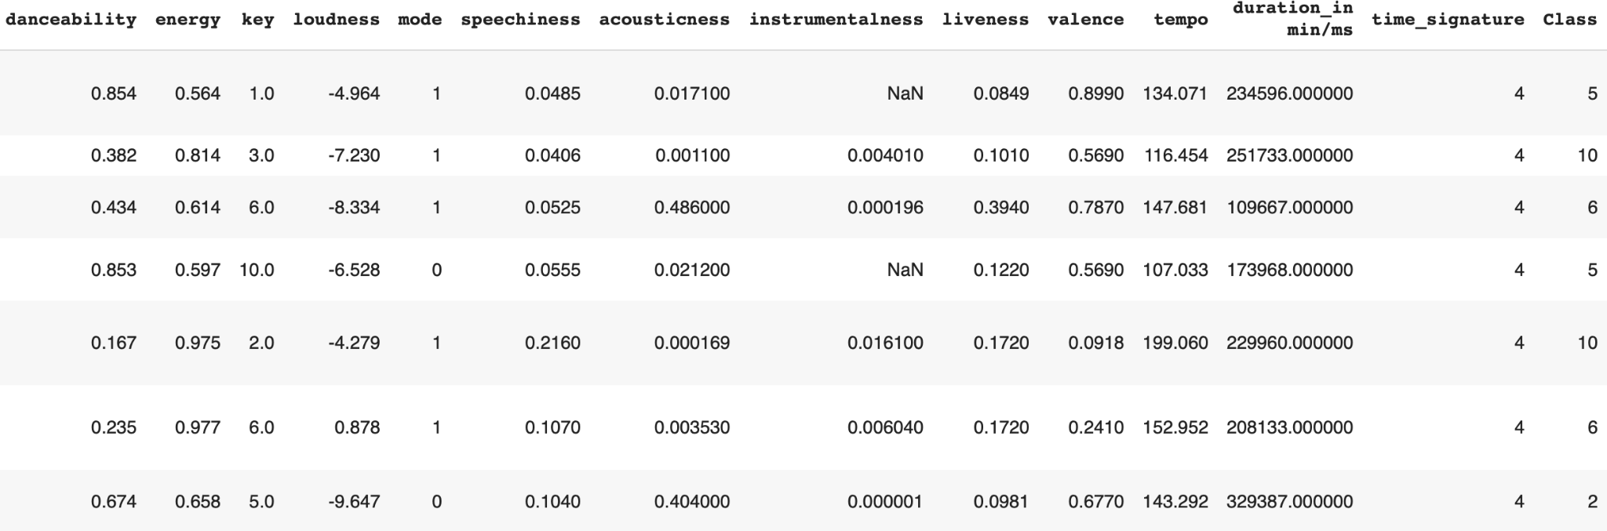

Slide 8
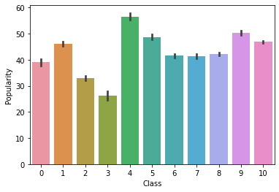
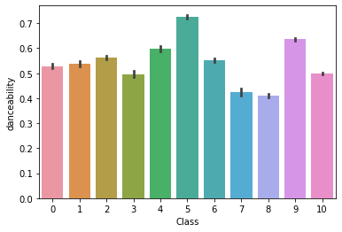
Some data exploration
Most popular is Class 4 = Country
Most danceable is Class 5= Hip hop

Slide 9
Data Preprocessing
Use Log() transformation
Use Standard scalar
Null-value
Skewed data
Data imbalanced
Data scaling
Replace it with mean, median or delete it
Use oversampling technique

Slide 10

Model Implementation
03

Slide 11
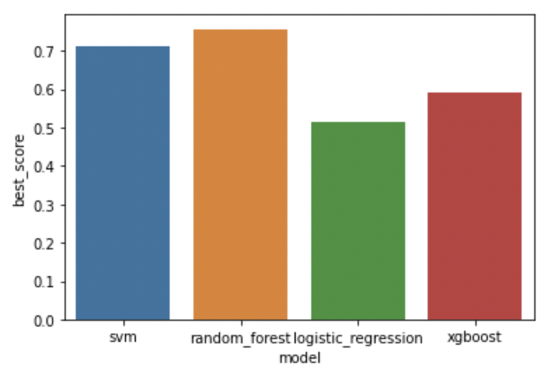
Model Choosing
Figure 1: Results of 5-fold Cross Validation to choose the best model

Slide 12

Experiments and results
04

Slide 13
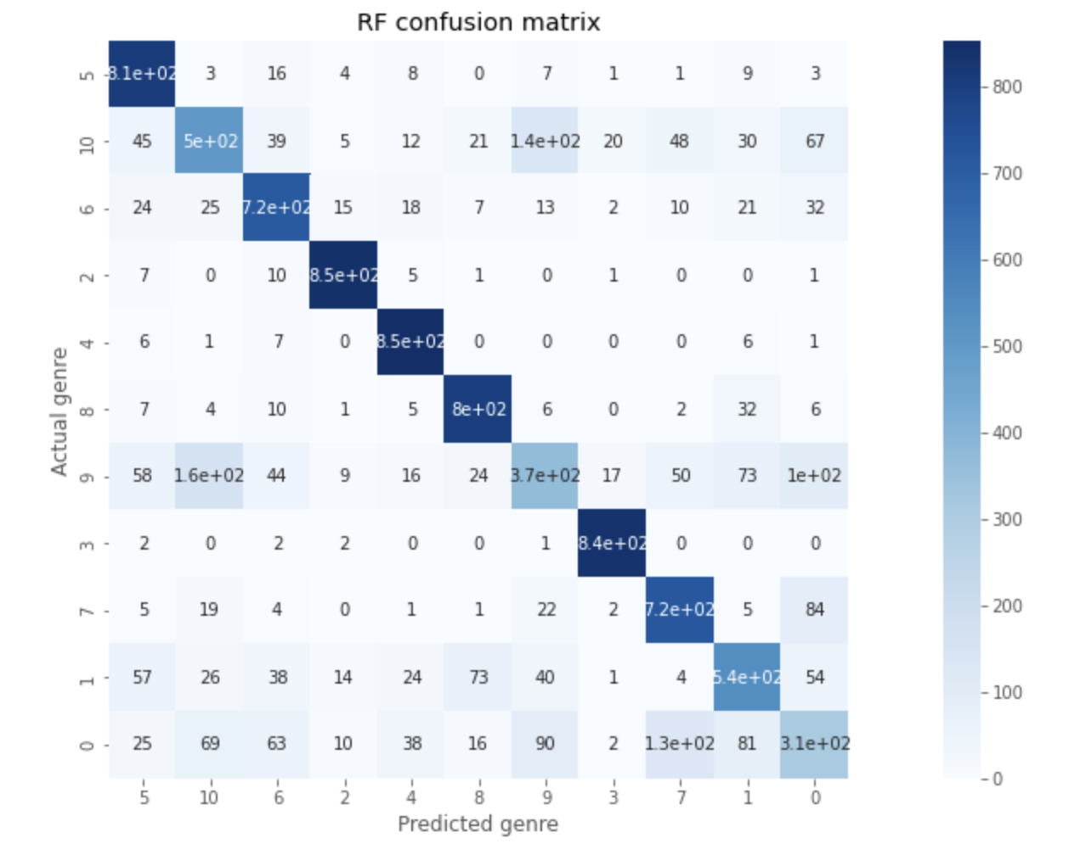
Confusion Matrix

Slide 14
Other classification metrics
Accuray | Precision (Avg.) | Recall (Avg.) | F1 (Avg.)
0.75877 | 0.7438 | 0.7614 | 0.7492
Random Forests Classifier

Slide 15
Future Work
05

Slide 16
Future Work
Increase performance
Investigate classifying by audio

Slide 17

THANKS!
Do you have any questions?

