Slide 1
Task relevance modulates the behavioural
and neural effects of sensory predictions
Ryszard Auksztulewicz, Karl J. Friston, Anna C. Nobre
周丽琴
2022/5/6

Slide 2
Background
Within the predictive-coding framework, predictions ground perceptual inference and are thought to be conveyed by descending connections in cortical hierarchies, which may be mediated by synchronized activity in the alpha- and beta-bands. Conversely, incoming sensory or neural inputs—that are unexplained by predictions—translate into sensory prediction error (PE) signals. These PE signals induce neural responses, which are thought to be propagated up sensory hierarchies in higher frequency bands such as gamma.
While predictability and task relevance could constitute 2 independent sources of top-down control, predictability and task relevance may interact in selecting the most informative and relevant PEs for belief updating.
To test whether the effect of predictability depends upon task relevance, we designed a task in which participants could use fluctuating spatial and temporal predictions to report either the location (left/right hemifield) or the latency (early/late relative to the cue) of visual targets.
We inferred the participants’ trial-by-trial predictions and PEs using an ideal-observer model based upon a hierarchical Bayesian inference. The resulting predictions and PEs, as well as their interactions with task relevance, were used to explain time-frequency (TF) responses (measured with MEG) to test whether the neural correlates of predictions and PEs are modulated by task relevance.

Slide 3
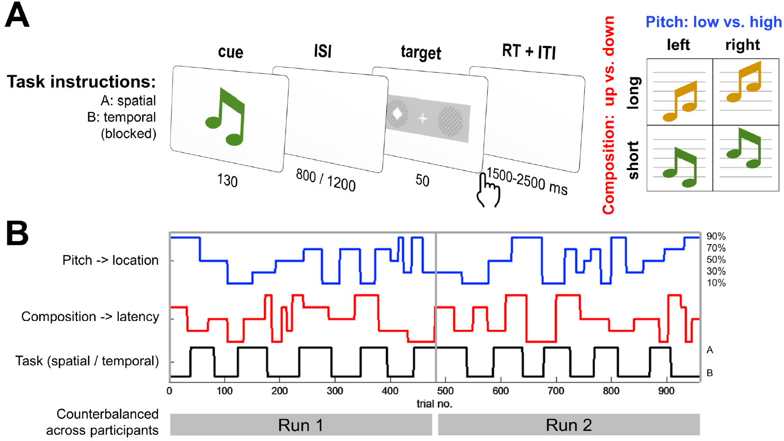
Experimental design
10 blocks，480 trials
10 blocks，480 trials

Slide 4
Behavioral results
In both tasks, cue validity led to improvements in discrimination accuracy depending on task relevance:
The interaction between predictability (a parametric factor encoding 90, 70, or 50% cue validity) and relevance (e.g., relevant: spatial predictability in a spatial task; irrelevant: spatial predictability in a temporal task) was significant for both tasks.

Slide 5

Behaviroal modelling
Obervation model
The model estimates the participants’ beliefs at 3 different levels:
the location xs1 and latency xt1 of the target: {0,1}, 1-valid location/latency, 0-invalid.
(2) the pitch-location contingency xs2 and the composition-latency contingency xt2,
(3) the volatility of these contingencies xs3 and xt3.

Slide 6
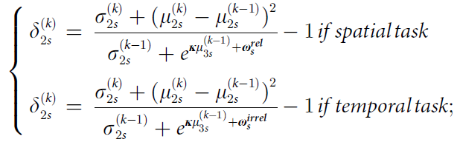
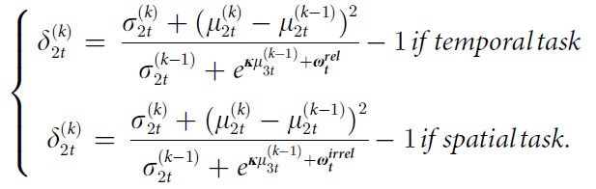
Estimate the trial-by-trial time-series (at each level i) of the participants’ beliefs $μ_{i}^{(k)}$ (i.e., posterior means of states $x_{i}^{(k)}$) and the updates on these beliefs $ε_{i}^{(k)}$(precision-weighted PEs) after observing a target:
The PE at the level below
Precision ratio
the HGF learning parameters ω were nonspecific：
the HGF learning parameters ω were context-specific：
Notes:
Variational approximation：变分近似。

Slide 7
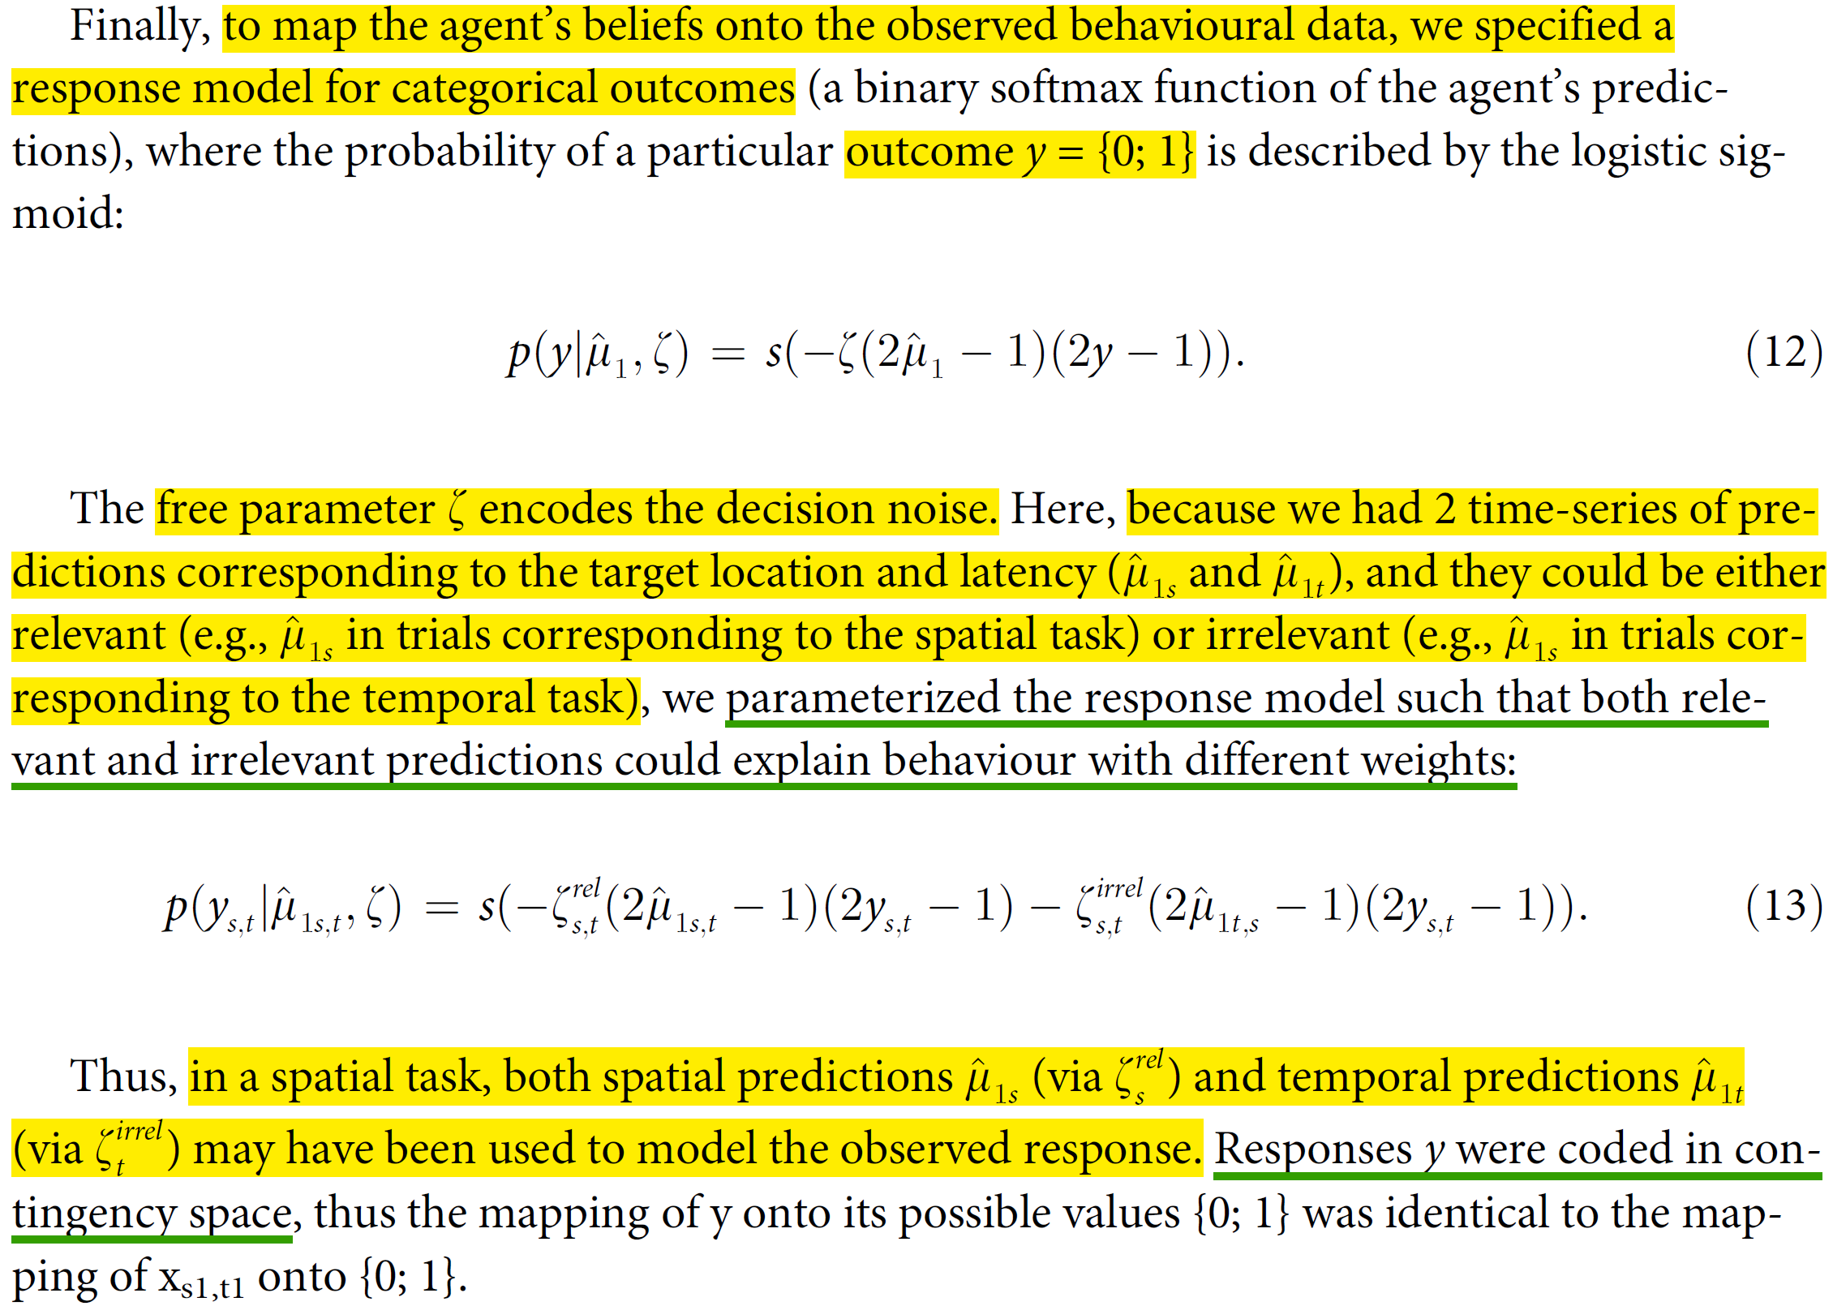
Response model

Slide 8
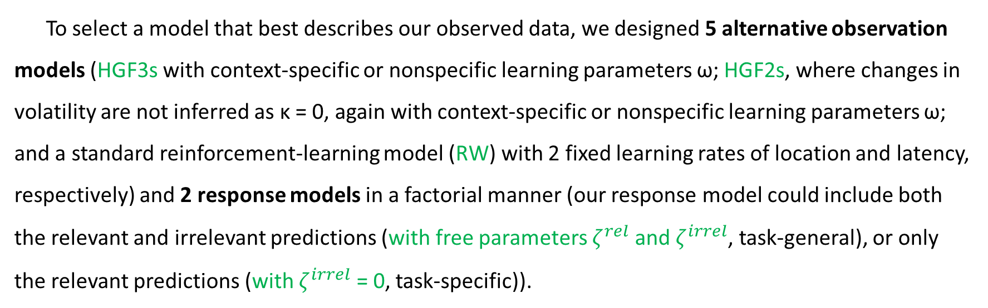
Alternative models
To select a model that best describes our observed data, we designed 5 alternative observation models (HGF3s with context-specific or nonspecific learning parameters ω; HGF2s, where changes in volatility are not inferred as κ = 0, again with context-specific or nonspecific learning parameters ω; and a standard reinforcement-learning model (RW) with 2 fixed learning rates of location and latency, respectively) and 2 response models in a factorial manner (our response model could include both the relevant and irrelevant predictions (with free parameters $ζ^{rel}$ and $ζ^{irrel}$, task-general), or only the relevant predictions (with $ζ^{irrel}$ = 0, task-specific)).

Slide 9
The winning model was HGF2, with context-specific learning parameters and observation parameters.
The posterior learning parameter ω_{rel} (denoting the weight of context-relevant PEs in updating subsequent predictions) was the only significant predictor of individual participants’ mean accuracy out of the 4 free model parameters considered.
as independent regressors

Slide 10
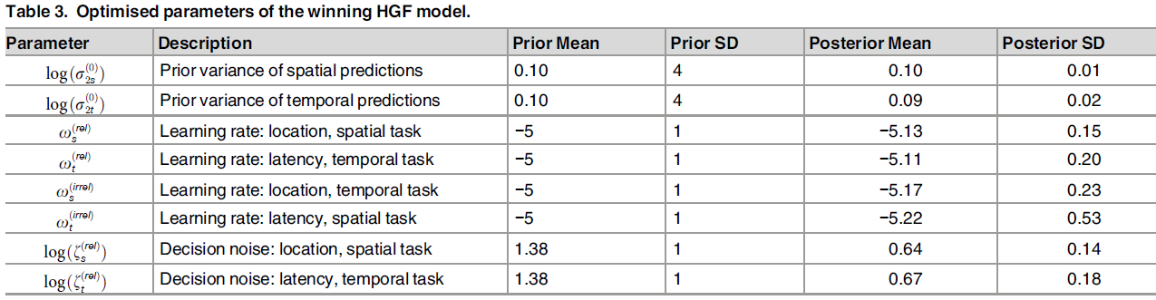
The learning parameters ω_{rel} and ω_{irrel} were significantly different within participants (repeated-measures ANOVA with factors Relevance and Task; Relevance: F_{1,16} = 5.11, partial η² = 0.15, p = 0.037; Task and Interaction: p > .25), providing further evidence that the learning parameters were sensitive to the observed behavioural effects of contextual relevance.

Slide 11
MEG
Cue evoked activity (cue – precue)：A1, MTG.
Target evoked activity (target – pretarget)：V1.
Cue – target：TPJ.

Slide 12
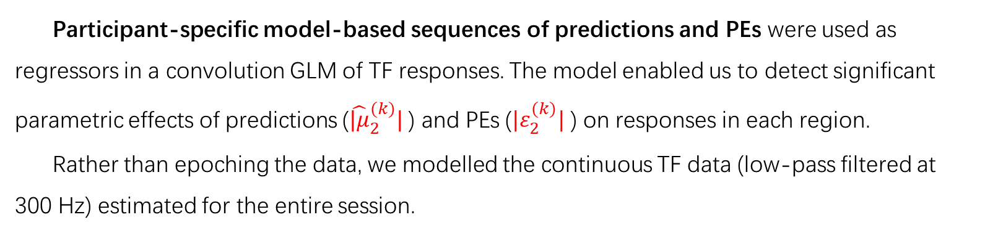
Convolution modelling for TF responses
Participant-specific model-based sequences of predictions and PEs were used as regressors in a convolution GLM of TF responses. The model enabled us to detect significant parametric effects of predictions (${\hat{|μ}}_{2}^{(k)}|$ ) and PEs ($|ε_{2}^{(k)}|$ ) on responses in each region.
Rather than epoching the data, we modelled the continuous TF data (low-pass filtered at 300 Hz) estimated for the entire session.
We modelled total power with a time range of −250 ms to 500 ms relative to events of interests (cue and target onsets), and a frequency range of 8–48 Hz. Each event regressor (i.e., coding for experimental events and their parametric modulations) was convolved with a sixth-order Fourier basis set, allowing for an estimation of TF responses (or their regressor coefficients) with the time-courses of 8–48 Hz power estimates modulated up to 8 Hz (750 ms epoch length at the highest-order Fourier basis function). The resulting TF maps of regressor coefficients were converted into 2D images and entered into second-level GLMs.

Slide 13

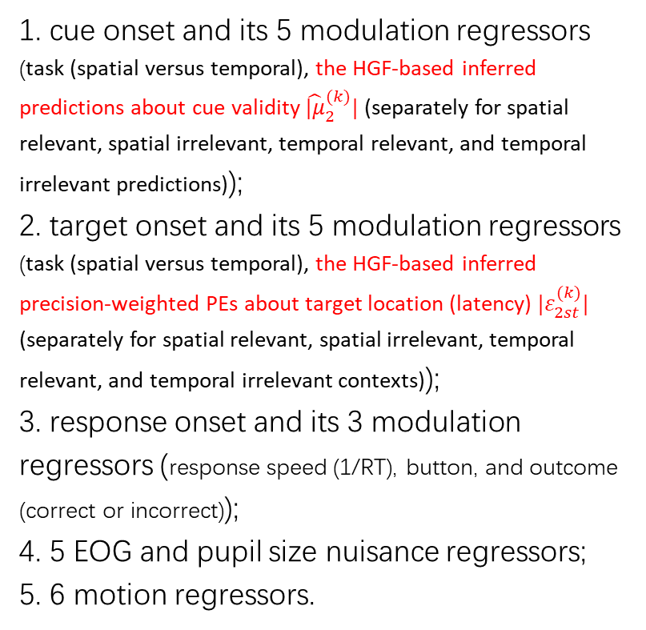
design matrix (X, event and nuisance regressors (columns, left to right)):
1. cue onset and its 5 modulation regressors (task (spatial versus temporal), the HGF-based inferred predictions about cue validity ${\hat{|μ}}_{2}^{(k)}|$ (separately for spatial relevant, spatial irrelevant, temporal relevant, and temporal irrelevant predictions));
2. target onset and its 5 modulation regressors (task (spatial versus temporal), the HGF-based inferred precision-weighted PEs about target location (latency) $|ε_{2st}^{(k)}|$ (separately for spatial relevant, spatial irrelevant, temporal relevant, and temporal irrelevant contexts));
3. response onset and its 3 modulation regressors (response speed (1/RT), button, and outcome (correct or incorrect));
4. 5 EOG and pupil size nuisance regressors;
5. 6 motion regressors.
m组基函数行 * freq列
time行 * m组基函数列
傅里叶级数(基函数)：

Slide 14
TF correlates of predictions and PEs
Predictions (post-cue):
Relevant > irrelevant: β power in MTG & TPJ.
Relevant < irrelevant: α power in A1 & V1.
Predictions correlated with cue-induced beta-band activity in auditory regions and alpha-band activity in visual regions, while stimulus-bound PEs correlated with gamma-band activity in posterior regions.
PEs (post-target):
Relevant > irrelevant: γ power in TPJ & V1.
Relevant < irrelevant: high β power in V1.

Slide 15
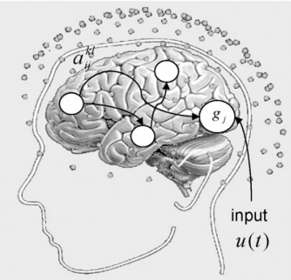
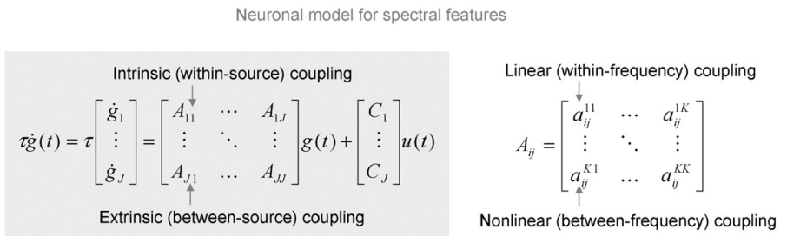
DCM for TF responses
To quantify the effective (directional) connectivity between different regions and frequency bands
(Chen, Kiebel, & Friston, 2008)

Slide 16
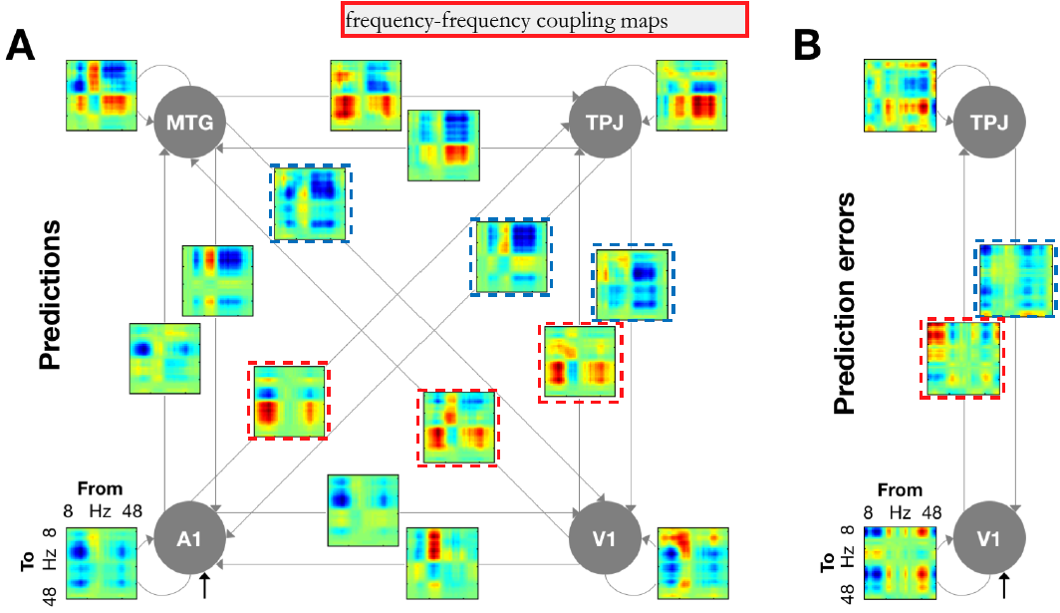
DCM was used to quantify the within- and cross-frequency amplitude–amplitude coupling in 2 time windows of TF responses: 0–500 ms relative to the cue onset, and 0–500 ms relative to the target onset.
ascending connections show excitatory effects
descending connections show inhibitory effects

Slide 17
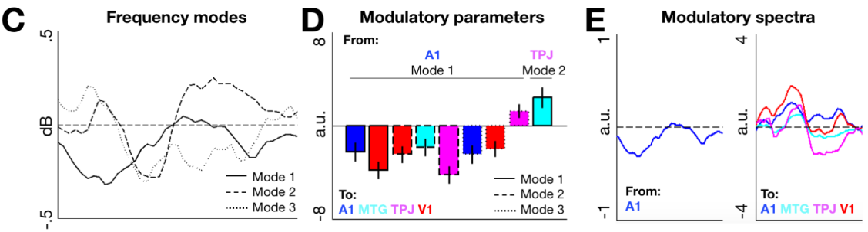
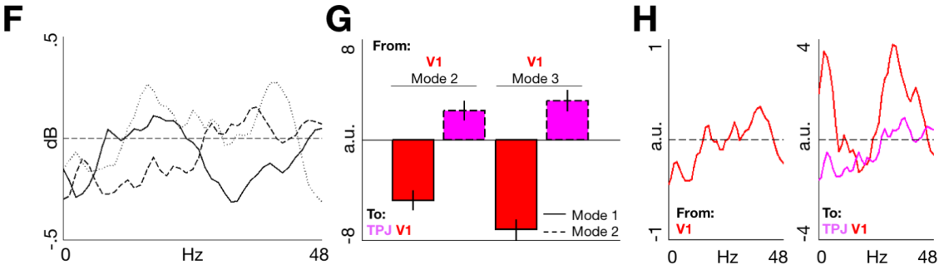
(参考其他文献：identified by a singular value decomposition
of the TF responses)
(an average across frequency modes weighted by the respective modulatory parameters)
Predictions
Task relevance primarily modulated the influence of low-frequency (alpha-beta) activity in A1 on low-frequency activity throughout the network, having a negative net effect on alpha-beta power in all regions. Additionally, contextual relevance modulated the influence of TPJ on MTG activity.
mode 1: 低频
PEs
PE relevance primarily modulated the influence of V1 activity on the network, leading to a shift from lower to higher frequencies in V1, as well as to increased propagation of both high- and low-frequency activity to TPJ.
mode 1: 高频
The DCM findings expand the previous results on low-frequency prediction signalling and highfrequency PE signalling by characterising the network-wide effective connectivity mediating these spectrally distinct effects.

Slide 18
Discussion
Current context (task relevance) modulated the influence of predictions on behavioral and neural responses: spatial/temporal predictability improved spatial/temporal discrimination accuracy, but not vice versa. Only the task-relevant predictions led to improvement in task performance.
At the level of neural responses, predictions and prediction errors (PEs) were correlated with activity in different brain regions and in dissociable frequency bands: predictions correlated with cue-induced beta-band activity in auditory regions and alpha-band activity in visual regions, while stimulus-bound PEs correlated with gamma-band activity in posterior regions.

