Slide 1
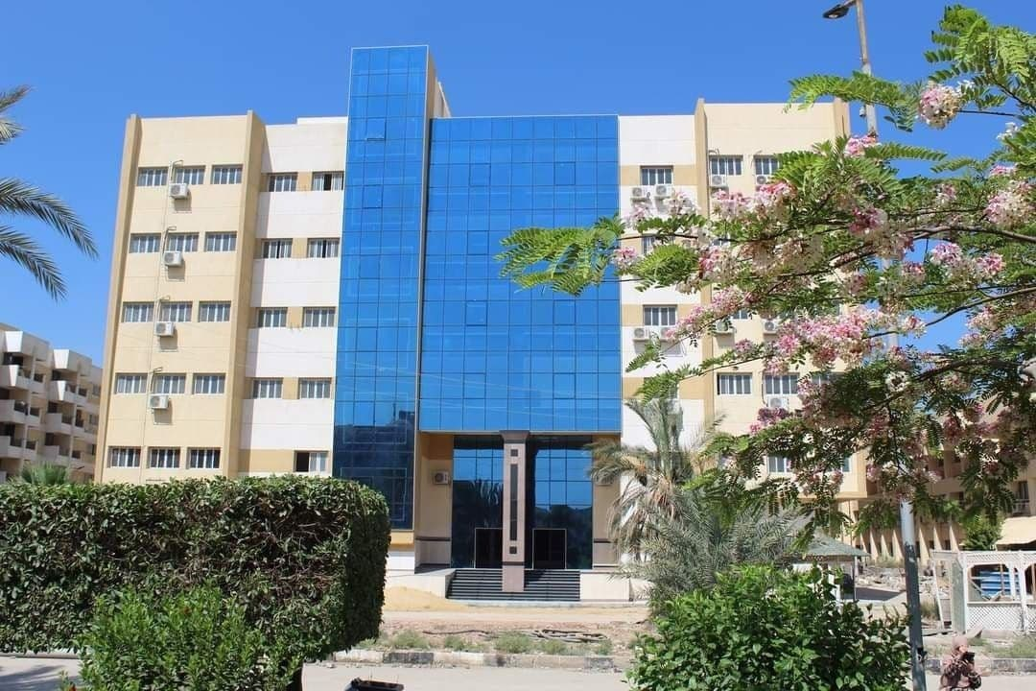
FCI Faculty Of Computers and Informations Fayoum Univercity

