Slide 1

Will There Be A Next Season?!
Predicting television series renewal with IMDb data and categorical models
Nora May
Metis, Project McNulty

Slide 2


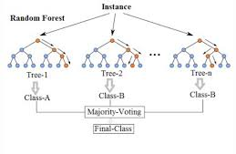
Outline
Data Collection and Cleaning
Feature Engineering
Model Selection
Predictions
Future Directions

Slide 3
Data
Collection
IMDb datasets, 4 relational

Slide 4
Data
Collection
IMDb datasets, 4 relational
Cleaning
Separate Series and Episodes
English Language only
Fill missing values for start year, total seasons

Slide 5
Data
Collection
IMDb datasets, 4 relational
Cleaning
Separate Series and Episodes
English Language only
Fill missing values for start year, total seasons
Construction
Aggregate information per episode for “Season” database
Categorical True or False for “is there a next season?”

Slide 6
Data
Collection
IMDb datasets, 4 relational
Cleaning
Separate Series and Episodes
English Language only
Fill missing values for start year, total seasons
Construction
Aggregate information per episode for “Season” database
Categorical True or False for “is there a next season?”
Selection
Test/Train split on series code
Separate out seasons that are currently airing/unknown

Slide 7
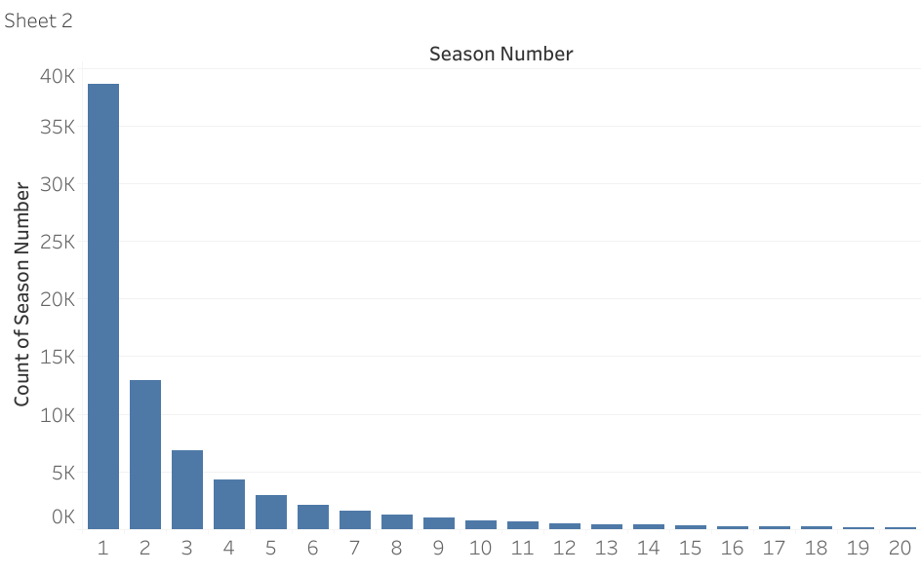
EDA

Slide 8
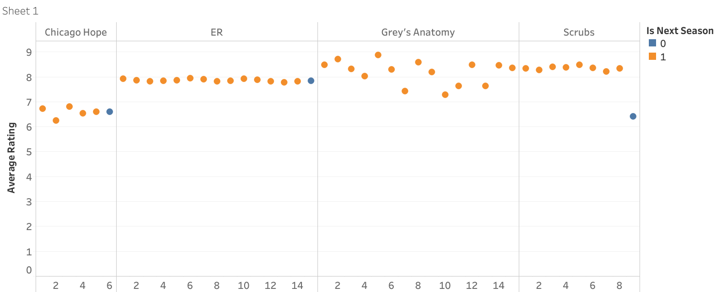
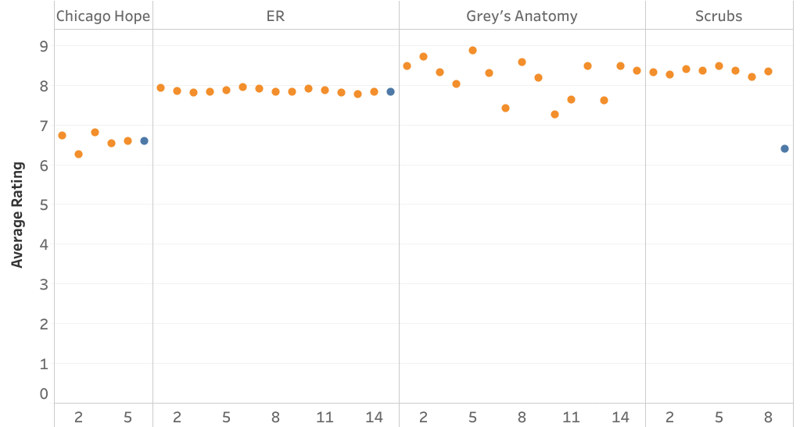
EDA

Slide 9
Modeling Methodology
Model
Tuning
EDA, Cleaning
Feature addition/selection
Logistic Regression
Random Forest
Accuracy
F1
ROC/AUC
C (regularization)
Number of Estimators
Max depth
Data
Score
Notes:
Hard predictions, not super interested in 53% chance, like lets say it happens or it doesn’t. Now that I think about it though, maybe I would have been interested to see how confident

Slide 10
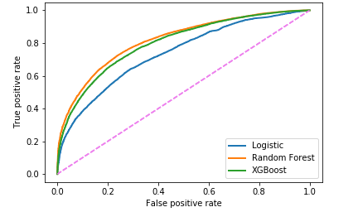
ROC AUC Score
Logistic = 0.74
Random Forest = 0.81
XGBoost = 0.79

Slide 11
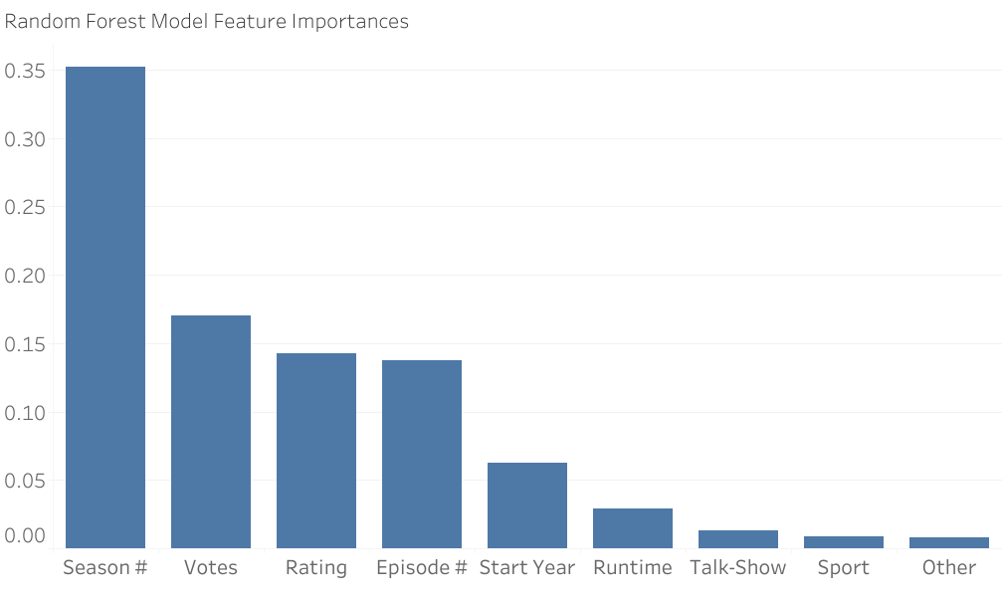
Random Forest Model: Feature Importances
50,000 observations (train), 100 estimators, max depth 11
71% accuracy (test), F1 Score: 0.73

Slide 12
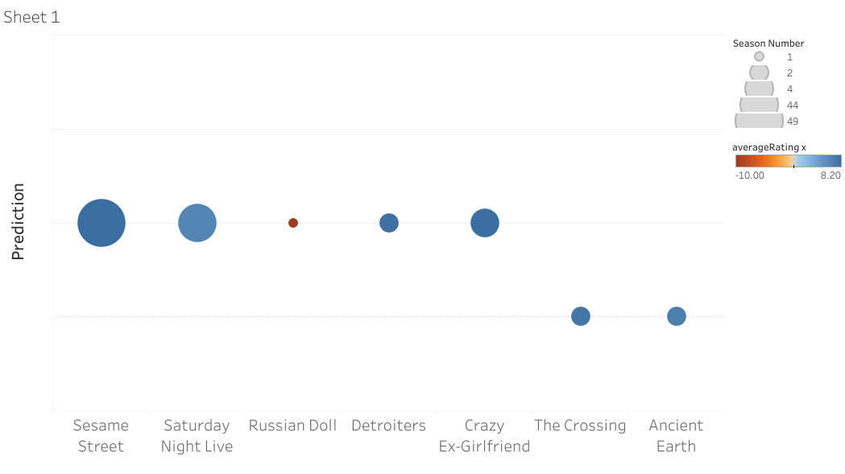
Predictions

Slide 13
Predictions
x
x
x

Slide 14
Future Work
Further tuning of XGBoost model
Features for cast, budget, network, viewership
Web app where you can find out if your favorite show will be on

Slide 15
That’s all Folks!

